Slide 1
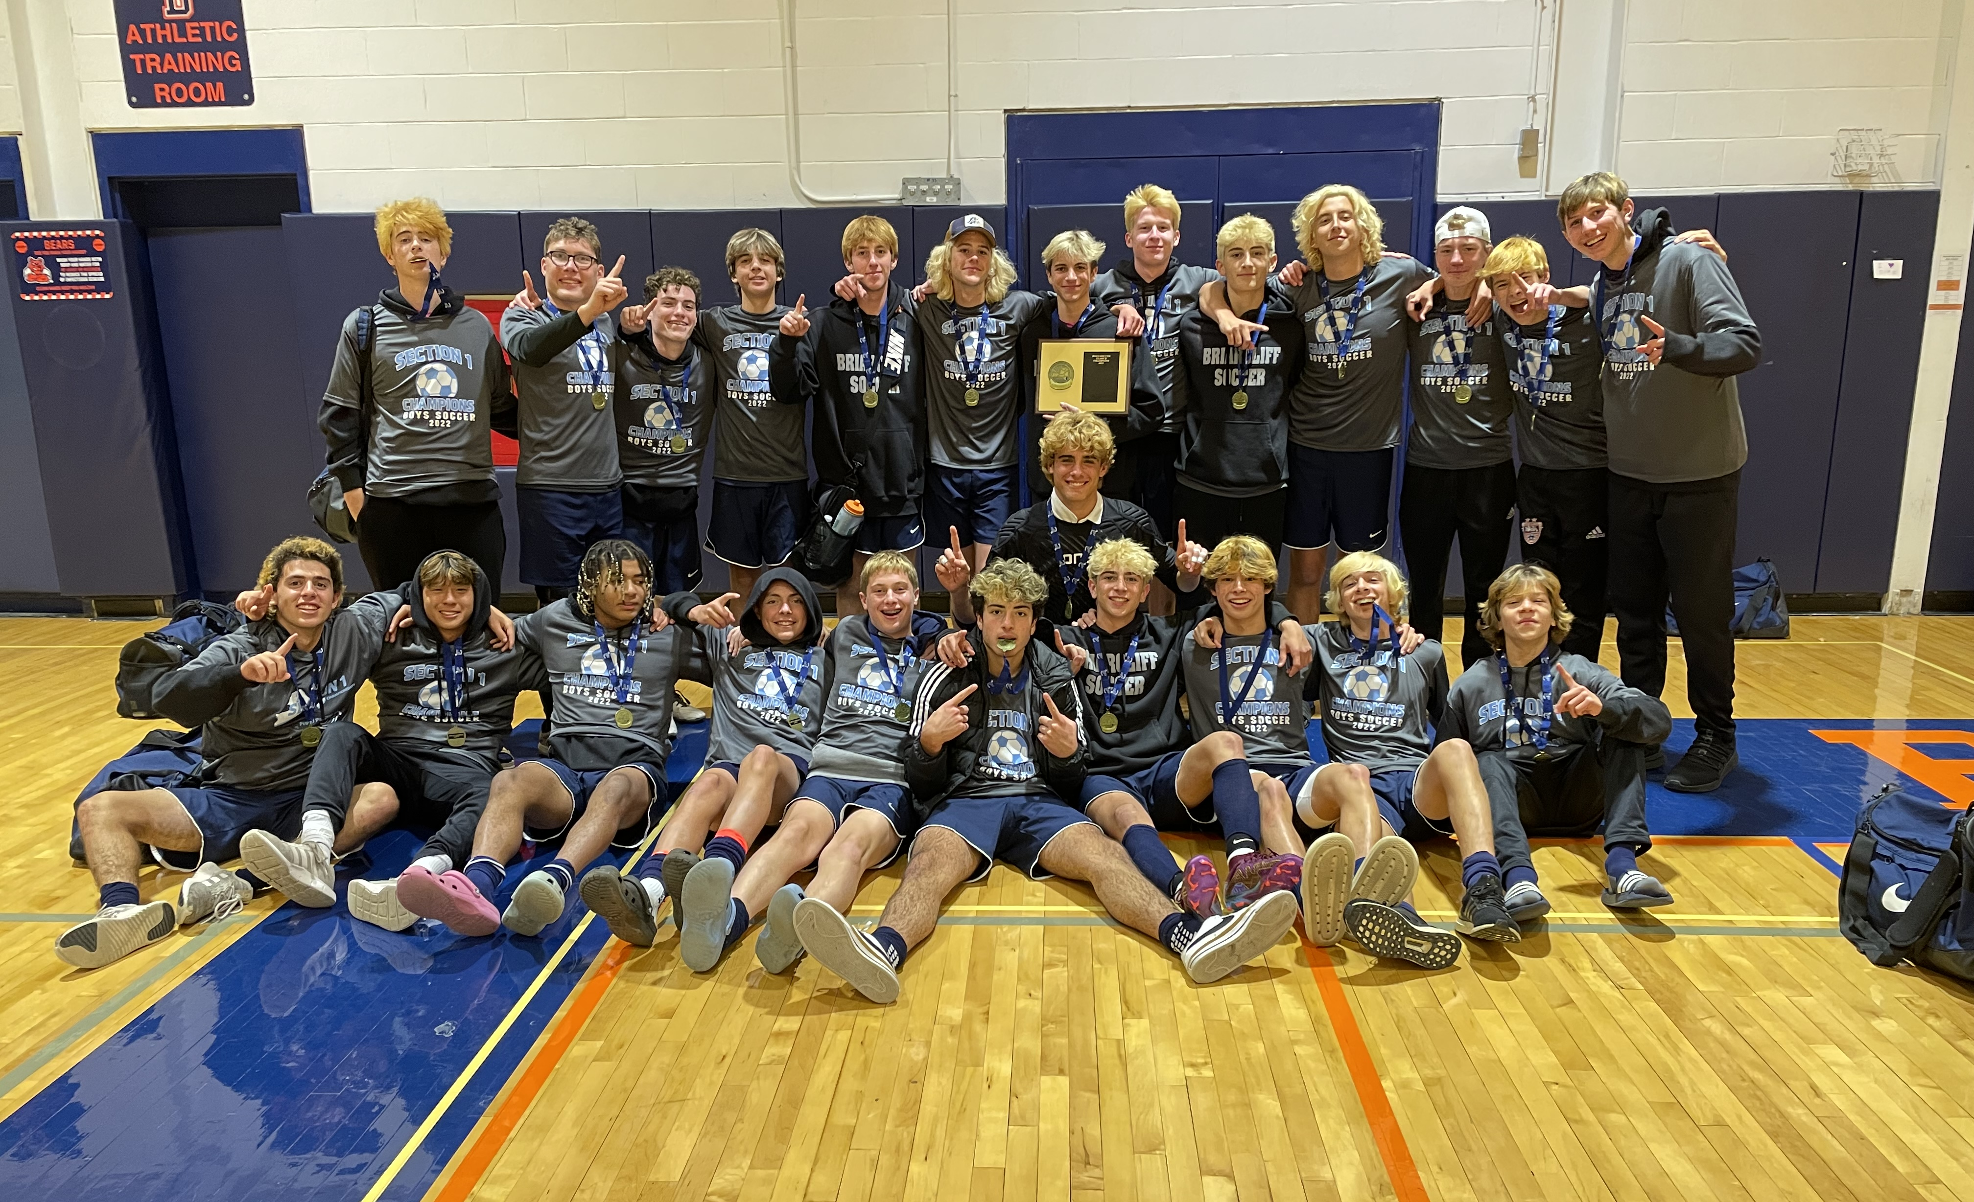
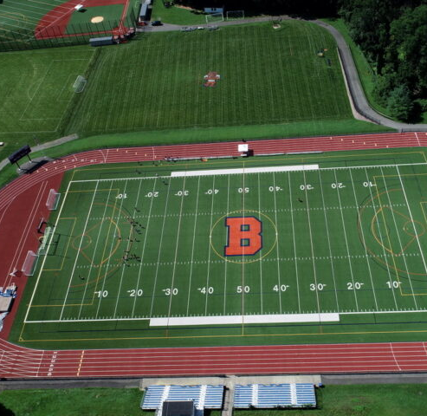
Briarcliff Boys Soccer 2026
“believe”

Slide 2
Varsity & JV Coaching Staff
Varsity Staff
Head Coach: Paul Bordonaro
pbordonaro@briarcliffschools.org
Assistant Coach: Chris Belliveau
chrisbelli23@comcast.net
Assistant Coach: Dr. Brandon Beck
bbeck@easternsoccer.com
JV Staff
Head Coach: John Ferguson
jfergs3324@gmail.com
Assistant Head Coach: TBD

Slide 3
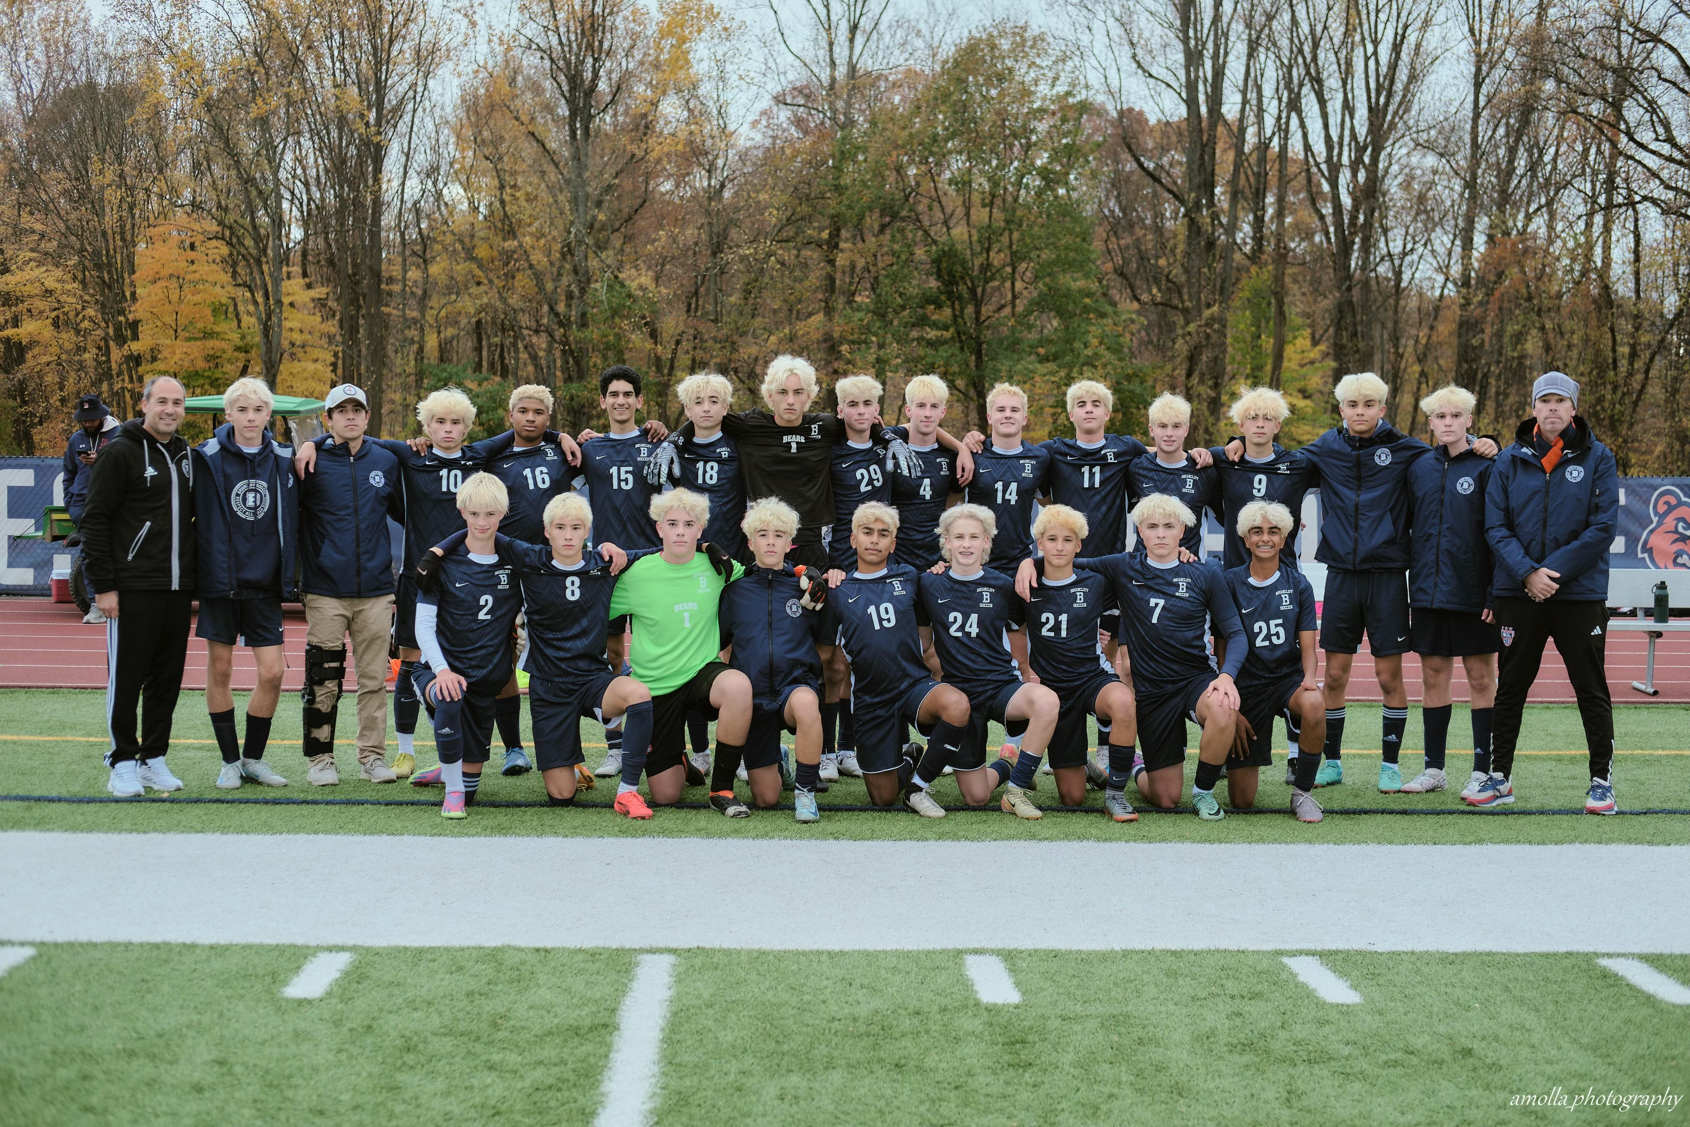
Tryout Process
Athletes must be signed up via Family ID AND cleared by the nurse/school physician BEFORE the first day of practice.
  Family ID will be open from Friday, July 24 – Friday, August 21.
Tryout will occur during the first week of the season: August 24th – August 29th
All athletes MUST be present for ALL tryout dates to be considered for teams this fall.

Slide 4
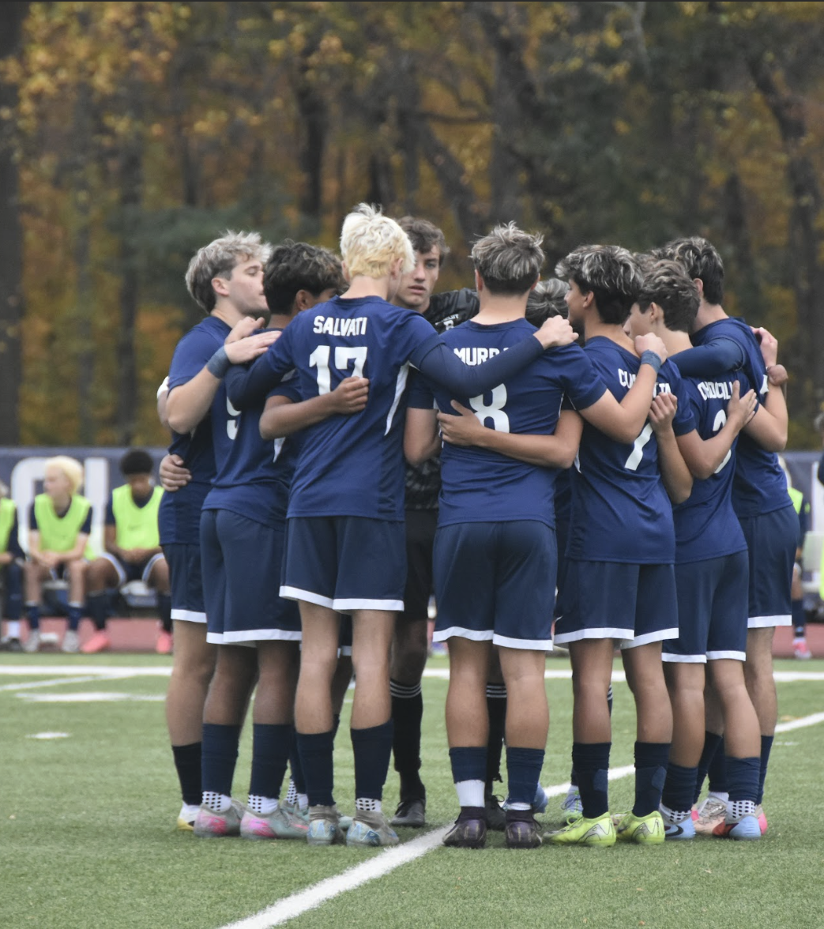
Tryout Process
All coaches will evaluate all athletes at different times during tryout sessions.
Coaches are responsible for grouping athletes based on age and/or ability level.
At the conclusion of the tryout process, each athlete will have an individual conversation with the coaching staff regarding team placement and potential playing time.

Slide 5
Schedule for the first two weeks
Varsity
Monday, August 24 – Saturday, August 29
  7:30 AM – 9:30 AM
  Varsity Roster will be finalized after training on Wednesday, August 26.
Monday, August 31
  Home Scrimmage vs. Yorktown 4:30 PM
Tuesday, September1 & Wednesday, September 2
  3:30 PM – 5:30 PM
Thursday, September 3
  Home Game vs. Pleasantville (Mt. Pleasant Cup) 4:30 PM
Friday, September 4
  3:30 PM – 5:30 PM
Saturday, September 5
  Mt. Pleasant Cup Final or Consolation Game @ Valhalla, Time TBD
Varsity will train Monday of Labor Day Weekend. Players are must be present, especially since we have a game vs. Bronxville the next day.
JV
Monday, August 24 – Saturday, August 29
  7:30 AM – 9:30 AM
  JV Roster will be finalized after training on Friday, August 28.
Monday, August 31 – Thursday, September 3
  3:30 PM – 5:30 PM
  We are working on a scrimmage for the beginning of this week.
Friday, September 4
  Home Game vs. Peekskill 4:45 PM
  Players must be present for this season opening game.
Saturday, September 5 & Monday, September 7
  Off

Slide 6
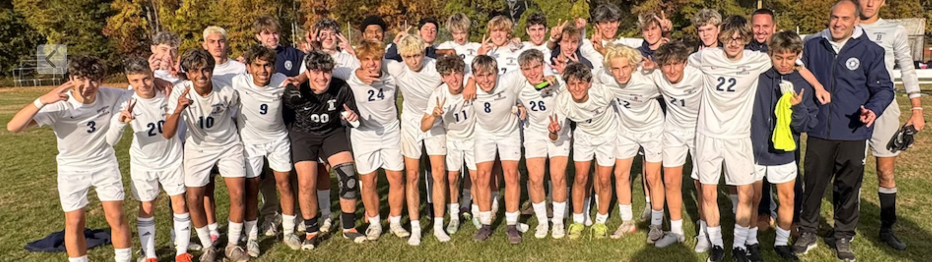
Game Schedule: Digital Sports
All Varsity and JV game schedules are available through the Digital Sports platform. The web link is below:
BHS Digital Sports

Slide 7
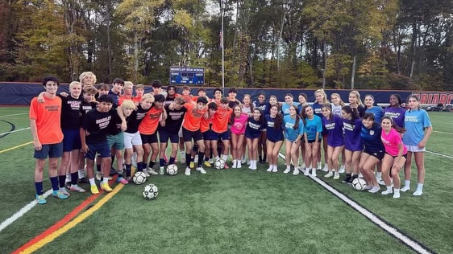
Program Philosophy & Culture
Building Individual Character
Student-Athlete
Creation of a positive & respectful environment
Individual & team preparedness
Accountability & leadership
Collaboration & selflessness
Strive for consistent improvement
Building on the Field Success
Varsity: 75% tactical, 25% technical
  Results = 100%
  Playing time is earned in training/game performance and is never a guarantee
JV: 50% tactical, 50% technical
  Results = 85%
  Playing time is earned in training/game performance and is never a guarantee

Slide 8
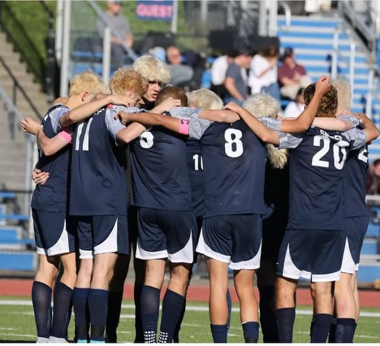
Commitment
Varsity
6 day per week commitment, attendance is mandatory
Typical week is Monday – Saturday
JV
5-6 day commitment, attendance is mandatory
Training may not always be held on weekends, but Saturday games are scheduled
As with any sports season, schedules are subject to change. All changes will be communicated as best as possible.

Slide 9
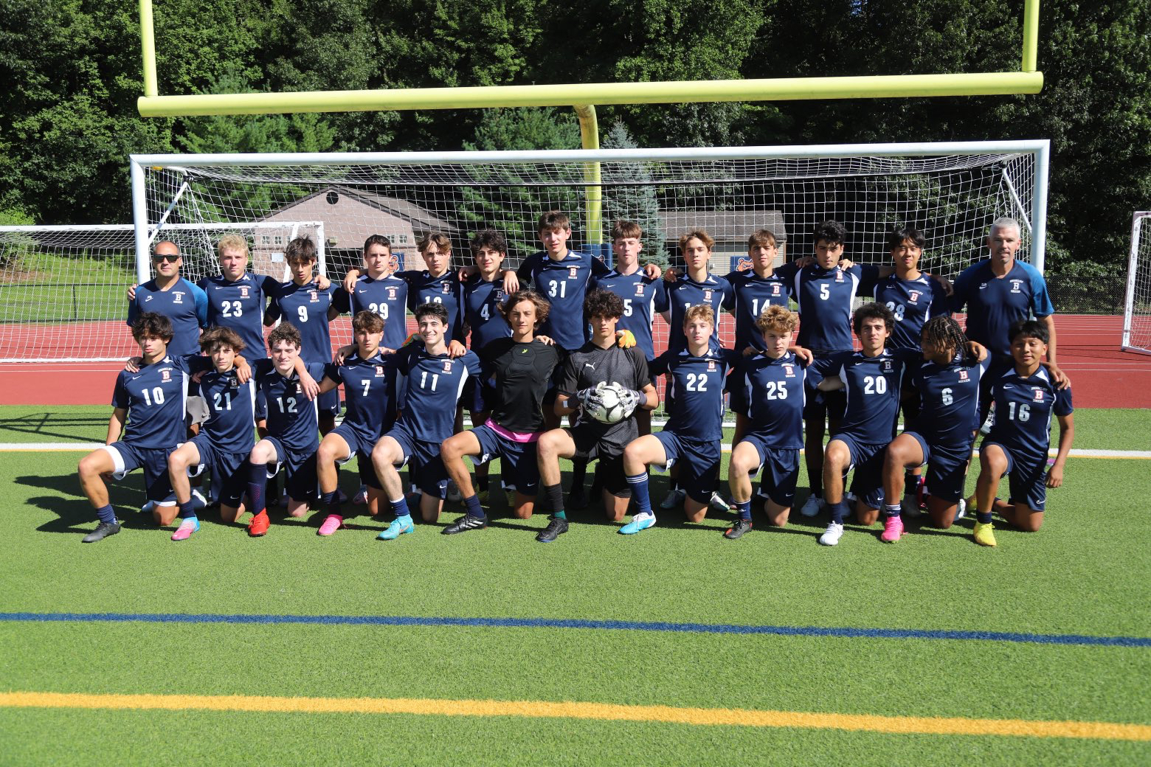
Expectations
All players are expected to be
  Punctual, Prepared, and Proactive
For training sessions, all must have:
  Two colored t-shirts (coordinated beforehand)
  Proper soccer shorts and soccer socks
  NOCSAE approved shin guards
  Cleats and sneakers
For games, the required uniform kit must be worn.
Plan to arrive to sessions 15 minutes early.
Quality sleep, nutrition, hydration, and time management is critical.
Proper character is always the standard, both in person and online.

Slide 10
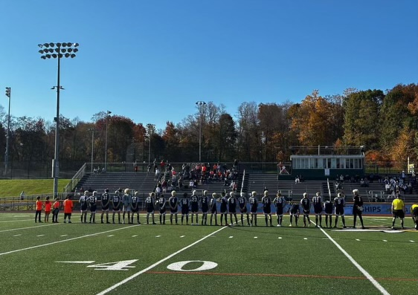
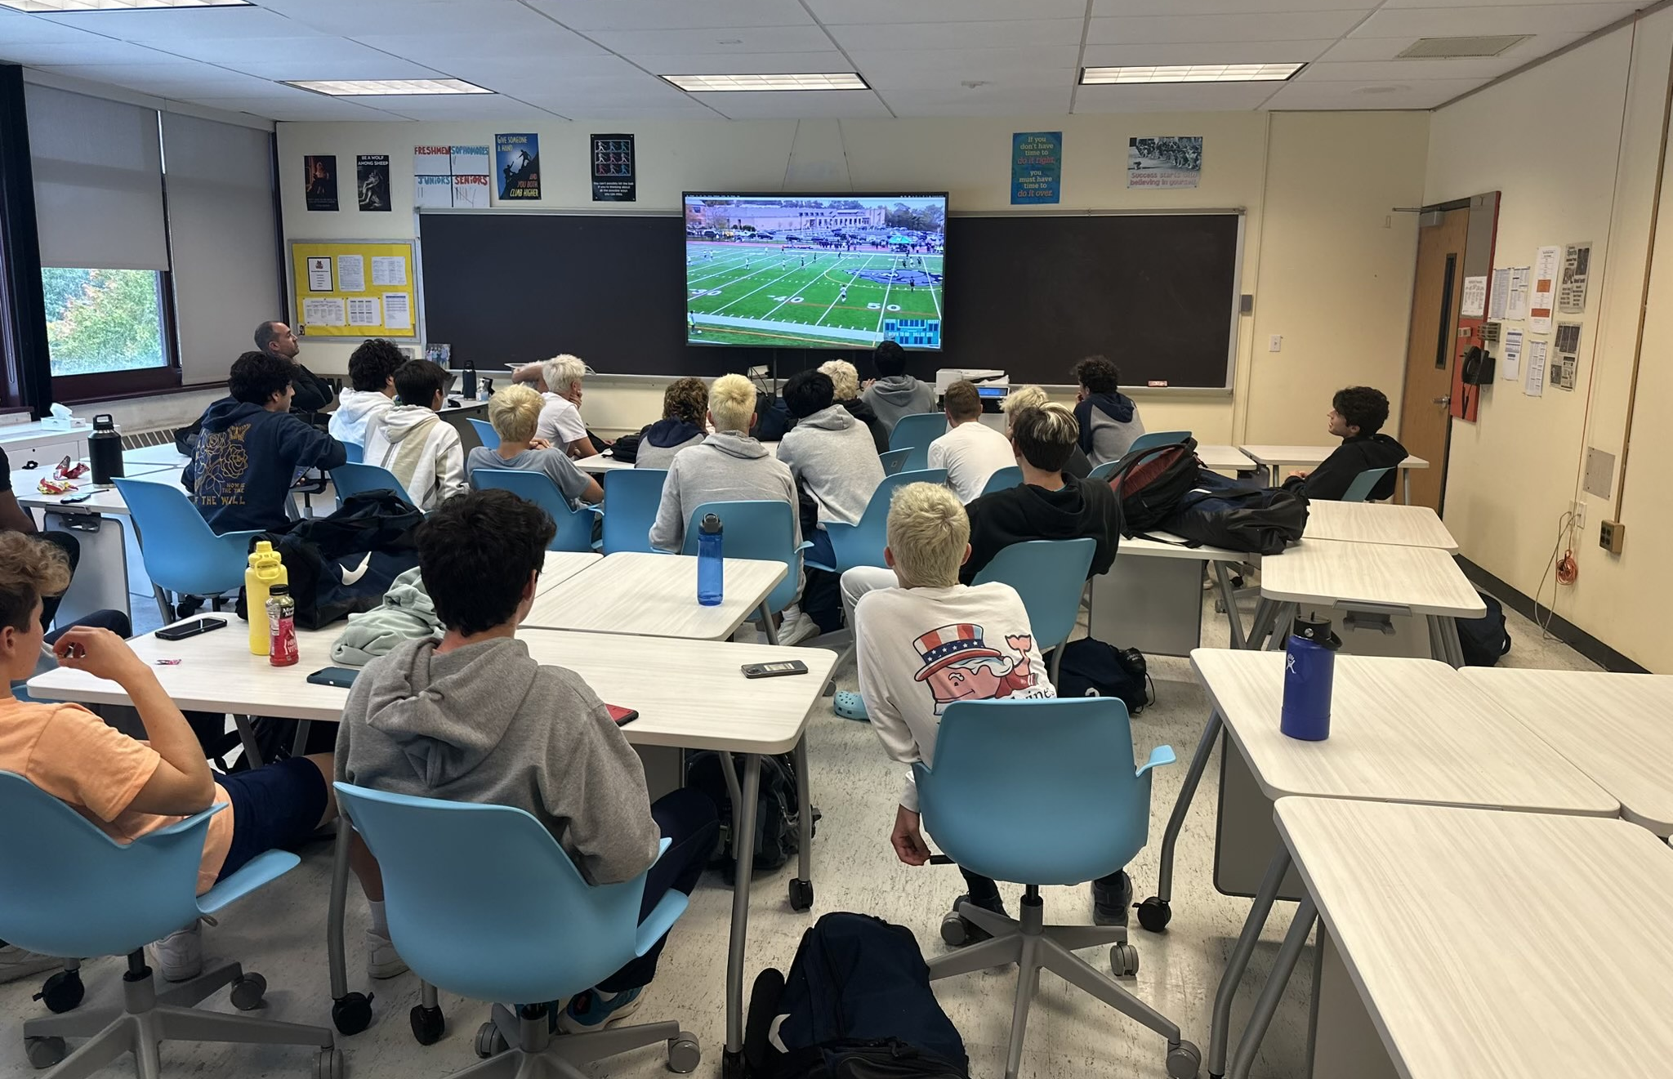
Training & Games
Training Sessions
All practices are closed to spectators
During school days, varsity and JV training will typically begin between 3:30 and 3:45
Weekend training session times cannot be predetermined but will be communicated
All players must attend every training session, even if injured
Games
Varsity & JV schedules can be found on the Briarcliff Digital Sports website.
Start time during the week is typically 5:00 PM with some 4:30 PM exceptions, weekend start times vary.
Enjoy the LoHud blog coverage along with our X (formerly Twitter) & Instagram (@bearsboyssoccer)

Slide 11
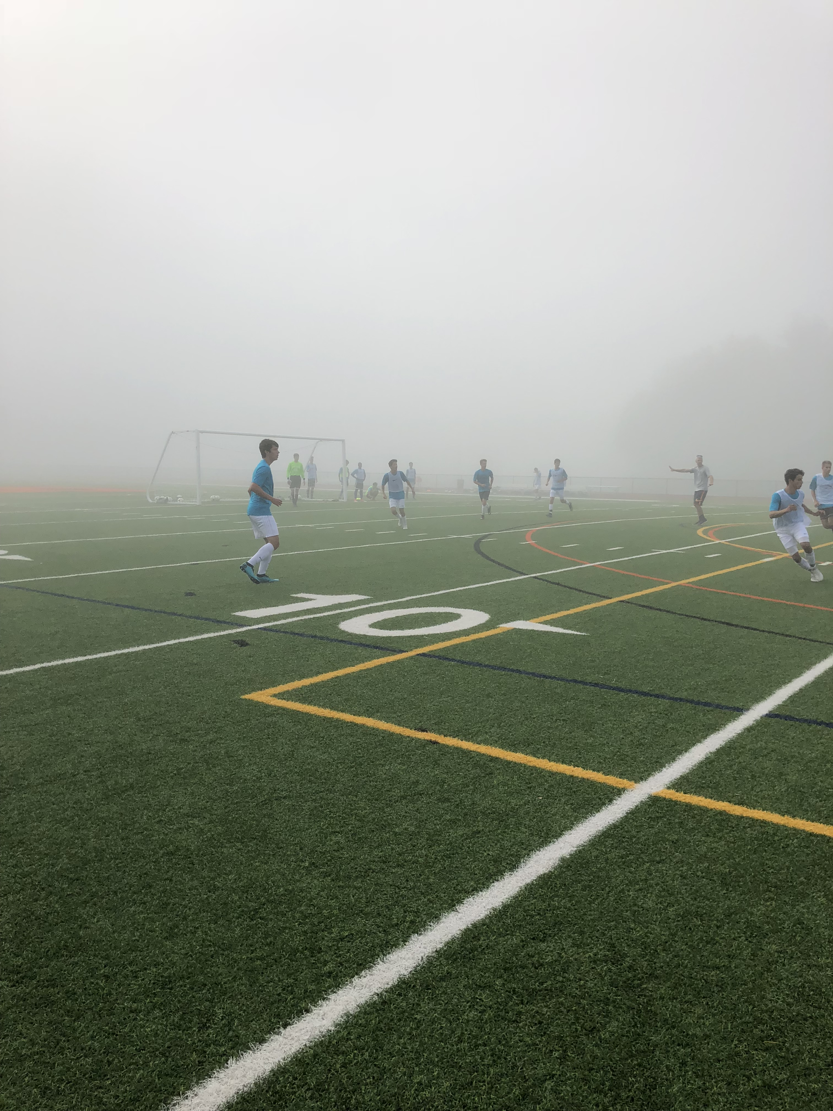
Absences
Excused Absence:
  Sick from school (let coaches know), college visits (please work with coach prior)
Unexcused Absence:
  Family vacation, skipping school/class, homework, and other similar reasons.
  An unexcused absence will result in a loss of playing time
Missing practice the day before a game:
  Excused absence: will not start
  Unexcused absence: will not play in first half or possibly the whole game depending on circumstances
Coaches have final discretion, and all will be treated equally.

Slide 12
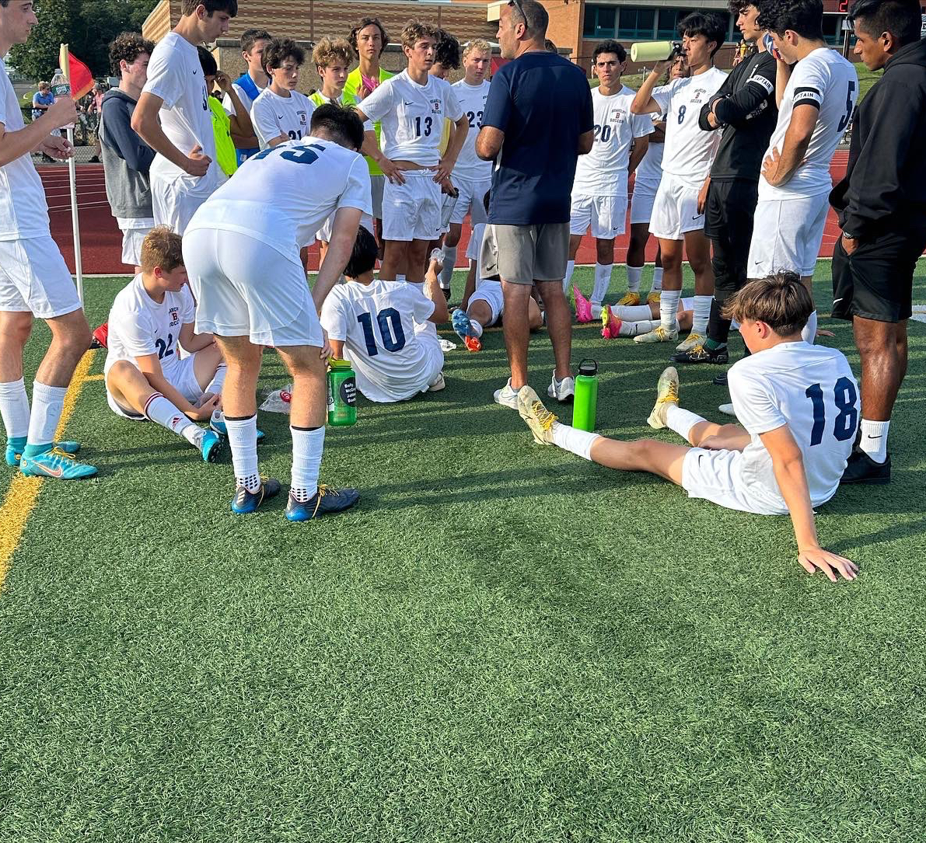
Communication
Players are responsible for communicating with coaches.
  This primarily should be done via the SportsYou app. Email can be used as well.
Communication can be for absences, lateness, or general questions.
If there is any issue at all, players should communicate directly with the coach.
With regards to playing time, these conversations will take place between coach and athlete only.
  Try to avoid, “How can I play more?”
  Instead use, “What can I do to improve?”
  The more specific, the better: “What can I do to improve my first touch?”
Proper self-reflection will lead to thoughtful, honest, and helpful dialogue.
Our doors are always open to maintain the best relationship with the players.

Slide 13
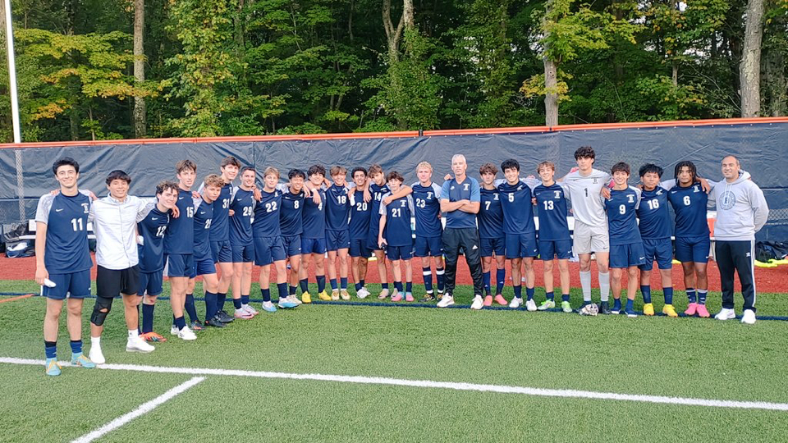
Thank You
Without your support, none of our seasons would be successful.
As a staff, we look forward to seeing you all come out to cheer on our teams this fall.
Above all else, we want this to be an incredibly positive experience for all players while helping them achieve personal growth at the exact same time.
Sincerely,
Coaches Bordonaro, Belliveau, Beck, and Ferguson

