Slide 1
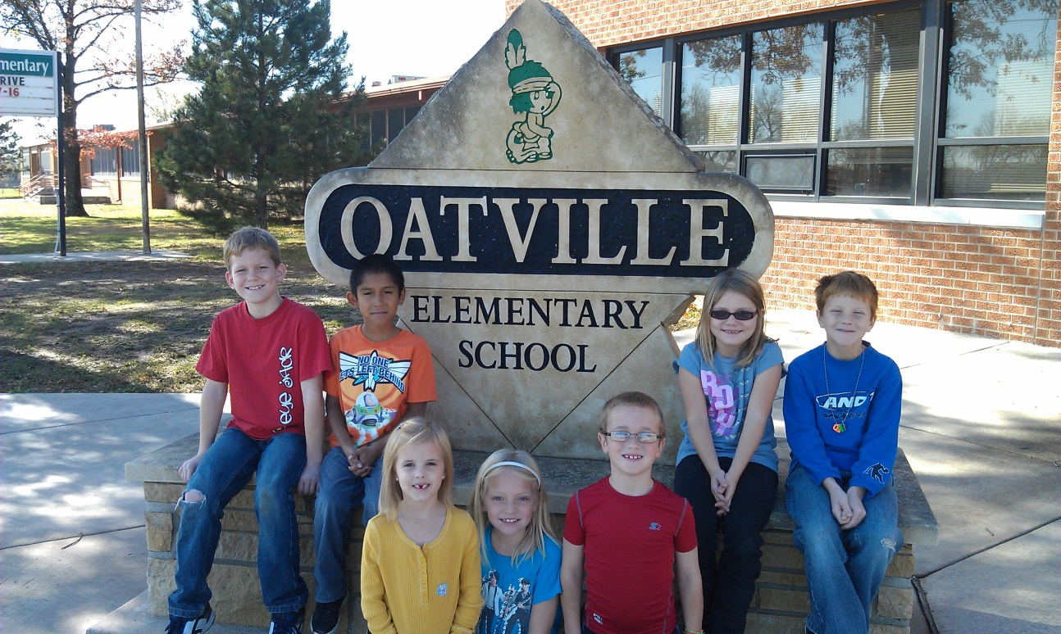
Oatville Elementary School
A great place for kids to learn!

Slide 2
Oatville Elementary
School Motto:
Today’s Learners, Tomorrow’s Leaders
School Mission Statement:
The mission of Oatville Elementary School is to build successful life long learners.

Slide 3
Enrollment:
September 20th Count

Slide 4
Student Demographics:
Ethnicity
Oatville
district

Slide 5
Student Demographics:
English Language Learners

Slide 6
Student Demographics:
Gender
Oatville
District

Slide 7
Student Demographics:
Economically Disadvantaged Students

Slide 8
State Reading Assessments
2010 - 2011

Slide 9
State Reading Assessments
2010 - 2011
Year | Oatville | State | AYP Target
2008 | 100% | 83.6% | 75.8%
2009 | 96.3% | 84.2% | 79.8%
2010 | 98.8% | 86.2% | 83.7%
2011 | 98.3% | 87.8% | 87.8%
2014 |  |  | 100%

Slide 10
State Math Assessments
2010 - 2011

Slide 11
State Math Assessments
2010 - 2011
Year | Oatville | State | AYP Target
2008 | 100% | 86.2% | 71.9%
2009 | 97.3% | 86.3% | 76.6%
2010 | 98.8% | 83.6% | 82.3%
2011 | 99.4% | 87.8% | 86.7%
2014 |  |  | 100%

Slide 12
State Science Assessments
2010 - 2011

Slide 13
State Science Assessments
2010 - 2011
Year | Oatville | State | QPA Target
2008 | 100% | 90.7% | 73%
2009 | 97% | 92% | 73%
2010 | 98% | 91% | 73%
2011 | 96.4% | 92.1% | 73%

Slide 14
Oatville Top Ten
10. SOS – Support One Student
9. Inclusion and meeting individual needs
8. Accelerated Reader and Accelerated Math
7. Technology for student engagement
6. Student Intervention Team and MTSS
5. Data driven instruction
4. Standards based instruction
3. Staff and grade level collaboration
2. PBIS and OLWEUS
1. High expectations with strong focus on student engagement and learning
Rigor + Relevance + Relationships = Success

Slide 15
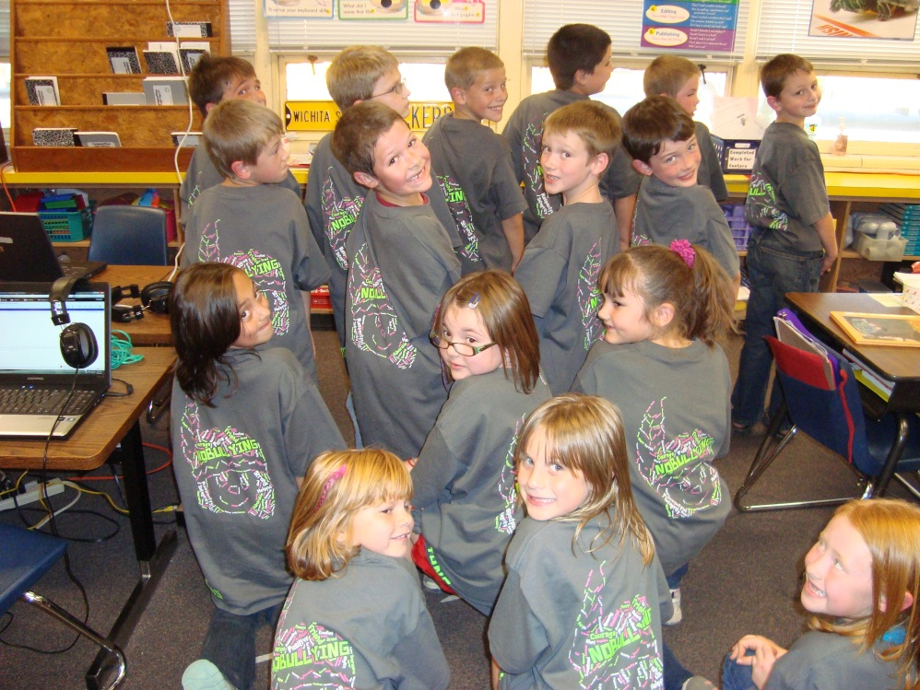
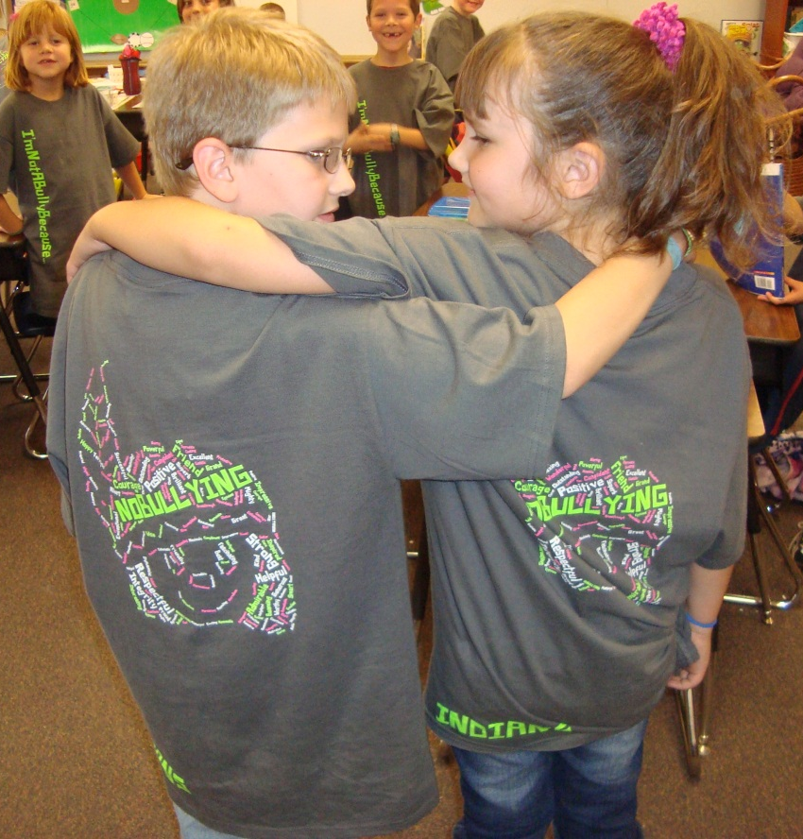
Life at Oatville
Oatville 2nd graders show off their new anti-bullying t-shirts. Staff and students wear these shirts every Tuesday to take a stand against bullying.

Slide 16
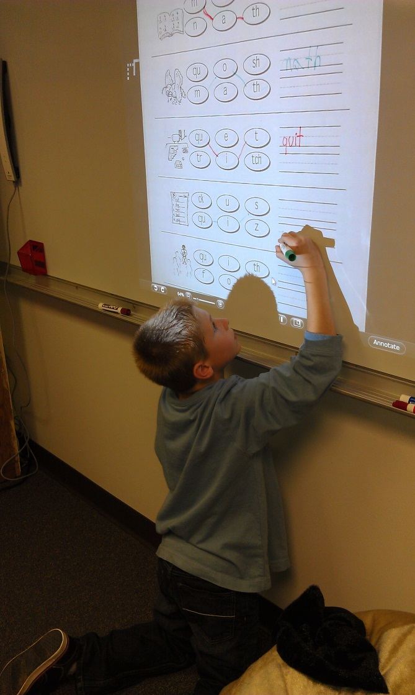
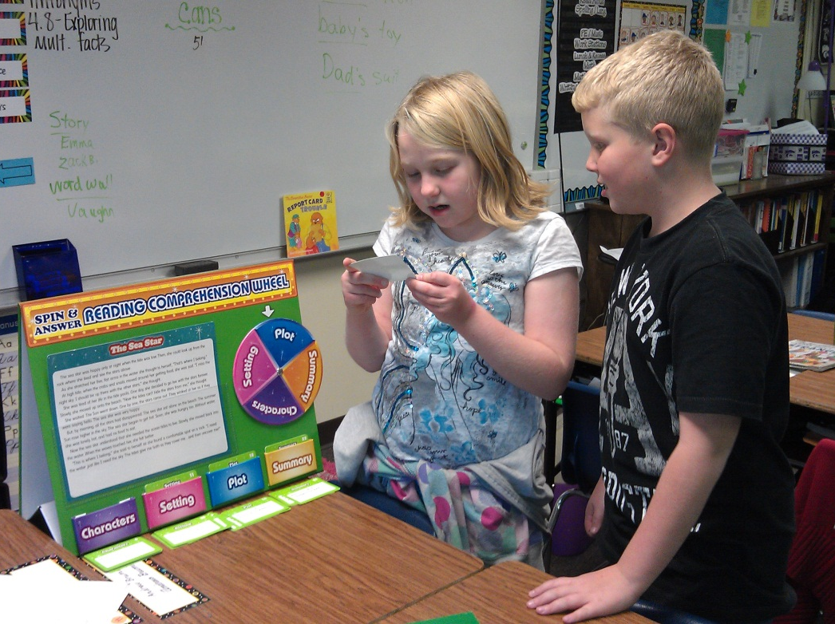
Life at Oatville
Oatville 3rd graders enjoy using technology and hands-on activities during Literacy First reading work stations.

Slide 17
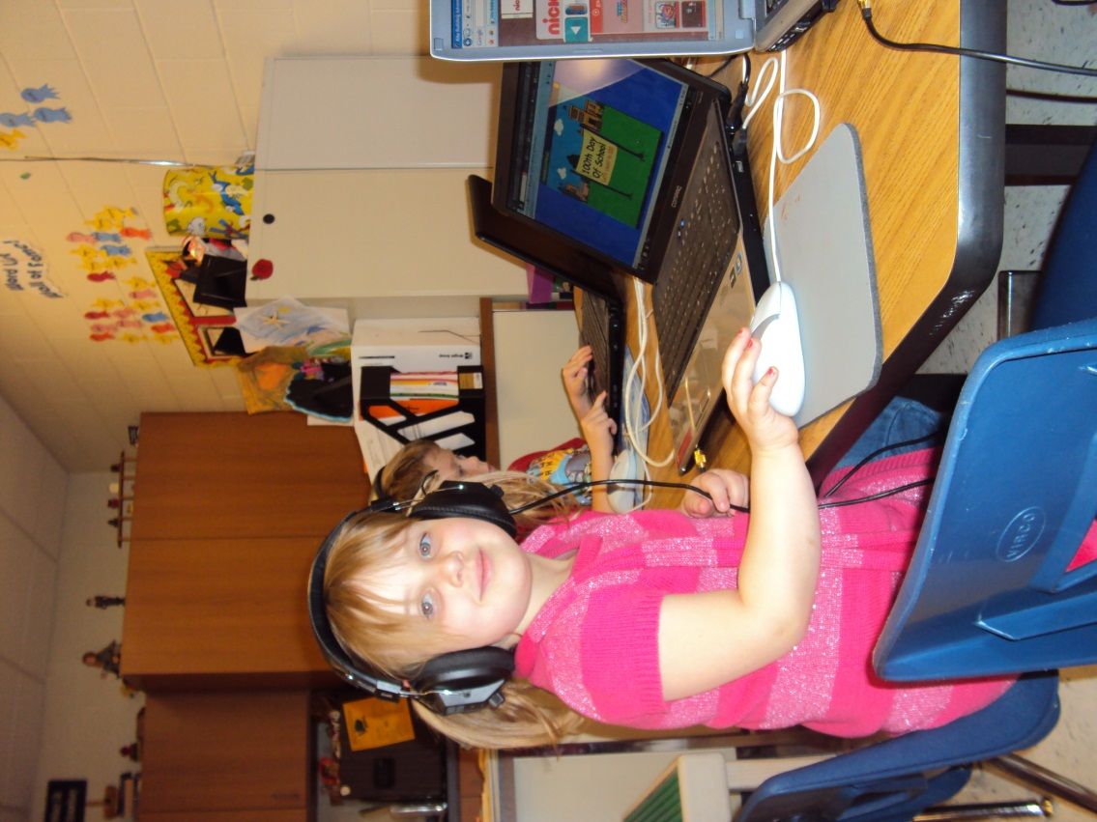
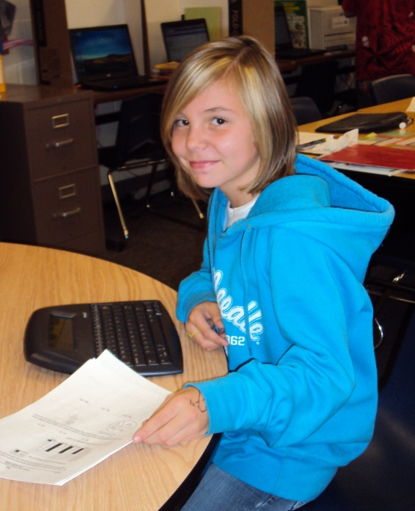
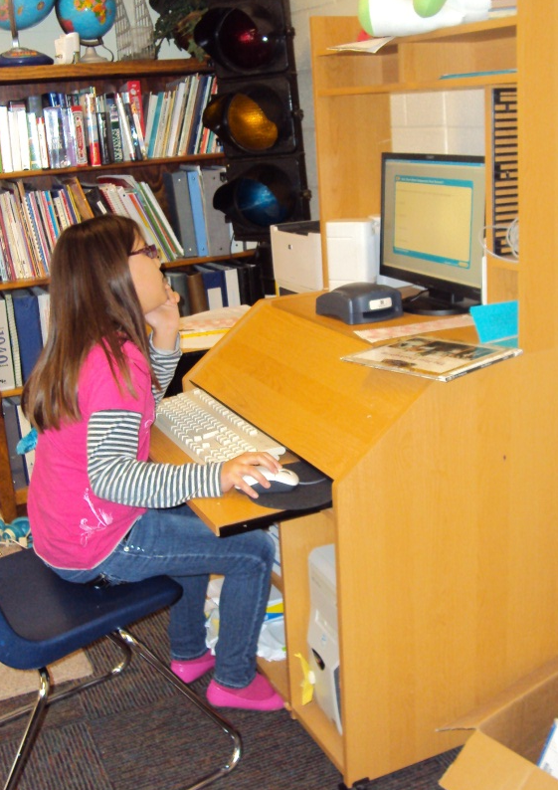
Life at Oatville
From Pre-K to 5th grade, Oatville students enjoy using technology on a daily basis.

Slide 18
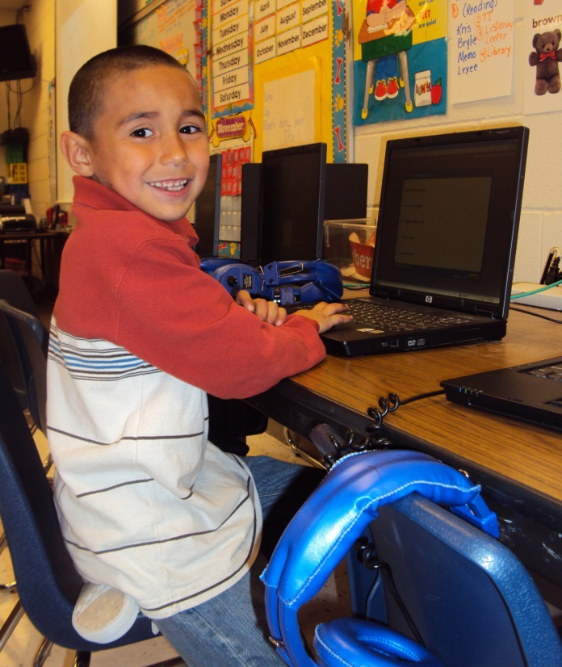
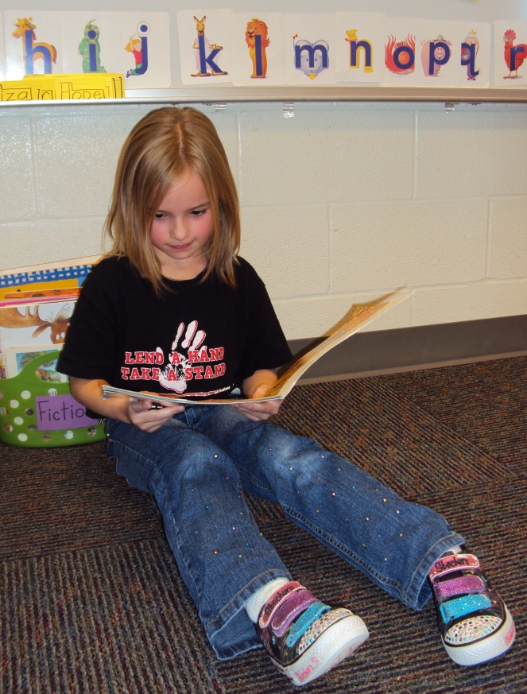
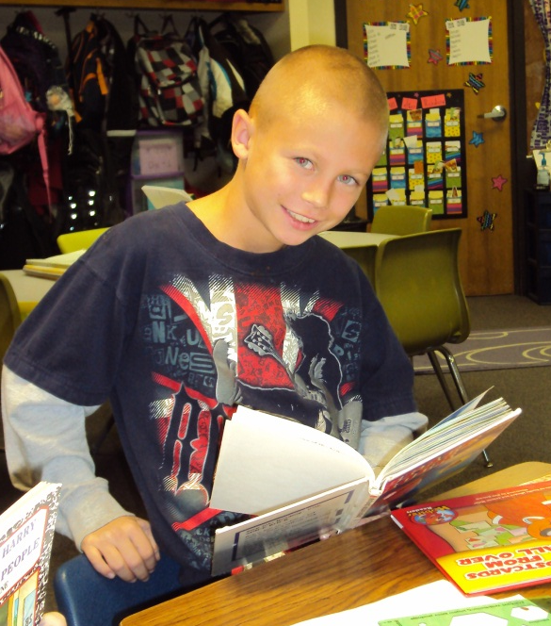
Life at Oatville
Oatville students are encouraged to develop a love of reading in hopes to create lifelong learners.

Slide 19
Oatville Elementary
Home of
Today’s Learners,
Tomorrow’s Leaders!

