Slide 1


Prairie Elementary
MOVING FORWARD…

Slide 2
Who we are…

Slide 3
Economically Disadvantaged
Who we are…

Slide 4
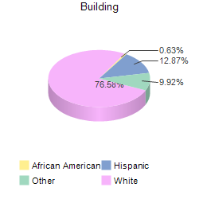

Race/Ethnicity
Who we are…

Slide 5
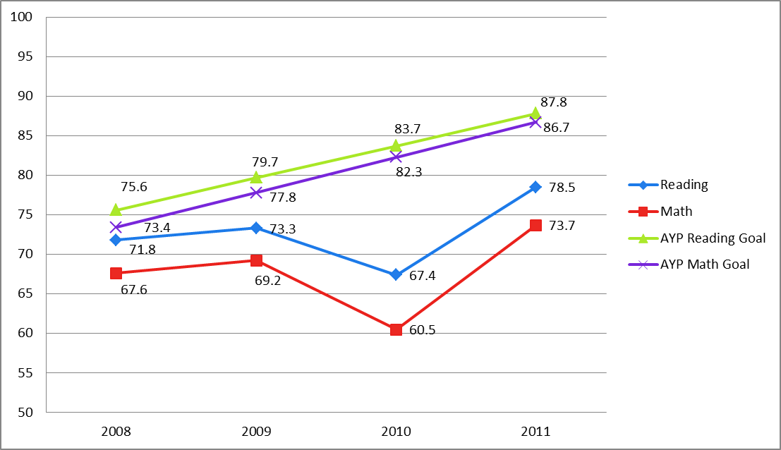
Where we’ve been. . . .
Year | Reading | AYP Goal | Math | AYP Goal
2008 | 71.8 | 75.6 | 67.6 | 73.4
2009 | 73.3 | 79.7 | 69.2 | 77.8
2010 | 67.4 | 83.7 | 60.5 | 82.3
2011 | 78.5 | 87.8 | 73.7 | 86.7
2012 |  | 91.9 |  | 91.1
2013 |  | 95.9 |  | 95.6
2014 |  | 100 |  | 100

Slide 6
Where we are. . . .
 | 2010 Reading | 2011 Reading
3rd: | 56.90% | 76.67%
4th: | 71.20% | 75%
5th: | 74.60% | 80.30%
Building: | 67.40% | 78.50%
SubGroups:
White: | 68.10% | 79.19%
SPED: | 47.80% | 54.54%
Free/Reduced Lunch: | 59.30% | 76.33%
% Gain
+ 19.77
+ 3.8
+ 5.7
+ 11.1
+ 11.09
+ 6.74
+ 17.03

Slide 7
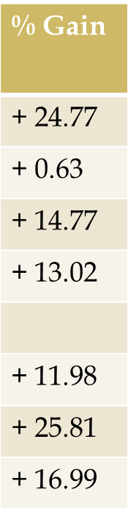
Where we are. . . .
 | 2010 Math | 2011 Math
3rd: | 56.90% | 81.67%
4th: | 72.70% | 73.33%
5th: | 50.80% | 65.57%
Building: | 60.50% | 73.70%
SubGroups:
White: | 59.70% | 71.68%
SPED: | 34.80% | 60.61%
Free/Reduced Lunch: | 54% | 70.99%

Slide 8
Where we are. . . .
% Gain
+2.0%
 | 2010 Science | 2011 Science
4th | 84.67% | 86.67%

Slide 9
Where are we going…….
All students will show a 10% improvement on the Kansas Reading Assessments in 2011-2012.
All students will show a 10% improvement on the Kansas Math Assessments in 2011-2012.
Office referrals will be reduced by 30%
85% of students will be in Tier 1 both academically and behaviorally.

Slide 10
How WE ARE going to get there…
TAPS after school program
3rd-5th 30 min. intense intervention time daily for math
Literacy First reading interventions
34 Students 1st-5th pulled daily for 20 minute Skill Based Groups in Math
60 Students K-5th pulled daily for 20 minute Skill Based Groups in Reading

Slide 11
How WE ARE going to get there…
PRAIRE P.R.I.D.E.
Positive Behavior Interventions and Supports

Slide 12
Maximize all students’ Academic Achievement along with Social/Emotional and Behavioral Development
How we are going to get there…
PK-5 Grade Level Behavioral Matrixes
Stop and Think Social Skills
Family Nights
Monthly and Quarterly Recognitions
Class Councils
Mandt Training for all staff
Relationship with Tri-City

Slide 13
Improvement Plan Grant
How WE ARE going to get there…
2 hours extra PLC time for all grade levels each month
PLC coaching with Dennis King
Hover Cams for interactive technologies
Funds to expand classroom libraries and math manipulatives
Additional AIMSWeb training on data based decision making
Additional EveryDay Math coaching and training

