Slide 1


We Treasure Learning at Ruth Clark

Slide 2


Student Demographics
Data Analysis and
School Improvement

Slide 3
Haysville USD 261 Motto: Caring, effective learning for all.
Mission Statement: The mission of the Haysville Public Schools is to advance learning for all through the relentless pursuit of excellence.
Ruth Clark Elementary School:
The mission of Ruth Clark is to prepare students to embrace learning, overcome adversities, and become life-long learners.

Slide 4

Ruth Clark Jaguar PRIDE Pledge
As a Ruth Clark student, I pledge to be respectful, responsible, and real. I will do my best at all times, wherever I go, to show Jaguar PRIDE.
Preparation
Respect
Integrity
Discipline
Excellence

Slide 6
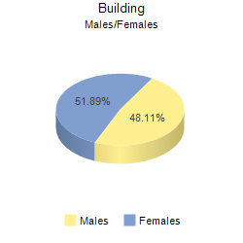
2010-2011 Student Gender
Notes:
192 Female 178 Male

Slide 7
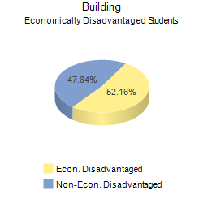
2010-2011 Socio-Economic Status
Notes:
193 Disadvantaged 177 non-disadvantaged

Slide 9
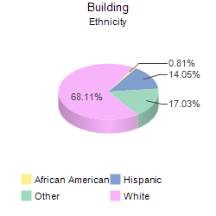
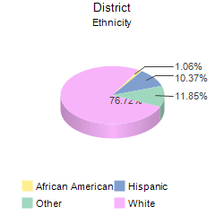
2010-2011 Building Diversity
Ruth Clark
Haysville

Slide 10
Ruth Clark ELL Students
Notes:
46 out of 333 students were ELL

Slide 11
Ruth Clark Concept Map
School Goal: Preparing students to embrace learning, overcome adversities, and become life-long learners.
Action Plan: Ruth Clark’s plan to reach this goal includes modeling and teaching the expectations and addressing the student needs in the following four areas; academics, communication, wellness and positive behaviors.

Slide 12
Academics
Standards-driven instruction
High expectations for all
Provide positive support
Communication
PTO parental involvement
Site Council
Focused PLC’s (data driven)
All call

Slide 13
Positive Behaviors
Established consistent routines and procedures
HALLS
GYM
BREAK
CAFÉ
BUS
Rewards and Recognition for accomplishments
Relationships
Wellness
Organized walking program
Nutrition – Healthy Lifestyle

Slide 14

Kansas Math Assessment
% Performing Proficient or Above
Year Ruth Clark State AYP Target
2007 91.0 84.4 67.2
2008 93.8 86.2 71.9
2009 94.2 86.3 76.6
2010 94.3 83.6 82.3
2011 94.2 85.5 86.7
2014 NCLB Target 100%

Slide 17
Summary of Target Area: Math
Scores have consistently improved for all students
There is no gap between male/female scores
Low SES scores continue to improve and the gap is closing
Data is continually monitored to address any discrepancies between gender, socio-economics and student with disabilities subgroups

Slide 18
Kansas Reading Assessment
% Performing Proficient or Above
Year Ruth Clark State AYP Target
92.1 81.9 71.7
95.9 83.6 75.8
87.2 84.2 79.8
94.3 86.2 83.7
95.5 85.5 87.8
2014 NCLB Goal 100%

Slide 19


Slide 21
Summary of Target Area : Reading
Scores continue to improve for all students
No discrepancy between gender on the assessment
Gap between socio-economically disadvantaged is closing
Continue monitoring for discrepancies between gender, ELL, SES and SpEd subgroups

Slide 22
Our scores dipped in science We attribute that quite honestly to our focus on reading and math. We are hoping to gain instructional time this year by addressing some of these standards through our Literacy First centers.
Notes:
Our scores dipped in science this year. We attribute that quite honestly to our focus on reading and math. We are hoping to gain instructional time this year by addressing some of these standards through our Literacy First centers.

