Slide 1

for Gems
MINING
Gifted
Education
in
USD 261

Slide 2
Who are gifted students?
The National Association for Gifted Children defines gifted as:
“Students, children, or youth who give evidence of high achievement capability in areas such as intellectual, creative, artistic, or leadership capacity, or in specific academic fields, and who need services and activities not ordinarily provided by the school in order to fully develop those capabilities”.
MINING for Gems

Slide 3
Gifted
MINING for Gems
According to the KSDE, “Gifted" as defined in K.A.R. 91-40-1(cc) means performing or demonstrating the potential for performing at significantly higher levels of accomplishment in one or more academic fields due to intellectual ability, when compared to others of similar age, experience and environment.

Slide 4
Our Journey To Success
MINING for Gems
1998-2004
Haysville gifted numbers were declining
Only 98 students Identified as
Gifted in Grades K - 12
Mission: Revive Our Gifted Program

Slide 5
Developing a Plan
Review Haysville’s identified process and services for gifted students;
  Options for students labeled gifted
  Identification process
  (Traditional 2 deviation above the norm IQ
  and 95% achievement)
  Review current gifted literature
  Visit other exemplary programs
Developed District Advisory Team to identify service options for gifted students
  Read and discussed “A Nation Deceived”
  Proposed various service options to building principals
MINING for Gems

Slide 6
Digging into Action
Collected gifted identification processes from other districts, cooperatives and inter-locals in Kansas
Reviewed literature
Visited model programs in Nebraska and Blue Valley
Developed CHS parent advisory team to illicit parent input for service options
Book Studies
Attended International, National, and State Gifted Organization Conferences.
MINING for Gems

Slide 7

Our Student Data
 | 2008 | 2009 | 2010 | 2011
Campus | 36 | 53 | 37 | 62
HWMS | 9 | 36 | 36 | 52
HMS | 34 | 22 | 24 | 26
Freeman | 2 | 5 | 5 | 7
Nelson | 6 | 8 | 10 | 4
Oatville | 8 | 13 | 16 | 5
Prairie | 5 | 3 | 5 | 5
Rex | 10 | 11 | 15 | 11
Ruth Clark | 2 | 13 | 14 | 9
TOTALS | 112 | 164 | 162 | 171
MINING for Gems

Slide 8
How many students are gifted?
NAGC statistics show that approximately 6% of students in the United States are identified as gifted and talented.
In Kansas (2010) approximately 3% of all students were identified as academically gifted.
USD 261 (2010) served 3.7% students who were identified as gifted.
MINING
for Gems

Slide 9
How We Serve Our Gifted Students
MINING for Gems
The range of services nationally, state-wide, and within our district includes:
Accommodations in the regular classroom
Part-time assignment to both regular and special classes
Acceleration or grade advancement
Dual enrollment
Test Out
College classes…… just to name a few

Slide 10
Our Teaching Focus
Haysville’s Gifted Teachers assist gifted students by meeting their social/emotional, organizational academic, and motivational needs.
Topics included in gifted classes are multiple intelligences, emotional challenges, underachievement, organizational skills, utilizing your talents and strengths…..
These topics are woven into project based learning activities and academic enrichment.
MINING for Gems

Slide 11
District Evaluation Process
Students can be referred to Student Improvement Team by self referral, parent referral, school personnel referral, or review of achievement scores.
Once a referral is made, the SIT team begins collecting information such as student work samples/projects, achievement scores, gifted screening data (RIST and Nonverbal Screener), Behavior Profile Analysis, and teacher, student, and parent checklists. General Education Interventions and differentiation are also completed in the classroom.
A complete comprehensive evaluation must include multiple information sources that are listed above. The evaluation team must determine through a preponderance of data, that student is eligible and needs special education services through gifted placement. If the student meets eligibility and need for services, then the student qualifies for placement in the gifted program.

Slide 12
Through quarterly Parent Nights, the
USD 261 Special Education Department sponsors guest speakers and informational presentations to educate the staff and parents of our gifted students, such as…
Meeting the Needs of
Our Gifted Parents

Slide 13
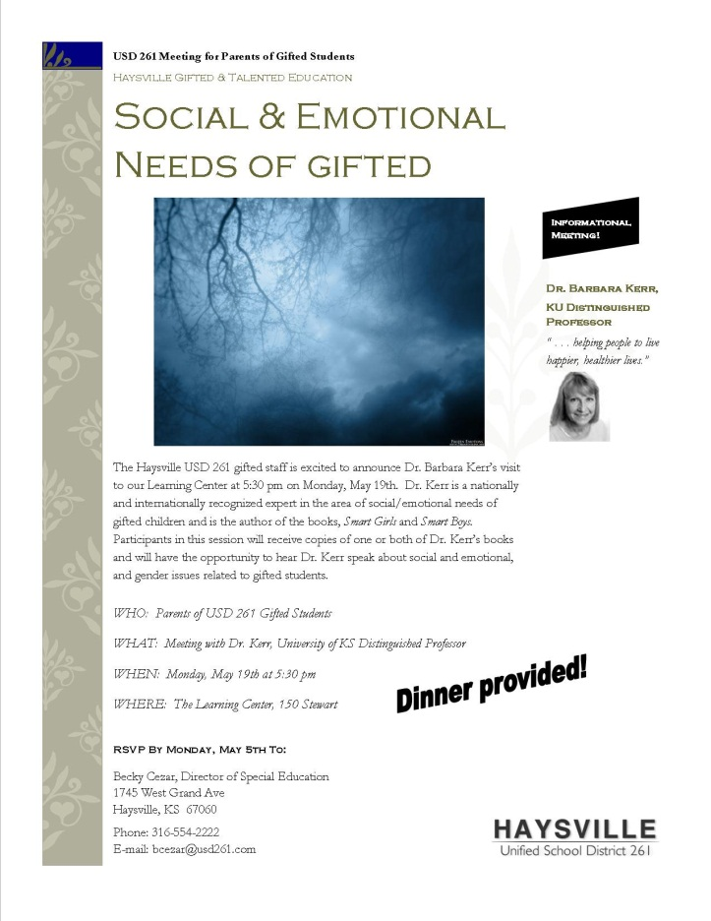

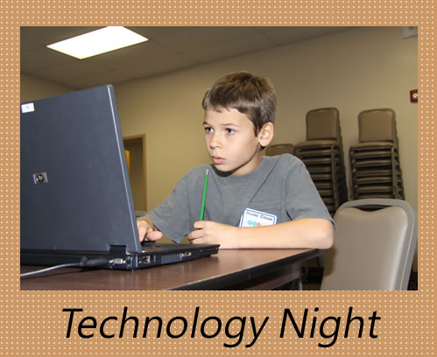
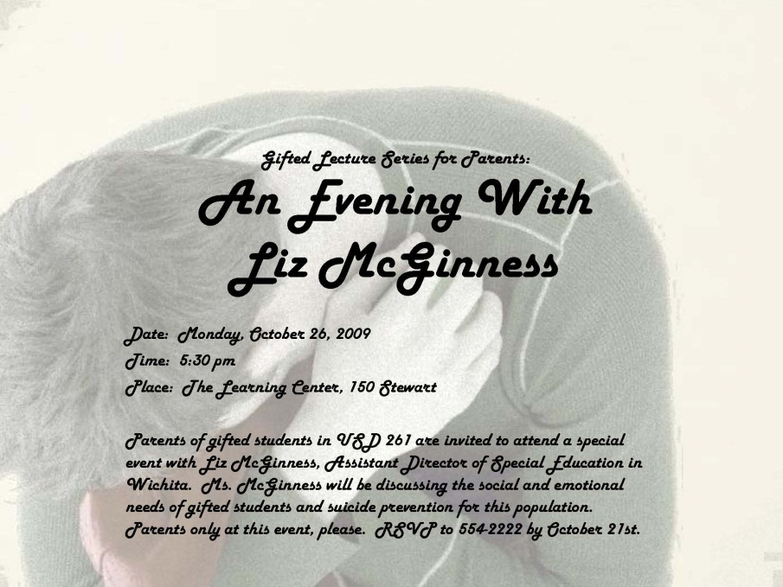
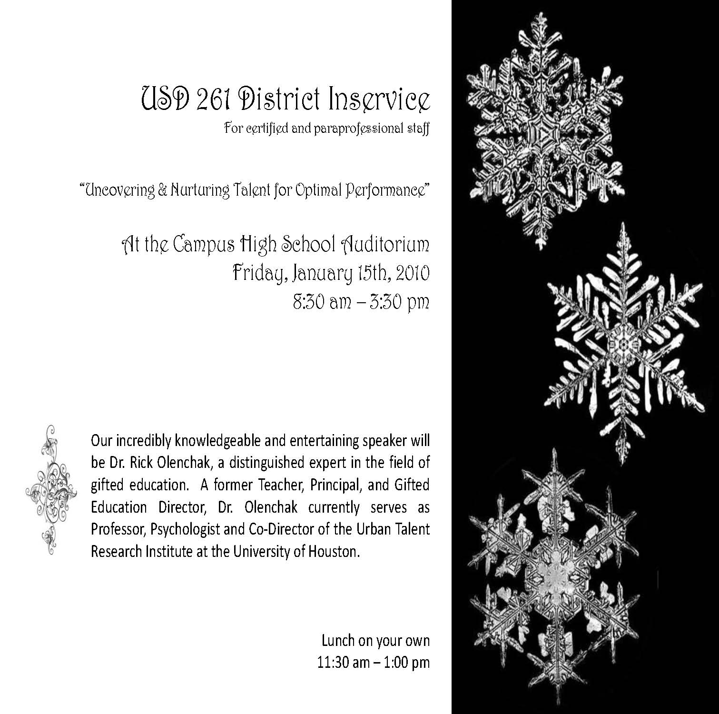
Guest Speakers
SOCIAL EMOTIONAL NEEDS
BY LIZ MCGINNESS
Dr. Rick Olenchak
Dr. Barbara Kerr

Slide 14
Gifted Student and Family Activities
Transition Activities
The Learning Center Activities
Families Reaching Out, Gifted in Kansas (http://frogiks.blogspot.com/)
Parent Scholarship to attend Regional KGTC Conference
Field Trips (Cow Town, Exploration Place, Corn Maze, Ropes Course, Cosmosphere…)

Slide 15
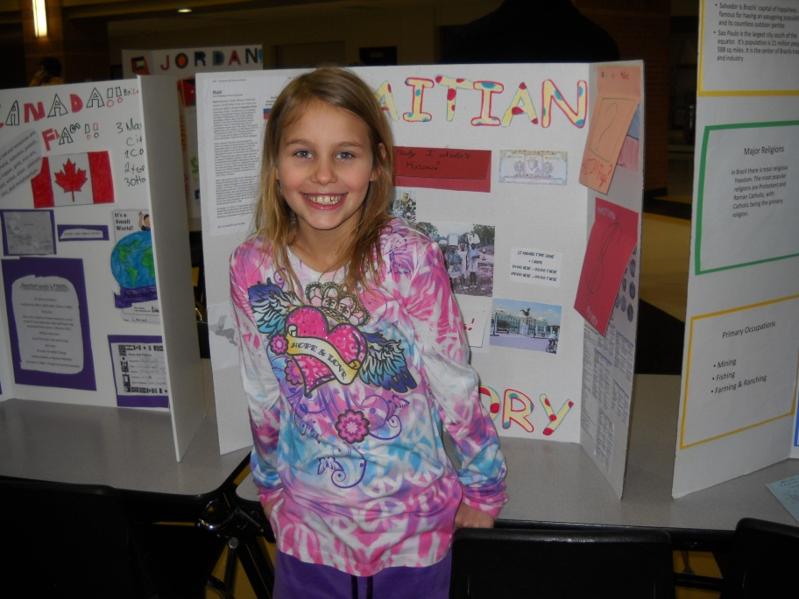
GIFTED FAMILY NIGHTS
International Night at Campus

Slide 16
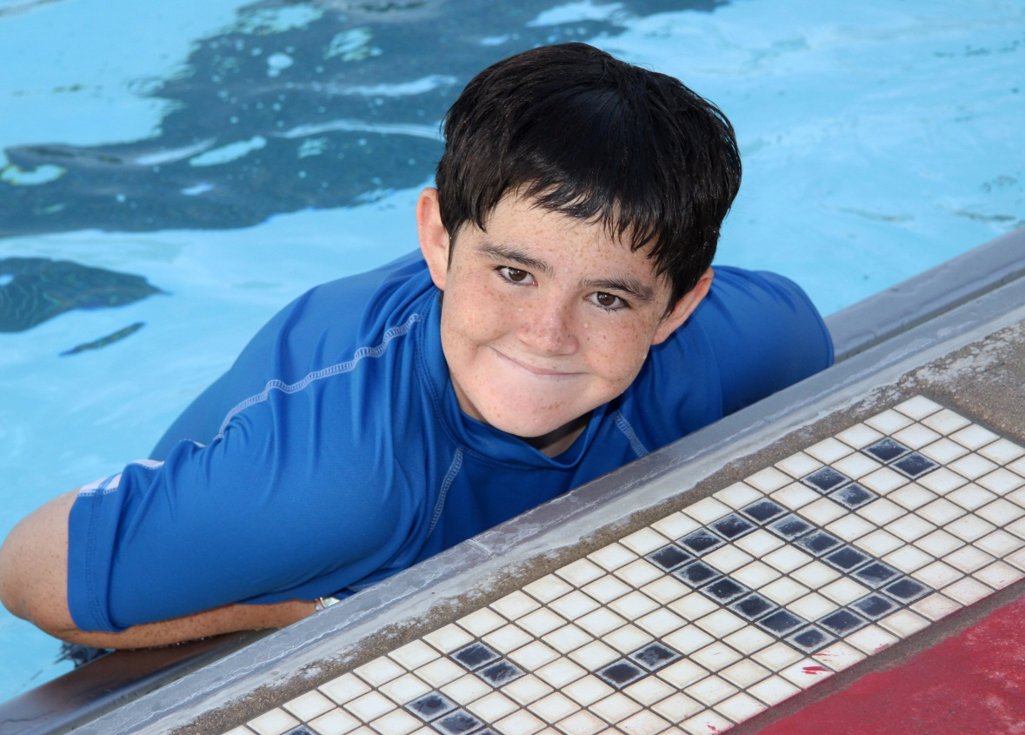
“Back to School”
Swim Party
Dewey Gunzelman Pool in Haysville
GIFTED FAMILY NIGHTS

Slide 17
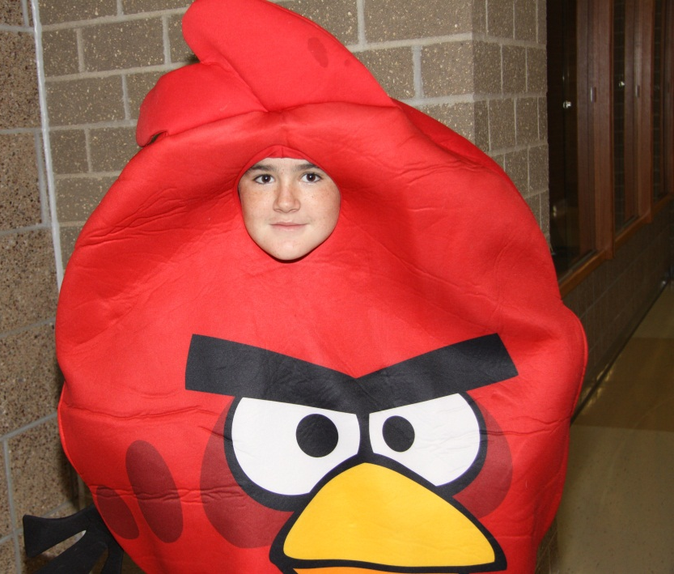
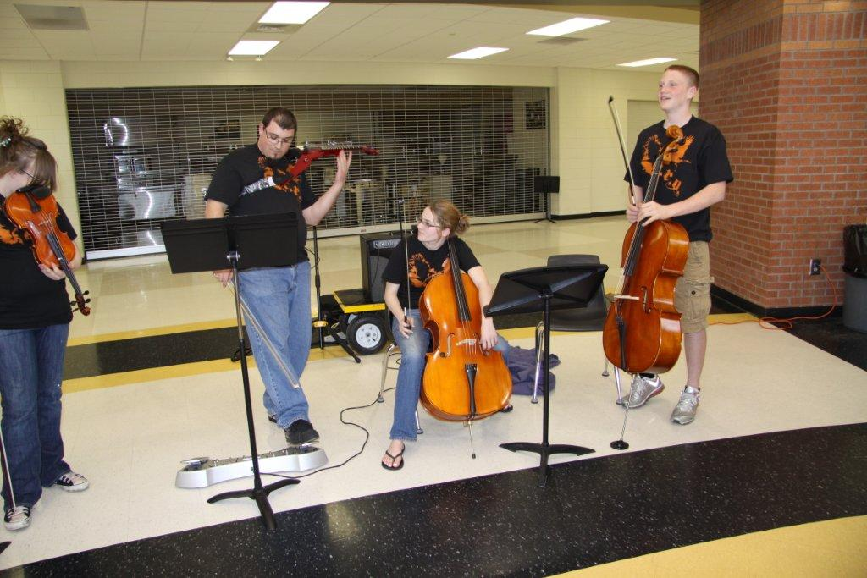
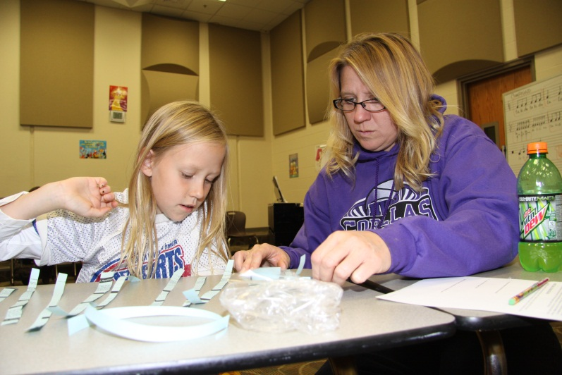
Family Fall Fun Night
GIFTED FAMILY NIGHTS

Slide 18
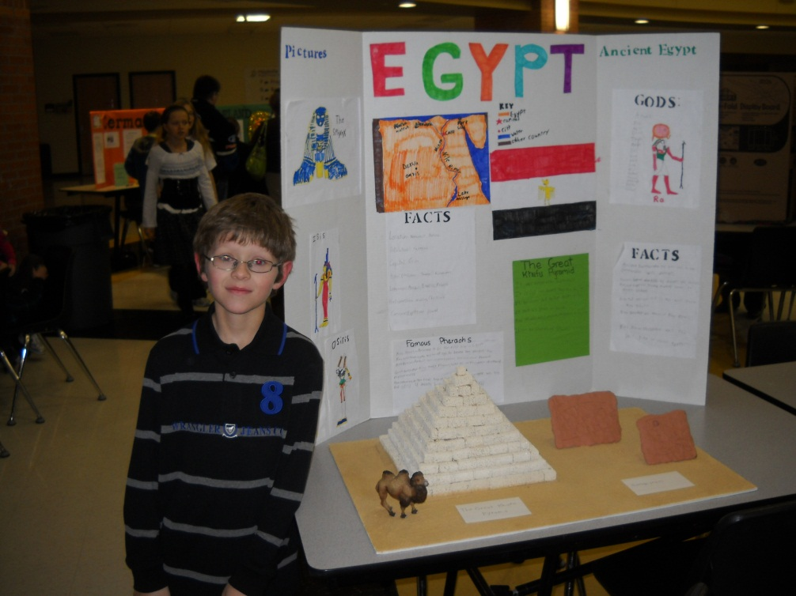
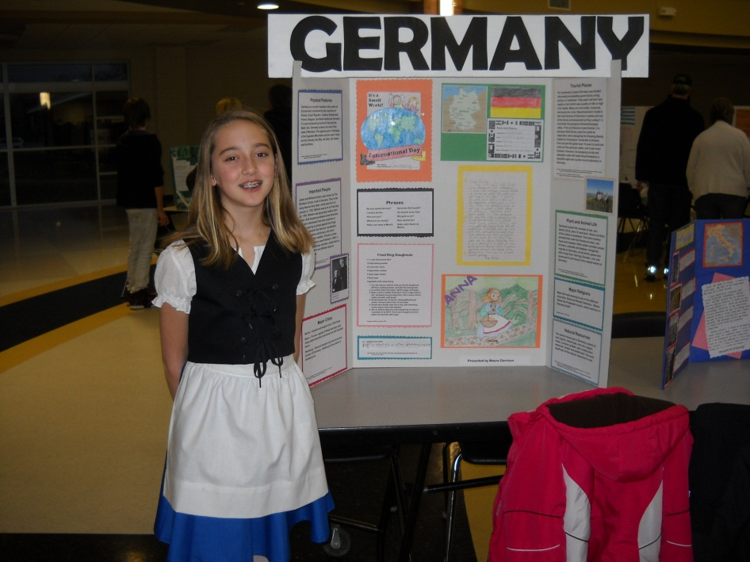
International Night
GIFTED FAMILY NIGHTS

Slide 19
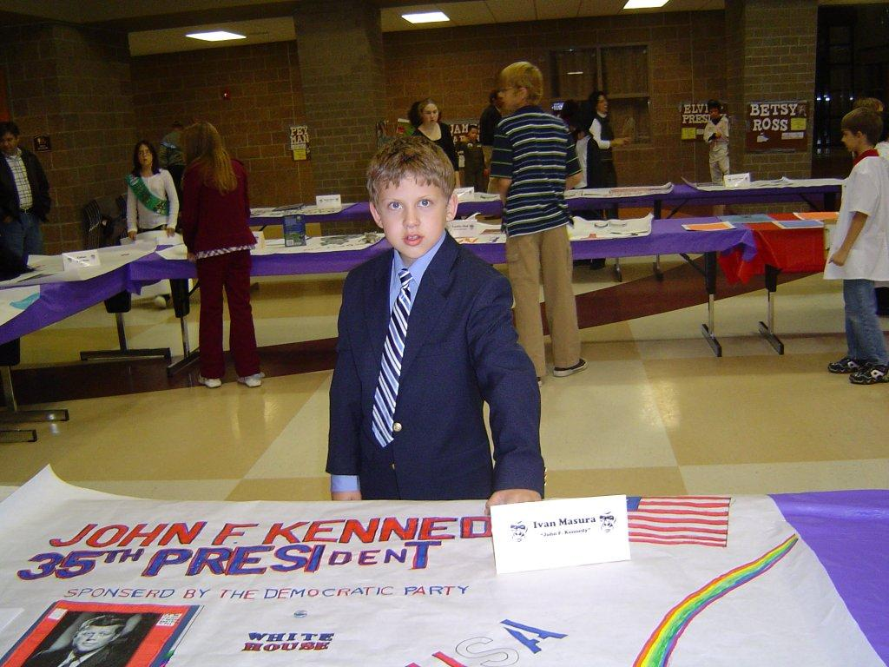
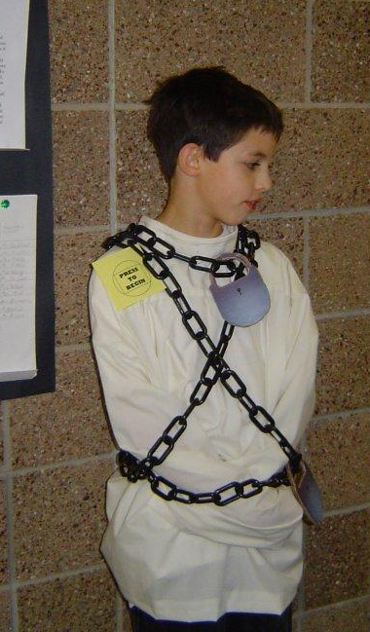
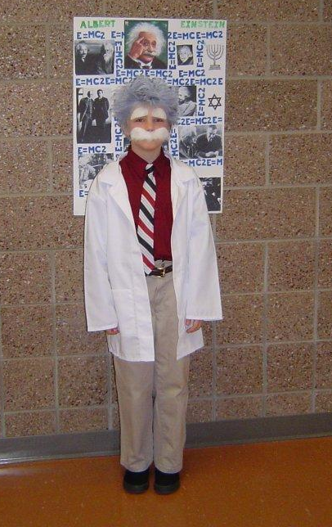
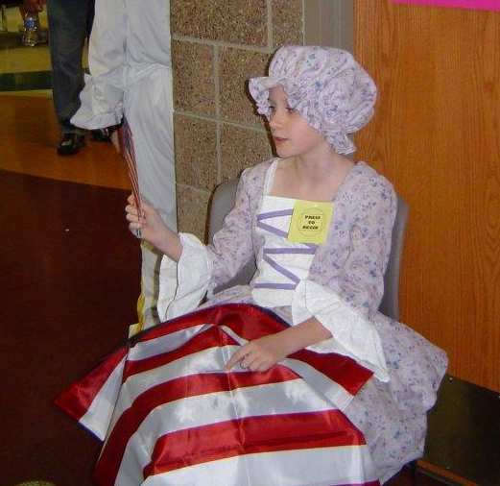
WAX MUSEUM
Albert Einstein
John F. Kennedy
Harry Houdini
GIFTED FAMILY NIGHTS
Betsy Ross

Slide 20
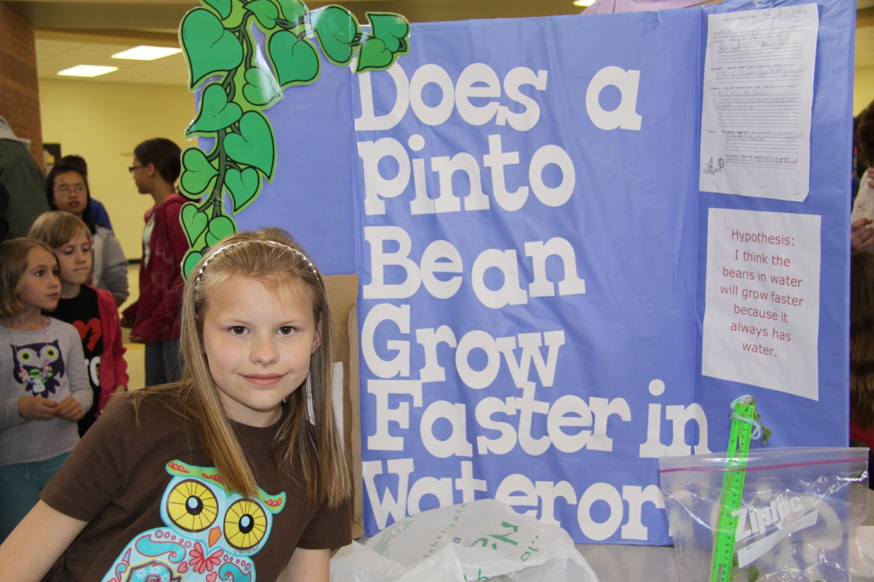
SCIENCE FAIR

Slide 21
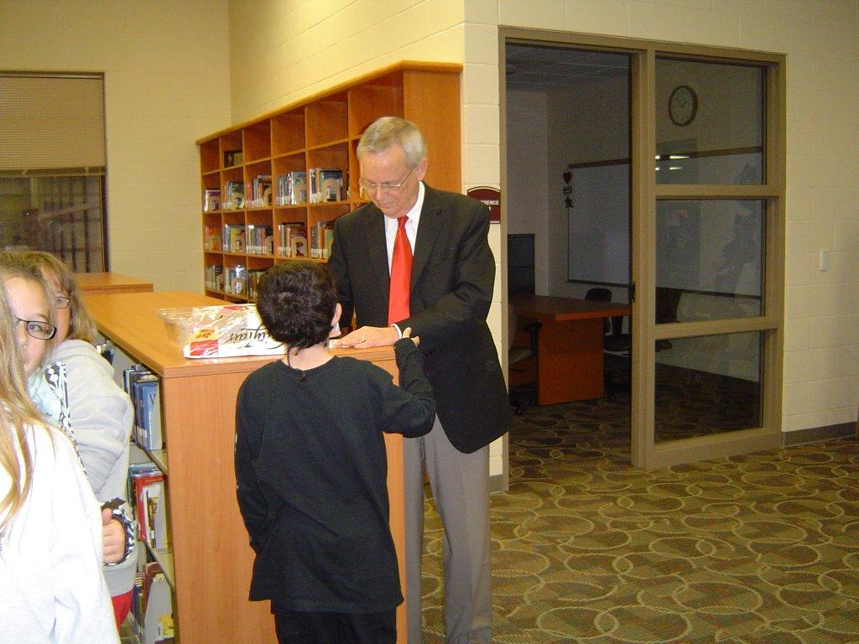
Larry Hatteburg
COLLABORATION ACROSS GRADE LEVELS

Slide 22
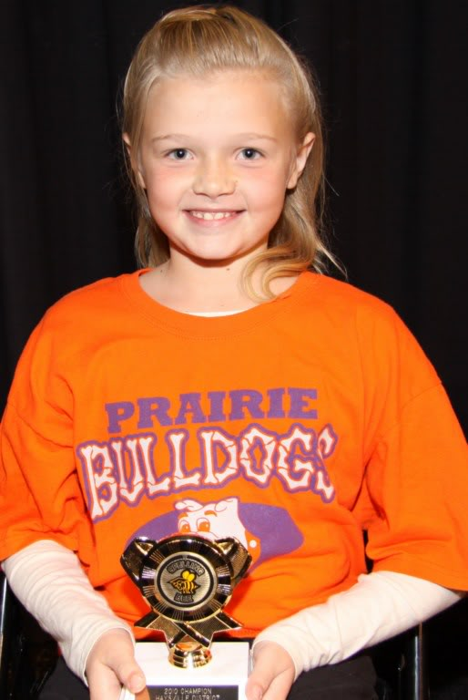
We are involved…
School and District Spelling Bee
Odyssey of the Mind
Battle of the Books
Scholar’s Bowl
National Junior Honor Society
ACT Test Preparation
Math Competition

Slide 23
How Can Haysville’s BOE Support US
Visit our classrooms
Attend our events
Talk to us when you have questions
Support additional staff needs
Together We Can Make A Difference

Slide 24
Next Steps
MINING for Gems
Process Evaluation
Student Progress Monitoring
Ongoing Process Analysis
Improved Communication

Slide 25

Questions
MINING for Gems

Slide 26
MINING for Gems
Contact Information
Becky Cezar, Director of Special Education
Angie Estell, Assistant Director of Special Education
Caylene Burns, Gifted Teacher, CHS
Ashley Madorin, Gifted Teacher, HMS/HWMS
Sally Holliday, Gifted Teacher, Prairie/Ruth Clark/HMS
Shari Burke, Gifted Teacher, Freeman/Oatville
Karla Jeardoe, Gifted Teacher, Rex/Nelson

