Slide 1
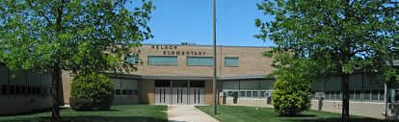
Nelson Elementary
I will act in such a way that I will be proud of myself and others will be proud of me too.
I came to school to learn and I WILL LEARN!
I will have a great day!

Slide 2

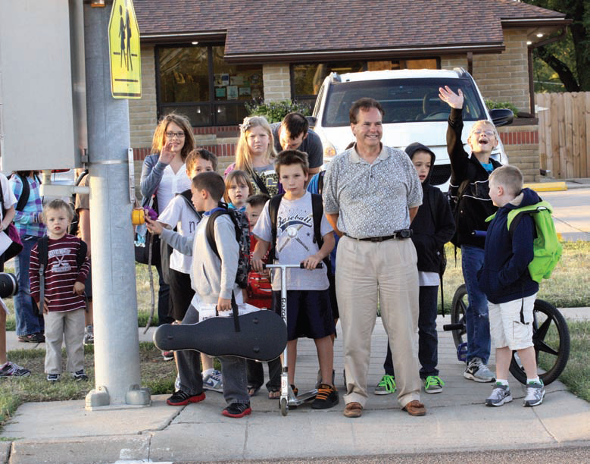
Student Demographics, Data
Analysis, and School Improvement Plan

Slide 3
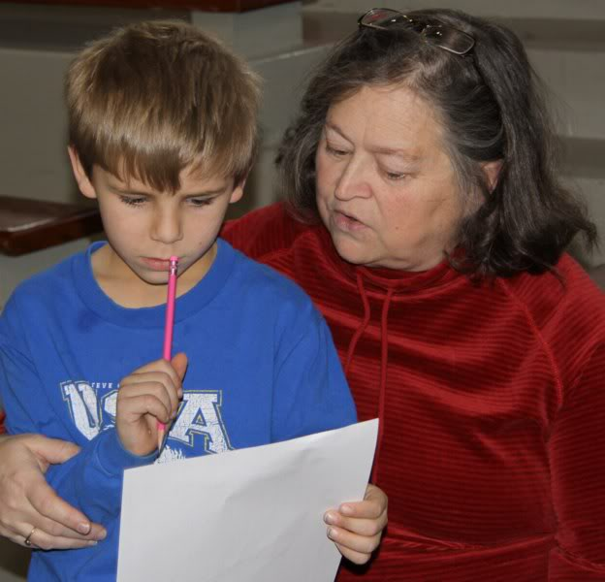
Building-Wide Goals
All sub-groups within 10% of each other.
All sub-groups above 93%.
The building average of all subgroups is over 93%.
95% of 1st grade students will master all of Phonological Awareness skills by the end of the year.
95% of 2nd grade students will master all of the Phonics skills by the end of the year.

Slide 4
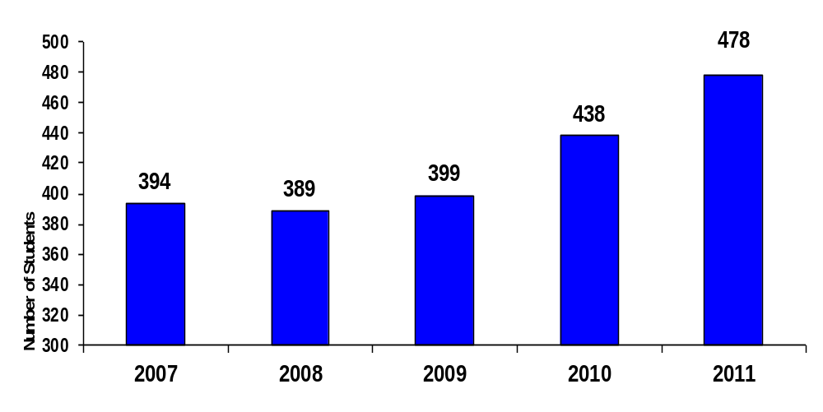
Nelson Student Enrollment
September 20th Count

Slide 5
2011-2012
Student Gender

Slide 6
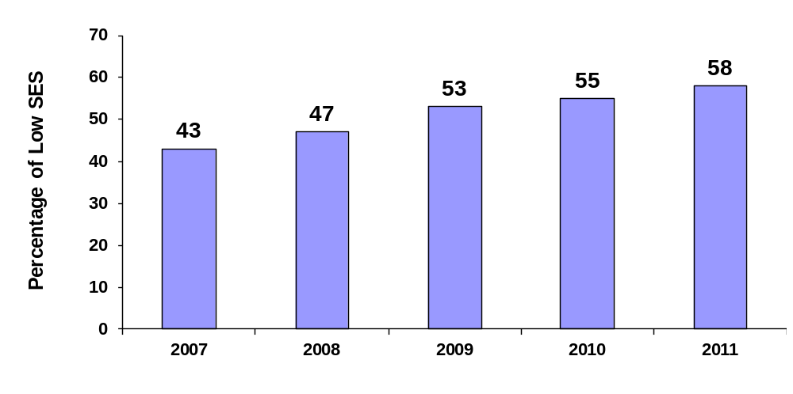
Student Data
Percentage of Low SES Students

Slide 7
2011-2012
Student Diversity

Slide 8

Kansas Math Assessment
% Performing Proficient or Above
Year | 3rd | 4th | 5th
2007 | 78.5 | 74.7 | 62.2
2008 | 93.5 | 87.7 | 91.5
2009 | 85.7 | 80.6 | 93.7
2010 | 69.4 | 74.6 | 98.6
2011 | 95.1 | 88.6 | 97.0

Slide 9
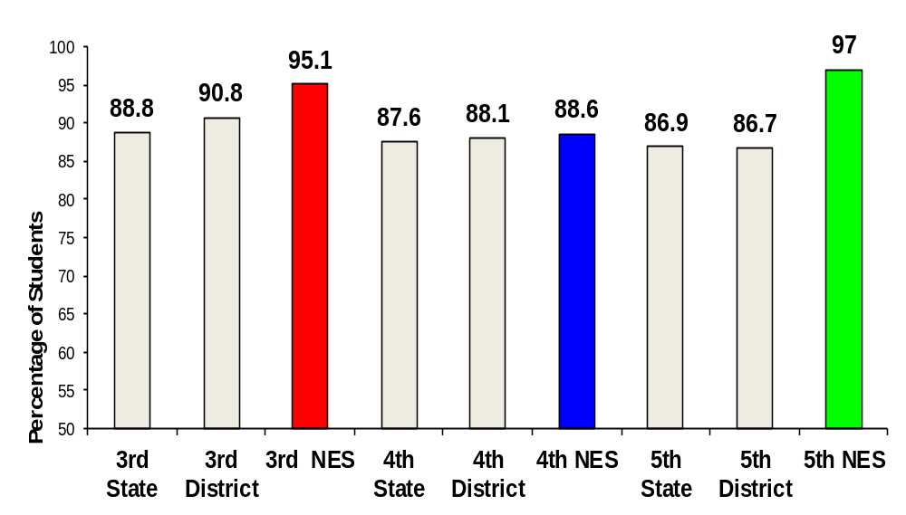
Nelson Student Data
2011 Kansas Math Assessment
Students Proficient or Above
Building-Wide

Slide 10
Summary of
Target Area: Math
Building-Wide
Continue to improve scores across grade levels and subgroups.
Continue to set goals and expectations that exceed those of previous years
Continue to implement Everyday Math with fidelity
Continue to monitor discrepancies related to Gender, Sped and SES subgroups

Slide 11
Kansas Reading Assessment
% Performing Proficient or Above
Year | 3rd | 4th | 5th
2007 | 73.1 | 78.3 | 76.5
2008 | 87.1 | 78.1 | 76.1
2009 | 91.1 | 92.5 | 72.2
2010 | 85.5 | 79.7 | 93.1
2011 | 93.4 | 89.9 | 97.0

Slide 12
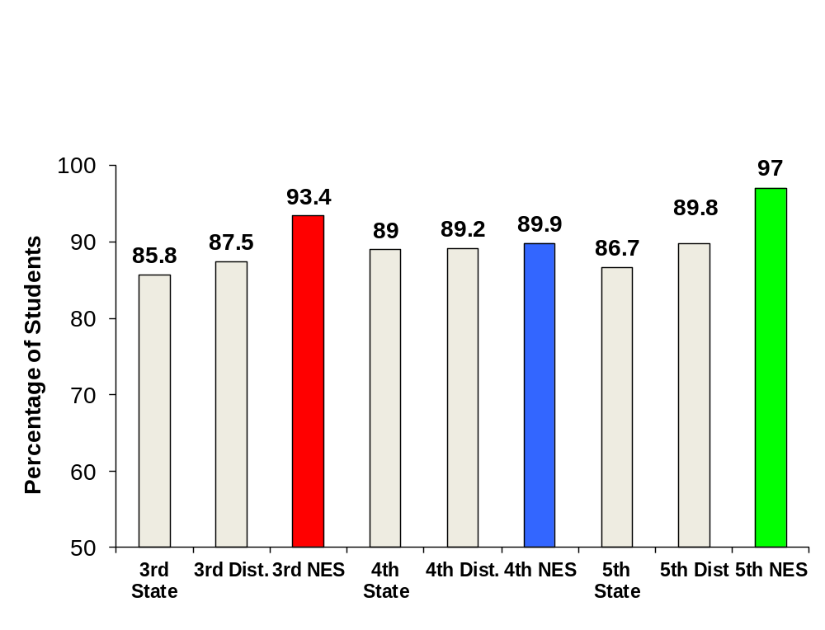
Nelson Student Data
2011 Kansas Reading Assessment
Students Proficient or Above
Building-Wide

Slide 13
Summary of
Target Area: Reading
Building-Wide
Scores have drastically improved in with all students.
Continue to set high expectations that exceed those of previous years
Continue to implement the Literacy First Process with fidelity
Continue to monitor discrepancies between gender, ELL, Sped, and SES subgroups

Slide 14
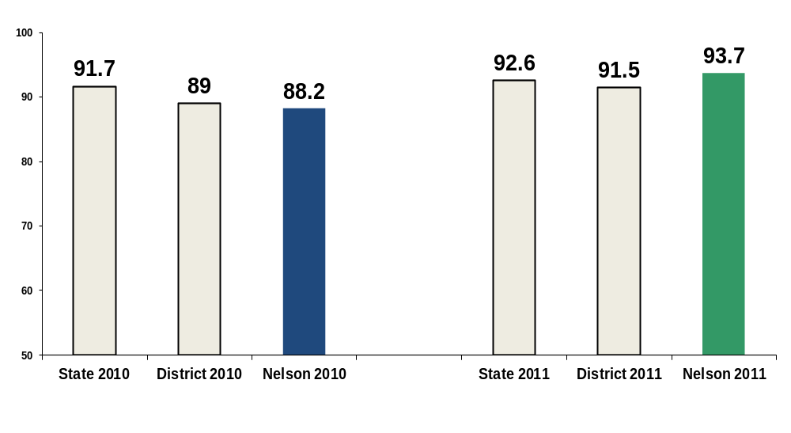
Nelson Student Data
2011 Kansas Science Assessment
Students Proficient or Above

Slide 15
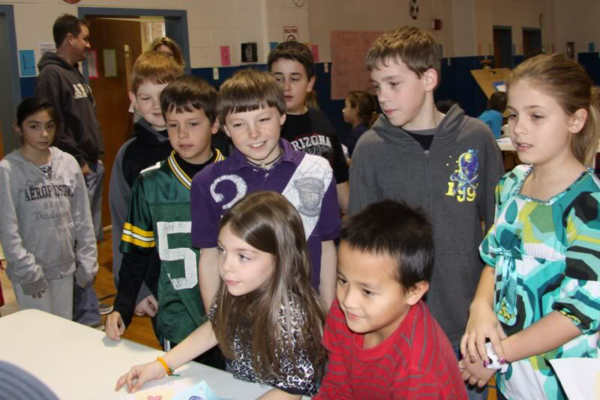
Nelson Superstars
Shine with Respect!

