Slide 1
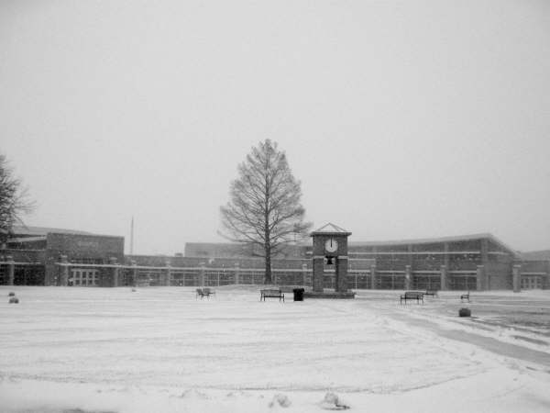
Student Achievement
Campus High School
Haysville Alternative High School
Board of Education
January 23, 2012

Slide 2
Our Vision for Campus & HAHS
What can we be?
Graduation rate of 90% by 2014
Meet AYP in Reading, Writing, and Math
Meet Standard of Excellence in Reading and Math
Average score of 23 on ACT
Provide a safe, nurturing environment for our students.
Notes:
SMART Goals handout is attached to the e-mail if you would like to use it.
Study Group handout document was attached to the e-mail.

Slide 3
CHS & HAHS Enrollment

Slide 4
Free and Reduced Lunch

Slide 5
Ethnicity

Slide 6
Graduation Rate
Formula for graduation rate changed in 2010-11.

Slide 7
Reading State Assessment

Slide 8
Math State Assessment

Slide 9

Graduation Rate: AYP!
Math: AYP!
Reading: AYP and Standard of Excellence!

Slide 10
ACT

Slide 11
# of Students in A.P. Classes

Slide 12
Major Log Entries

Slide 13
Violent Acts (Fights)

Slide 14
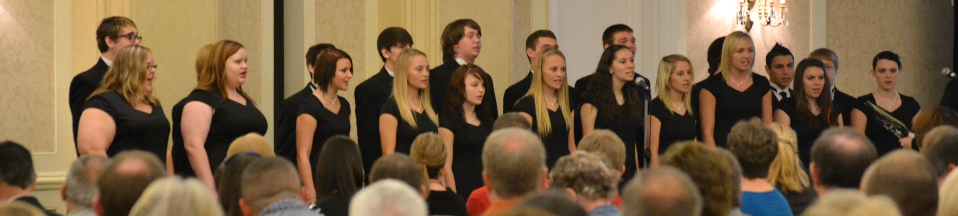
Do Good Work!
Contributions from CHS/HAHS Clubs & Activities this school year:
  Approximately $8,400 of donations to non-profit organizations
  Approximately 2,000 hours of community service

