Slide 1
Facility Management Plan
School dude information

Slide 2
Facilities Overview
Maintenance
USD 261 Currently has 16 facilities totaling 1.1million square feet that we maintain.
USD 261 has over 259 acres that we maintain.
We have 12 full time maintenance employees.
Last year Maintenance completed 3,505 work orders.
Since July 1 Maintenance has completed 932 work orders.
Those numbers do not include items that were completed with out a work order being submitted.
This also does not include delivery services or mowing.

Slide 3
Facility overview
Custodial
We have 56 full time custodial employees.
Custodians did an outstanding job of cleaning our facilities this summer.
Custodians have been asked to take on more duties due to Covid 19 and have excelled at these requests.
Custodians take care of our yearly inventory. This allowed us to furnish the 5 new classrooms at Freeman without having to make furniture purchases.

Slide 4
Facility Overview
Transportation
Transportation Staff consists of:
4 Office Staff
3 full time mechanics
49 Bus Drivers
13 Bus Aides
11 Van Drivers

Slide 5
Facility Overview
Transportation Continued
39-Big Buses
22-Mini Buses
3-Colt Buses
19-Activity Vehicles
47-Big Bus Routes
27-Mini Bus Routes
7-Van routes
Transported 3041 Students
Drove a Total of 430,866 miles last year

Slide 6
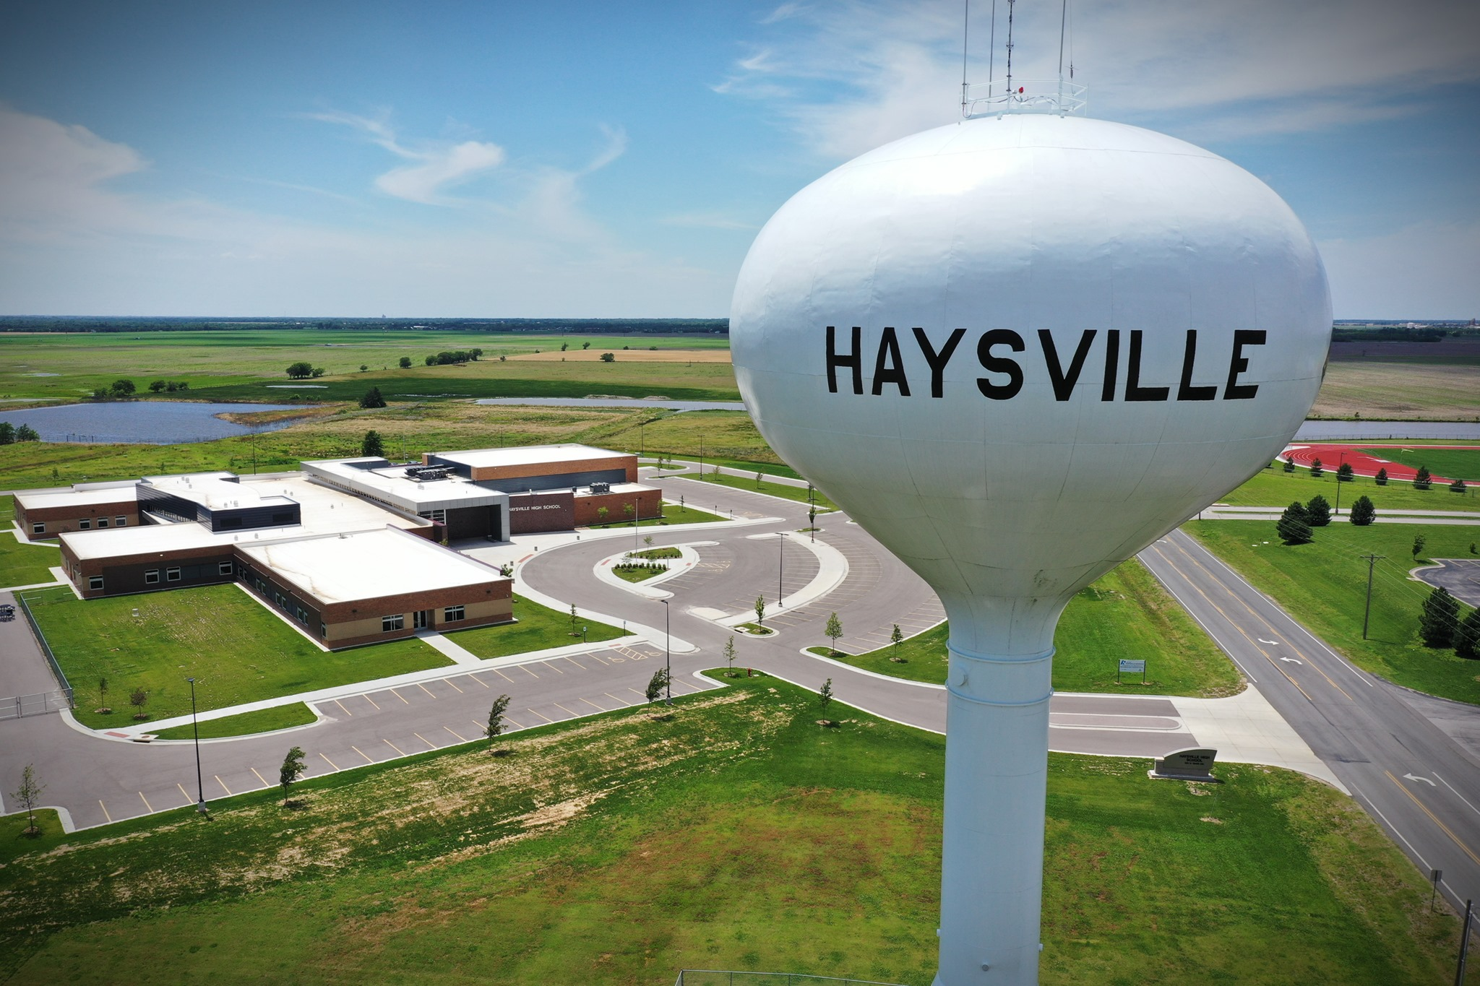
Questions?

