Slide 1
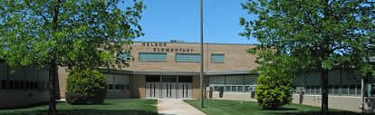
Nelson Elementary
I will act in such a way that I will be proud of myself and others will be proud of me too.
I came to school to learn and I WILL LEARN!
I will have a great day!

Slide 2

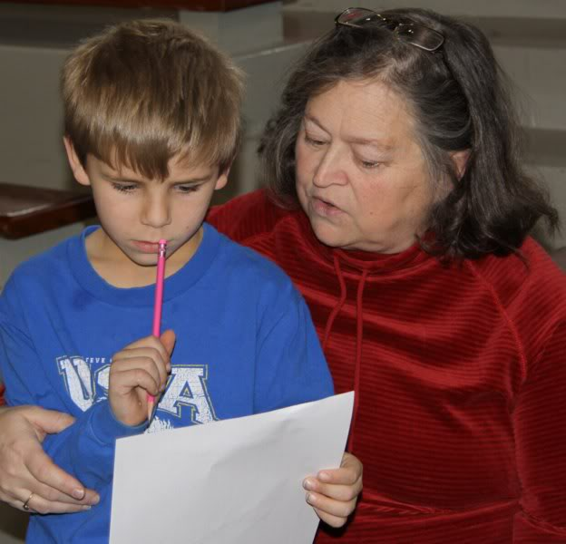
Building-Wide Goals
All sub-groups within 10% of each other.
All sub-groups above 93%.
The building average of all subgroups is over 93%.
95% of 1st grade students will master all of Phonological Awareness skills by the end of the year.
95% of 2nd grade students will master all of the Phonics skills by the end of the year.

Slide 3
Nelson Student Enrollment
September 20th Count

Slide 4
2012-2013
Student Gender

Slide 5
Student Data
Percentage of Low SES Students

Slide 6
2012-2013
Student Diversity

Slide 7

Kansas Math Assessment
% Performing Proficient or Above
Year | 3rd | 4th | 5th
2007 | 78.5 | 74.7 | 62.2
2008 | 93.5 | 87.7 | 91.5
2009 | 85.7 | 80.6 | 93.7
2010 | 69.4 | 74.6 | 98.6
2011 | 95.2 | 88.6 | 97.0
2012 | 98.1 | 97.0 | 97.2

Slide 8
Nelson Student Data
2012 Kansas Math Assessment
Students Proficient or Above
Building-Wide
3rd
4th
5th

Slide 9
Summary of
Target Area: Math
Building-Wide
Focus on implementing Common Core Math standards to increase application level of skills.
Continue to improve scores across grade levels and subgroups.
Continue to implement Everyday Math with fidelity
Continue to monitor discrepancies related to Gender, Sped and SES subgroups

Slide 10
Kansas Reading Assessment
% Performing Proficient or Above
Year | 3rd | 4th | 5th
2007 | 73.1 | 78.3 | 76.5
2008 | 87.1 | 78.1 | 76.1
2009 | 91.1 | 92.5 | 72.2
2010 | 85.5 | 79.7 | 93.1
2011 | 93.4 | 89.9 | 97.0
2012 | 90.7 | 84.8 | 90.1

Slide 11
Nelson Student Data
2012 Kansas Reading Assessment
Students Proficient or Above
Building-Wide
3rd
4th
5th

Slide 12
Summary of
Target Area: Reading
Building-Wide
Focus on implementing Common Core ELA standards to increase application level of skills.
Continue to set high expectations that exceed those of previous years
Continue to implement the Literacy First Process with fidelity
Continue to monitor discrepancies between gender, ELL, Sped, and SES subgroups

Slide 13
Nelson Student Data
2011 Kansas Science Assessment
Students Proficient or Above

Slide 14

2012 Recognitions
Six Standards of Excellence
State Title I Reward School
National Distinguished Title I School
Kansas Teacher of the Year Region IV Finalist: Ramie Allison

