Slide 1
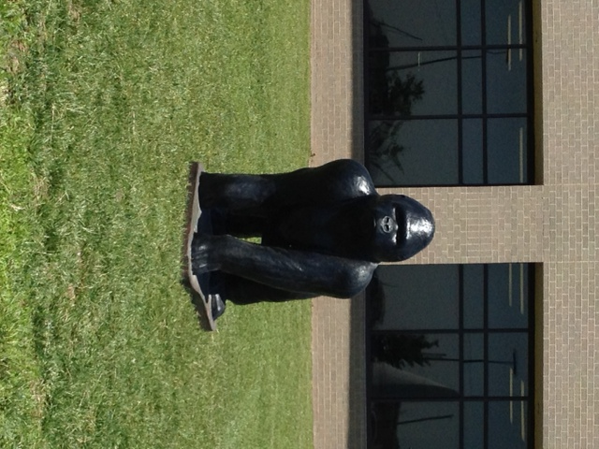
Haysville West Middle School
Home of the Gorillas

Slide 2
Reading
Group | 2009 | 2010 | 2011 | 2012
Multi-Racial | x | 71.8 | 86.1 | 92.2
Free / Reduced | 72.7 | 76.6 | 85.2 | 89.4
Student w/ Disabilities | 59.4 | 67.1 | 77 | 76.3
ELL | 75.5 | 69.6 | 88.9 | 91.9
Hispanic | 80.3 | 80 | 86.6 | 88.6
White | 80.4 | 84.5 | 88.8 | 92.8
Asian | 78.4 | 80 | 91.5 | 95.1
All Students | 78.5 | 82.3 | 88 | 92.1

Slide 3
Math
Group | 2009 | 2010 | 2011 | 2012
Muli-Racial | x | 64.1 | 88.6 | 92
Free / Reduced | 57.9 | 62 | 81.9 | 86.8
Students w/ Disabilities | 34.8 | 46.6 | 70.6 | 70.4
ELL | 63.3 | 64.3 | 92.9 | 91.7
Hispanic | 63.6 | 57.6 | 88.9 | 88.4
White | 65.6 | 70.7 | 83.3 | 87.1
All Students | 64.6 | 68.1 | 84.6 | 88.5

Slide 4
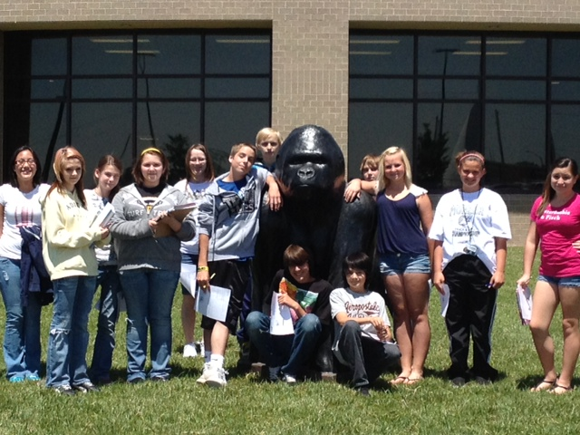
Initiatives Supporting Improvement
PBIS
Literacy First
MTSS
Capturing Kids Hearts
Team West
Kids Caring for Christ

