Slide 1

USD #261COVID Response
“Students benefit from in-person learning, and safely returning to in-person instruction in the fall of 2021 is a priority.”

Slide 2
Committee Members
Parents
BOE
HEA Leadership
Health Services
District Leadership Team

Slide 3
Purpose of Committee
Review CDC and Sedgwick County HD Guidelines
Evaluate current status of COVID data in Sedgwick County
Provide feedback and input for the USD #261 COVID Response Plan

Slide 4

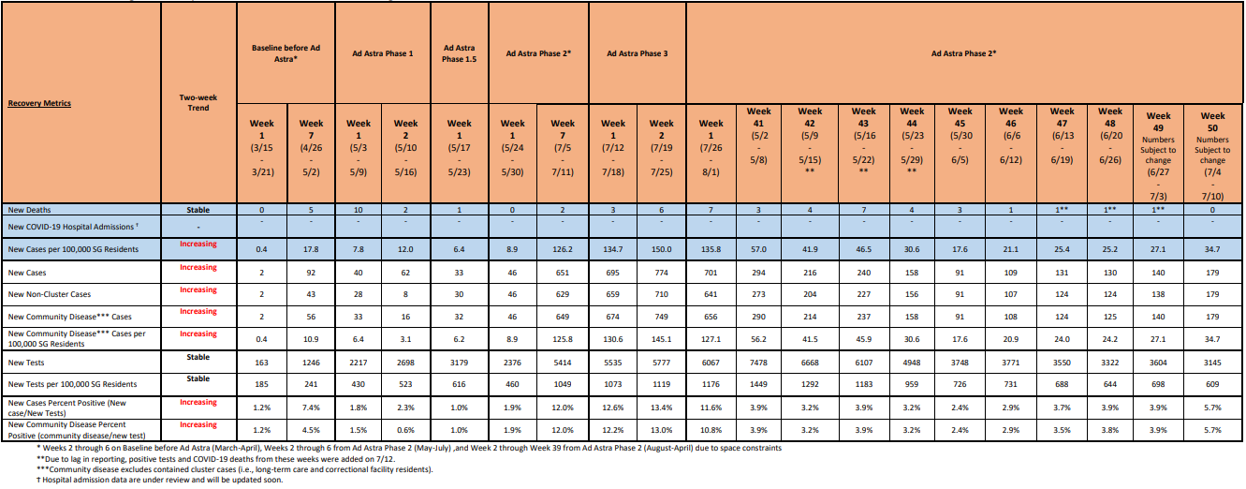



Current Data from Sedgwick County

Slide 5
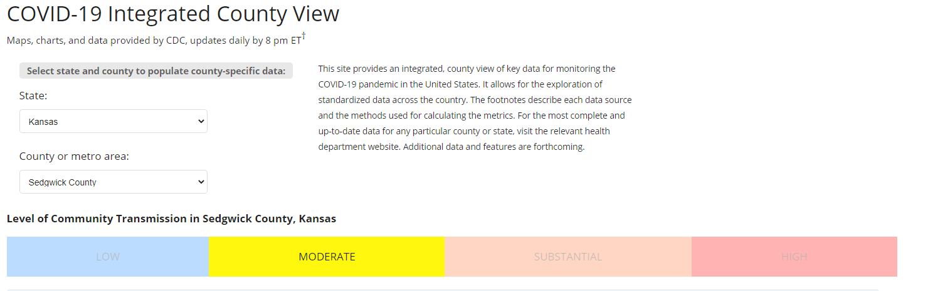
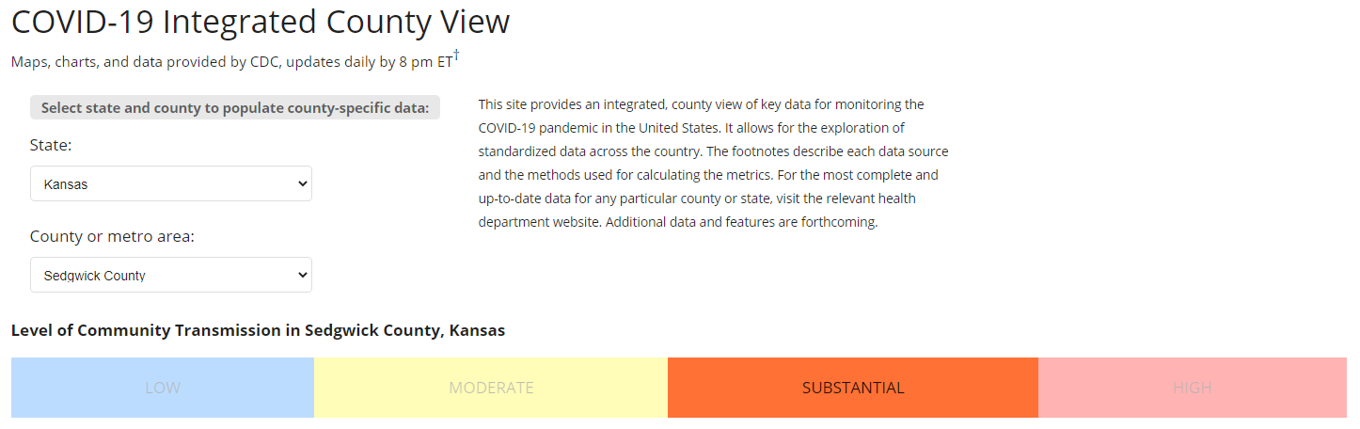
Transmission Rate in Sedgwick County
July 14, 2021
July 19, 2021

Slide 6

Vaccinations
* “A growing body of evidence suggests that people who are fully vaccinated against COVID-19 are less likely to have an asymptomatic infection or transmit COVID-19 to others than people who are not fully vaccinated. In most settings, people who are fully vaccinated can safely resume activities they did before the pandemic, except where prevention measures are required by federal, state, local, tribal, or territorial laws, rules, and regulations, including local business and workplace guidance.”
*CDC Guidance for COVID-19 Prevention in K-12 Schools

Slide 7
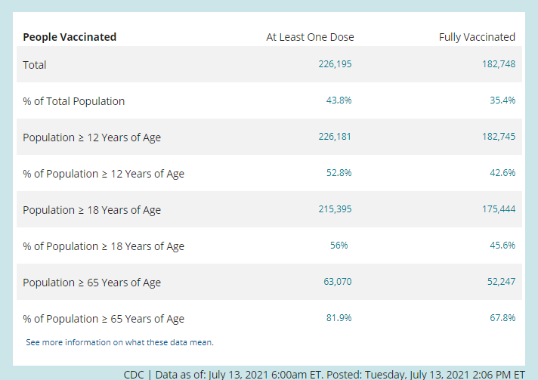
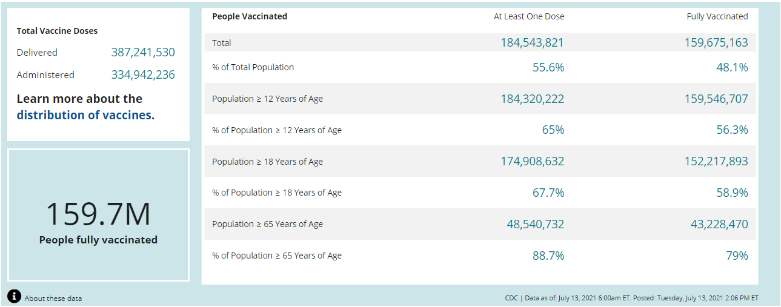
Vaccination Rates
Sedgwick County
United States

Slide 8
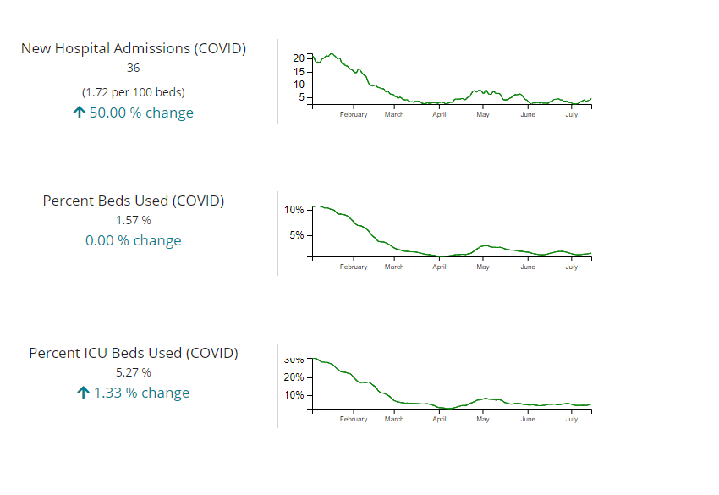
Hospitalization Rates in Sedgwick County

Slide 9
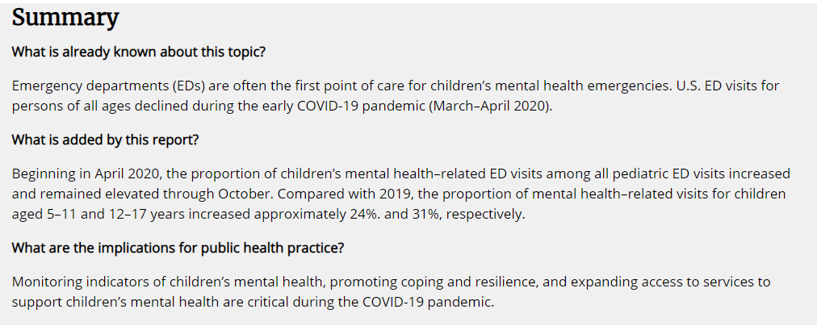
Mental Health Related Emergency Department Visits Among Children 18 and Younger
*Mental Health–Related Emergency Department Visits Among Children Aged <18 Years During the COVID-19 Pandemic — United States, January 1–October 17, 2020Weekly / November 13, 2020 / 69(45);1675–1680

Slide 10
Recommendation from Committee
Masks are optional for all students and staff
Continue to monitor data
Adjust as needed

Slide 11
Next Steps
Present to BOE
Continue to meet with organizations such as the Sedgwick County Health Dept. and Kansas COVID Workgroup for Kids
Expansion of committee
Address additional daily operations

Slide 12
Recommendation to the BOE
District Leadership will continue to monitor data from Sedgwick County Health Department, KDHE, and the CDC throughout the 21-22 school year.
Motion-Effective July 20, 2021, the wearing of masks by USD 261 students and staff is optional for the 21-22 school year.

