Slide 1
Staffing for All Day Kindergarten
January 2014

Slide 2
A Committee is formed…
What if? Think Tank format
Concepts
Readings/Discussions
Calling/Visits
Conferences
Over one year of dialogue!
History/Relevance

Slide 3
Where did we land?
It grew…
      All Day Kindergarten
      Boundaries
      Continuous Progress PreK-1
Boundaries a ADK built around PreK-1
History/Relevance

Slide 4
ADK with the Prek-1 Concept
Key Components/Definition
Work Teams
Graduated Roll Out…
  taking the time to make it work well.
What

Slide 5
Key components/definition
Aligned transition from Birth to 2nd Grade to give kids a solid foundation of basic skills
Early interventions
Extended learning
Innovative and research based with a rigor & relevance focus
Differentiated and student centered
Focus on Literacy
Gender concept friendly
Multi-age flex grouping
Continuous progress with standards based reporting
Parent partnerships
What

Slide 6
Funding & Facilities
Hire 7 new Kindergarten teachers
Fill 3 vacant Library Media Specialist positions
Total cost $450,000
Provide initial set-up for new classrooms: desks, chairs, materials
Total cost $14,000/classroom
Work teams
Personnel
Transfer process in place per Negotiated Agreement
Interview protocol established for new positions
How Much & Who

Slide 7
scheduling
Principals met to discuss considerations on the building schedule including lunch and specials (PE, Music, Technology, and Library) needs
Work teams
Communication & Marketing
Marketing this concept
Communication plan so parents are informed
How

Slide 8
Professional development
Determined possible calendar dates for training
Identified training priorities for veteran staff
Identified training priorities for new staff
Brainstormed possible district presenters
Brainstormed topics for additional trainings
Two-year training plan that aligns with the graduated roll out
Work teams
How

Slide 9
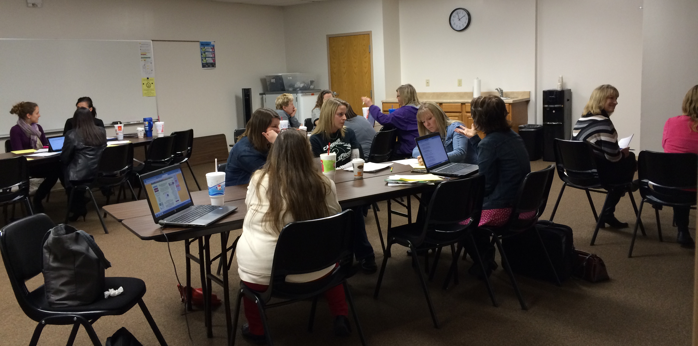
Curriculum
Identified materials/resource needs as well as equipment
Enhance PBIS to align management signals
Determined grouping criteria, testing windows, para support, and flexing schedule
Defined continuous progress as well as identifying areas of need: to align with the PreK (4 year old) and Kindergarten grade cards, the teachers would like a 3 year old and 1st grade standards based grade card.
Identified instructional strategies tailored to these classrooms –
“Busy Hands, Busy Brains”
Building bridges to learning
Helps connect process and application
Begins with active participation
Benefits critical thinking skills
Work teams
How

