Slide 1
BOE
Presentation
Assessment Update

Slide 2
Trend Data for
USD261 SOE

Slide 3
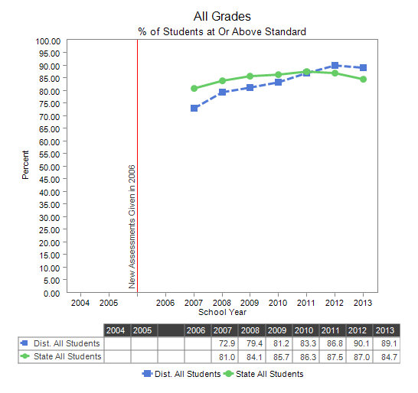
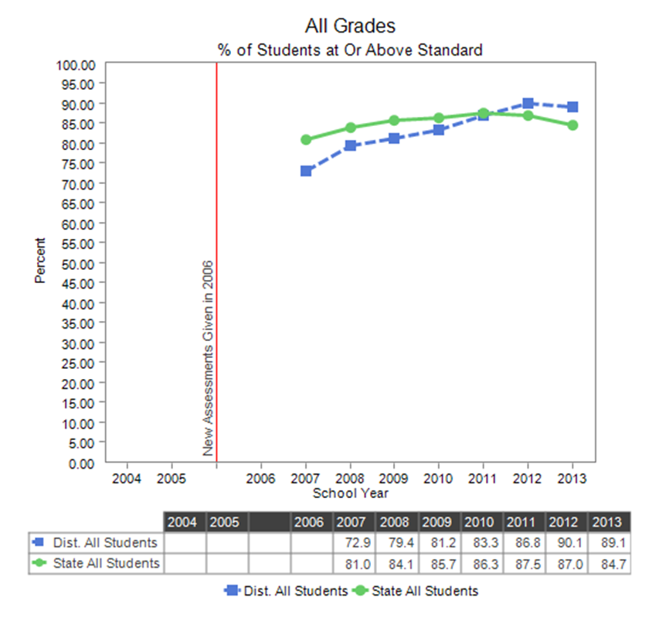
District Reading
Trend Data

Slide 4
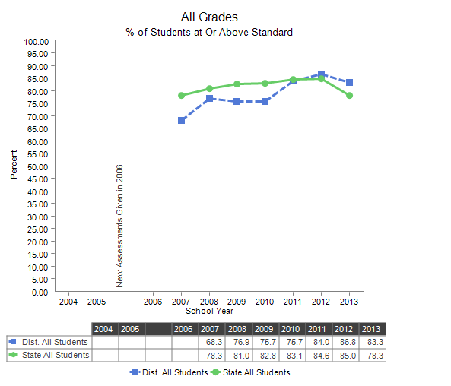
District Math
Trend Data

Slide 5
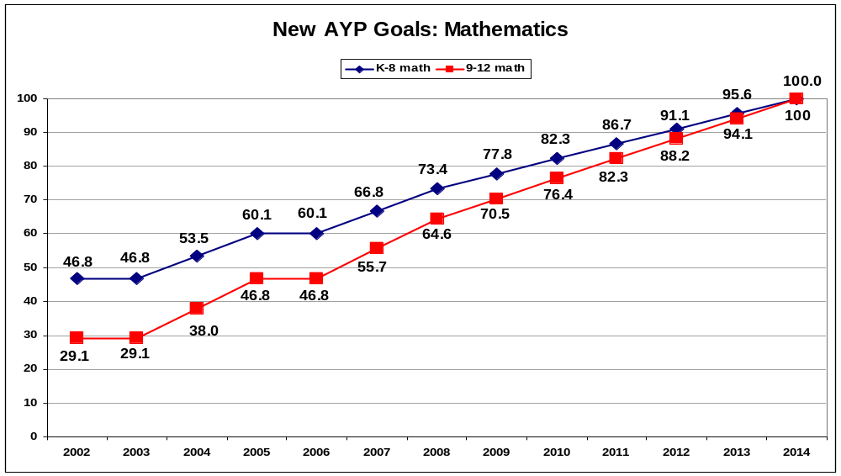

AYP Eliminated!
Now…Measureable Objectives
AMO and API

Slide 6
Status – Why the changes?
NCLB (ESEA) Assessments 2002 - 2014
  100% proficient by 2014
ESEA Waiver –
  AMO
  API
  Continuous student improvement
College Career Ready Standards
  2014 ELA/Math Transitional Assessments
  2015 ELA/ MATHSummative Assessments

Slide 7
AMO
Annual Measureable Objective
ESEA Waiver
4 Criteria based on State Assessment Results
  Achievement Results (building API scores)
  Growth Results
  Gap Reduction Results
  Reducing Non-Proficient

Slide 8
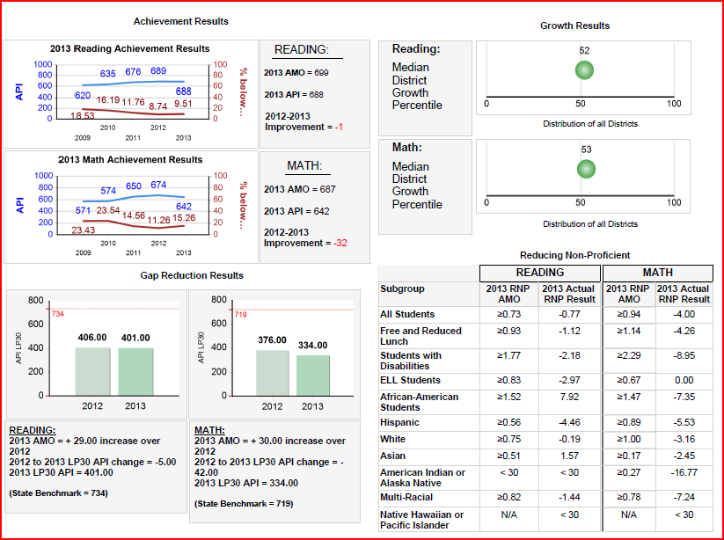
AMO District Report

Slide 9
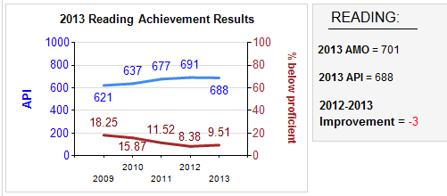
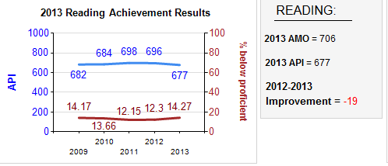
District Reading
Achievement
District
State
Notes:
The achievement AMOs are based on two variables:
The blue line is the buildings Assessment Performance Index (API); AND
The red line is the percent of students below proficient

Slide 10
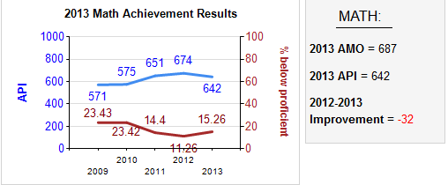
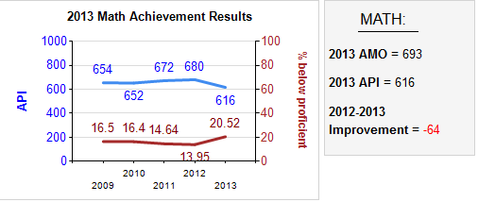
District Math
Achievement
District
State

Slide 11
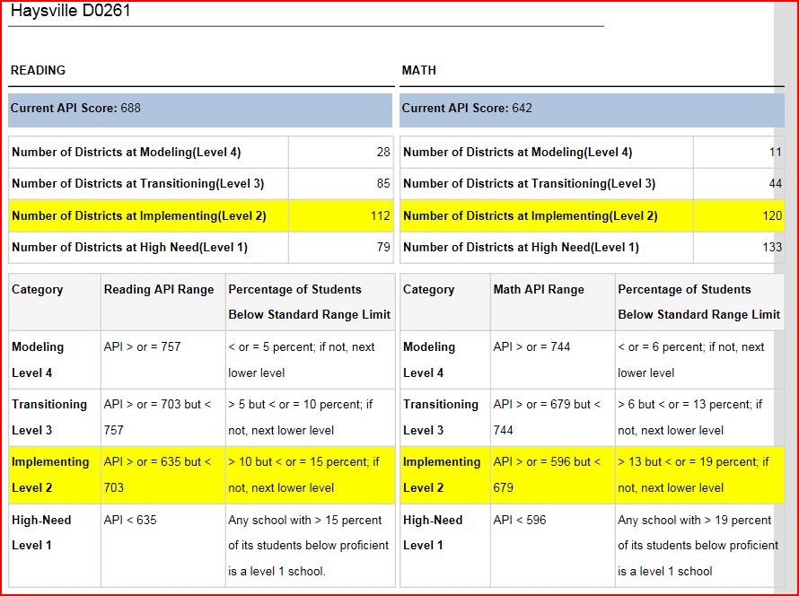
AMO/API Comparison Report

Slide 12
Spring 2014
Transitional State Assessments
Science no changes (same format, etc.)
Transitional Year – New Test for ELA and Math!
Aligned to CCRS
Fewer Test Type choices
No Sped ALT now DLM
More Technology
Fewer Accommodations

Slide 13
Individual Schools
Reading and Math
Achievement
AMO Reports

Slide 14
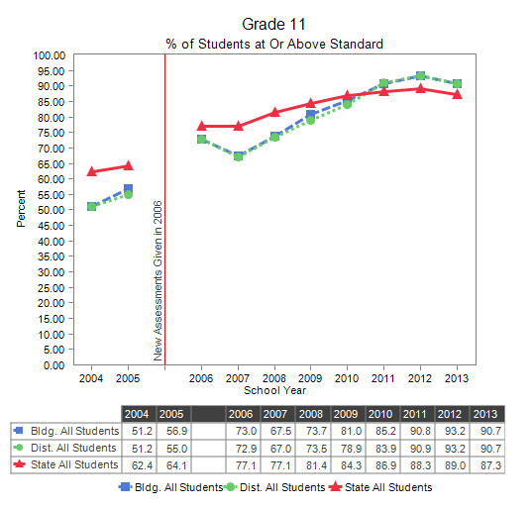
High School Reading

Slide 15
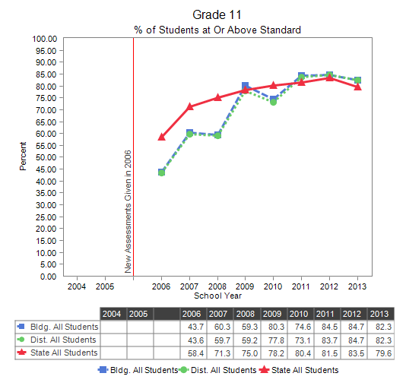
High School Math

Slide 16
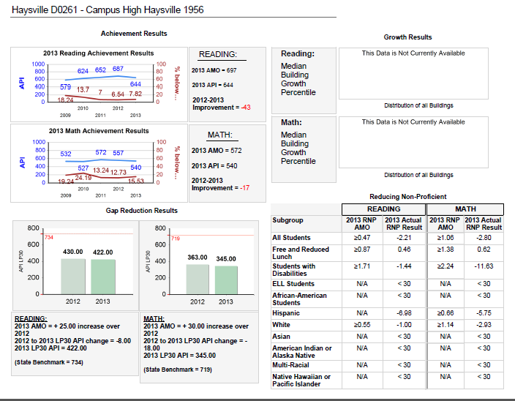
CHS AMO Report

Slide 17
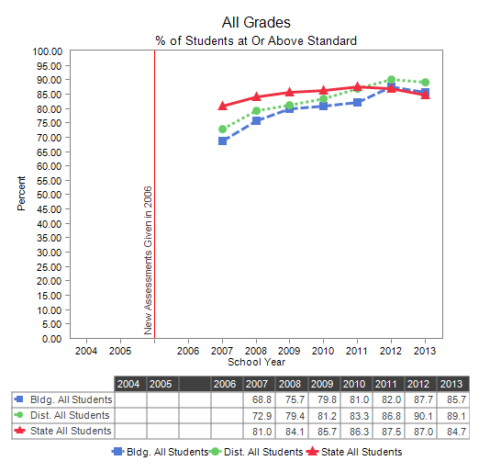
Haysville Middle Reading

Slide 18
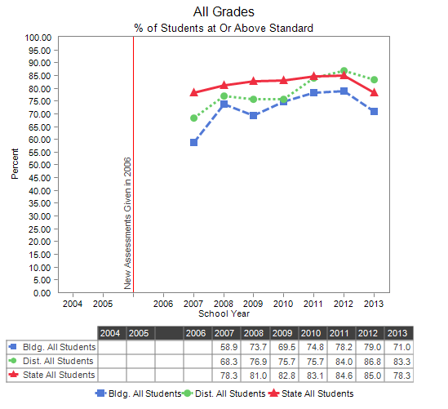
Haysville Middle Math

Slide 19
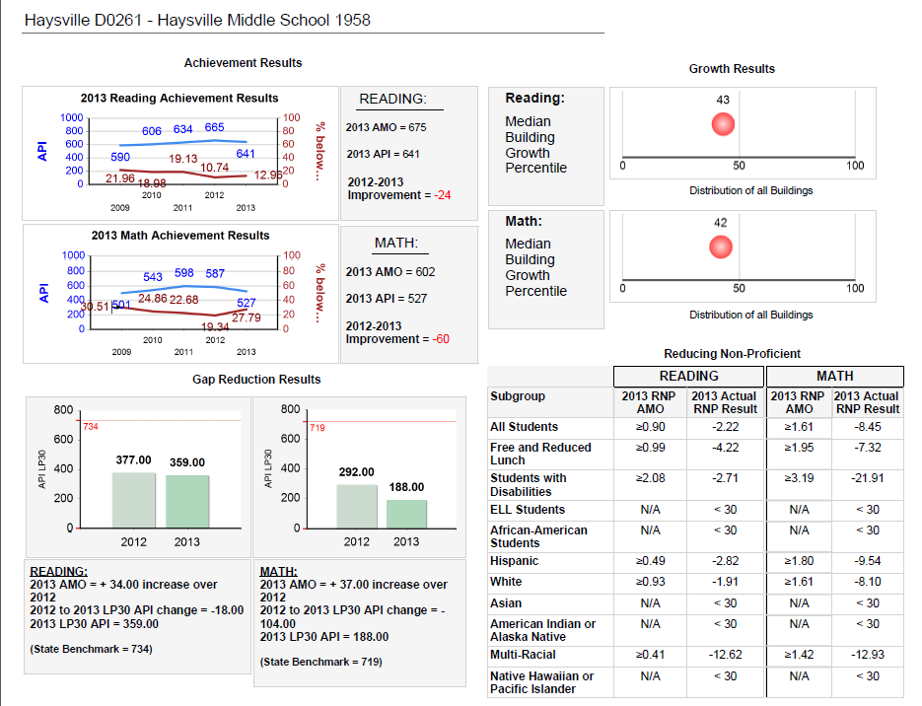

Slide 20
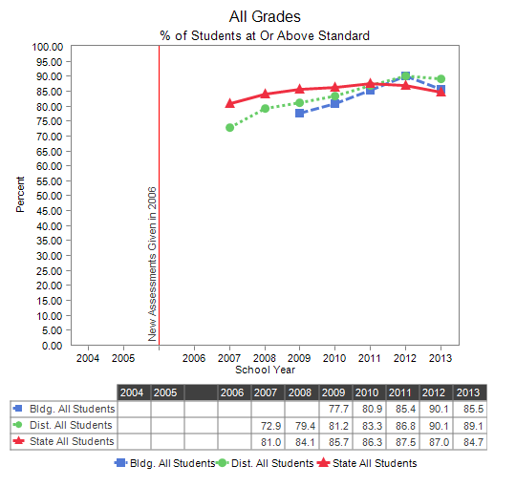
Haysville West Middle School
Reading

Slide 21
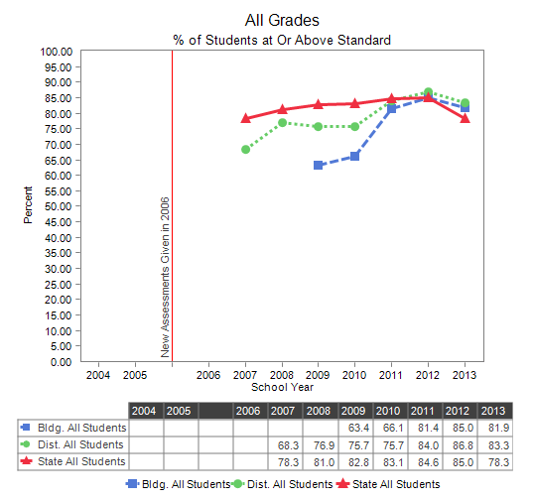
Haysville West Middle School
Math

Slide 22
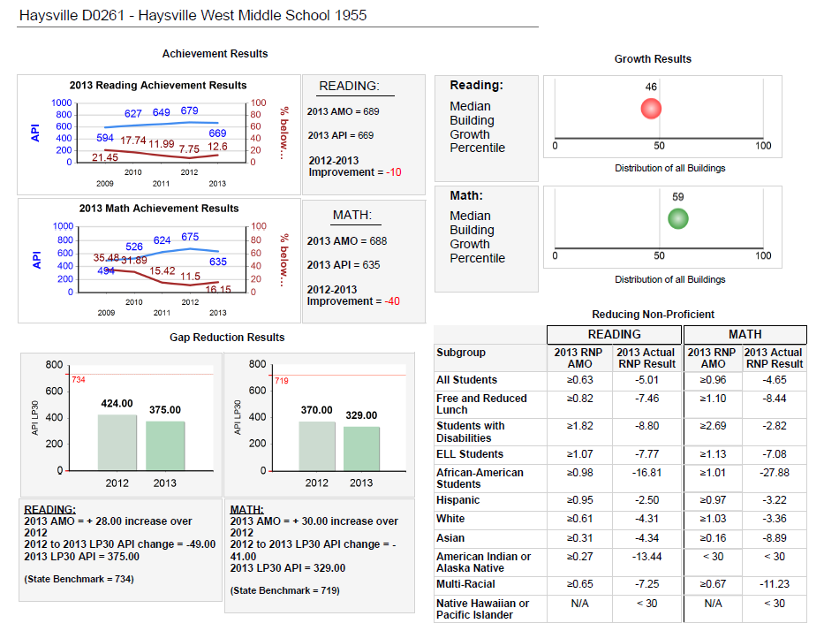

Slide 23
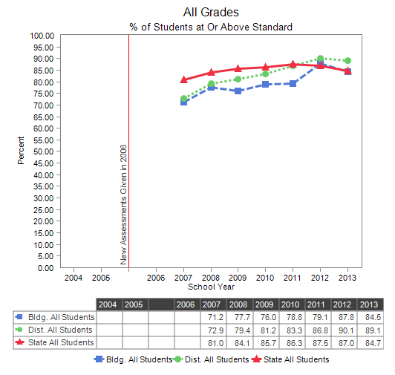
Freeman Reading

Slide 24
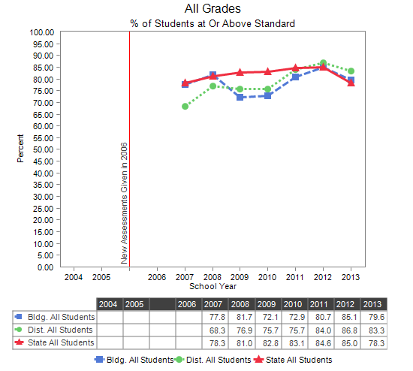
Freeman Math

Slide 25
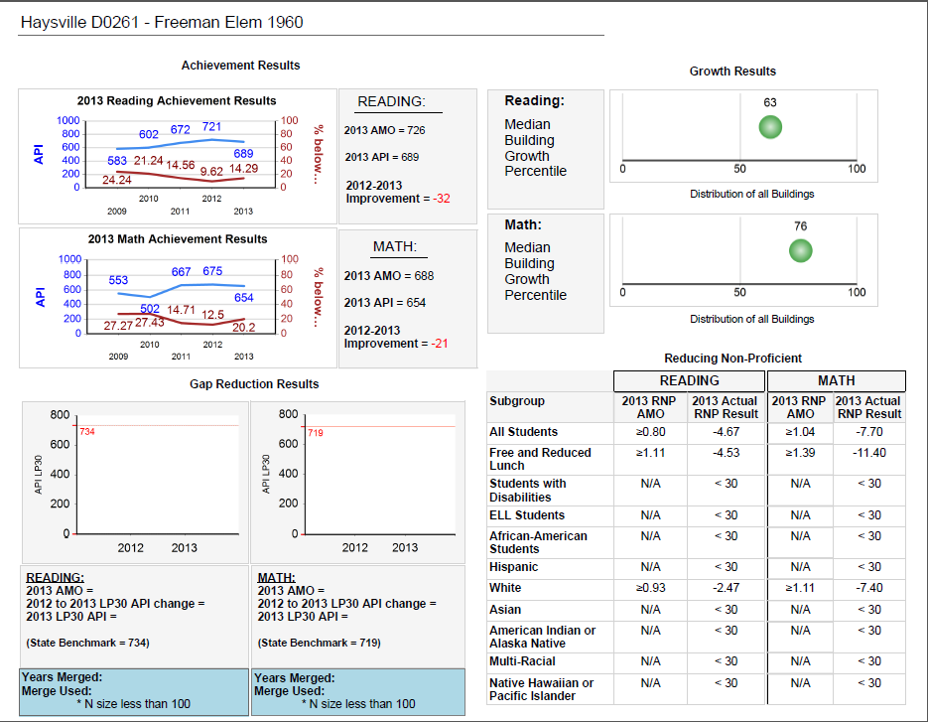
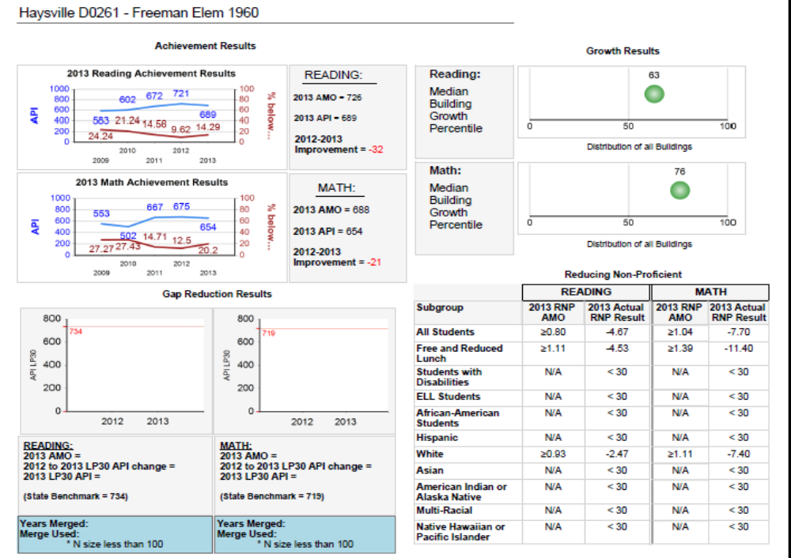

Slide 26
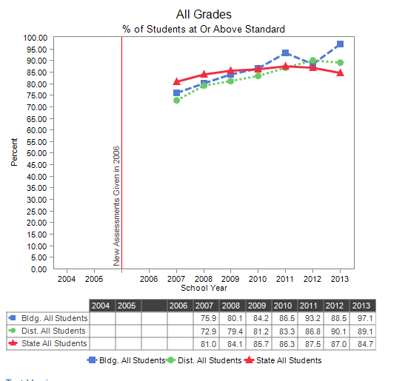
Nelson Reading

Slide 27
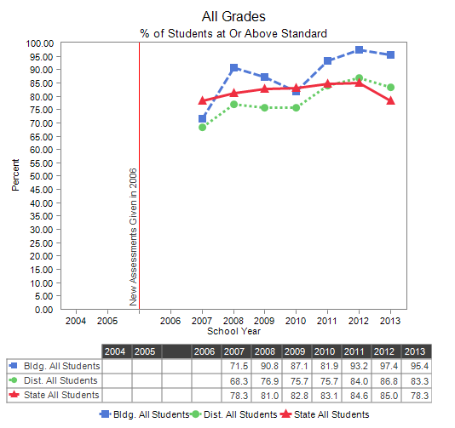
Nelson Math

Slide 28
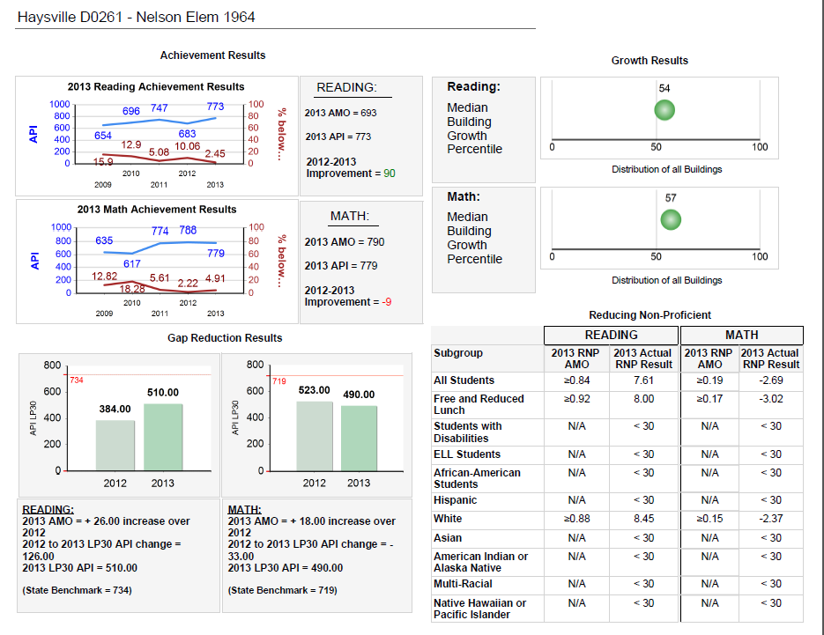

Slide 29
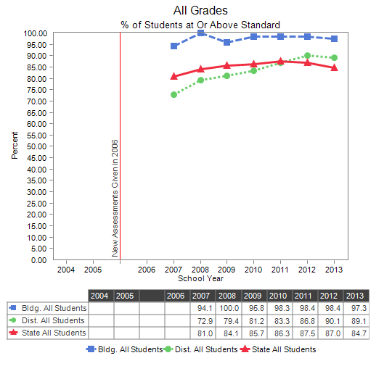
Oatville Reading

Slide 30
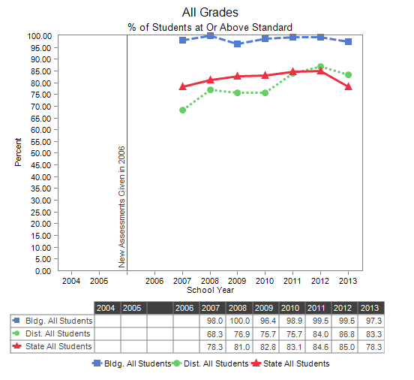
Oatville Math

Slide 31
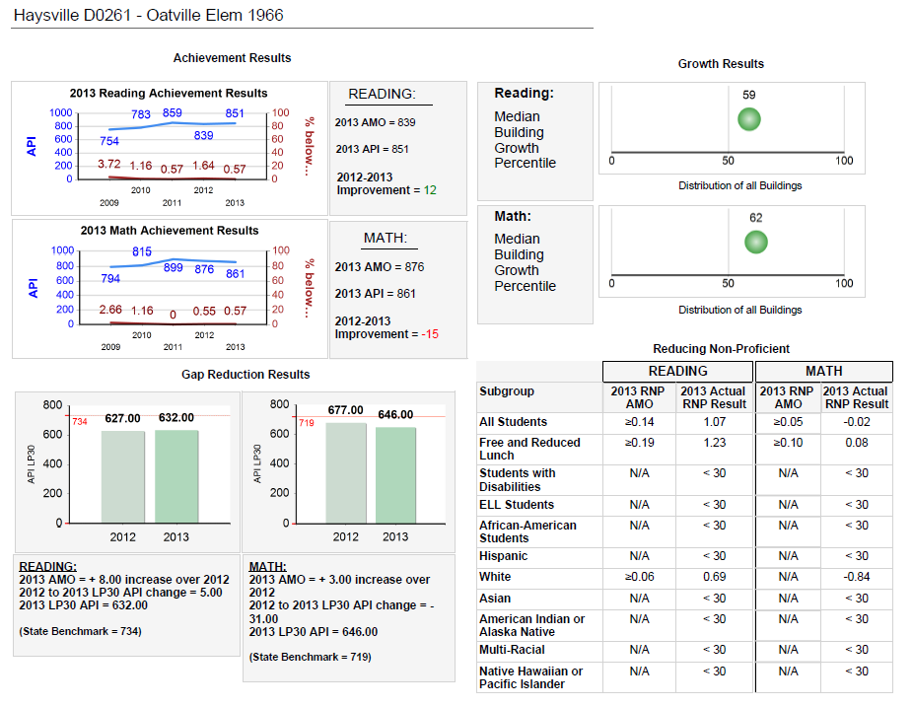

Slide 32
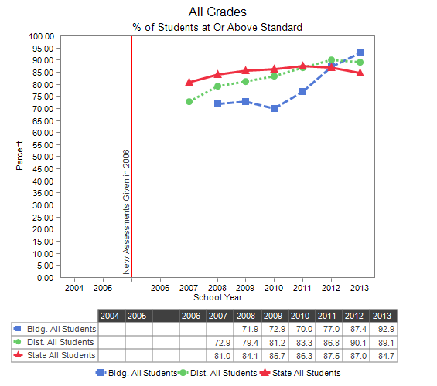
Prairie Reading

Slide 33
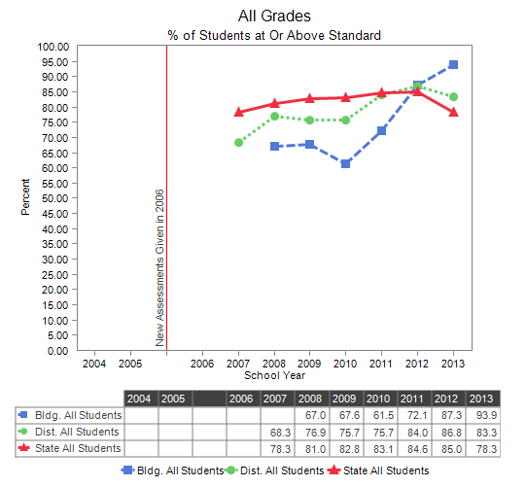
Prairie Math

Slide 34
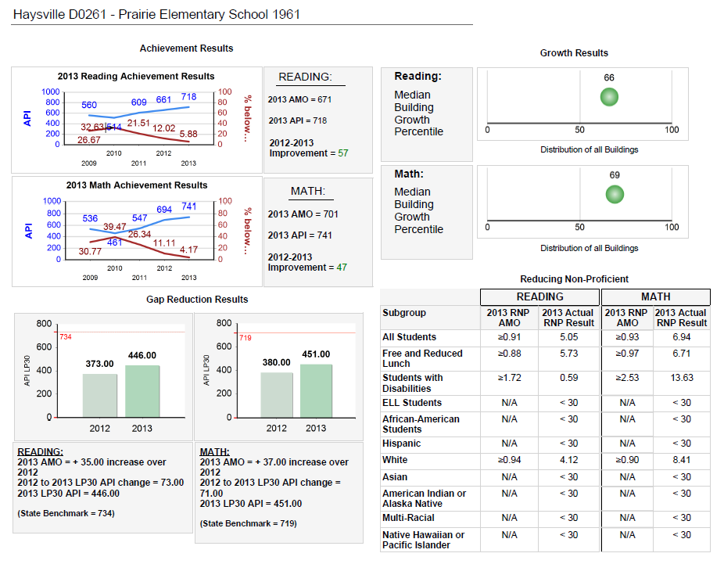

Slide 35
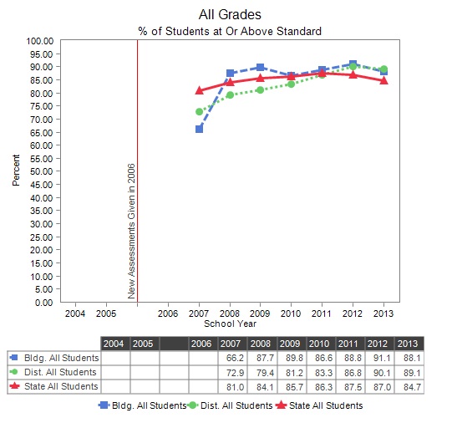
Rex Reading

Slide 36
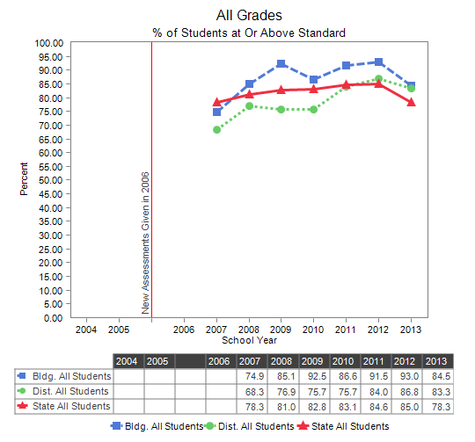
Rex Math

Slide 37
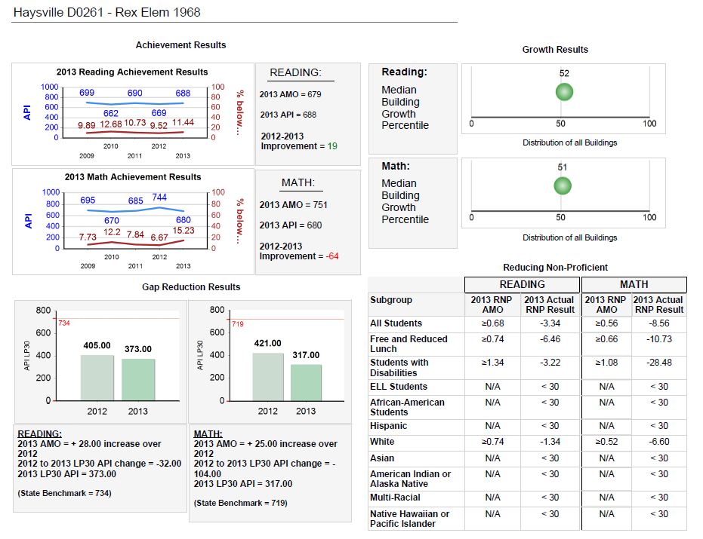

Slide 38
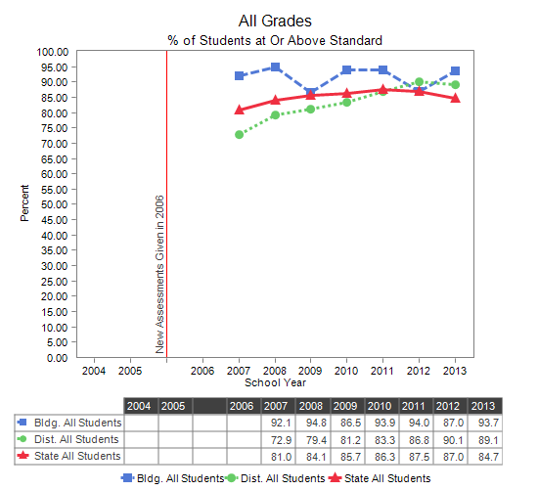
Ruth Clark Reading

Slide 39
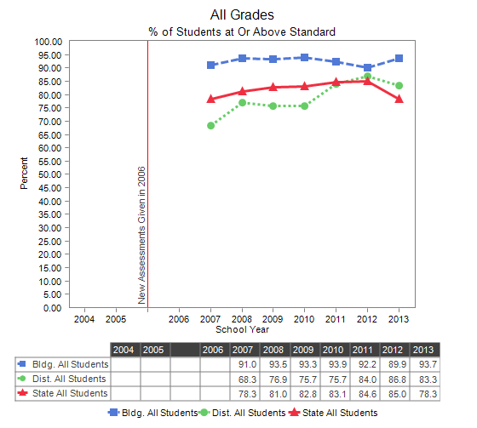
Ruth Clark Math

Slide 40
