Slide 1

Strategic Plan 2019 – 2020
Goal Area 2 high quality workforce
Goal statement:
“To recruit, develop and retain a high quality workforce”.
First, a little information . . .

Slide 2

high quality workforce
85 % of our district budget is devoted to
paying people to do work.
Approximately
900 full-time staff
Approximately
300 part-time staff
We are the largest
employer in Haysville.
We added 34 positions in
the three last three years.
We have five “Critical Strategies”

Slide 3

#1 Promote a positive image of the district
Create recruitment materials to highlight recent achievements.
Implement a community “Thank you” program.
Expand partnerships with the City of Haysville.
Cultivate an expanded partnership with WSU.

Slide 4

#2 Improve compensation and incentives
Continue to seek ways to improve support staff pay/benefits.
Actively participate in the negotiations process.
Advocate for a reduction of the KPERS penalty.

Slide 5

#3 Build Supportive relationships with building staff
Work with the city and the school to Improve student safety.
Sponsor meetings with HEA and the new Uni-Serve Director.
Co-direct the development of the District Crisis Plan.
Collaborate with USD 261 and partner agencies.

Slide 6

4. Enhance on-boarding and off-boarding process
Improve I.D. badge process
Update background checks and prices
Include all exiting employees in the exit survey data.
Investigate Human Resource software “Frontline” and “Spark Hire”

Slide 7

#5 Targeted marketing and recruiting
Develop a greater social media presence for recruitment.
Develop targeted social media ahead of recruitment trips.
Partner with W.S.U. for recruitment swag and “tie-ins”.
Utilize signing bonuses for hard to find positions.

Slide 8
Critical Strategy #1 “Promote a positive image of the district and community.”
Action Steps:
Design new recruitment materials that highlight recent achievements and partnerships.
Expand the Home Show presence with the City of Haysville to include additional events.
Cultivate an expanded partnership with W.S.U. Haysville through co-branding and shared public events and information.
Implement a community “Thank you” program that recognizes community partners who contribute to USD 261.
Critical Strategy #2 “Improve compensation and incentives.
Action Steps:
Participate in the negotiation process to improve teacher salary, benefits and incentives.
Continue to improve support staff pay raises by encouraging them to invest in their own development (like our substitute teachers, nurses and tech support).
Reflect teacher pay raises in the salaries of support staff and administrative staff.
Investigate some degree of reduction of the KPERS penalty.
Critical Strategy #3 “Build Supportive relationships with building staff.”
Action Steps:
Develop the District Crisis Plan by meeting with all school employees in their schools.
Develop the “Like-a-Bike” program with the assistance of the Transportation Department, SROs and principals.
Sponsor meeting with HEA and new Uni-Serve Director.
Improve collaboration between USD 261 and other partner grant agencies. (Ex., Gear Up, SPARK, WSU, Chamber of Commerce, Haysville Forward, City of Haysville, and others)
Critical Strategy #4 “Enhance on-boarding and off-boarding.”
Action Steps:
Improve the I.D. badge process.
Increase the use of background checks as part of the hiring process.
Include all exiting employees in the exit survey process.
Investigate “Frontline” and “Spark Hire” as enhancements
Critical Strategy #5 “Target marketing and recruiting.”
Action Steps:
Develop a greater social media presence for recruitment.
Possibly implement a “Finder’s Fee” on an as needed basis.
Partner with WSU Haysville for recruitment “swag”.
Develop targeted social media ahead of recruitment trips

Slide 9
Strategic Goal Area 3

Slide 10
Strategic Goal Area: 3.0 Facilities and Infrastructure
3.1: Complete a facilities review with a facilities
master plan.
3.2: Complete an infrastructure review with an
infrastructure master plan.
3.3: Inform, educate, and involve our community
to know about the district facilities and infrastructure.

Slide 11
Strategic Goal Area: 3.0 Facilities and Infrastructure
3.1: Complete a facilities review with a facilities
master plan.
Involve an architectural firm, administrative staff, Board of Education, district staff, community stakeholders to assist in a school district’s needs assessment and develop a district Facilities Master Plan.

Slide 12
Strategic Goal Area: 3.0 Facilities and Infrastructure
3.2: Complete an infrastructure review with an
infrastructure master plan.
Complete an annual infrastructure needs assessment and action plan to address the technology needs of the district’s student, staff and other stakeholders. This would include, but not limited to, purchasing new technologies, retiring old technologies, and updating the district’s current and new facilities as needed.

Slide 13
Strategic Goal Area: 3.0 Facilities and Infrastructure
3.3: Inform, educate, and involve our community
to know about the district facilities and infrastructure.
Inform and educate Superintendent’s Leadership Council, the Board of Education, district staff and community stakeholders of the district’s Master Plan.

Slide 14

COMMUNITY
PARTNERSHIPS
HAYSVILLE USD 261
STRATEGIC GOAL AREA 4

Slide 15

Goal Facilitators
Debbie Coleman
Adia Ludwig
Misty Long
Executive Assistant, Board Clerk
Communications Director
Website Coordinator

Slide 16

To strengthen community relationships through intentional partnerships.
Goal Statement

Slide 17



Increase #USD261derful awareness.
Critical Strategy:
4.1

Slide 18

Increase internal and external support of the District’s success.
Critical Strategy:
4.2

Slide 19

Develop and enhance two-way partnerships with businesses and organizations.
Critical Strategy:
4.3

Slide 20

Develop and enhance two-way partnerships with families/guardians of our students.
Critical Strategy:
4.4

Slide 21


Keep District stakeholders apprised of critical information and promote the District’s achievements in order to increase pride in USD 261.
Critical Strategy:
4.5

Slide 22

Partner with City, USD 261 community members and members of the local first responder agencies to strengthen relationships and awareness of District amenities, opportunities and needs.
Critical Strategy:
4.6

Slide 23
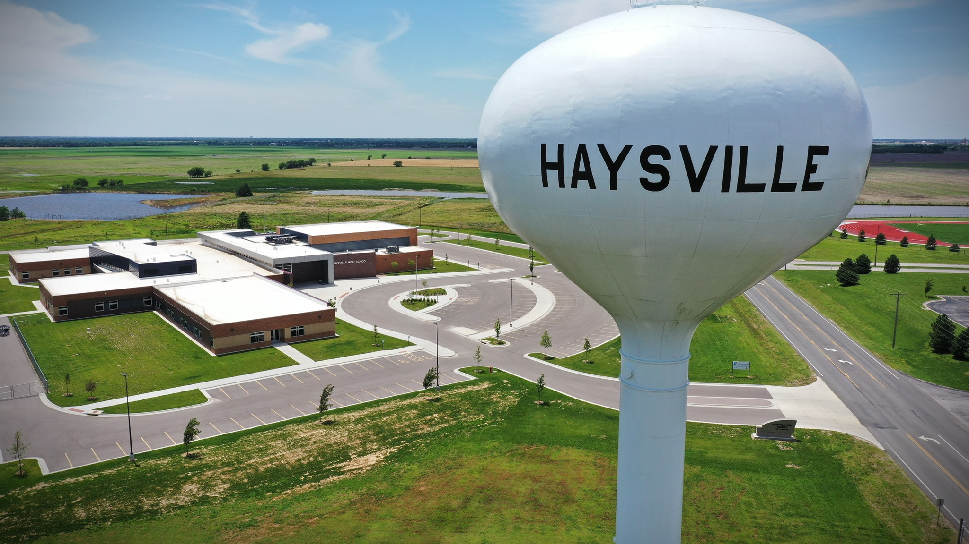
THANK YOU

Slide 24
Strategic Goal Area 5: Financial
Goal Statement: To Pursue and develop the financial resources to support the goals of the district
Goal Facilitator(s): Dr. Clint Schutte

Slide 25
Objectives:
Objective 5.1: Identify growth (population) potential for Haysville USD 261.
Objective 5.2: Aggressively market programs & opportunities for Haysville USD 261.
Objective 5.3: Lobby and advocate for public education funding.
Objective 5.4: Identify financing options.

