Slide 1


City & District Recreation Commission Idea
City of Haysville Kansas

Slide 2
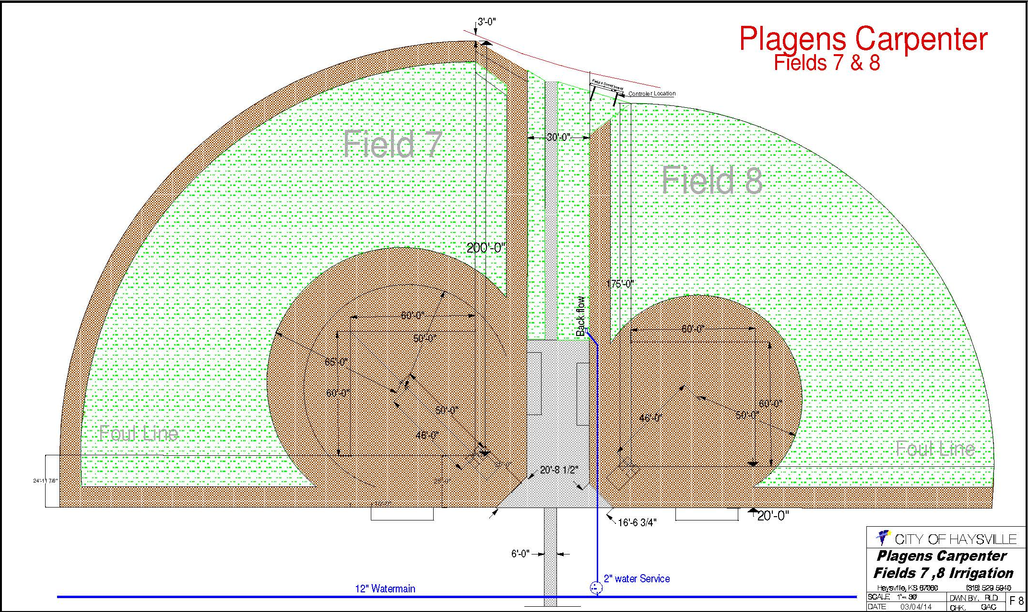
Successful Collaboration

Slide 3
Plans for the Future
Taking over management for Baseball and Softball
  This will include setting up practice schedules for Nelson Ball Fields
Looking to expand Football with flag football for younger players
Hiring an individual to expand programs
Setting aside money for scholarship programs
Partnering with the district to better communicate camps and coordinate programs
Expand offerings to include Possible Art classes, Tennis program, and Summer camps

