Slide 1

Administrative Staffing
April 17, 2023

Slide 2

Goal
“Investigate and determine feasibility of assistant principals at all elementary schools.”

Slide 3
Student Enrollment by Building
Freeman-440
Nelson-479
Oatville-393
Prairie-464
Rex-476
Ruth Clark-352
HMS-768
HWMS-521
HHS-122
CHS-1553

Slide 4
Current # of Administrators by Building
Freeman-Principal
Nelson-Principal
Oatville-Principal
Prairie-Principal
Rex-Principal
Ruth Clark-Principal
HMS-3 Building Administrators
HWMS-3 Building Administrators
HHS-Principal, Teacher (paid plan)
CHS-Principal, 3 A.P.’s, A.D.

Slide 5
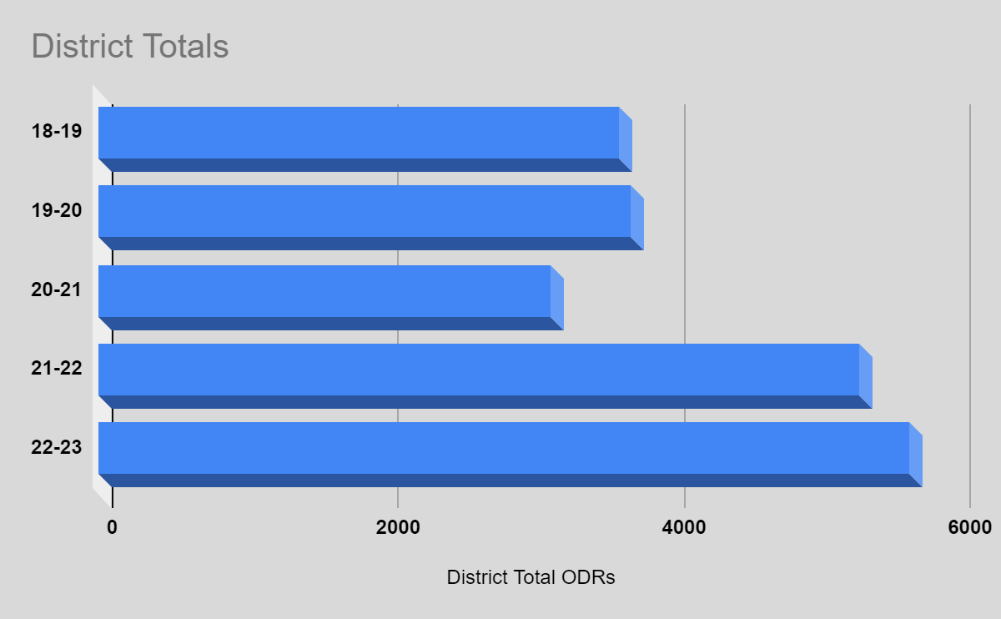
District Total ODRs by Year

Slide 6
USD 261 Total # of IEPs by Year

Slide 7
Total # of IEPs by Building
Building | 2018-2019 | 2019-2020 | 2020-2021 | 2021-2022 | 2022-2023
Freeman | 64 | 61 | 67 | 71 | 90
Nelson | 106 | 116 | 137 | 99 | 95
Oatville | 70 | 73 | 61 | 80 | 82
Prairie | 89 | 94 | 106 | 102 | 94
Rex | 75 | 85 | 76 | 85 | 106
Ruth Clark | 62 | 65 | 54 | 69 | 102
Haysville Middle School | 127 | 139 | 120 | 158 | 141
Haysville West Middle School | 75 | 78 | 68 | 74 | 90
Campus High School | 236 | 232 | 179 | 235 | 258
Haysville High School | 9 | 9 | 8 | 8 | 8
Tri-City Day School | 12 | 11
Chisholm | 4 | 8 |  | NA | NA
Out of District (Heartspring) | 1 | 0 | 0 | 0 | 0
Total Students: | 930 | 971 | 876 | 981 | 1066

Slide 8
Office Discipline Referrals By School Year (ODR)
Building | Year
 | 18-19 | 19-20 | 20-21 | 21-22 | 22-23
Freeman | 84 | 44 | 87 | 114 | 154
Nelson | 46 | 55 | 24 | 222 | 290
Oatville | 73 | 73 | 53 | 76 | 167
Prairie | 177 | 133 | 19 | 49 | 164
Rex | 33 | 225 | 184 | 283 | 280
Ruth Clark | 28 | 19 | 11 | 18 | 26
Elem Total | 441 | 549 | 378 | 762 | 1081

Slide 9
Special Education I.E.Ps by Building
Building | 2018-2019 | 2019-2020 | 2020-2021 | 2021-2022 | 2022-2023
Freeman | 64 | 61 | 67 | 71 | 90
Nelson | 106 | 116 | 137 | 99 | 95
Oatville | 70 | 73 | 61 | 80 | 82
Prairie | 89 | 94 | 106 | 102 | 94
Rex | 75 | 85 | 76 | 85 | 106
Ruth Clark | 62 | 65 | 54 | 69 | 102

Slide 10


Campus High School

Slide 11
CHS Office Discipline Referrals (ODR)
Building | Year |  |  |  |  | Average # Per Year 2018-2023
 | 18-19 | 19-20 | 20-21 | 21-22 | 22-23
CHS | 736 | 888 | 682 | 1490 | 2061 | 1171

Slide 12
Total # of IEPs at Campus
Building | 2018-2019 | 2019-2020 | 2020-2021 | 2021-2022 | 2022-2023
Campus High School | 236 | 232 | 179 | 235 | 258

Slide 13
Athletic Director/Asst. Principal
School Name | Student Count | AP Count | AD Only | AD/AP Role | Activities | Student Count : 1 AP Ratio
Derby High School | 2,185 | 4 | 1 | 0 | Yes - AD | 546
Wichita East High School | 2,462 | 5 | 1 | 0 | Yes - AD | 492
Wichita Heights High School | 1,179 | 4 | 1 | 0 | Yes - AD | 295
Wichita North High School | 2,011 | 6 | 0 | 1 | AD/AP | 335
Wichita Northeast High School (Magnet) | 692 | 1 | 1 | 0 | Yes - AD | 692
Wichita Northwest High School | 1,470 | 3 | 1 | 0 | Yes - AD | 490
Wichita South High School | 1,752 | 4 | 1 | 0 | Yes - AD | 438
Wichita Southeast High School | 1,853 | 6 | 0 | 1 | AD/AP | 309
Wichita West High School | 1,281 | 4 | 1 | 0 | Yes - AD | 320
Campus | 1,553 | 3 | 1 | 0 | No | 518

Slide 14
Recommendation
Add two Full time Asst. Principals at K-5 Level
Assigned to Freeman, Prairie, Nelson, Rex
Add one full time Asst. Principal at CHS
CHS AD
Expand AD duties to support Middle School

Slide 15

Estimated Cost
Two Elementary A.P.
  $125,000.00
One A.P. at CHS
  $80,000.00
Total Estimated Cost
  $205,00.00

Slide 16
How Do We Pay for Positions
Actual savings
  $210,840.16
Estimate Additional Savings
No additional monies added to administrative budget

Slide 17

Questions, Comments, Concerns?

