Slide 1

23-24 Enrollment Update
USD 261

Slide 2
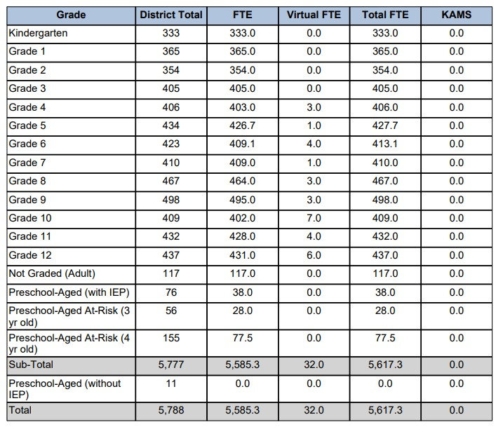
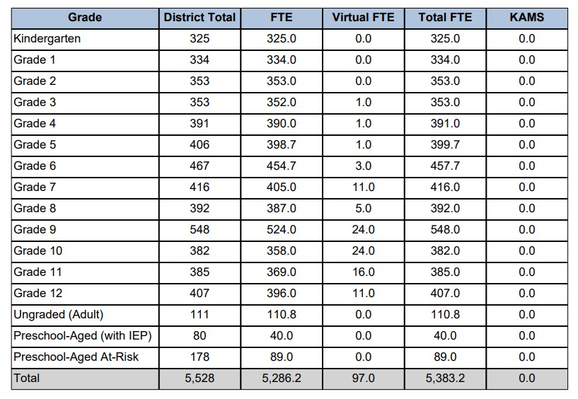


Unaudited FTE
2022-23 SO-66
2023-24 SO-66

Slide 3
Grade Level Comparison
SO 66
Grade Level | 22-23 | 23-24 | Difference | Cohort Group
K | 333 | 325 | -8
1 | 365 | 334 | -31 | 1
2 | 354 | 353 | -1 | -12
3 | 405 | 353 | -52 | -1
4 | 406 | 391 | -15 | -14
5 | 427.7 | 399.7 | -28 | -6.3
6 | 413.1 | 457.7 | 44.6 | 30
7 | 410 | 416 | 6 | 2.9
8 | 467 | 392 | -75 | -18
9 | 498 | 548 | 50 | 81
10 | 409 | 382 | -27 | -116
11 | 432 | 385 | -47 | -24
12 | 437 | 407 | -30 | -25
Adult | 117 | 110.8 | -6.2
Pre-K (IEP) | 38 | 40 | 2
Pre-K (A.R.) | 105.5 | 89 | -16.5
Total | 5617.3 | 5383.2 | -234.1
Difference | -234.1

Slide 4
Enrollment By Building
School | 22-23 | 23-24 | Difference | % Change
CHS | 1650 | 1599 | -51 | -3%
HHS | 96 | 123 | 27 | 22%
HMS | 761 | 737 | -24 | -3%
HWMS | 539 | 538 | -1 | 0%
Freeman | 438 | 429 | -9 | -2%
Prairie | 463 | 431 | -32 | -7%
Oatville | 401 | 361 | -40 | -11%
Rex | 483 | 441 | -42 | -10%
Nelson | 464 | 438 | -26 | -6%
Ruth Clark | 346 | 320 | -26 | -8%

Slide 5
Out of District Enrollment
2022 - 2023 School Year
LOE Students | 398
OOD Staff | 137
Total OOD | 543
2023 - 2024 School Year
LOE Students | 351
OOD Staff | 131
Total OOD | 482

Slide 6

Things to Consider
Unaudited numbers
  Won’t Increase
Weightings
Declining Enrollment
Oversight by the Kansas Supreme Court?
$5088 or $5388 BASE?
2 Years or 1 Year?
School Finance Formula Sunsets July 1, 2027

Slide 7

Questions, Comments, Concerns ?

