Slide 1

January 2024 Update
Haysville USD 261

Slide 2

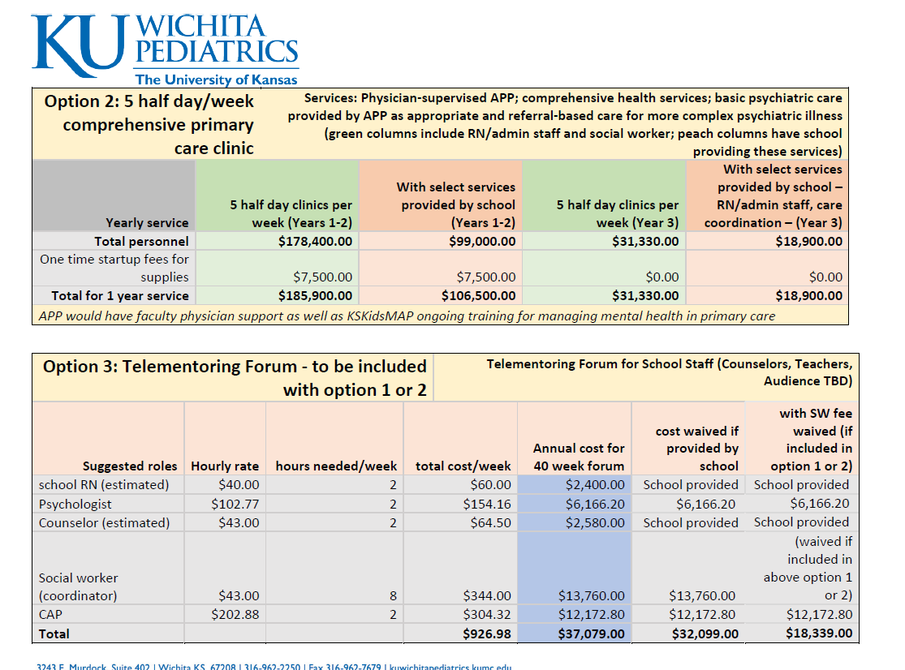
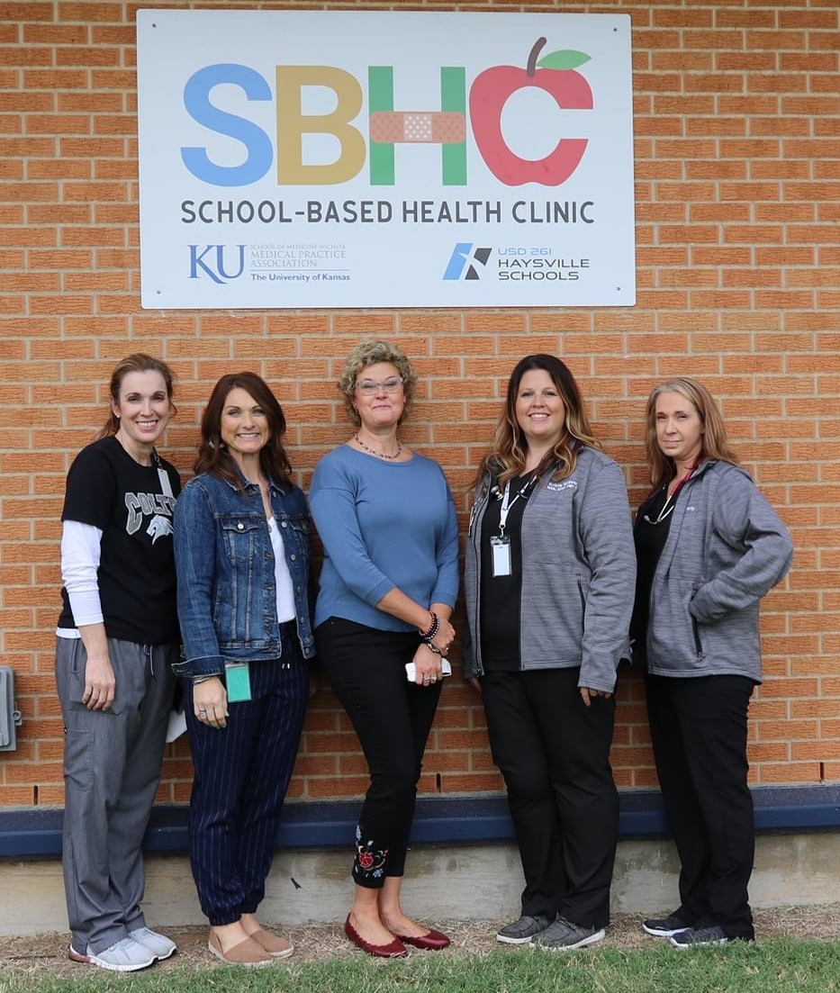

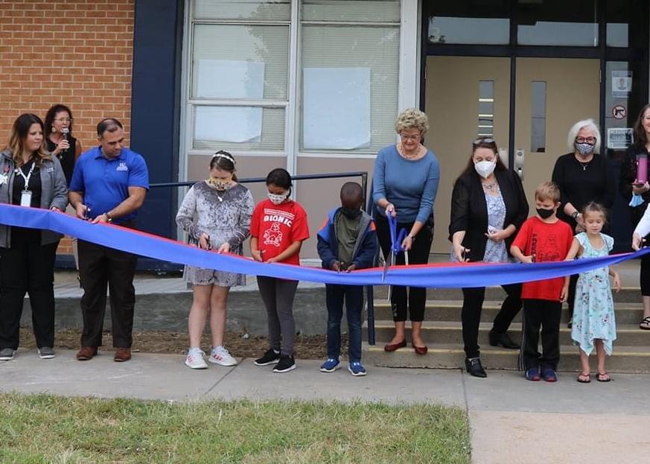
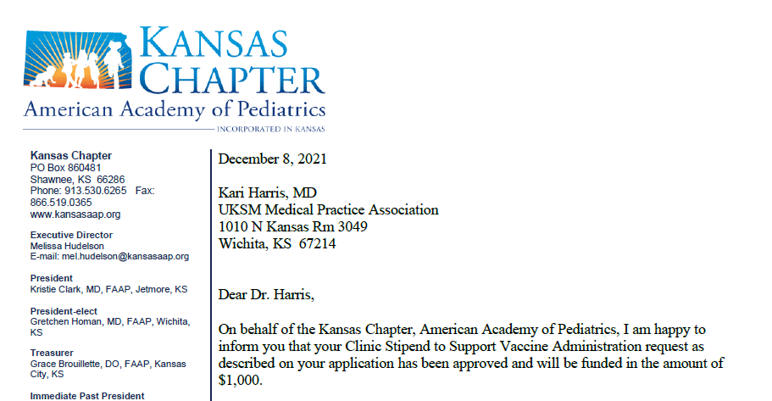
SBHC Milestones
April 2021
Meet Alums!
Nov 2021
SBHC Discussion Begins
SBHC Staff Hired
Thank you CUA
KU Peds and the Wichita Open!
BOE Approves SBHC
Clinic Opens!
KAAP Vaccine Stipend
Oct 2021
May 2021
Dec 2021
Notes:
October – almost immediately we recognized the need for improved care for mental health; we supported Krista in additional training through the REACH Institute (a >$2K course), provided mentorship and training through KSKidsMAP. When we opened, there were no Medicaid providers, few even in Wichita. Drive, stress, social determinants of health, demographics of the population all resulted in barriers to receiving healthcare. Even just finding vaccine providers that could get what was needed for kids to stay in school was a challenge. Kansas Chapter, American Academy of Pediatrics (KAAP) helped with that by providing our first external grant funding in Dec 2021 to help us purchase supplies that would ultimately result in us becoming a Vaccines for Children (VFC) clinic – the only one in Haysville. VFC provides vaccines at no cost to children who could otherwise not afford them. Ultimately, we have vaccinated over 400 kids, protecting them from many deadly diseases. In all, we have provided more than 1300 vaccines to the Haysville community.

Slide 3
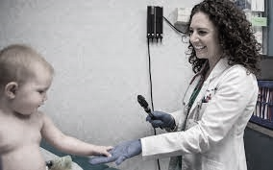




Feb 2022
Year 1 Ends
KSDE
Stronger Connections
Dec 2022
500th
Clinic Visit!
Visits = 1,141
Kids = 626
Adults = 515
Psych = 23
Vaccines = 583
Medicaid ~60%
HRSA Funding – AYM HI
Sept 2022
Welcome
Dr. Lewis!
Double-boarded in Family and Sports Medicine with additional training in pediatric mental health!
Nov 2023
Psychology Services Start
HRSA Funding
Dr. Parman Retires
KS Childrens Foundation Student Advisory Council
$3500
August 2022
ICX2
Nov 2022
May 2023
June 2023
$76,000
Healthcare Hero!
Notes:
In August we also saw our 1000th visit.
Psychology began in August providing 8-12 hours each week of direct therapy services to children by the most highly trained therapists in the field. Dr. Lewis joined the team in September bringing her expertise as a double-boarded physician in family medicine and sports medicine and has additional training in pediatric mental health. Later that month, federal funding was awarded through our KSKidsMAP grant to begin Interprofessional Child-centered Integrated Care (ICX2) meetings. This is dually important in both providing child and adolescent psychiatry-informed care for youth with mental illness but also increasing the impact of the funds by training up the PCP workforce to identify and address mental illness in kids. Funding covered the non-billable time for team meetings, infrastructure through the addition of managerial time, and evaluation time for the model. After 6 months of implementation, 27 children had been served decreasing barriers of travel and transportation, time from work and school, and months long waits to receive necessary care. It is important for you to understand just how innovative and important this model is. According to nationally published data, KS needs >400 CAPs to serve the kids under 18 in our state with mental illness. We have <60 and fewer than 10 outside the NE part of the state. We simply cannot expect all kids to receive expert care. Unfortunately, and especially with mental health care, many kids are treated by non-experts who do not follow guidelines or evidence when treating and this can be harmful to children. By utilizing child psychiatrist time in this way, our PCP team is able to treat kids according to the standard of care while also building their own skillset to apply to additional kids. In just over 15 hours, 27 kids were treated through this model, functionally doubling the # of kids our CAP could have connected with over that same amount of time. This program is life-changing for kids with mental illness.
Year 1 #s. – Medicaid is a big deal financially. Most practices limit to <10% Medicaid because it is cost-prohibitive. In HV over 30% of children live below the poverty level, ranking Haysville in the worst 25% of communities nationally and in Kansas. Poverty can have detrimental effects on mental health, academic achievement, and physical health (Conduent Healthy Communities Institute, 2022). KU Peds opened this SBHC to serve those who may otherwise not have been able to access care.
Nov – Dr. Parman retired and closed his practice and donated $2K of supplies. This left us as the only clinic in Haysville for children or adults.
Dec – AYM HI funding guaranteed a primary care physician in house 2 half days/week as well as solidified this as a rotation site adding resident physicians most of Dr. Lewis’ days and thus increasing capacity and competence of additional physicians.
May brought additional funding from Kansas Childrens Foundation to implement a student advisory project – a project we are all super excited about. This not only gives students a voice in the clinic operations, but also builds mentoring relationships between students and healthcare staff.
In June, the SBHC program was recognized for these efforts at the annual Health Care Heroes event hosted by WBJ.
November the district was awarded a Stronger Connections grant from KSDE. Funding from this grant award will cover write-offs and adjustments for un/underinsured kids seen in the clinic. This will replace district funding to date.

Slide 4
The Numbers - 2023
HV SBHC
Visits:
1826
Unique Patients: 693
Other Pediatric Clinics Median
Visits:
2000 – 2200
Unique Patients: 500 – 750
Notes:
Closing 2023, numbers looked good for the SBHC. We saw nearly 700 patients meeting the median for other pediatric clinic panel sizes. Those patients were seen for 1826 visits which is just under the median visit count of 2000-2200. Given that these are medians and our patient visits tend to be heavy with mental health care which takes more time it is not surprising that our visit counts are slightly lower.

Slide 5
The Numbers
Medical Visits CY23
Psych Visit CY23
Notes:
Visit numbers separated for Primary Care and Psychology

Slide 6
The Numbers
Payer Mix CY22
Payer Mix CY23
Notes:
Medicaid Utilization has climbed from 55% of patients in CY22 to 59% of patients in CY23.
Private Practices will cap Medicaid at 5% of the practice’s patients.
Medicaid reimbursement is roughly 30% below that of Medicare which is about 30% below private insurance payers. This discrepancy is further exacerbated when those payments are for primary care services. This is why there is a need for continued funding to cover those who are uninsured or underinsured. The KSDE Stronger Connections grant makes it possible for us to continue to provide high quality healthcare to kids who may not otherwise receive it.

Slide 7
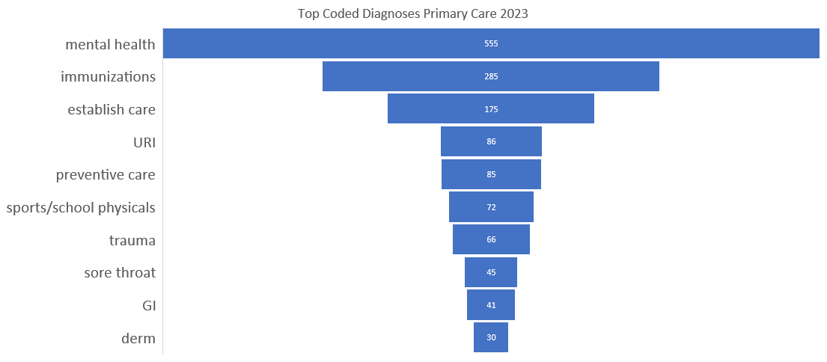
The Care – Primary Care
Notes:
This represents coded diagnoses. Many patients will have multiple diagnostic codes in one visit. These are grouped according to complaint so there are limitations with this data. Still, mental health is by far the most common diagnoses we see in primary care visits at the SBHC.

Slide 8
The Care – Psychological
Depression
Trauma
Generalized Anxiety
Social Anxiety
ADHD
Notes:
Psychology visits differentiated by code. Again, diagnoses are grouped by similar themes as there are multiple codes that represent depression.
Depression 197
Trauma 79
ADHD 74
Generalized Anxiety 73
Social Anxiety 31

Slide 9
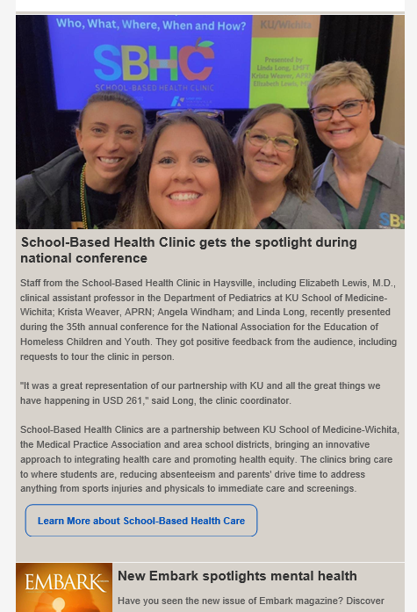
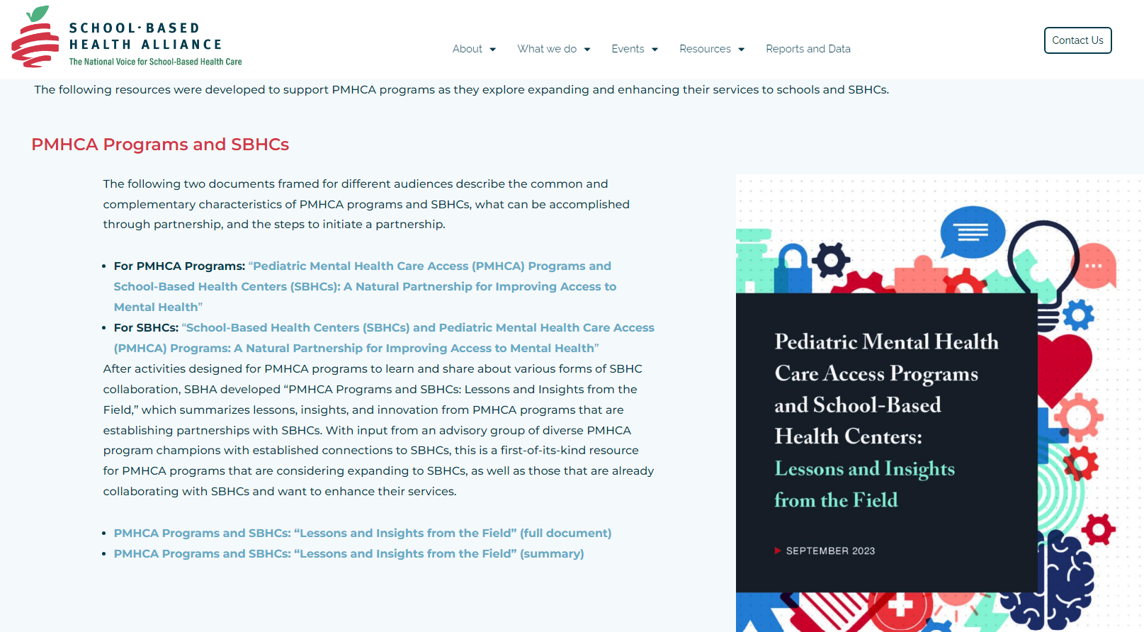

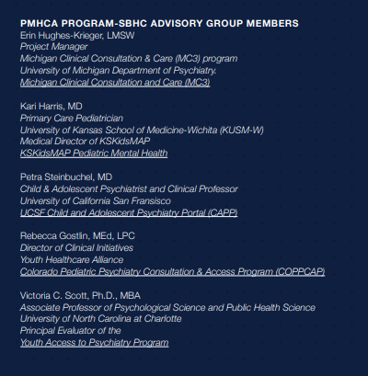
The Innovation
Notes:
The SBHC Team also understands the importance of evaluating our work and disseminating those results. In a state like KS where there are so few evidence-based SBHC centers we need to figure out what works and what doesn’t and share that information. Education beyond K12 is also super important and we are educating our healthcare colleagues about the benefits of SBHC and the innovative approaches we are using to reach students. In 2023, our team did the following:
Dr. Lewis, APRN Krista, Linda and Angela presented at the National Association for the Education of Homeless Children and Youth Conference in November in New Orleans.
Dr. Kari Harris served as an advisory council member for the School-based Health Alliance and was a key contributor for a resource developed to help integrate Pediatric Mental Health Care Access Programs with School-based Health Centers.
Completed descriptive data collection on the ICX2 model. This has been turned into an abstract that will be presented at the 2024 Society of Pediatric Psychology Annual Conference and a manuscript describing the project is forthcoming.

Slide 10
Take Away
USD 261 contributed $138K X 3 years to support primary care clinic 5 half days/week (2021-2024)
KU added externally funded benefits to support students:
  Direct psychology time
  Physician and resident physician time
  Vaccines at no cost to children who qualify (working on adults)
  Innovated psychiatric care for HV students
  Developed afterschool and summer program for ADHD
  Built in a CHW to support students
  Nearly $100K/year in additional funding through 2027
~$130K/year is needed to cover un/underinsured patients each year and keep primary care clinic open (additional services are all built from primary care clinic)
  Stronger Connections (KSDE) grant covers this cost through 2026!

Slide 11
Future Plans
Funding – Stronger Connections Federal Grant awarded to USD #261 $545,240
  Will fund un/underinsured through 2026 without additional district funds
  Will add additional psychology time and staff to cover reception
  Will continue BREATHE programming
  Will add programming for Haysville High Students
KU will continue to bring additional funding to the clinic to support
  Psychology time
  Interprofessional Child-centered Integrated Care (ICX2 – psychiatry-led mental health care meetings)
  Physician time
  Student Advisory Council
  Additional Infrastructure
  And More!
Haysville SBHC Primary Care Clinic remains the basis from which all additional programming has arisen and can continue.

Slide 12
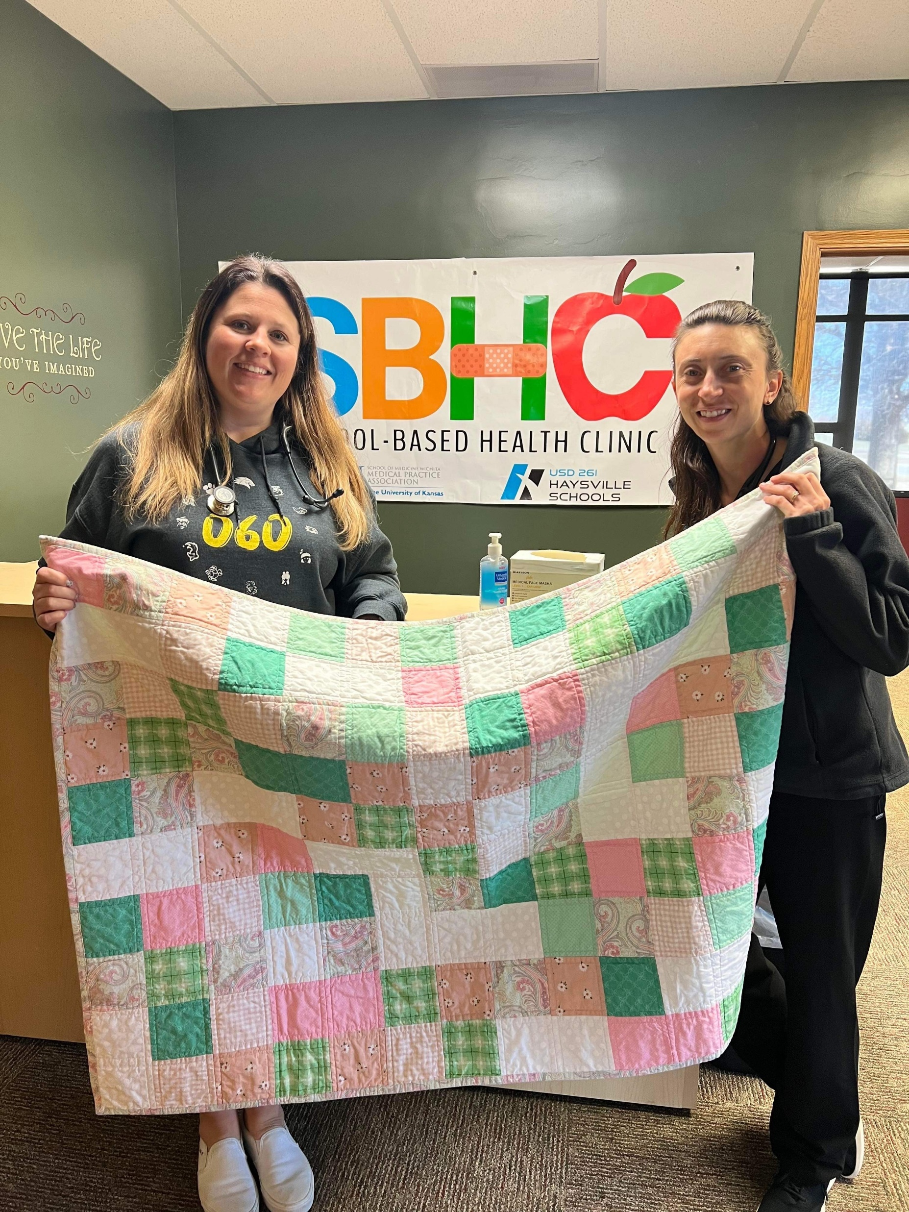
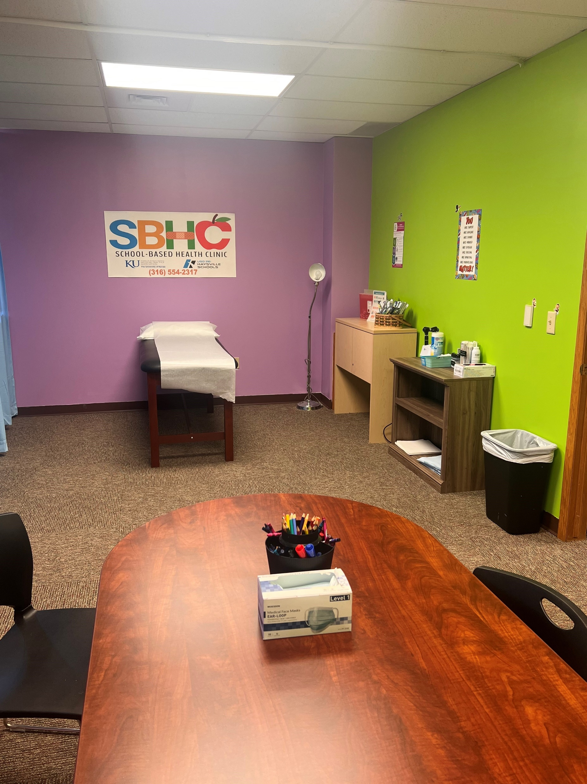
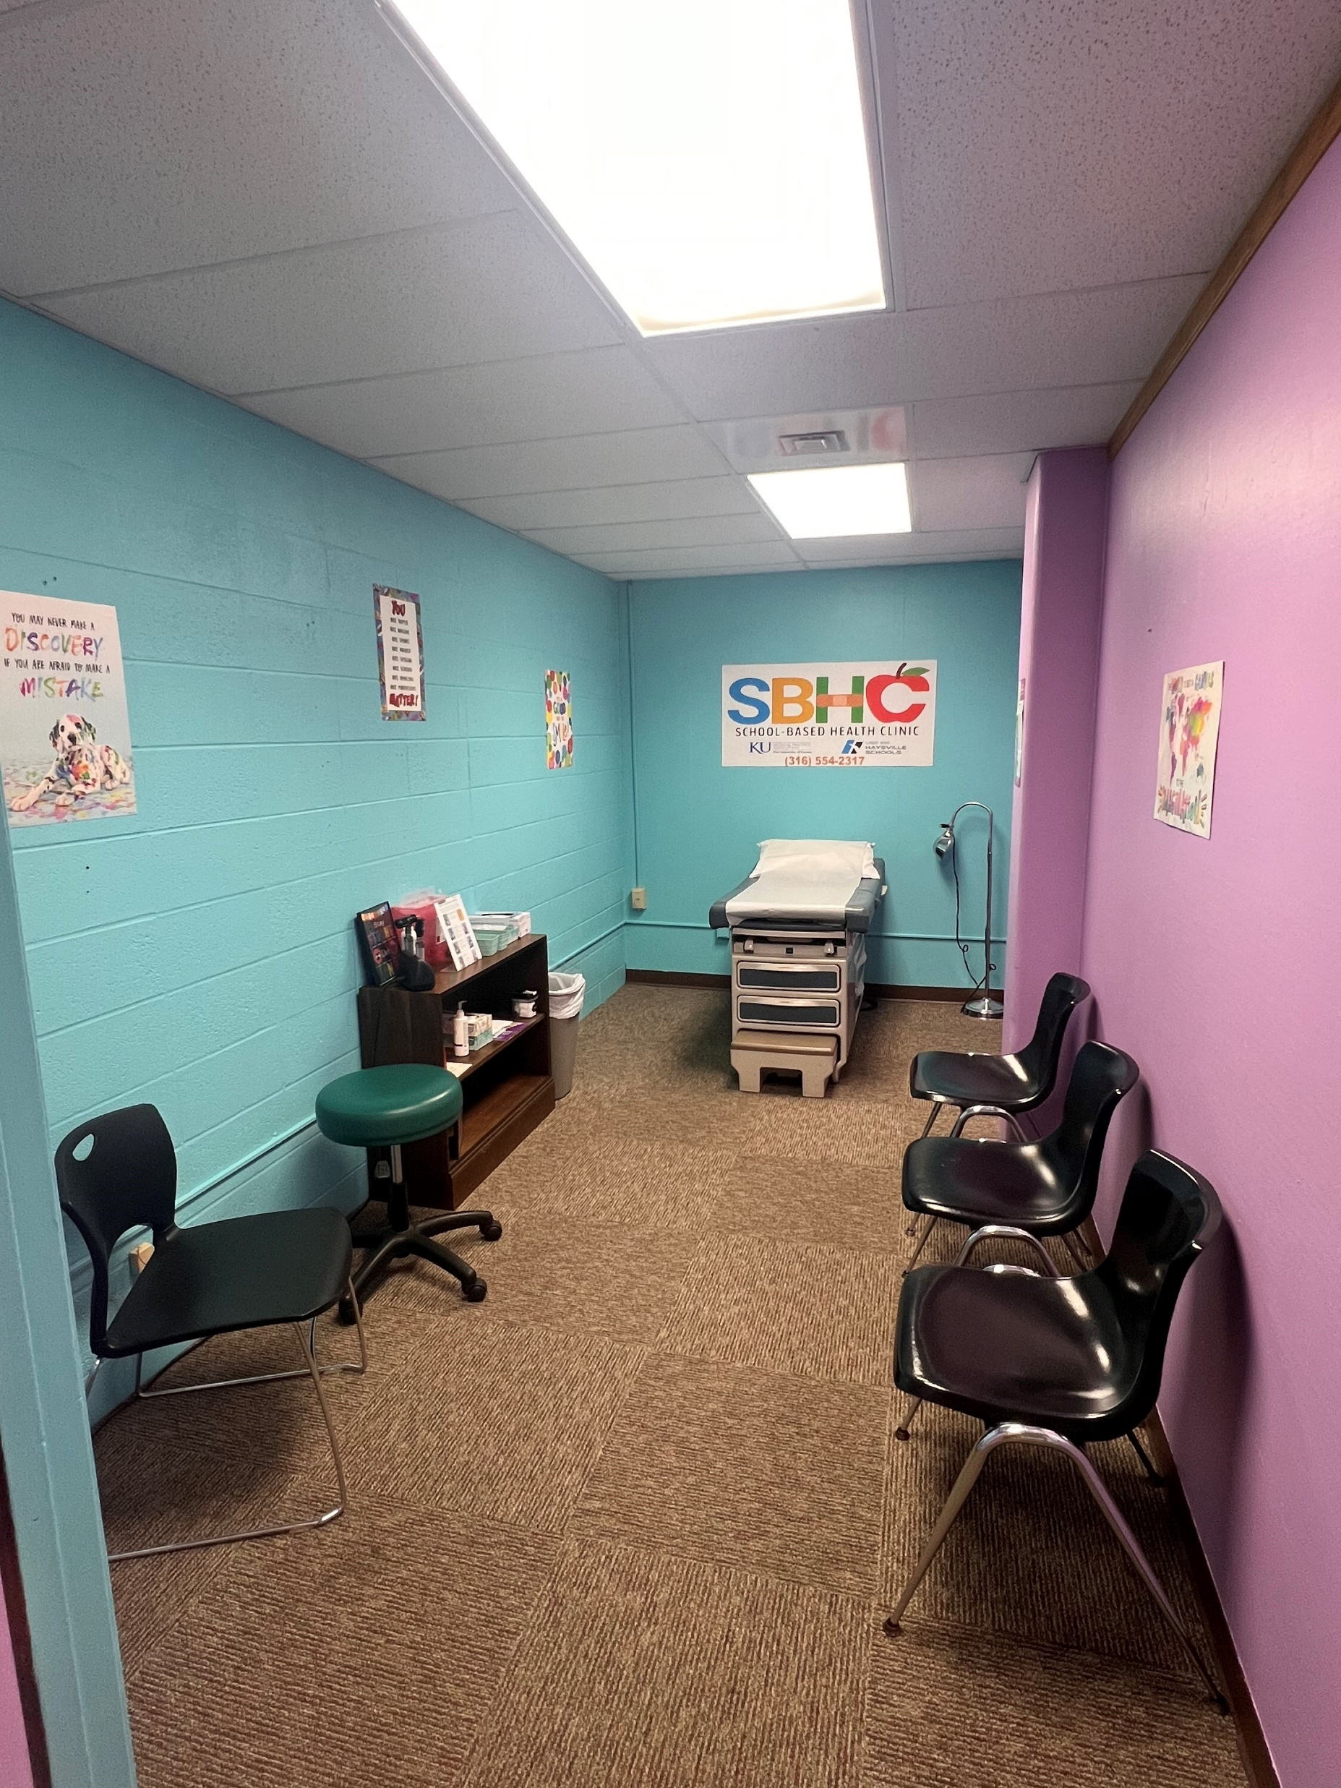
Thank you for your continued support of student health and wellness!

