Slide 1
Capital Improvement Update
October 21, 2024

Slide 2
Community Engagement
Community Retreat
Staff Back to School Convocation
Ministerial Alliance
Chamber of Commerce
Haysville Senior Center
USD 261 Joint Site Council Meeting
Campus High School
Nelson
Rex
Freeman

Slide 3
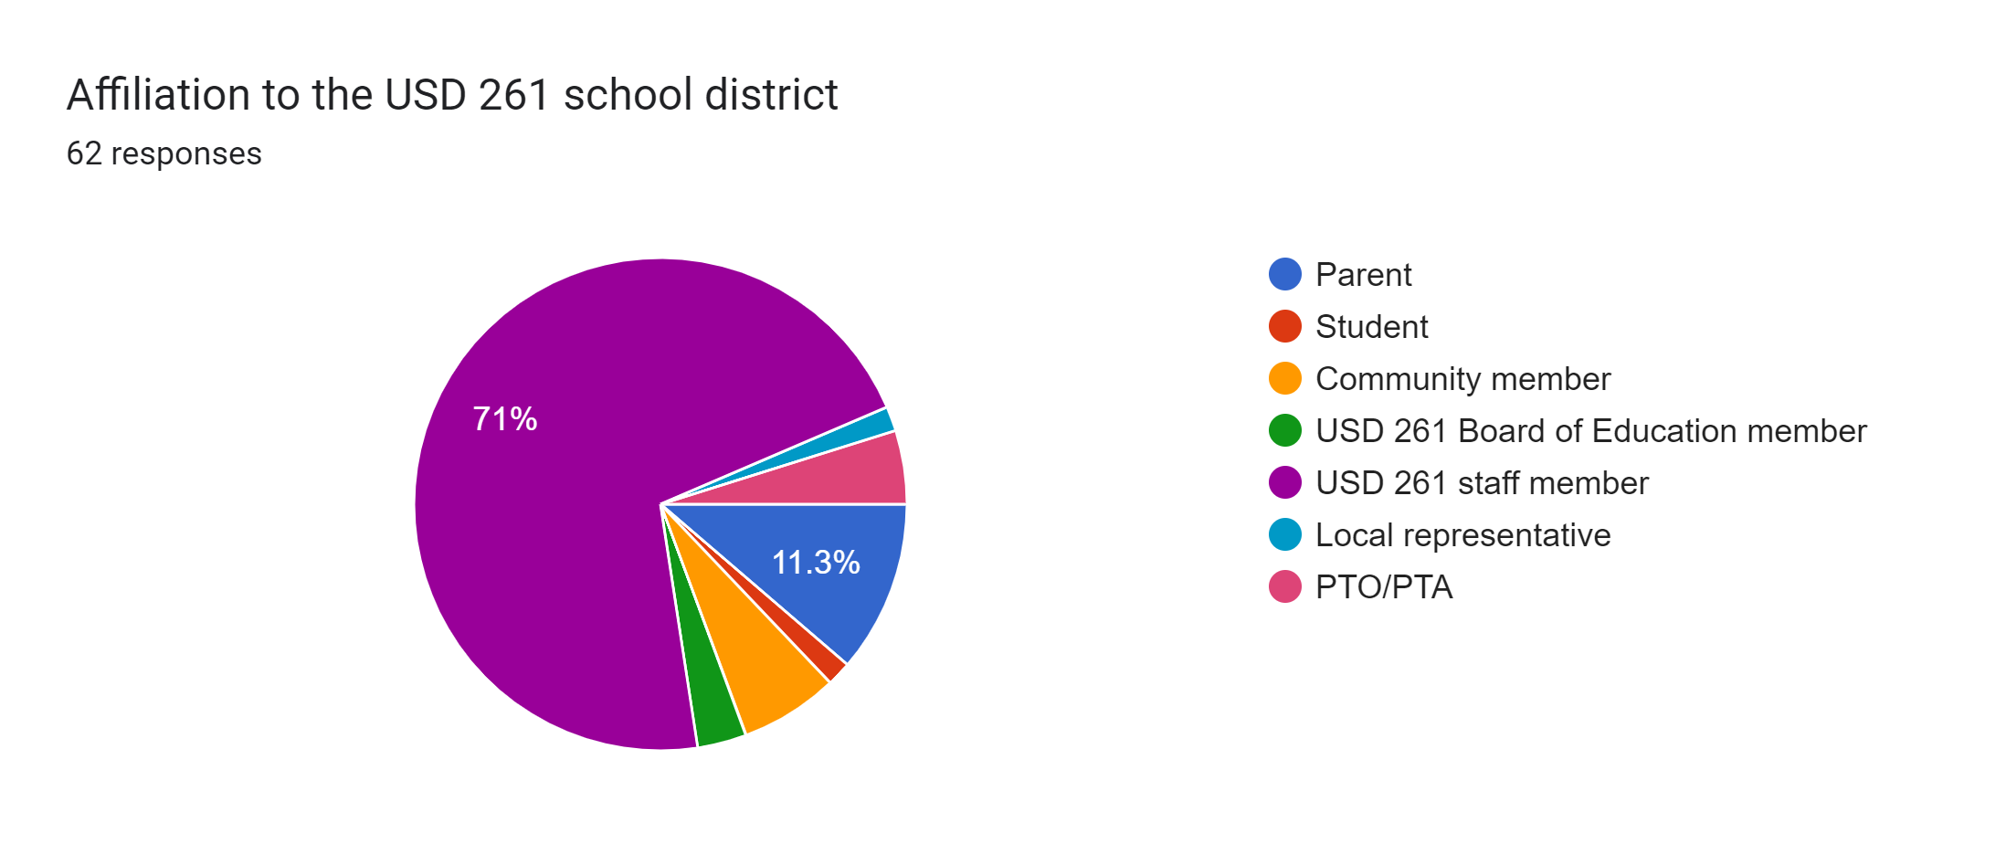
What did we learn-Community Retreat

Slide 4
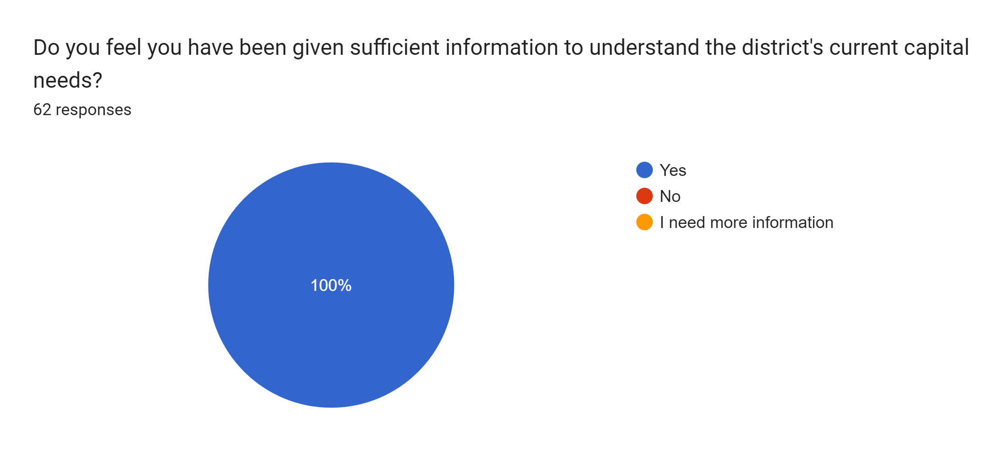
Community Retreat

Slide 5
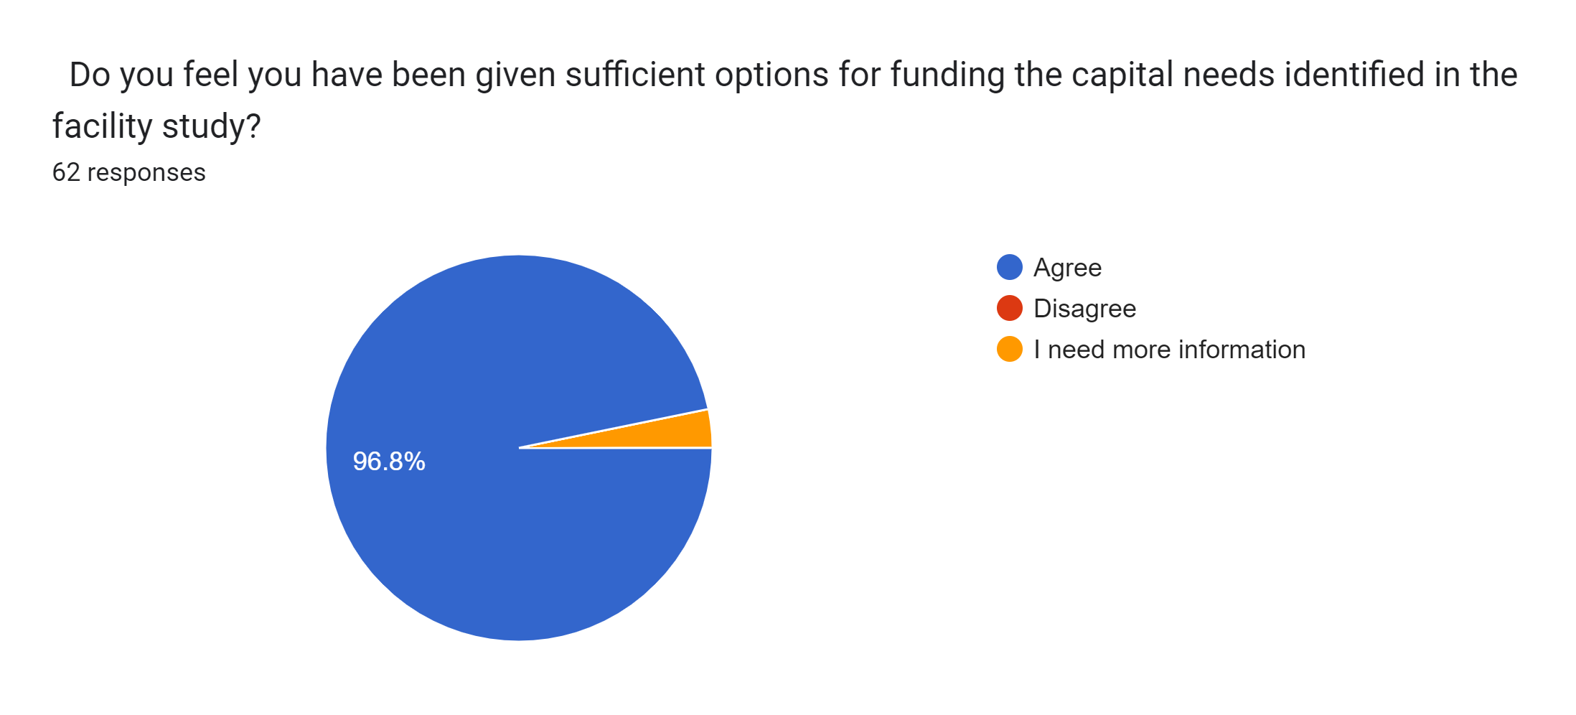
Community Retreat

Slide 6
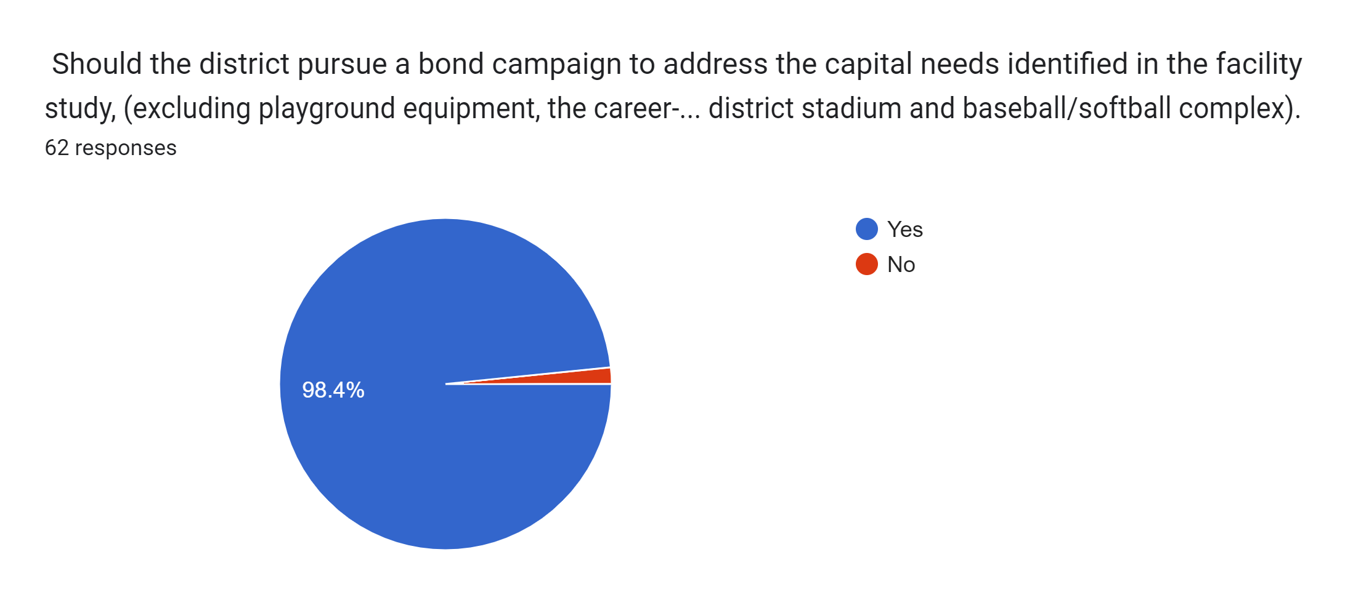
Community Retreat

Slide 7
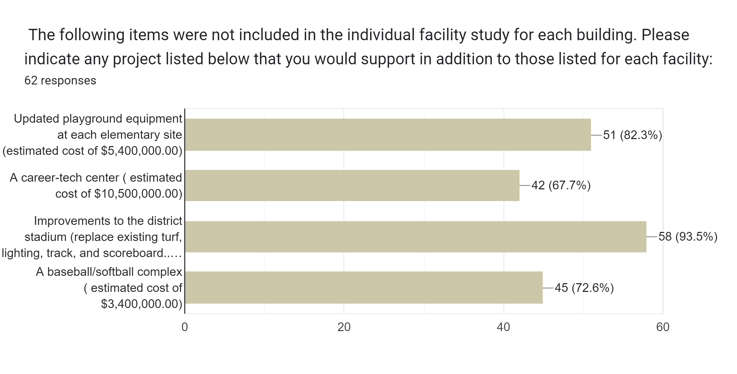
Community Retreat

Slide 8
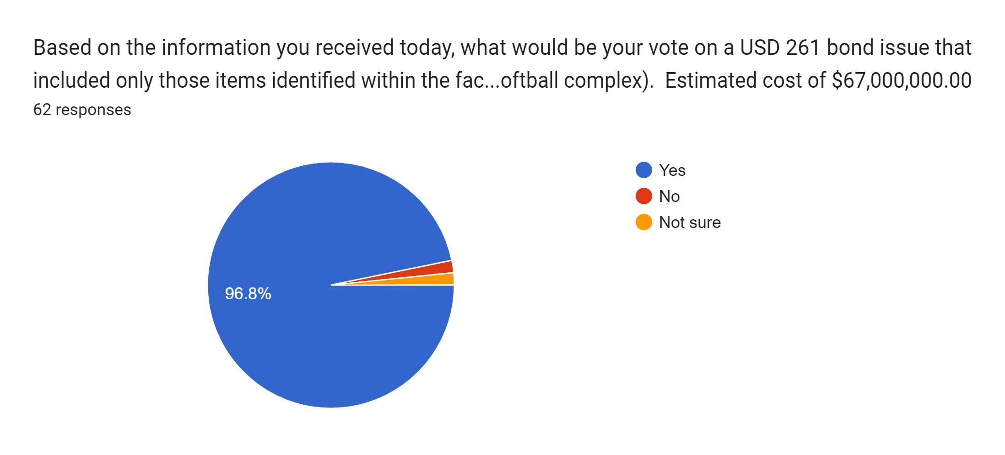
Based on the information you received today, what would be your vote on a USD 261 bond issue that included only those items identified within the facility study for each building (excluding playground equipment, a career-tech center, and improvements to the district stadium, a baseball/softball complex). Estimated cost of $67,000,000.00

Slide 9
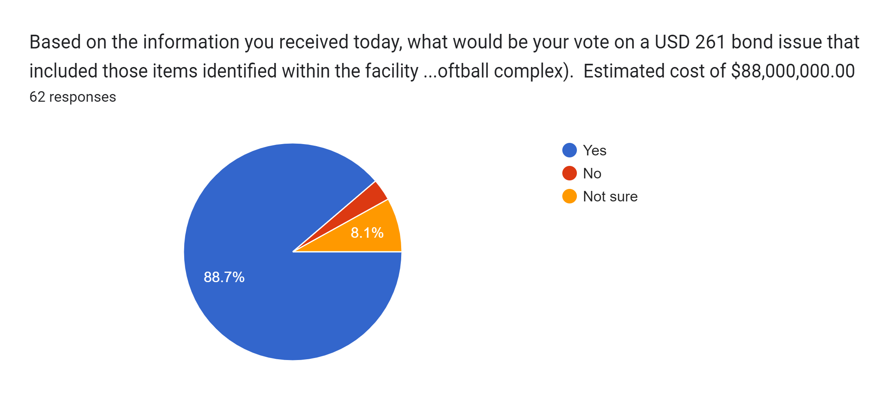
Based on the information you received today, what would be your vote on a USD 261 bond issue that included those items identified within the facility study for each building and the items not included with each building (including playground equipment, a career-tech center, and improvements to the district stadium, a baseball/softball complex). Estimated cost of $88,000,000.00

Slide 10
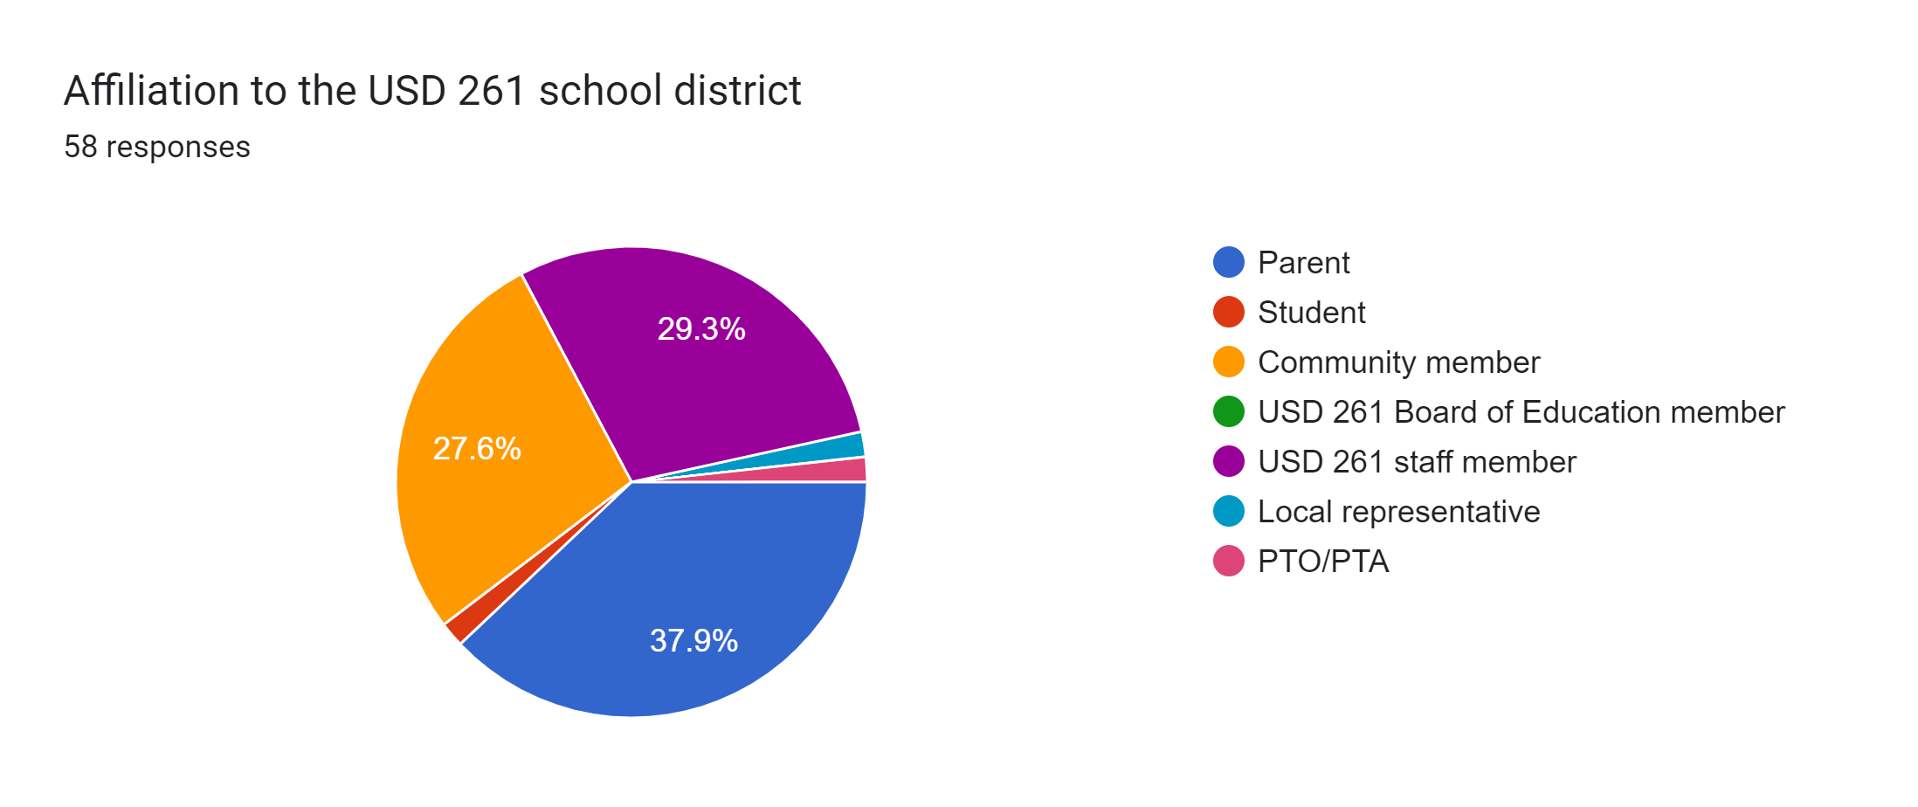
What did we learn-Community Engagement Meetings?

Slide 11

Community Engagement Meetings

Slide 12
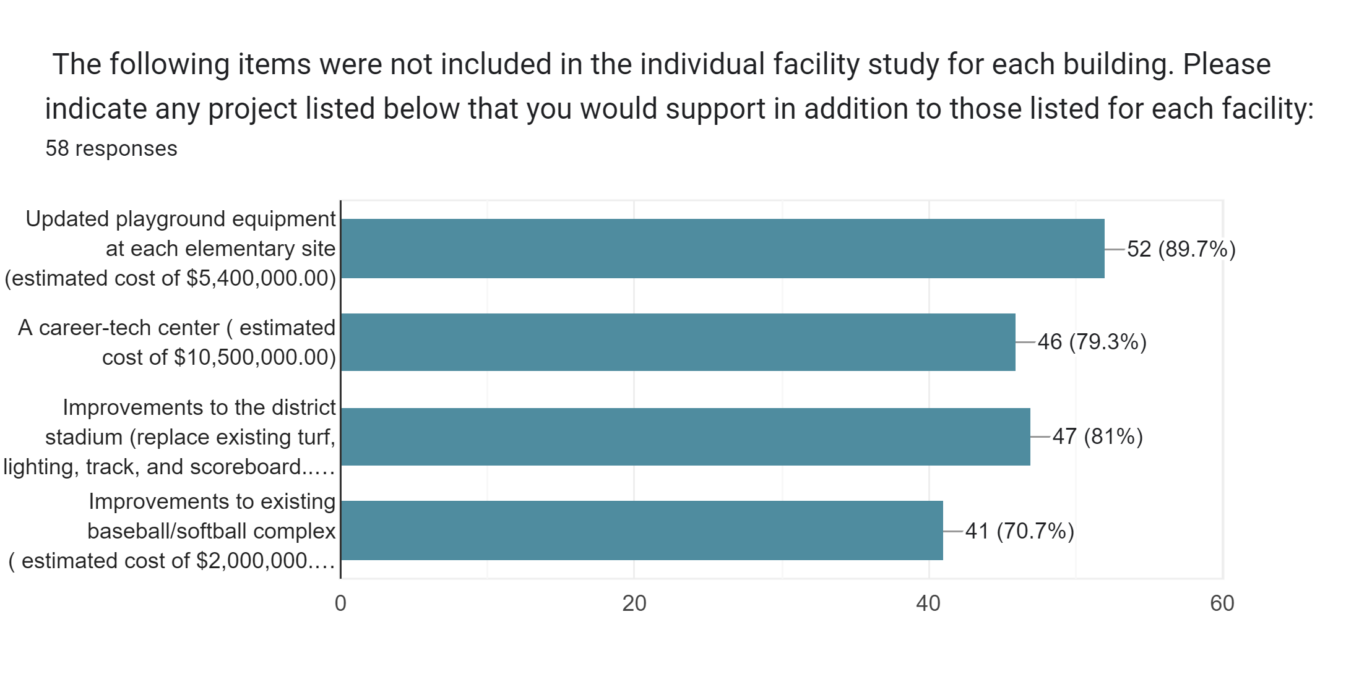
Community Engagement Meetings

Slide 13
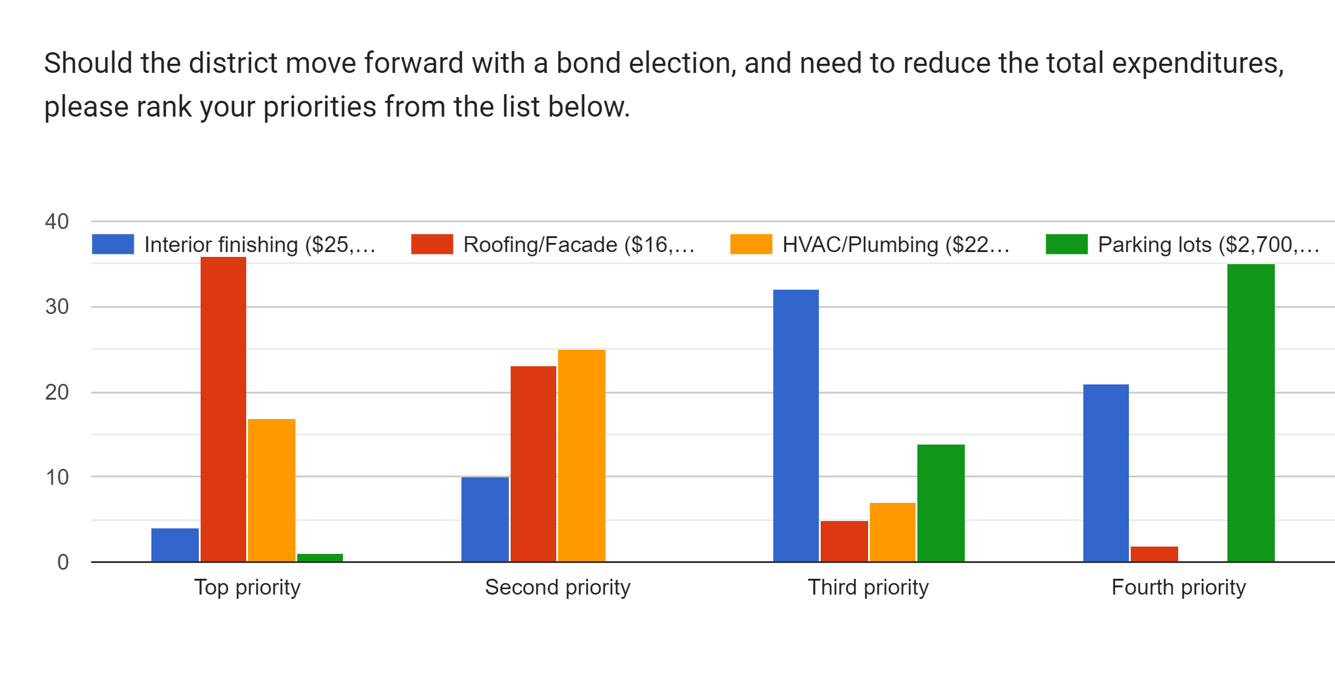
Community Engagement Meetings

Slide 14

Based on the information you received today, how would you vote on a USD 261 bond issue that included only those items identified within the facility study for each building (excluding playground equipment, a career-tech center, improvements to the district stadium, improvements to existing baseball/softball complex).

Slide 15
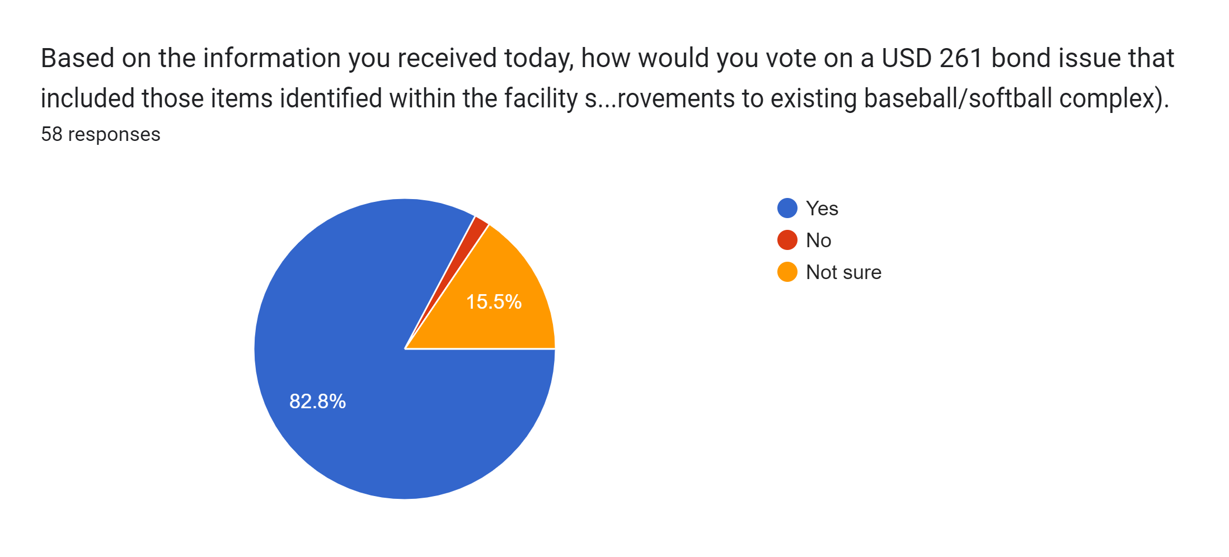
Based on the information you received today, how would you vote on a USD 261 bond issue that included those items identified within the facility study for each building and the items not included with each building (includes playground equipment, a career-tech center, improvements to the district stadium, Improvements to existing baseball/softball complex).

Slide 16
Recommendations for Moving Forward
Capital Improvements are needed
Current funding will not cover the cost of needs
Two Options
Hire an Architect
Meet with bond manager
Determine scope of work
Select Bond Chairpersons: A minimum of two
Create committees
April 2025 election

Slide 17
Tonight
Grant authority to move forward
Questions?

