Slide 1
College applications
101
Class of 2027

Slide 2
The two-part process
Apply for admission online
  Direct to Institution
  Common Application
Supporting documents sent through Naviance
  Make sure you know your log in information
  We send transcripts and letters of recommendation from LDHS staff electronically to colleges once you apply

Slide 3
Types of admissions decisions
  Rolling Admissions
  Regular Decision
  Early Action
  Early Decision – BINDING!!!!

Slide 4
The Common app
  commonapp.org
  Use your personal email
  Essays (have your English teacher proof)
  Common App matching with Naviance
    Allows them to “talk to each other”
    Auto updates in Naviance
  FERPA waiver
  Not all colleges require the same things on the application (supplements, etc)
  Time-consuming

Slide 5
transcripts
  Parents must sign off to give permission if you’re under 18
  Transcript Request Form
    Only need one general signed form
  Official transcript must come directly from our office
  Unofficial transcript access (handout)
  STARS (Self-reported Transcript and Academic Record System)
    Penn State, Pitt, other colleges use it
    See your counselor for historical grades printout
    Use a computer and not your phone

Slide 6
Letters of recommendation
  Fill out Bio Sheet in Naviance
    May need to update
  Ask recommenders first and then request in Naviance
  Common App recommendations outside of LDHS
    Must request through Common App before you submit
    Don’t request through Naviance
  Give at least two weeks notice!
  LDHS staff can’t upload until August 1

Slide 7
Important dates
  You can’t add any applications into Naviance before August 1!!!
  You can’t submit your Common App before August 1.
  You can work on your Common App and complete your Bio Sheet in Naviance, but you can’t submit anything before Aug 1.

Slide 8
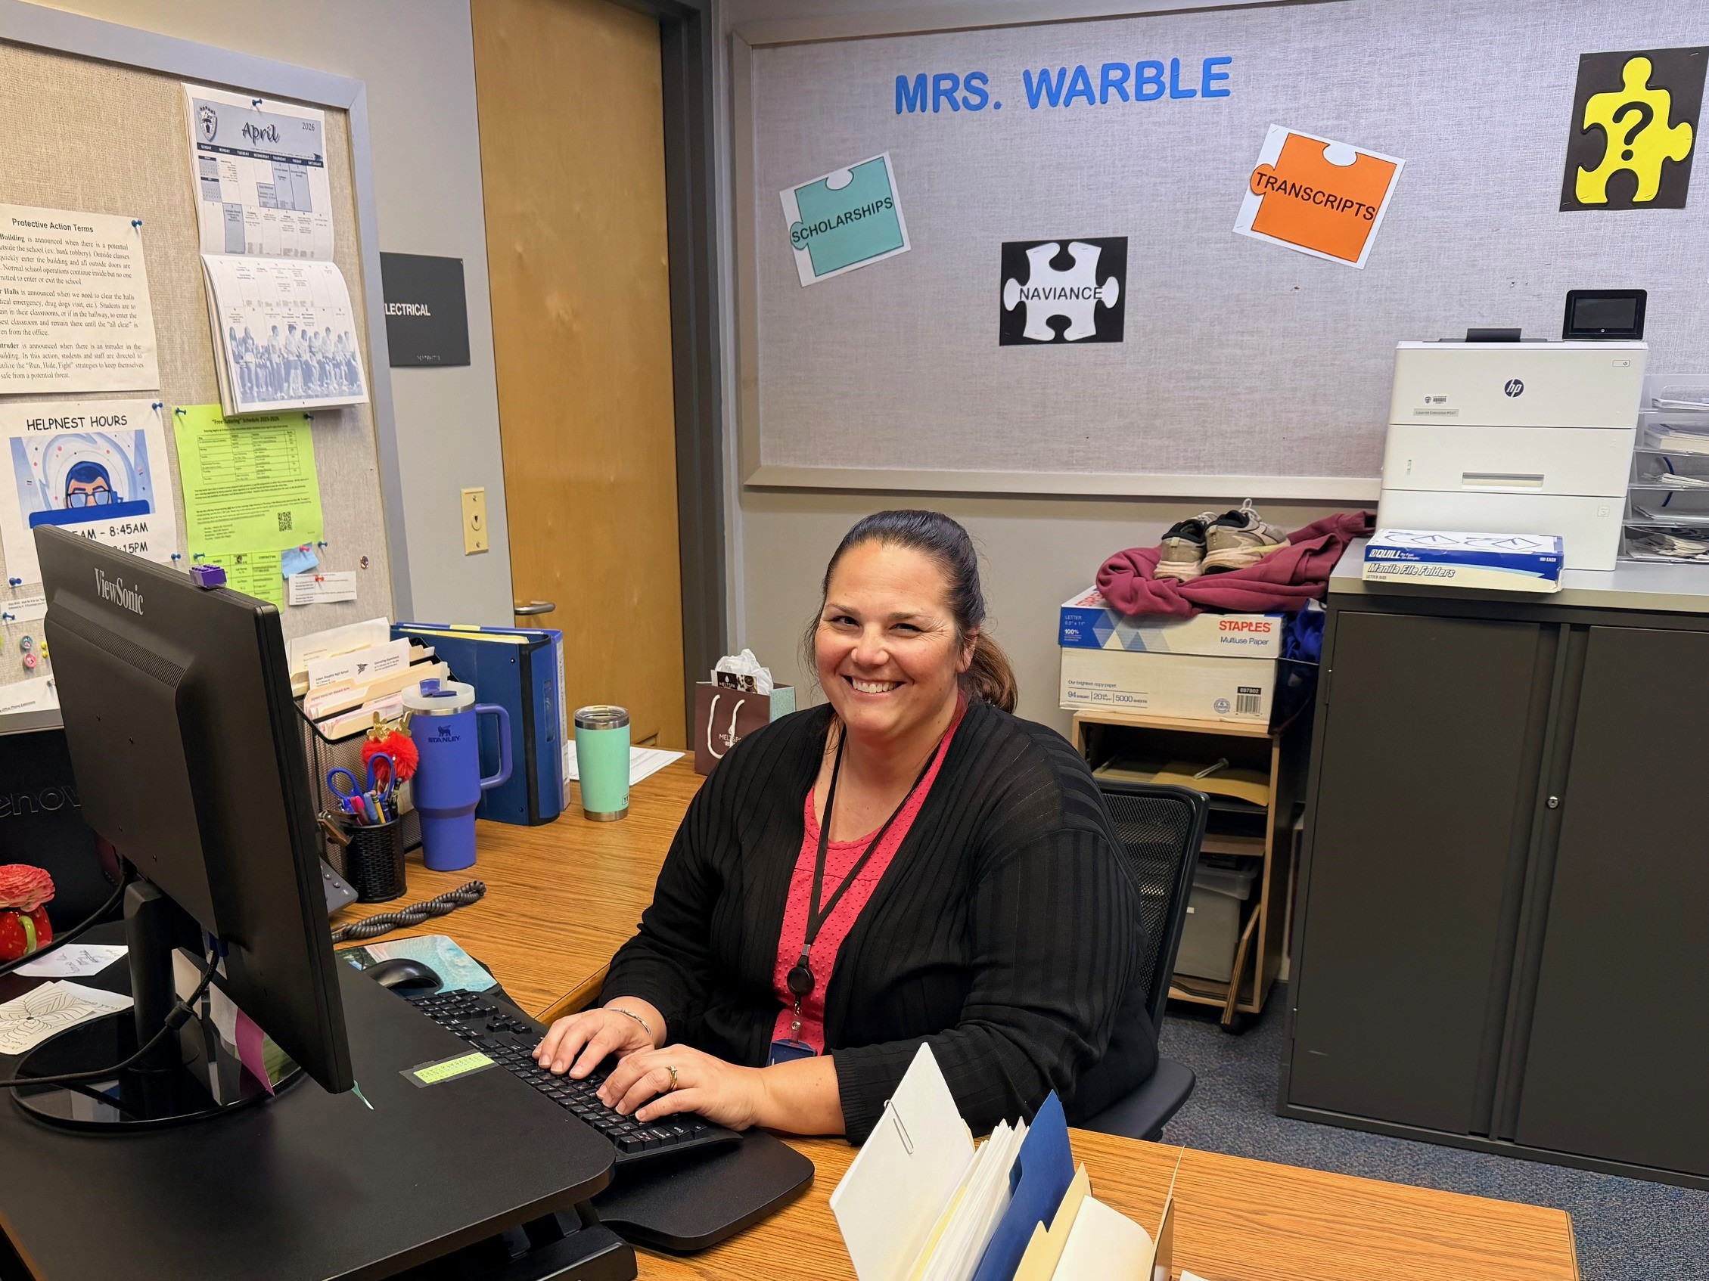
Mrs. warble
Processes all college applications in Naviance
Best person to talk to about process
May message you in Canvas
Make her life easy!!

