Slide 1
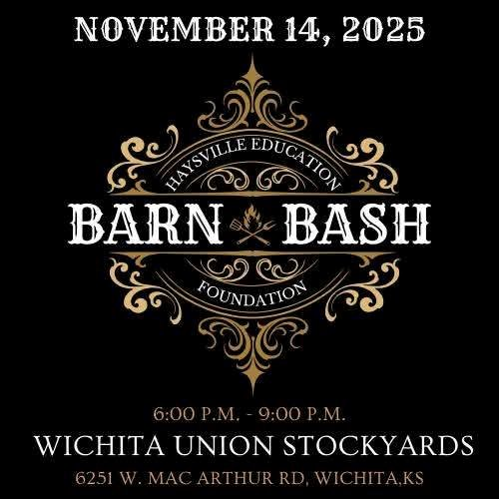
Barn Bash 2025​
Recap & Impact​
Haysville Education Foundation​
Notes:
Jessica

Slide 2
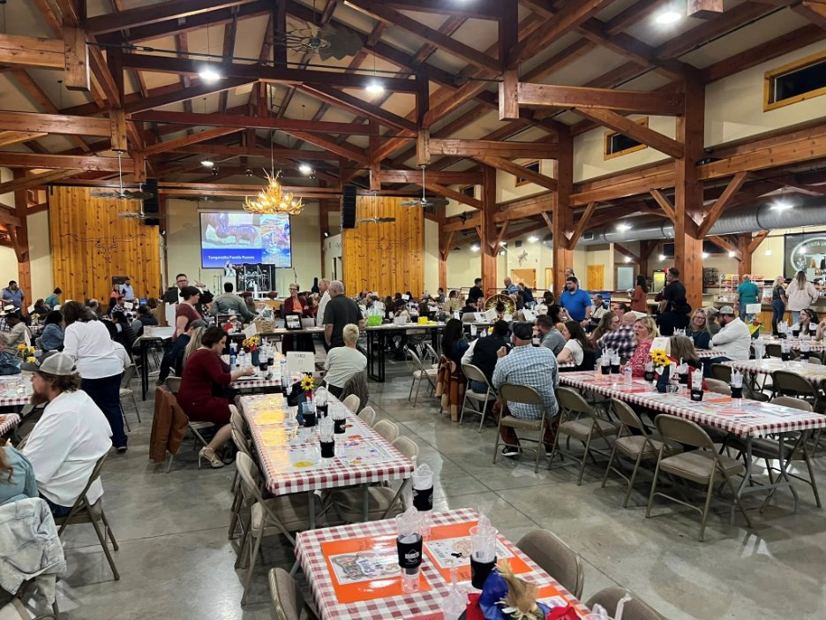
Event Overview​
Fundraising Success​
The most successful fundraising event in the foundation’s history – record fundraising!​
Event Activities​
Live band, auctions, raffles, interactive activities, and dinner from the Campus BBQ team.​
Strategic Fundraising Focus​
Every element of the event was designed to maximize revenue and elevate the attendee experience.
Notes:
Jessica

Slide 3
Key Metrics and Financial Highlights
Total Revenue​ | $57,779.13​
Donations​ | $3,810​
Fund-a-Need​ | $3,700​
Live Auction​ | $8,500​
Sponsorships & Other Activities​ | $41,769.13​
Notes:
Jessica

Slide 4
Strategic Adjustments
Notes:
Adia

Slide 5

Strategic Adjustments
Refocusing Event Purpose​
Refocused on our primary objective of raising funds in support of the foundation's mission, emphasizing support for educational programs.​
Enhanced Sponsorship Packages​
Improved to provide greater value, leading to increased sponsors, sponsorship levels, and benefits.​
Expanded Outreach Efforts​
Efforts extended beyond traditional networks, engaging new sponsors and community members to boost support.​
Optimized Ticket Pricing​
Lowered ticket prices and offered staff discounts- increased paid attendance without reducing overall revenue.​
Notes:
Adia

Slide 6
Marketing and Outreach Initiatives
Multi-Channel Outreach​
Leveraging multiple channels and promotions maximized outreach and strengthened community ties.​
Targeted Email Campaign​
A focused email campaign engaged past attendees, promoting early ticket sales and event importance.​
Enhanced Social Media Activity​
Increased social media presence created buzz and boosted community interaction around the event.​
Fall Festival Presence​
Parade participation and hosted a booth at the Haysville Fall Festival to raise awareness.​
Notes:
Adia

Slide 7
Event Enhancements​
Enhanced Entertainment​
Introduction of a live band created an energetic and engaging atmosphere for attendees.​
Attendee Participation Prizes​
Best Hat and Best Dressed awards encouraged attendee involvement and added fun to the event.​
Photo Booth Engagement​
Provided entertainment and boosted brand visibility through social media sharing.​
Expanded Auction Offerings​
More high-value auction items, including a popular trip, increased fundraising success despite fewer baskets.​
Bull Riding Excitement​
Return of bull riding added thrilling entertainment and additional fundraising opportunities.​
Notes:
Adia

Slide 8
Volunteer Recognition

Slide 9
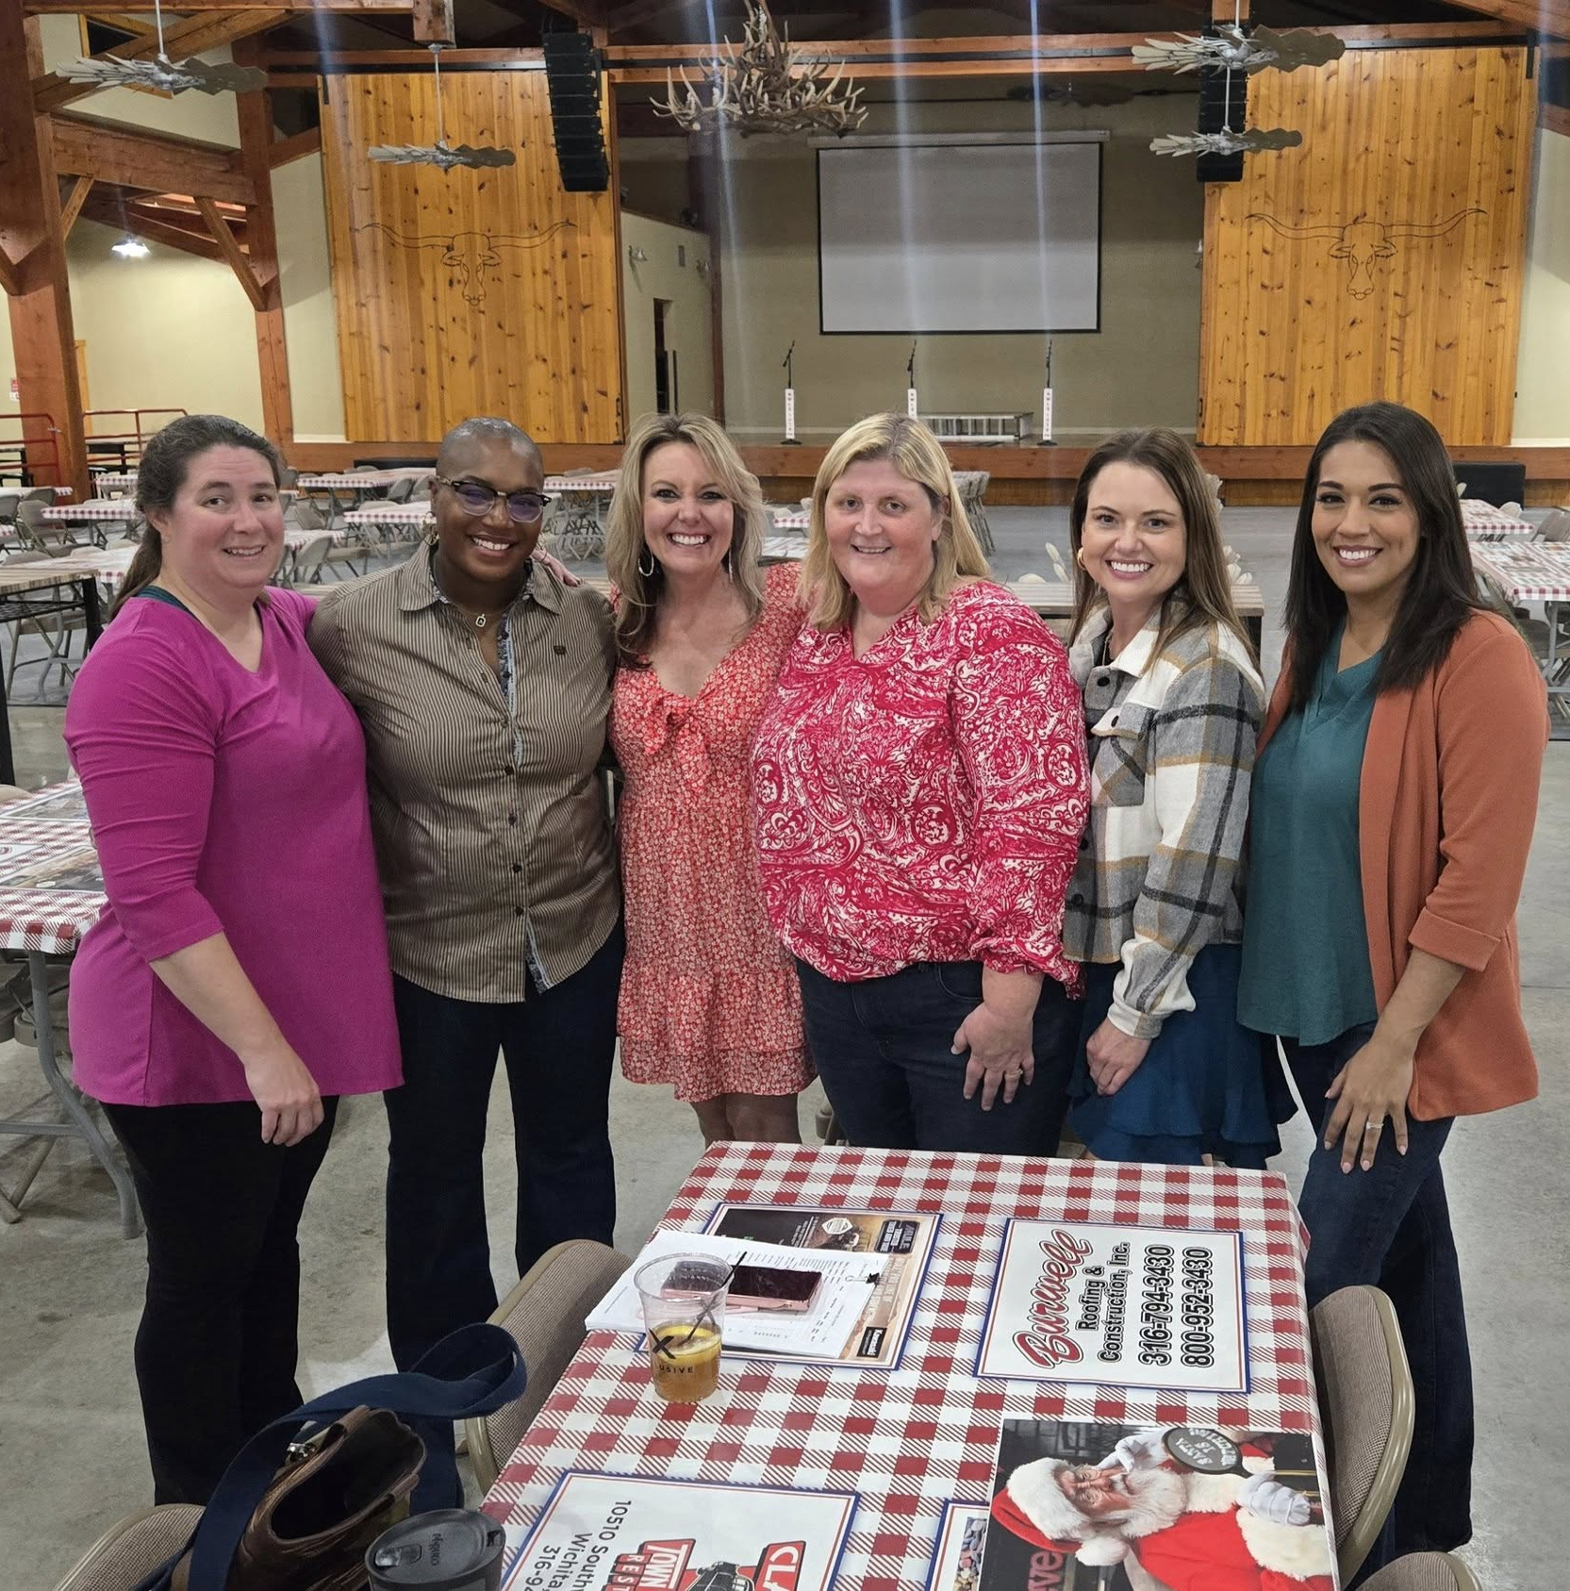
Volunteer Recognition
Key Volunteer Contributions​
Jennifer and Jason Jones played a crucial role in planning and executing the event catering with tireless dedication, including grocery shopping for the entire event!​
Teamwork and Coordination​
Volunteers Adia, Misty, Christy, and Jessica demonstrated exceptional teamwork in communications, logistics, and management.​
Impact on Event Success​
Their collective dedication contributed directly to the event’s record-breaking success and increased community support.

Slide 10
2026 Strategic Focus
Notes:
Sarah

Slide 11
2026 Strategic Focus
Strengthen Board
Engagement & Governance​
Establish clear board expectations that support the Foundation’s mission, fundraising efforts, and community visibility.​
Review and update bylaws to reflect current operations and support future growth.​
Expand & Diversify Fundraising Efforts​
Explore additional fundraising opportunities to build year‑round support.​
Partner with local organizations, businesses, and community events to maximize exposure and collective impact.​
Enhance Operational
Efficiency​
Create a more streamlined and user‑friendly grant application process.​
Evaluate financial needs to sustain both fundraising activities and operational efforts.​
Establish a clear annual budget to
support strategic priorities and responsible stewardship.​
Increase Accessibility &
Impact of Grants​
Open grant applications to staff in the spring to allow for thoughtful planning.​
Award grants in the fall to align with instructional needs and
classroom implementation.​
Ensure grantmaking continues to directly support innovation, student opportunities, and educator excellence.​
Notes:
Sarah

Slide 12
Thank You
Thank you for your continued support of the​ Haysville Education Foundation.​
Your leadership, guidance, and advocacy make our work possible.​
The success of Barn Bash—and every grant awarded—reflects a shared commitment to our students and educators.​
Together, we are strengthening classrooms, expanding opportunities, and investing in the future of education across USD 261.​
We look forward to continuing this work—together.

