Slide 1
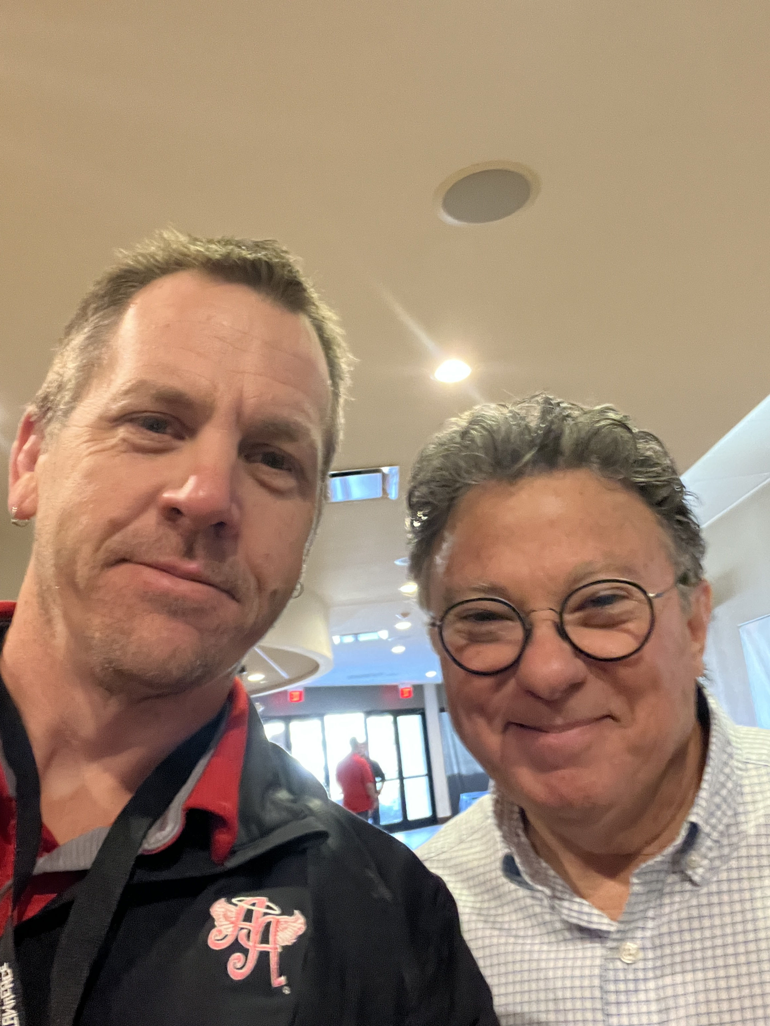

Understanding Behavior, Building Connection, & Emergency Safety Interventions
Collaborative and Proactive Solutions, Positive Behavior Supports, and Trauma Informed Sequence at the Tri-City Day School

Slide 2
An Emergency Safety Intervention is the use of seclusion or physical restraint at a last resort when a student presents a danger to self or others. At Last Resort: When a student presents a reasonable and immediate danger with the present ability to apply such physical harm AND alternatives have been exhausted or deemed inappropriate due to safety (K.S.A. 72-6153)
Physical Restraint: Bodily force used to substantially limit a student's movement temporarily
  Bodily force means the amount of pressure used by one’s hands, arms, or body on another person’s body
  The amount of bodily force used to restrain the student should be only what is necessary to diffuse the emergency and ensure the safety of staff and students
  Limiting a student’s movement means to control a child’s movement for the purpose of preventing the movement from continuing to cause harm to self or others
  Physical escorts where staff are controlling a student’s upper body to transport to another location is considered a physical restraint.
  If mechanical or chemical restraints are ordered by a person appropriately licensed to issue the order is used, the IEP should detail the circumstances under which the mechanical or chemical restraint should be used, how often it should be used, alternatives, or discontinuation of the use of the mechanical or chemical restraint as a goal
  Physical restraint does NOT include pressure by one’s hands, arms or body that is consensual, solicited, and for the intent to provide comfort, assistance or instruction
  The intent of physical restraint is to keep students and staff safe and NOT for discipline, punishment, or staff convenience

Slide 3
Overarching Goals for Tri-City
Tri-City students have a positive experience preparing them for adult life
Parents have positive feelings about Tri-City rooted in their students’ experiences
Staff are happy (fostering connection and engagement with the school and students)
The community Tri-City serves has positive feelings and are proud of the school

Slide 4
Positive Behavior Supports
Multi-Tiered system of support to address students’ academic, social, emotional, and behavioral needs
Provides clear expectations within each environment the student encounters at school
Involves the teaching and reteaching expectations
Utilizes rewards to encourage the display of adaptive behavior
Core Belief: All students can be taught and follow behavioral expectations

Slide 5
Collaborative & Proactive Solutions (CPS)
Informed by neuropsychology: executive functioning, language processing, emotion regulation, adaptability, and social skills
Lagging skills/unsolved problems in these areas can limit a student’s ability to meet expectations across settings
Focus is not the behavior itself, but the problems causing the behavior
Concerning behavior functions as communication: the student is currently unable to meet a particular expectation
The person ideally suited for participating in the problem-solving process with the student is the person whose expectation the child is having difficulty meeting
Move away from punitive disciplinary measures and towards preventing them from being necessary
Notes:
Psychosocial treatment model for challenging behaviors based on social learning theoretical foundations
Relies heavily on the neuropsychology, delineating – executive processing, language processing, emotion regulation, adaptability, and social skills
Deficits (unsolved problems) in these processing areas create difficulties for some students to display adaptive behaviors across environments (unsolved problems and lagging skills to meet expectations)
Focus is not on displayed behaviors; the focus is on the problems causing the behaviors
The function of concerning behavior is that it communicates that the student is not able to meet particular expectations

Slide 6
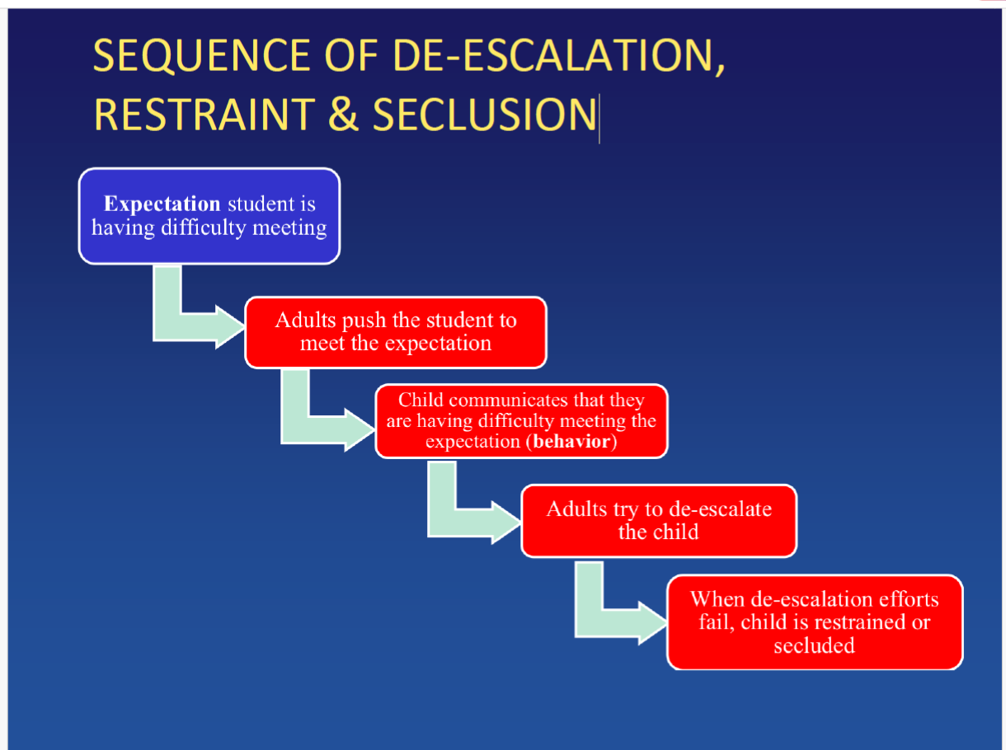
Collaborative & Proactive Solutions (CPS)

Slide 7
Trauma Informed Sequence
Regulate (calm body/create safety)
  Calm voice + body, reduce demands, offer space/choices
  Rhythm/Sensory Tools: breathing, movement, quiet spot
Relate (build felt safety through connection)
  Attune + Validate: “I’m here. You’re safe”
  Brief listening; avoid lecture during escalation
Reason (teach + problem-solve after calm)
  Debrief, identify triggers/needs, teach replacement skills
  Make a simple plan + practice
  Rule of thumb: The more escalated the student, the more you stay in Regulate/Relate (less talk more rhythm)

Slide 8
2023-2024
Back to School Training introduced common Collaborative and Proactive Procedures vocabulary & “Kids do well if they can” mantra
Continued Loops (Behavior Specific Praise); loops are spent weekly at Gator Galleria and monthly at Gator Gold
Individual Token Economies in place for some students (6 of 22)
Monthly PBIS Drawings
Explicit instruction on expected behaviors within every environment students encounter
5:1 ratio positive to corrective statements

Slide 9
2024-2025
PBIS
  Continued instruction on expected behaviors within all environments
  Implemented Behavior Tiers
  Continued the Ratio, Behavior Specific Praise, Loops, Gator Galleria, and Gator Gold
  Gator Snack Shak
  Token Economies for some students (4 of 24)
C&PS
  Back to School Training on Collaborative and Proactive Solutions
  Implemented the Model for Complex Change
  Changed Office Referral form from Functions of Behavior as defined by ABA and instead utilized Skills from the ASUP 2024
  Instead of reteaching expectations for “frequent flyers” we use this data to complete ASUP

Slide 10
2025-2026
  Trauma Informed Sequence
  Best of the Best Assemblies
  Continued the Behavior Tiers, Positive Ratio, Behavior Specific Praise, Loops, Gator Galleria, Gator Gold

Slide 11
ESIs by Academic Year
Academic Year | Frequency of ESI
2022-2023 | 677
2023-2024 | 92
2024-2025 | 158
2025-2026 | 222
-Frequency of ESIs for the 25/26 School year is extrapolated
For the 2025-2026 Academic School Year, four students account for 137 of the 222 ESIs.

Slide 12
Student A (51/146 ESIs)
2025-2026 School Year
Month | ESI
8/2025 | 4
9/2025 | 5
10/2025 | 12
11/2025 | 17
12/2025 | 9
1/2026 | 3
2/2026 | 1

Slide 13
Student B (31/146 ESIs)
2025-2026 School Year
Month | ESI
8/2025 | 6
9/2025 | 15
10/2025 | 2
11/2025 | 3
12/2025 | 1
1/2026 | 1
2/2026 | 3

Slide 14
Student C (20/146 ESIs)
2025-2026 School Year
Month | ESI
8/2025 | 5
9/2025 | 5
10/2025 | 8
11/2025 | 1
12/2025 | 0
1/2026 | 0
2/2026 | 1

Slide 15
What’s Under the Surface: Drivers of Crisis
ESI Communicates: “I can’t meet this expectation right now.”
Likely Drivers: Unmet regulation needs, skill gaps, environment mismatch, escalation cycles
Focus Areas: Reduce demands during dysregulation, increase connection, teach skills later
Goal: Move from reactive crisis response to proactive support system
If we only focus on the behavior, we miss the message. Our job is to solve the problems underneath the behavior, so emergencies become rare.

Slide 16
“Challenging behavior is simply the signal….the fever…the means by which a child communicates that he/she is having difficulty meeting certain expectations.”
– Ross W. Greene

