Slide 1

SBAC Reporting System
July 14, 2015
BOARD OF TRUSTEES
Sergio Hernandez, Jr., President
Shannon Thomas-Allen, Vice President
Mercedes Ibarra, Clerk
Angela Fajardo
Juan Navarro
Kent Taylor, Superintendent

Slide 2
Reflection on 2015 SBAC Testing
2015 SBAC Testing Window closed 6/18
Approximately 3, 300 Lennox students in grades 3-8 took the SBAC test
Students took 4 separate tests (Math and English CAT & PT)
Overall positive testing experience with very few technology glitches
Support from technology department, categorical program assistants and school site leadership.

Slide 3

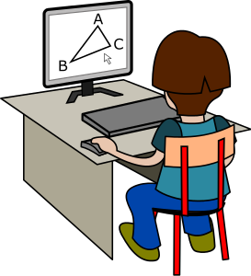
SBAC Scores Cannot be Compared to CST
CST | SBAC
Knowledge and Skills Based | Increased rigor requiring complex thinking
Single answer bubble-in responses | Open ended question requiring written responses.
Five Scoring Levels (Far Below Basic, Below Basic, Basic, Proficient Advanced) | Four scoring levels

Slide 4
How is the new SBAC Test different?
CST Test Question | SBAC Test Question
How many right angles are in a rectangle? A 1 B 2 C 3 D 4 | A rectangle is 6 feet long and has a perimeter of 20 feet. What is the width of this rectangle? Explain how you solved this problem.
The student types in their response here. There are two questions the student must answer correctly in this SBAC item.

Slide 5
Scores Will Look Different
The new tests are too fundamentally different from the old exams to make any reliable comparisons between old scores and new. This year's results will establish a new baseline for the progress we expect students to make over time.
Based on trial runs of the new assessments in California and other states, many if not most students will need to make significant progress to reach the standards set for math and literacy that accompany college and career readiness.
Parents will receive a report of their child's scores. But no student, parent or teacher should be discouraged by these scores, which will not be used to determine whether a student moves on to the next grade. Rather, the scores will represent an opportunity to focus on the needs of students and support teachers and schools in their work to achieve college and career readiness.
http://www.cde.ca.gov/nr/re/ht/caasppfaq.asp

Slide 6
Achievement Levels
    Achievement level classifications based on overall scores
        -Level 1—Standard Not Met
        -Level 2—Standard Nearly Met
        -Level 3—Standard Met
        -Level 4—Standard Exceeded (College and Career Readiness)

Slide 7
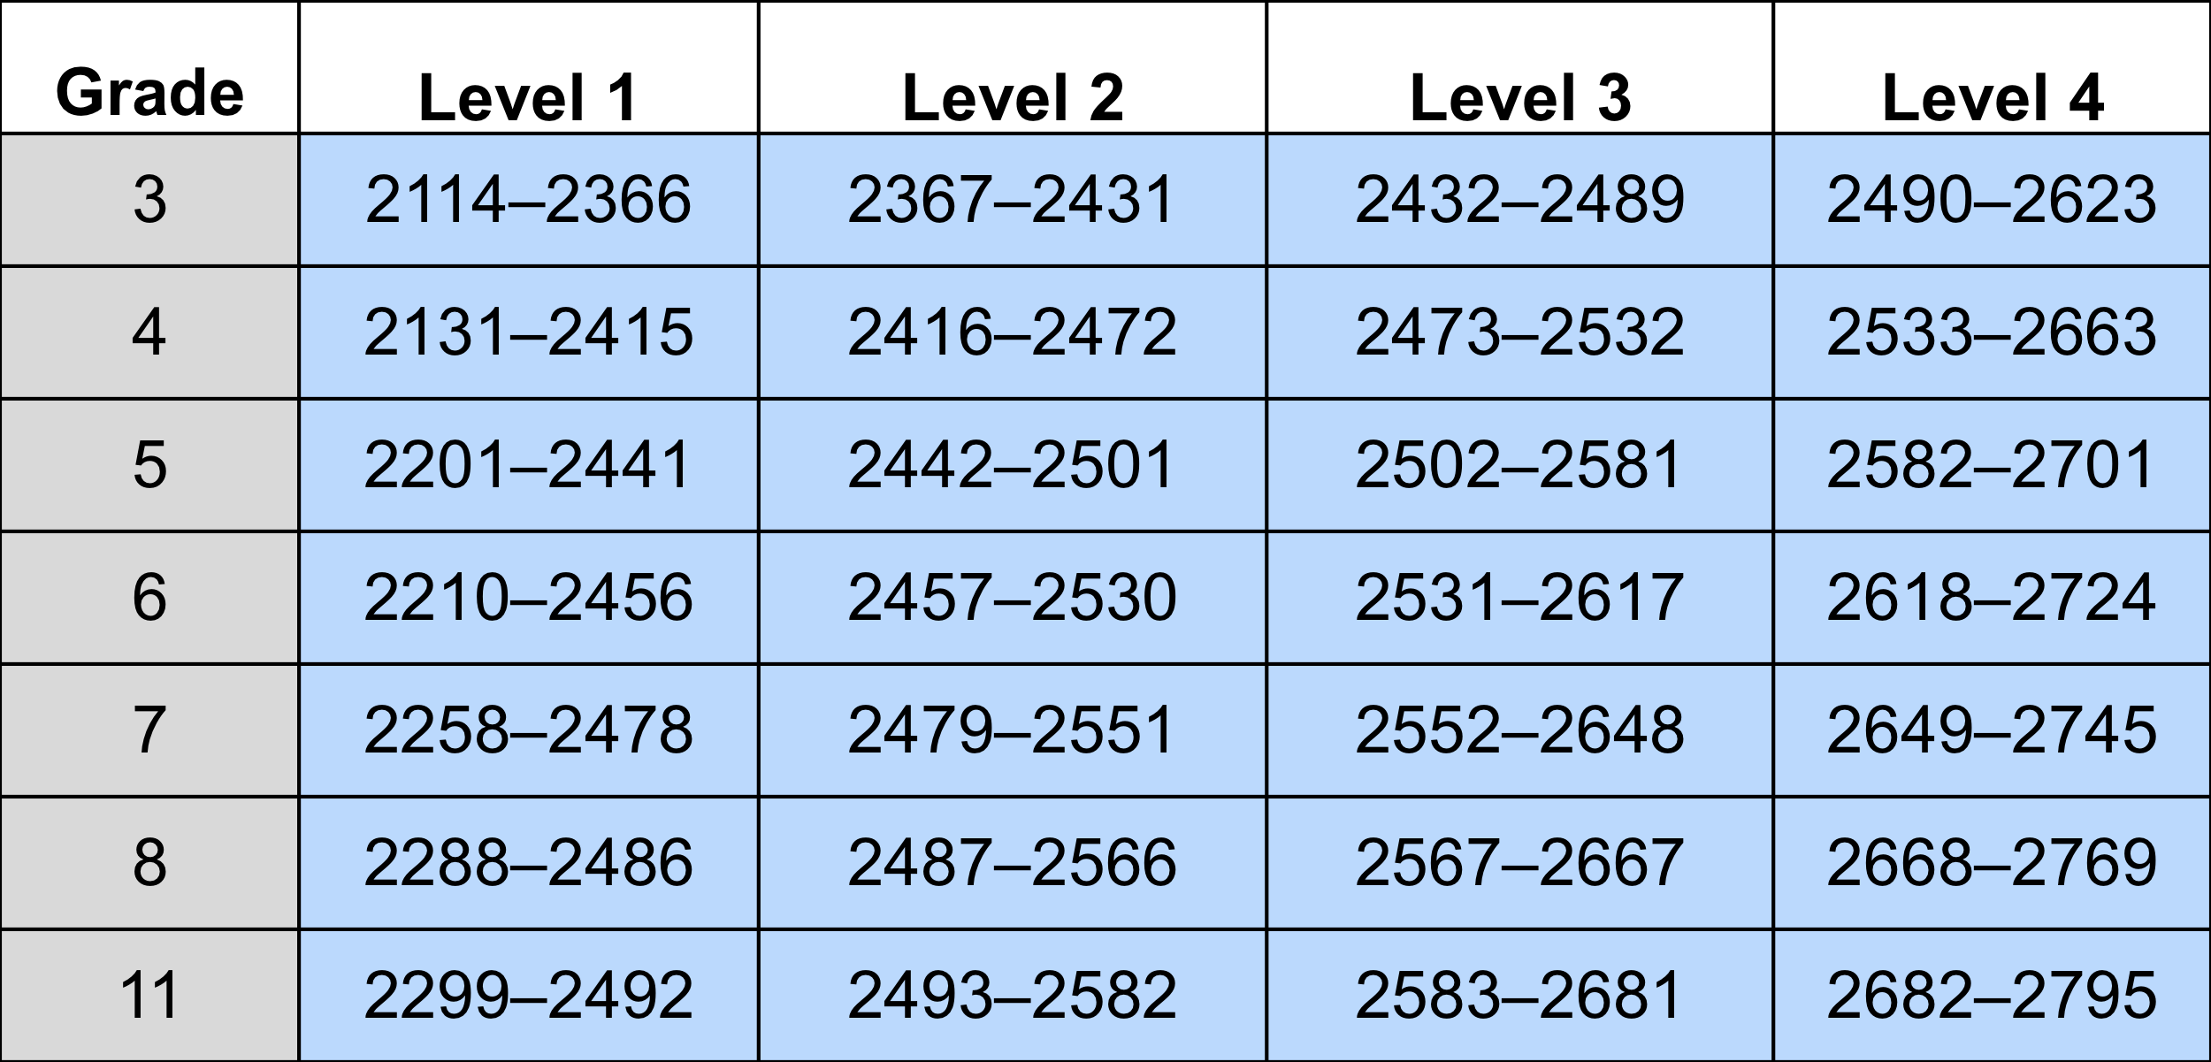
Smarter Balanced Scale Score Ranges for ELA/Literacy

Slide 8
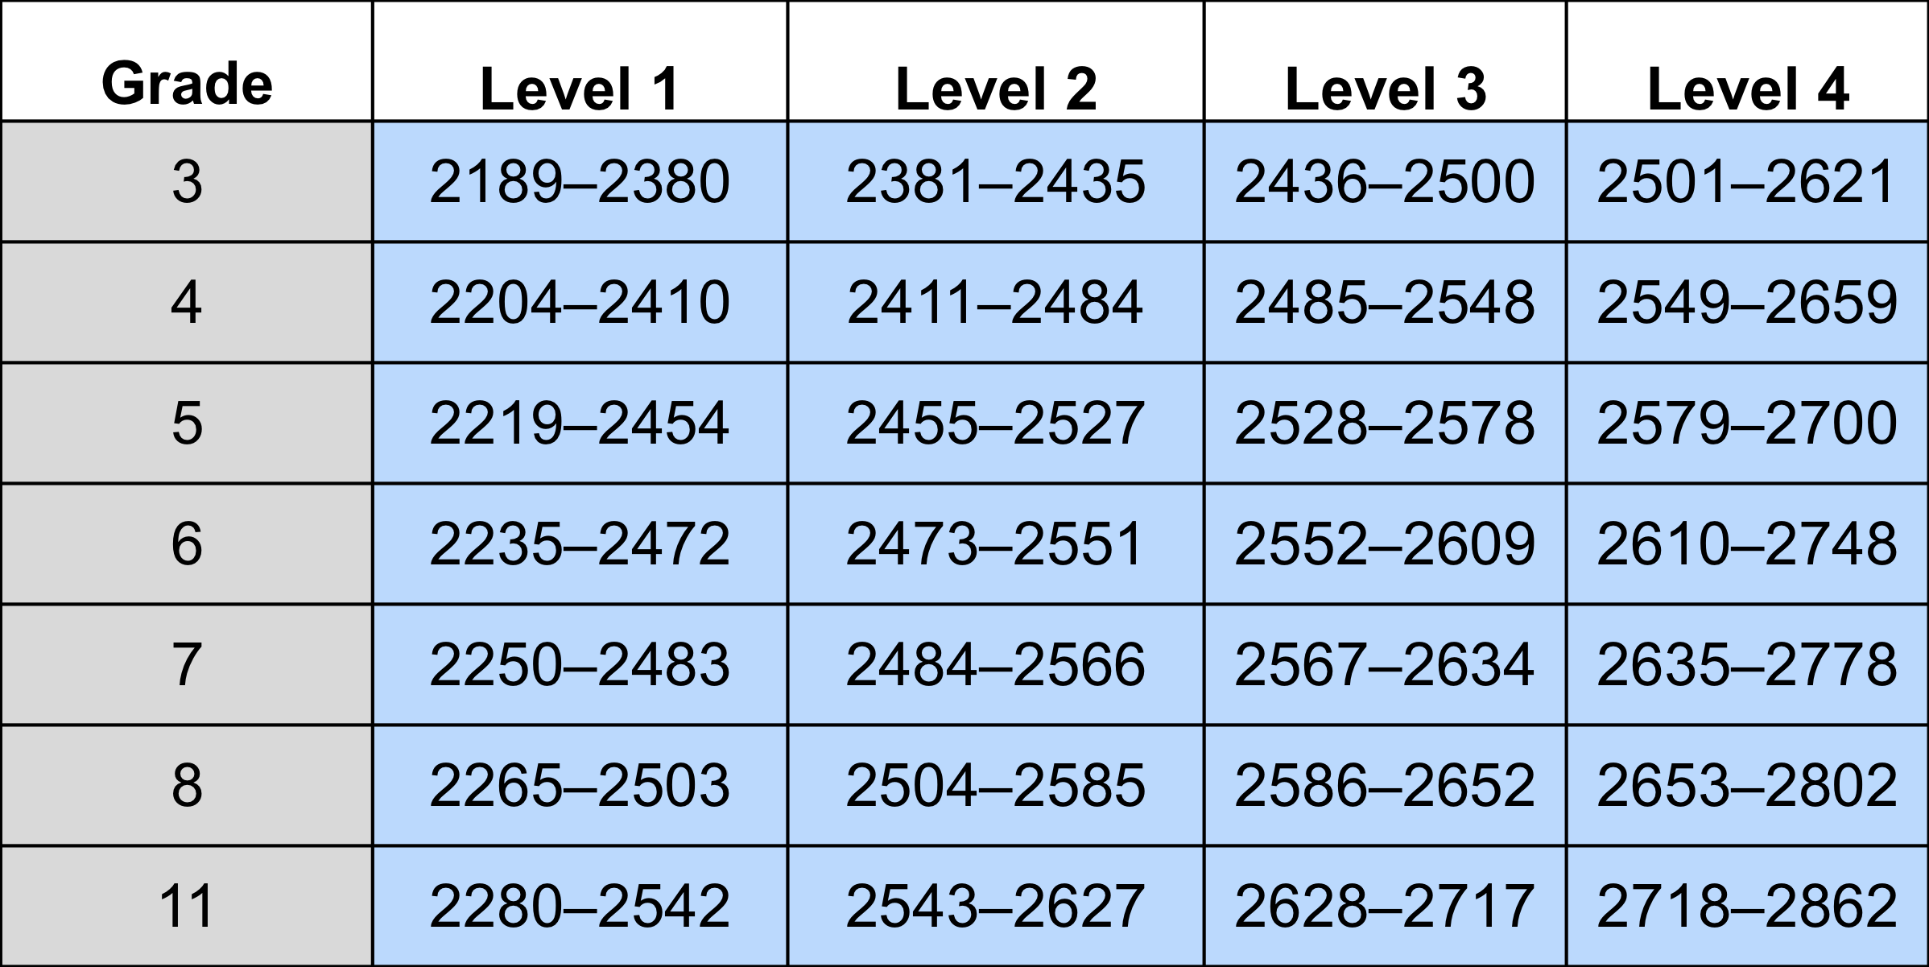
Smarter Balanced Scale Score Ranges for Mathematics

Slide 9
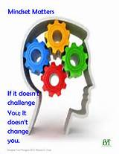
Looking at Test Scores through a Growth Mindset
Care about and invest in learning
Believe that effort is a positive thing, causing their intelligence to grow
Try hard in the face of frustration
Look for new learning strategies.
Collaborative environment where students take responsibility for their own learning

Slide 10

Understanding the Reports

Slide 11
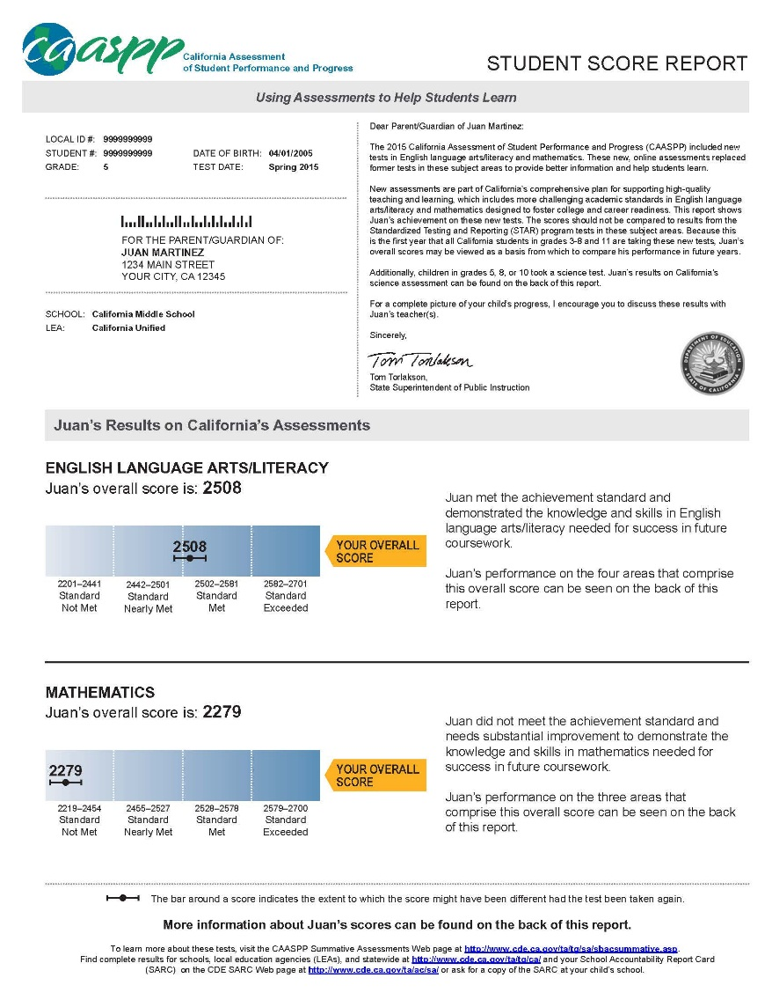
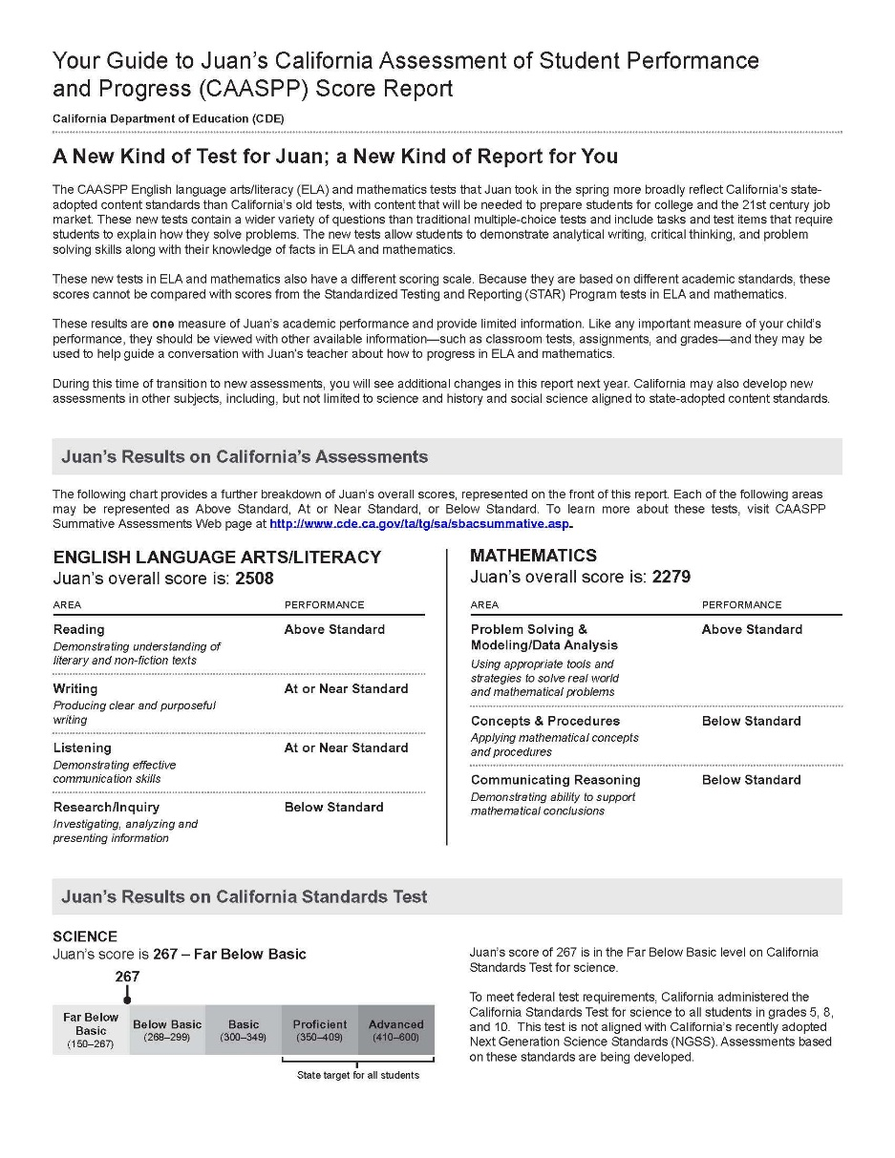
Elements of the Student Score Report
Front Page
Back Page
5
1
2
3
6
7
4
8

Slide 12
Timeline for Public Reporting
Early August
LEAs preview embargoed public reporting site.
Mid-August
CDE releases public reporting results through DataQuest based on results through June 30.
Mid-September
CDE releases updated public reporting results based on results for 100% of LEAs.

Slide 13

Questions?
Thank you!

