Slide 1

Coordinated School
Health Advisory
Committee
April 21, 2026

Slide 2
Agenda
Welcome & Introductions
Overview: What is CSHAC?
Wellness Policy
Nutrition Updates & Smart Snacks
Physical Education
Spotlight: MUSC & Boeing Center for Children’s Wellness
Reflecting on Past Goals Setting New Objectives
2

Slide 3
Introductions
Tonya Crosby
Serves as the designated officer for ensuring compliance with the wellness policy and oversight of the committee
Oversees compliance with all USDA and SC Department of Education reporting requirements
Encourages each school to identify a Wellness Champion
David “Scotty” Whaley
Serves as District physical education & health coordinator
Oversees compliance for school’s participation in MUSC’s wellness program
Communicates with schools and administration district wide initiatives in physical education and health
Colleen Boulware
Serves as School District Nutritionist
Oversees Smart Snack compliance across all schools
Leads and coordinates district-wide nutrition education initiatives
Roberta Green
Serves as the District’s Director of Food Service Operations
Oversees and assists with the operations of community outreach activities
Coordinates district-wide nutrition operations programs
3

Slide 4
What is CSHAC?
BCSD recognizes student wellness and proper nutrition are related to a student’s well-being, growth, development, and readiness to learn.
Student participation in the U.S. Department of Agriculture (USDA) School Breakfast Program results in:
Higher grades and standardized test scores
Lower absenteeism
Better performance on cognitive tasks
Students who are physically active through:
Recess
Physical activity breaks
High-quality physical education, and extracurricular activities
…do better academically
Students who are physically active through:
Recess
Physical activity breaks
High-quality physical education, and extracurricular activities – do better academically

Slide 5

Local Wellness Policy
Guides a school district’s efforts to establish a school environment that promotes student’s health, well-being, and ability to learn
Educational agencies participating in the National School Lunch Program (NSLP) and the School Breakfast Program (SBP) are required to develop a wellness policy.
Requirements:
  Set goals for nutrition, physical activity, and
  Define nutrition standards for all foods served on school campus
  Include guidelines for all non-sold foods and drinks
  Involve community members in policy implementation
  Regularly inform & update the public
5

Slide 6
2025–2027 Nutrition Program Updates
(NSLP, SBP & Snacks)
2025–2026 Changes (Effective July 1, 2025)
Added Sugars Limits:
• Cereals ≤ 6g/oz
• Yogurt ≤ 12g/6 oz
• Flavored Milk ≤ 10g/8 oz
Grain-Based Desserts no longer creditable
Snack focus: whole grain-rich & reduced juice
2027–2028 Changes (Full Implementation)
Added Sugars ≤ 10% weekly calories
Continued sodium reductions
Maintain whole grain-rich requirements
Snack & Product Trends
Shift away from high sugar cereals & desserts
Increased review of artificial dyes & additives
Changes in chips & cereals (e.g., Doritos)
More whole, minimally processed options
6

Slide 7
Smart Snacks
This applies to all foods & beverages sold to students on school grounds during the school day (includes al la carte and fundraisers)
Up to 5 fundraiser exemptions per year for BCSD schools
Low-fat and fat-free milk permitted by the NSLP/BSP 100% fruit or vegetable juice 8 fl oz for elementary; 12 fl oz for secondary
High Schools Only: Low and No-calorie beverages with or with-out caffeine and/or carbonation; calorie-free, flavored
7

Slide 8

8

Slide 9



Partnership with MUSC/Boeing Center for Children’s Wellness
9
Notes:
Transition to allow MUSC/Boeing reps to share their presentation

Slide 10
Areas of Focus for BCSD
Nutrition Education & Promotion
Physical Activity
Other School-Based Wellness Activities
10

Slide 11
Handouts
Wellness Goals & Results
2025-2026
Suggestions for 2026-2027 Wellness Activities
12

Slide 12
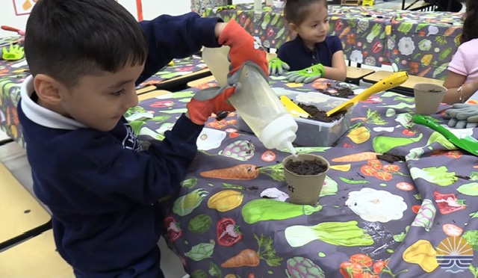
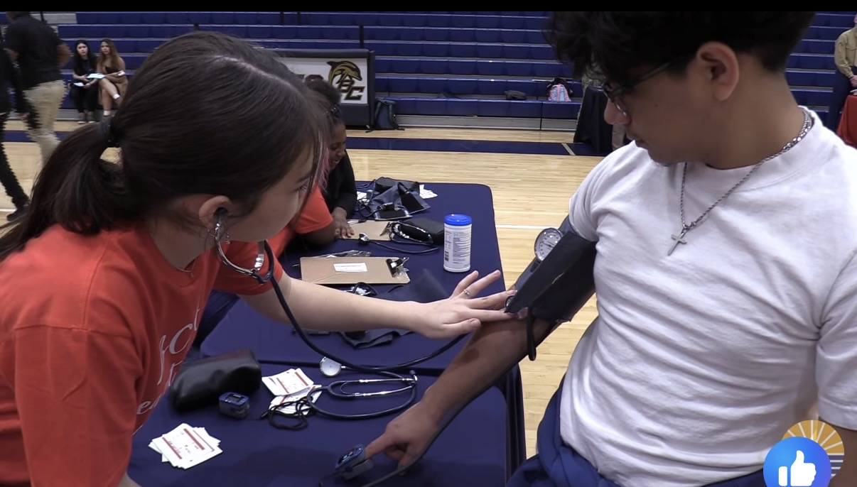
Did You Know?
The Nutrition Group has
a Facebook Page
Farm to Schools at Hilton Head Island Elementary
The MUSC Center for Children’s Wellness has a Facebook Page
Heart Healthy Awareness Day at Battery Creek High
13

Slide 13

Any
Questions?
14

