Slide 1
2026-27
Budget and
Truth-In-Taxation Hearing
June 15, 2026

Slide 2
Economic Update

Slide 3
United States Economic Overview
Growth Outlook
  GDP Growth 2.0% to 2.2%
  Inflation 3.4% to 3.9% (May 2026 4.2%)
  Unemployment 4.3% to 4.5%
Growth Outlook
  National economy remains resilient, with consumer demand/spending supporting growth
  Households are strained, elevated credit card debt, record debt levels
  Business investment slowing modestly
  Economy is stable but cooling as inflation pressures have emerged
Notes:
Biggest Risks
Energy-price shocks
Weaker consumer spending
Tighter financial conditions from higher interest rates

Slide 4
Michigan Economic Overview
Growth Outlook:
  Growth remains moderate
  Manufacturing continues to dominate
  Auto industry transition remains major factor
Current Conditions:
  Home prices remain elevated with limited inventory in many regions
  Businesses dealing with higher operating costs
  Wage pressures increasing for employers
  Skilled labor & healthcare workers remain in high demand
Notes:
Economic Drivers updated
Automotive manufacturing
Advanced manufacturing
Skilled trades
Logistics and distribution
Challenges
Manufacturing softness
EV transition uncertainty
Higher operating costs
Housing affordability concerns
Opportunities
Skilled labor demand
Infrastructure investment
Healthcare expansion
Growth in West Michigan
Workforce Challenges
Talent shortages
Competition for workers
Rising labor costs

Slide 5
Ottawa County Economic Overview
Growth Outlook:
  Commercial growth along lakeshore corridor
  One of Michigan’s strongest economies
  Growth likely to outpace state average
  Continue to see population growth
Current Conditions:
  Increased traffic and service demand
  Strong small-business environment with access to logistics
  Housing shortage with affordability issues
  Infrastructure expansion needed
Notes:
Regional Risks updated
Manufacturing slowdown
Housing affordability
Workforce shortages
Infrastructure strain

Slide 6
Updates:
School Aid Fund (SAF) & Consensus Revenue Estimating Conference

Slide 7
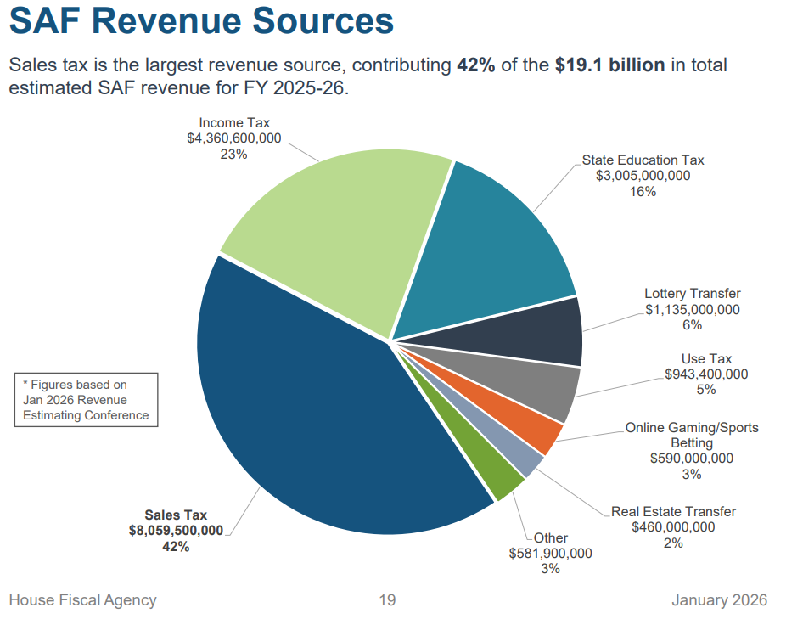
School Aid Fund Overview – FY 2025/26

Slide 8
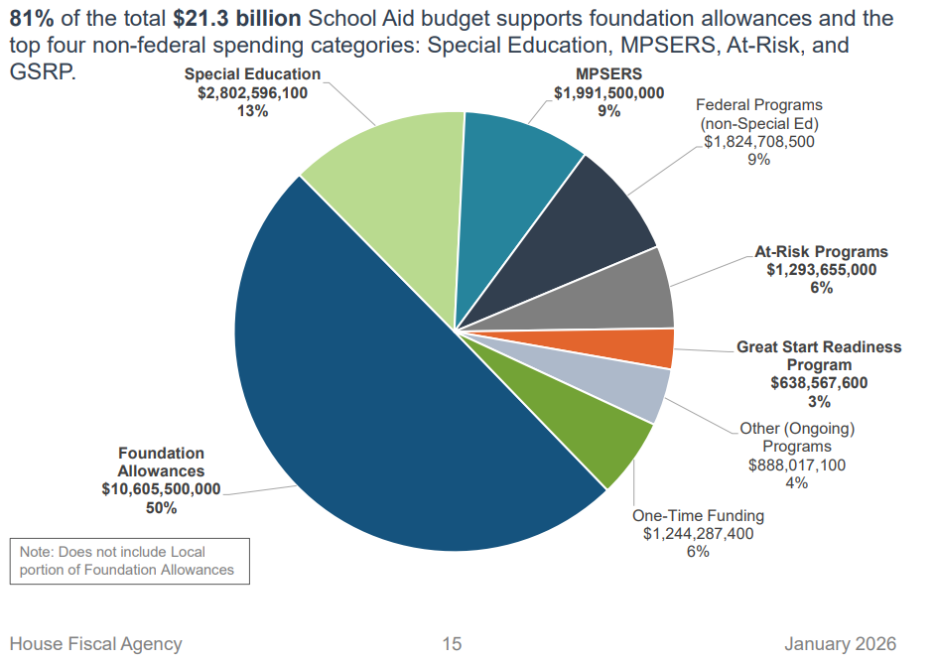
School Aid Appropriations – FY 2025/26

Slide 9
School Aid Appropriations – FY 2025/26
Down from 64% in FY 2019/20

Slide 10
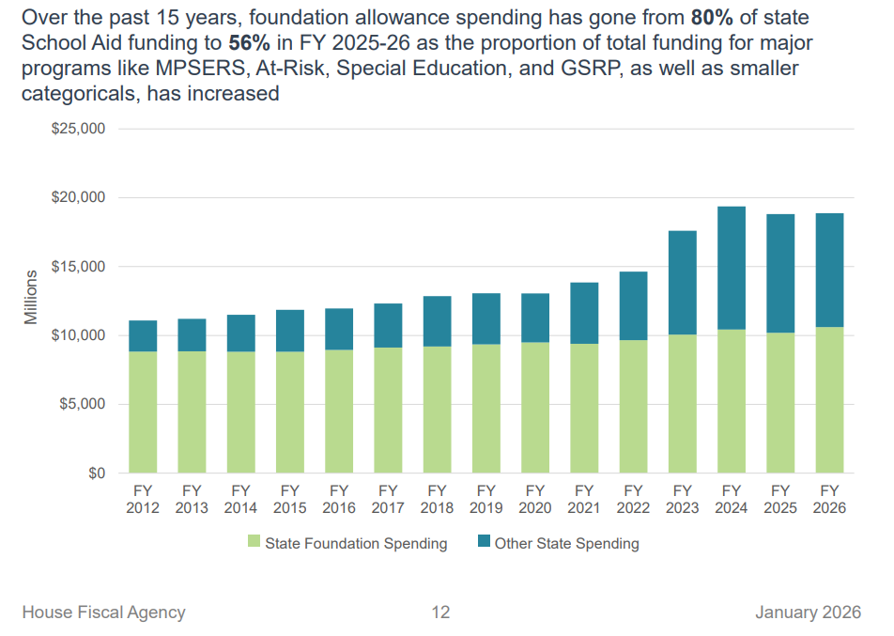
School Aid Appropriations History

Slide 11
Consensus Revenue Estimating Conference (CREC)
May 2026 CREC – some good news and positive revenue adjustments, however there are many reasons for caution
Both the General Fund (GF/GP) and School Aid Fund (SAF) are seeing slight increases to revenues, however due to significant expenditure increases, the GF/GP will start 26-27 with a baseline deficit of $1B
GF/GP pressures have already resulted in budget proposals that recommend significant expenditure shifts from GF/GP to SAF
Notes:
GF exp increases
Fed: Medicaid SNAP, increase every year thru 32 > Getting less so have to pay more
Early estimates are $450M more this year for Medicaid and $100M more for SNAP
Medicaid is state’s largest single expenditure

Slide 12
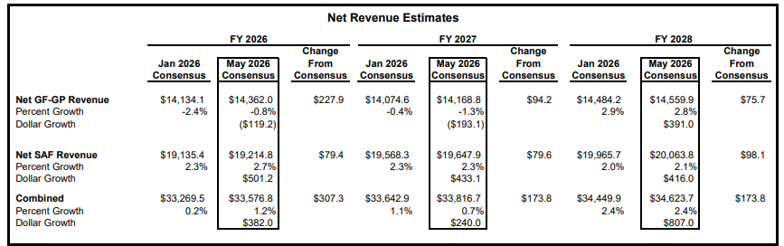
Consensus Revenue Estimating Conference (CREC)

Slide 13
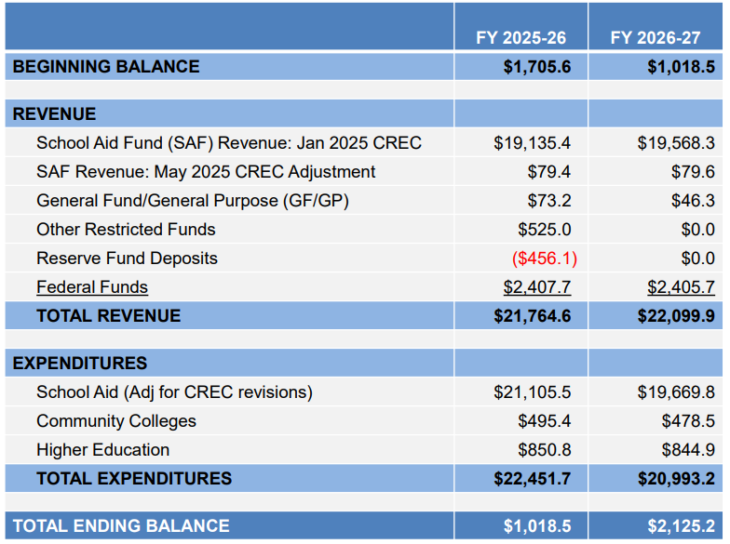
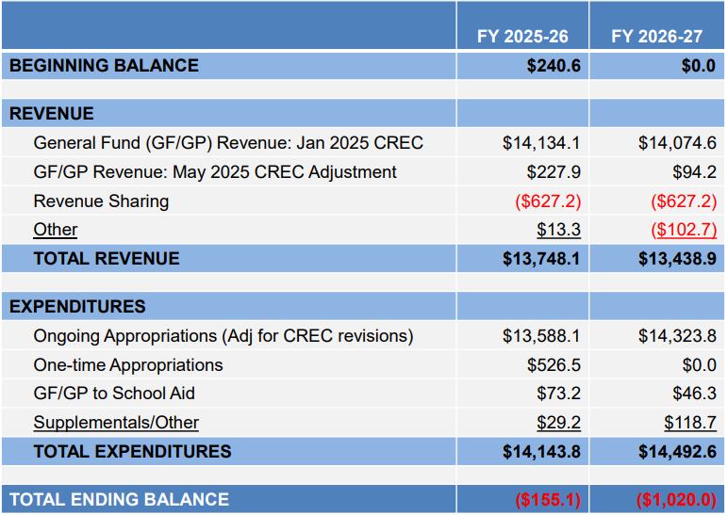
FY 2026/27 Baseline (Balance Sheets)
School Aid Fund
General Fund
Notes:
From HFA
All lines adjusted per today’s CREC
$20.993.2 is baseline, no increases, FG or otherwise
Could very well see an increase to the amount of SAF dollars going to higher ed.
GF/GP:
CREC revision leave current & next year with negative balances.
They need $1B just to make budget whole, not including Medicaid changes coming
The length of time gas prices are elevated will really determine if we see a much worse situation at the next CREC.

Slide 14
Community College & University Funding Paid by the School Aid Fund
(Millions)
Year | Community Colleges | Universities | Total | Per K12 Student
2010-11 | 0 | 0 | 0 | 0
2013-14 | 197.6 | 200.6 | 398.2 | 262
2016-17 | 260.4 | 237.1 | 497.5 | 334
2019-20 | 378.4 | 185.7 | 564.1 | 386
2022-23 | 448.6 | 547.9 | 996.5 | 712
2025-26 | 493.0 | 850.8 | 1,348.8 | 980
26-27 Proposed | 525.4 | 1,379.4 | 1,904.8 | 1,399
Notes:
$1,399 per pupil = $3,217,700

Slide 15
A presentation of the 2026-27 proposed budget and property tax millage rate proposed to be levied to support the budget is included in the remaining portion of this hearing

Slide 16
Wrapping Up the 2024-25 School Year
Updating the current year budget
  A Factor that sheds light on the upcoming year
Overall budget stability leads slightly favorable changes from January’s amendment, inclusive of:
  Increased Act 18 and Medicaid revenues
  Staffing adjustments and retirements
  Decreased Operations and Transportation costs
While the fund balance remains strong, the District needs to continue keeping an eye on enrollment trends and uncertainty in school funding

Slide 17
FY 2025-26 Budget Update | Current Budget | Proposed Amendment
Revenues | 38,794,200 | 38,977,900
Expenditures | 38,667,100 | 38,738,200
Excess Revenues (Expenditures) - (non-recurring) | 304,200 | 277,500
Excess Revenues (Expenditures) - (recurring) | (177,100) | (41,800)
Net Excess Revenues (Expenditures) | 127,100 | 235,700
Audited July 1, 2025 Fund Balance | 7,180,783 | 7,180,783
Projected June 30, 2026 Fund Balance | 7,307,883 | 7,416,483
Projected Fund Balance Percentage | 18.90% | 19.15%

Slide 18
FY 2026-27 Notable Revenue Assumptions
Blended enrollment of 2,293 student FTE (decrease of 10 FTE)
Without finalization of the School Aid Budget, using Governor’s proposal
  $250 increase in per-pupil funding ($10,300 per pupil)
  Net decrease in State categorical funding
Enhancement Millage funding estimated at $880,000
  Year 8 of 10
Indirect cost subsidy of $75,000 from the Food Service Fund

Slide 19
FY 2026-27 Notable Expenditure Assumptions
Employee Compensation Assumptions:
  Wages per negotiated contracts and other employment agreements
  Employer retirement contribution rate of 27.91%, effective October 2026
  Health insurance State-mandated hard cap increase of 3.00%
Impact of staff retirements/resignations and replacements; new programming to meet student needs
Inflationary increases to utilities and contracted services

Slide 20
FY 2026-27 General Fund Proposed Budget | FY 2025-26 Final Amended Budget | FY 2026-27 Proposed Budget
Revenues | 38,973,900 | 39,298,300
Expenditures | 38,703,400 | 39,116,900
Excess Revenues (Expenditures) - (non-recurring) | 277,500 | 606,600
Excess Revenues (Expenditures) - (recurring) | (41,800) | (425,200)
Net Excess Revenues (Expenditures) | 235,700 | 181,400
Projected Beginning Fund Balance | 7,180,783 | 7,416,483
Projected Ending Fund Balance | 7,416,483 | 7,597,883
Projected Fund Balance Percentage | 19.15% | 19.42%

Slide 21
2026-27 Proposed Operating Tax Levy
Voters approved a two year, 18.4894-mill levy for operations in May 2026. The 0.4894 mills in excess of the 18-mill cap on operational levies was approved as a hedge against potential Headlee rollbacks.
  As such, Spring Lake Public Schools will be levying the full 18.00 mills on non-homestead properties for the upcoming year.
The current authorization for levying the operating millage runs through December 2028.

Slide 22
2026-27 Proposed Debt Tax Levy
When bonds are approved, voters agree to tax themselves enough to repay the debt over a prescribed number of years.
Based on the Department of Treasury’s annually-required calculation, the District will levy 7.00 mills for the upcoming year, the same rate that was levied for the current tax year.

Slide 23
Next Steps
At its regular meeting tonight, the Board will take action on:
  2026-27 Original Budget Resolution
  2026 Operating Tax Levy
  2026 Debt Tax Levy
This presentation will be available on the District’s website beginning June 17, 2025

Slide 24
Thank you!

