Slide 1

NEW TITLE IX REGULATIONS
SEXUAL HARASSMENT
Training Materials for Investigators AND Decision-makers
Presented 10/21/20

Slide 2
Why Are We Here?
The new Title IX regulations require that all Title IX Coordinators, investigators, decision-makers, and any person who facilitates an informal resolution must receive training. See 106.45(b)(1)(iii).

Slide 3
New Title IX Regulations Require Training on:
The definition of sexual harassment in § 106.30
The scope of the recipient’s education program or activity
How to conduct an investigation and grievance process including hearings, appeals, and informal resolution processes, as applicable
How to serve impartially, including by avoiding prejudgment of the facts at issue, conflicts of interest, and bias
Issues of relevance of questions and evidence, including when questions and evidence about the complainant’s sexual predisposition or prior sexual behavior are not relevant, as set forth in paragraph (b)(6) of this section
Issues of relevance to create an investigative report that fairly summarizes relevant evidence, as set forth in paragraph (b)(5)(vii) of this section

Slide 4
Title IX Grievance Procedures
Notes before we start:
All timelines are instructional/school days
* Asterisk denotes suggestions, not mandated
    Example: Regulations say “prompt” response to actual knowledge of harassment. We suggest that means 2 school days.
Suggested roles for school staff:
    Investigator = Title IX Coordinator
    Decisionmaker = Superintendent
    Appeal = One school board member, attorney, neighboring superintendent (flexible)

Slide 5
INVESTIGATOR
Title IX Coordinator
1. Lead on investigation (use building-level admin as needed)
2. Responsible for communication with parties
DECISIONMAKER
Superintendent
1. Makes ultimate decision
2. Hands out discipline if necessary
APPEAL
One school board member
1. Can fluctuate depending on availability/training
2. Doesn’t taint the entire board if there is a teacher cancellation hearing or student expulsion appeal

Slide 6


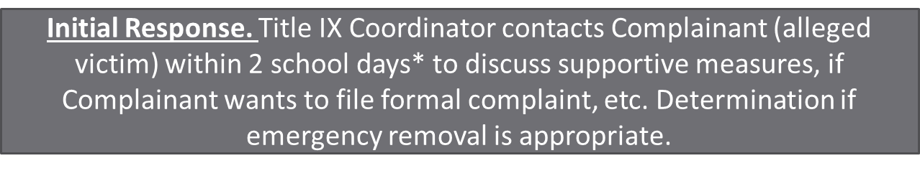


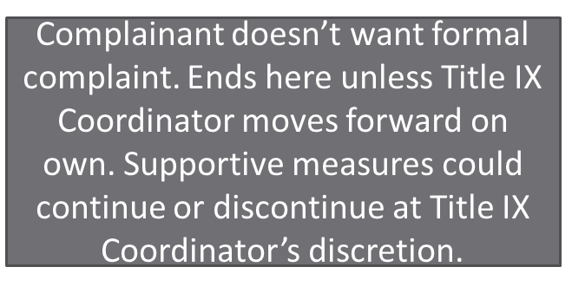
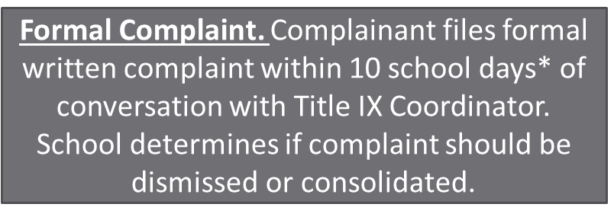

Title IX Grievance Procedures Flowchart

Slide 7








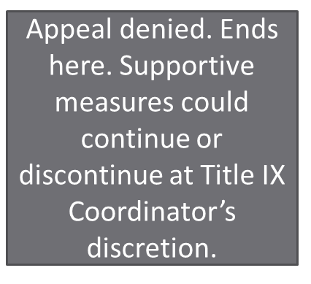

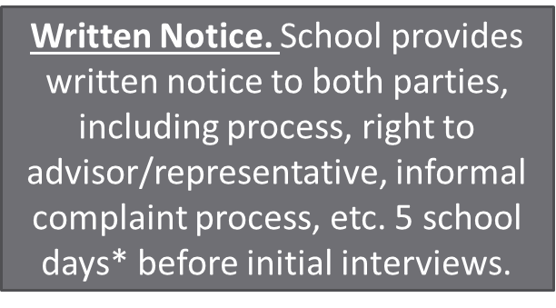

Slide 8




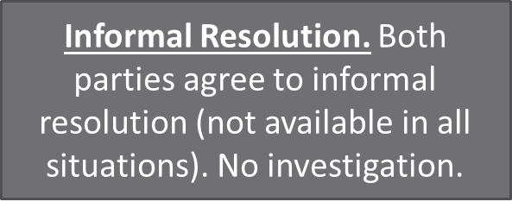
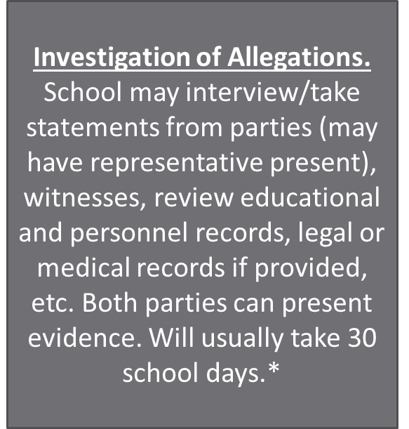

Slide 9


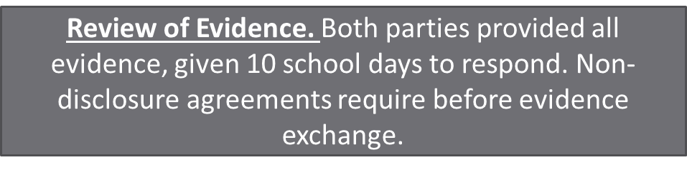


Slide 10
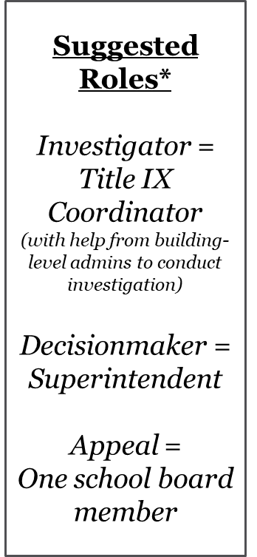

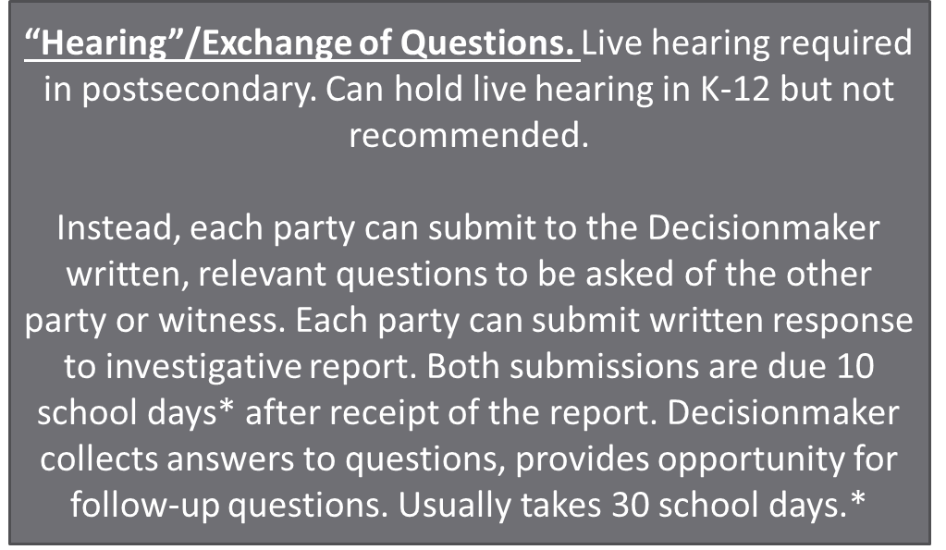


Slide 11


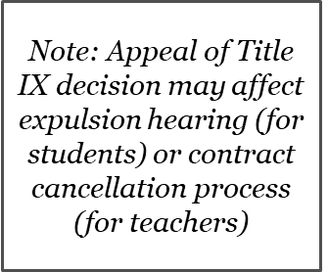



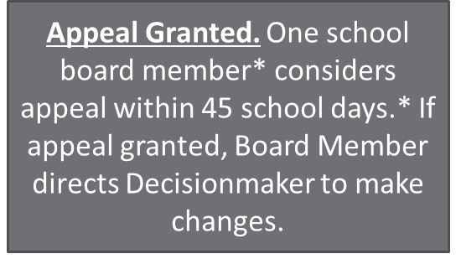


Slide 12
Reports vs. Formal Complaints

Slide 13


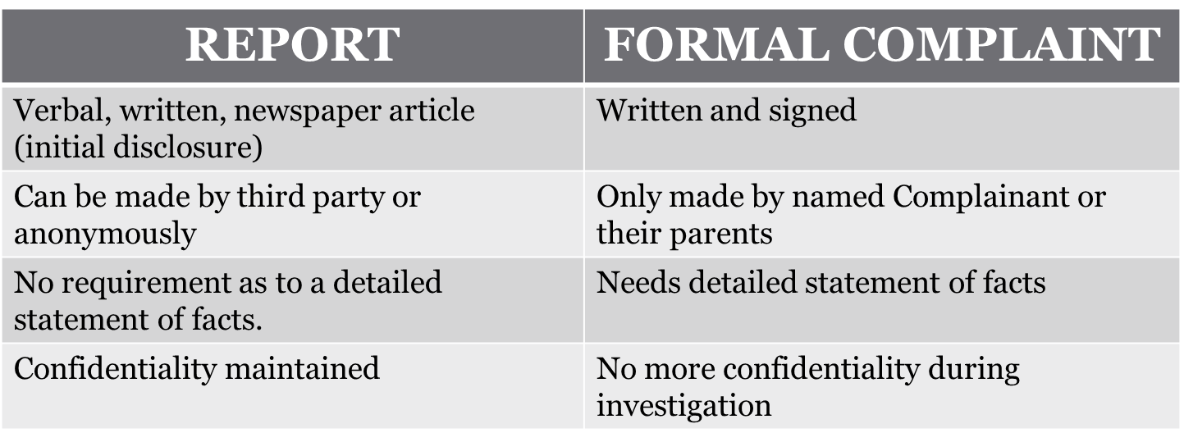
Notes:
First, an important clarification.

Slide 14
Similarities
Supportive measures put in place regardless of report or formal complaint
Respondent may be removed from an education program or activity on an emergency basis (immediate threat to physical health or safety of any individuals arising from the allegations), whether or not a formal complaint is pending.
Notes:
First, an important clarification.

Slide 15
Response to Report
  Response obligations must include:
  Offering supportive measures to Complainant (alleged victim), and
  Title IX Coordinator contact the Complainant to discuss the availability of supportive measures with or without the filing of a formal complaint, consider the Complainant’s wishes regarding supportive measures, and explain the process for filing a formal complaint.
Notes:
First, an important clarification.

Slide 16
1. The Definition of Sexual Harassment

Slide 17
Sexual Harassment, Type 1
Sexual harassment means conduct on the basis of sex that satisfies one or more of the following:
A school employee conditioning the provision of an aid, benefit, or service of the recipient on an individual's participation in unwelcome sexual conduct
    This is the quid pro quo (something for something else) type.

Slide 18
Sexual Harassment, Type 2
Unwelcome conduct determined by a reasonable person to be so severe, pervasive, and objectively offensive that it effectively denies a person equal access to the recipient's education program or activity
  With the 3rd prong covering most everything physical, this prong is focused on verbal or written/electronic forms of harassment.
  Standard is subjective with respect to the unwelcome-ness of the conduct (i.e., whether the complainant viewed the conduct as unwelcome), but as to elements of severity, pervasiveness, objective offensiveness, and denial of equal access, determinations are made by a reasonable person in the shoes of the complainant.

Slide 19
Why severe “and” pervasive?
Rationale for preventing a hostile workplace environment free from any severe or pervasive sexual harassment that alters conditions of employment does not allow for the social and developmental growth of young students learning how to interact with peers in the elementary and secondary school context and fostering robust exchange of speech, ideas, and beliefs in a college setting. Thus, the Department does not believe that aligning the definitions of sexual harassment under Title VII and Title IX furthers the purpose of Title IX or benefits students and employees participating in education programs or activities.
In other words, U.S. Dept. of Education thinks the nature of education means a higher quantity of low grade offensive speech must be tolerated as part of free expression.
While non-severe instances of unwelcome harassment may negatively impact a person, and schools retain authority to address such instances, Title IX is focused on sex discrimination that jeopardizes educational access.
In other words, U.S. Dept. of Education thinks sex-based conduct toward students must be severe to rise to the level of sexual harassment.

Slide 20
Sexual Harassment, Type 3
"Sexual assault" (as defined by the Jeanne Clery Disclosure of Campus Security Policy and Campus Crime Statistics Act at 20 USC 1092 (f)(6)(A)(v));
"dating violence" (as defined by the Violence Against Women Act at 34 USC 12291 (a)(10));
"domestic violence" (as defined by the Violence Against Women Act at 34 USC 12291 (a)(8)); or
"stalking" (as defined by the Violence Against Women Act at 34 USC 12291 (a)(30)).

Slide 21
More on SH Type 3
  “Fondling,” defined under the Clery Act (referring to the FBI’s Uniform Crime Reporting system), as “the touching private body parts of another person for the purpose of sexual gratification, without the consent of the victim,” is the only type of sexual harassment that depends on the intent or purpose of the perpetrator or victim.
  While the sexual harassment definition does not identify “grooming behaviors” as a distinct category of misconduct, some grooming behaviors may constitute sexual harassment, and behaviors that do not constitute sexual harassment may still be deemed inappropriate behavior addressed under other areas of policy, procedure, and/or handbook.

Slide 22
2. The Scope of the Recipient’s Education Program or Activity

Slide 23
Educational Program or Activity
34 CFR 106.44(a)
Schools must respond when sexual harassment occurs in the school’s education program or activity, against a person in the United States.
Education program or activity includes locations, events, or circumstances over which the school exercised substantial control over both the respondent and the context in which the sexual harassment occurs, and also includes any building owned or controlled by a student organization that is officially recognized by a postsecondary institution.

Slide 24
Triggering Title IX
Off-campus incidents incur Title IX response:
  if the off-campus incident occurs as part of the recipient’s “operations” pursuant to 20 U.S.C. 1687 and 34 CFR 106.2(h);
  if the recipient exercised substantial control over the respondent and the context of alleged sexual harassment that occurred off campus pursuant to § 106.44(a); or
  if a sexual harassment incident occurs at an off-campus building owned or controlled by a student organization officially recognized by a postsecondary institution pursuant to §106.44(a).
If complainant is no longer enrolled when the complaint is filed, or if the perpetrator is no longer enrolled or employed, no reason for the school to do a investigation because the school can’t do anything.

Slide 25
Example of Defining Scope
For the purposes of Title IX, the scope of the Corporation’s educational program or activities includes locations, events, or circumstances over which the Corporation exercises substantial control over both the respondent and the context in which the sexual harassment occurs [only for postsecondary: and also includes any building owned or controlled by a student organization that is officially recognized by a postsecondary institution.]
This includes all activities taking place within a school building or on Corporation property; any athletic, extracurricular, or co-curricular activity officially recognized by the Corporation and led by a Corporation employee; computer and internet networks, digital platforms, and computer hardware or software owned or operated by, or used in the operations of, the Corporation.

Slide 26
3. How to Conduct an Investigation and Grievance Process

Slide 27
Non-Disclosure Agreement

Slide 28
Interview Complainant
  Identify – who, what, when, where.
  Specific descriptions of incident(s)
  Similar experiences in the past
  Determine what offended Complainant
  Impact on Complainant
  Discuss complainant’s response
  Identify Witnesses
  What relief is being requested

Slide 29
Other Interviews
  Potential witnesses named by Complainant
    Purpose for interview – investigating allegations against {Individual}
    Complainant indicated you might have information
    Who/when/why/how of what you did or did not witness or hear
    Ask that they not discuss the interview (NDA)
    Explain no retaliation for telling the truth
In closing
    Any other information?
    Contact me if you remember anything, or if observe anything relevant.

Slide 30
Respondent Interview
  Define the allegation at issue
  Ask to identify situations where he/she harassed others or engaged in behavior in violation of rule
  Confront with general allegations
  Confront with more specifics
    Note responses
  Permit him/her to offer evidence/witnesses
  Ask that they not discuss the interview (NDA)
  Explain no retaliation against complainant

Slide 31
Other Interviews
  Potential witnesses named by Respondent
  Same general questions as other witnesses
  Ask that they not discuss the interview (NDA)
  Explain no retaliation against complainant
Complainant and/or Respondent (Follow Up)
  If necessary
  Clarify allegations and inconsistencies
  Gather additional information

Slide 32
Review of Records and Evidence
Review Personnel/Student Files
  Look for patterns
  Prior relationships
Review other Contemporaneous Evidence
  Video
  Log Sheets
  Phone and e-mail records
  Records made at the time of allegations

Slide 33
Analyzing the Evidence
Credibility Decisions
  Bias
  History of Similar Conduct
  Corroboration
  Other Discipline
  Eye contact, voice tone, demeanor during interviews.
Determine if Substantiated
  Review notes, statements and other evidence

Slide 34
Inspection and Review of Evidence
Must provide all evidence, even that not relied upon to the parties for inspection, parties have 10 days to respond
Evidence must be “directly related to the allegations”
  Non-treatment records and information, such as a party’s financial or sexual history, must be directly related to the allegations at issue in order to be reviewed by the other party.
  School has discretion on how to provide the evidence.
  May redact information not directly related to the allegations.
  “Confidential” information may not be redacted if directly related to the allegations.
106.45(b)(5)(vii)

Slide 35
Investigative Report
“Create an investigative report that fairly summarizes relevant evidence and, at least 10 days prior to a hearing (if a hearing is required under this section or otherwise provided) or other time of determination regarding responsibility, send to each party and the party’s advisor, if any, the investigative report in an electronic format or a hard copy, for their review and written response.”
106.45(b)(5)(vii)
The regulations do not proscribe how to incorporate the parties’ response into the final determination.

Slide 36
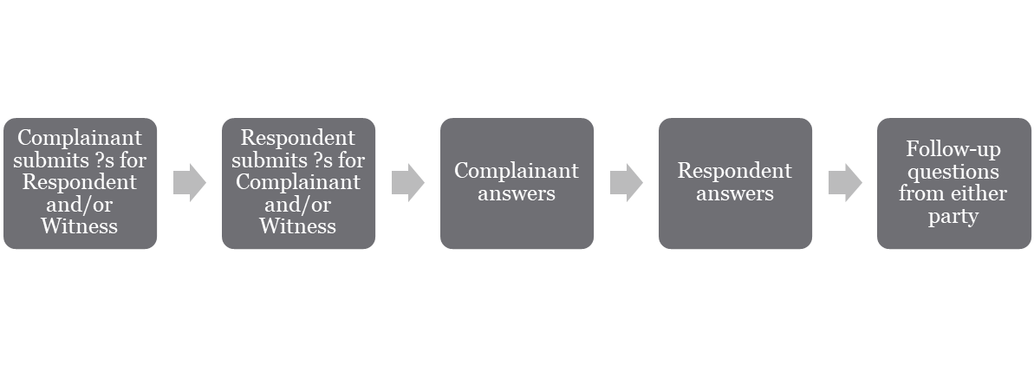
Submission of Written Questions
After the recipient has sent the investigative report to the parties pursuant to paragraph (b)(5)(vii) of this section and before reaching a determination regarding responsibility, the decision-maker(s) must afford each party the opportunity to submit written, relevant questions that a party wants asked of any party or witness, provide each party with the answers, and allow for additional, limited follow-up questions from each party.
106.45(b)(6)(ii)
Notes:
First, an important clarification.

Slide 37
Determination
Must include:
Identification of the allegations potentially constituting sexual harassment;
A description of the procedural steps taken from the receipt of the formal complaint through the determination, including any notifications to the parties, interviews with parties and witnesses, site visits, methods used to gather other evidence, and hearings held;
Findings of fact supporting the determination;
Conclusions regarding the application of the recipient’s code of conduct to the facts;
A statement of, and rationale for, the result as to each allegation, including a determination regarding responsibility, any disciplinary sanctions the recipient imposes on the respondent, and whether remedies designed to restore or preserve equal access to the recipient’s education program or activity will be provided by the recipient to the complainant; and
The recipient’s procedures and permissible bases for the complainant and respondent to appeal.

Slide 38
Optional Hearing
“For recipients that are elementary and secondary schools, and other recipients that are not postsecondary institutions, the recipient’s grievance process may, but need not, provide for a hearing.”
106.45(b)(6)(ii)
May, but need not provide a hearing for K-12.
Footnote in comments indicate decision to hold a hearing could be made on a case-by-case basis.

Slide 39
It’s All About the Process
OCR and Courts will generally not second-guess the outcome of an investigation, as long as the investigation is done according to policy and appropriate standards
READ, RE-READ, ASK QUESTIONS, FOLLOW THE POLICY + PROCEDURES

Slide 40
Follow Up!
Retain documentation (7 years)
  Complete notes and reports
  Ensure everything signed and dated
Check in with Complainant
Check in with Respondent (if still employed)
Review policies and procedures

Slide 41
4. How to Serve Impartially

Slide 42
Role of Title IX Coordinator
Impartial Investigator and Consultant
Trained to understand Title IX, analyze whether something rises to level of substantiation
Title IX Coordinator’s delegates (building administrators, counselors, etc.) conduct “on the ground” investigation at her delegation
Determines if harassment is substantiated based on preponderance of the evidence, writes formal report
Coordinates with legal counsel as necessary

Slide 43
Single Investigatory Model Prohibited
“The decision-maker(s), who cannot be the same person(s) as the Title IX Coordinator or the investigator(s), must issue a written determination regarding responsibility.” 106.45(b)(7)(i).
Title IX Coordinator not required to investigate, but cannot be the decision maker.

Slide 44
Conflicts of Interest
Two types: Legal conflicts (less common in this situation) and Perceived conflicts (more common)
Person named as Harasser or Witness ≠ Member of investigatory team
If district-level administrator, board member, or Title IX Coordinator is named as Harasser or Witness, good idea to call in outside investigator

Slide 45
5. Issues of Relevance of Questions and Evidence

Slide 46
Evidence that Must Be Deemed Irrelevant, with Exceptions
Questions and evidence about a Complainant’s sexual predisposition must always be deemed irrelevant, and therefore excluded.
Questions and evidence about a Complainant’s prior sexual history must be deemed irrelevant, and therefore excluded- with two limited exceptions:
1. Where Respondent contends that someone other than the respondent committed the misconduct
2. Where the question(s) or evidence concern incidents between the Complainant and Respondent and are offered to prove consent.

Slide 47
6. Issues of Relevance to Create an Investigative Report that Fairly Summarizes Recent Evidence

Slide 48
Issues of Relevance to Create an Investigative Report
  Evidence is relevant if it has “any tendency” to make a fact that is “of consequence” to the determination of sexual harassment “more or less probably that it would be without the evidence.”
      The evidence must be directed to a matter of consequence, essentially the definition of sexual harassment.
      The evidence must be probative – it must make something more or less probative. It does not have to be in dispute. Whether something is more or less likely is guided by logic and human experience.

Slide 49
Issues of Relevance to Create an Investigative Report
Example: Defendant is bank robbery case was overheard saying he wanted to rob the bank, human experience tells us that when someone says they will do something, they are more likely to do it.

