Slide 1

EMS 101
For Incoming 6th graders and New students for the 26-27 school year

Slide 2




  Receive EMS and LWSD’s messages in ONE central place.
  Send messages to Teachers.
  Student grades
  Late/missing work
  Communicates how students are doing in class
  Student assignments
  Due dates
  Assignment worksheets
LWSD’s single sign-in tool for all programs.
The password is the same as their laptop log-in password

Slide 3
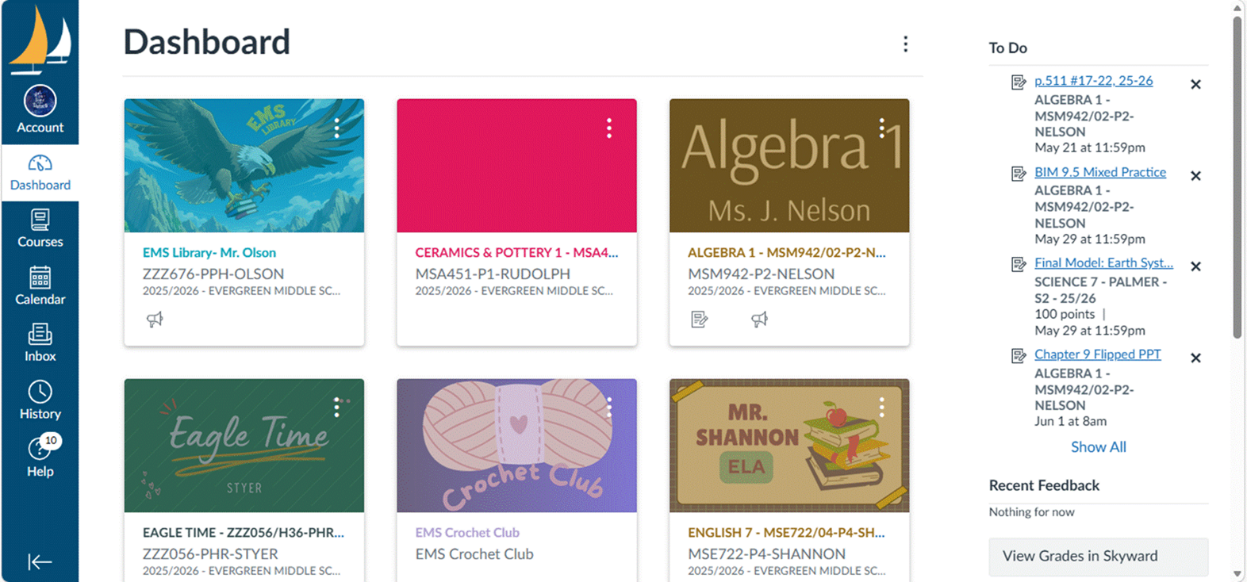
CANVAS

Slide 4
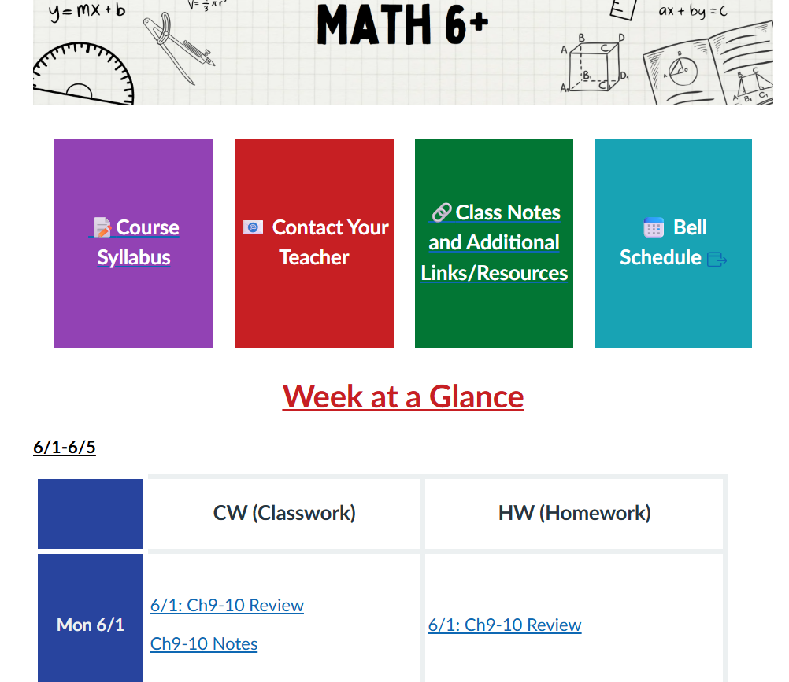
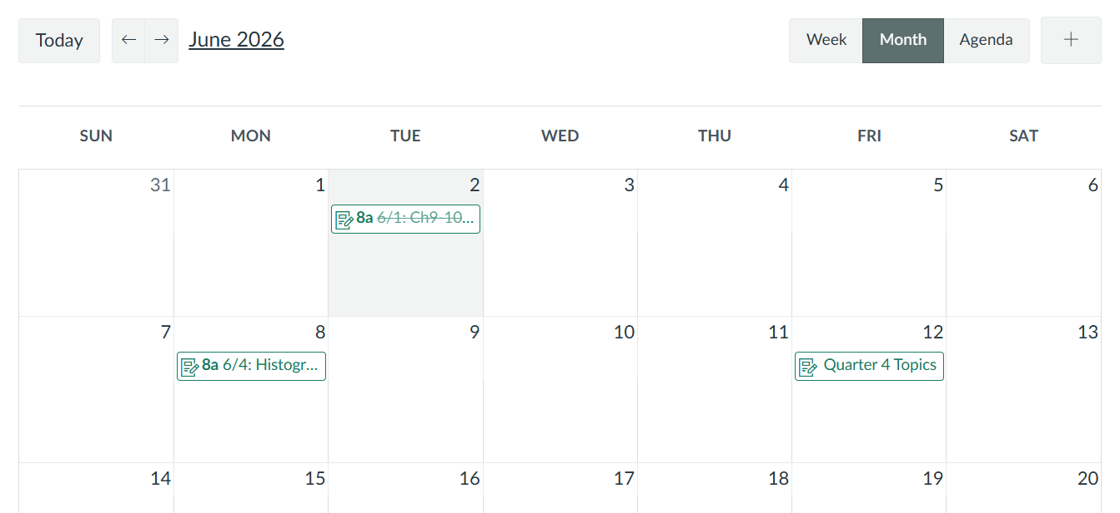
CANVAS

Slide 5

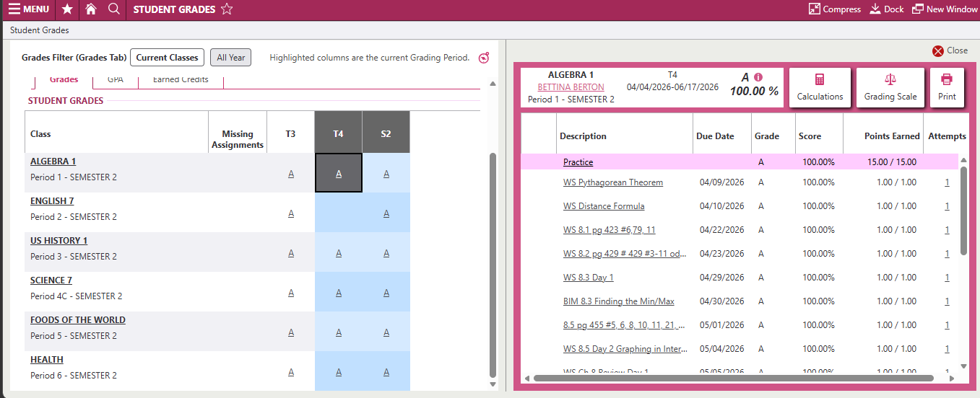
Skyward

Slide 6
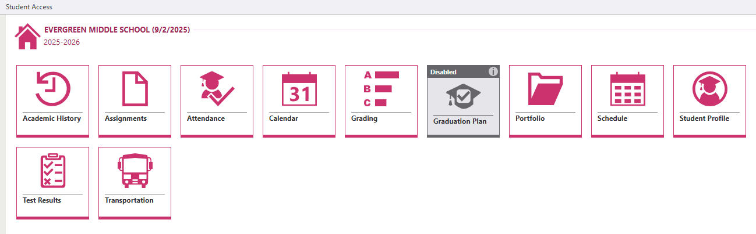
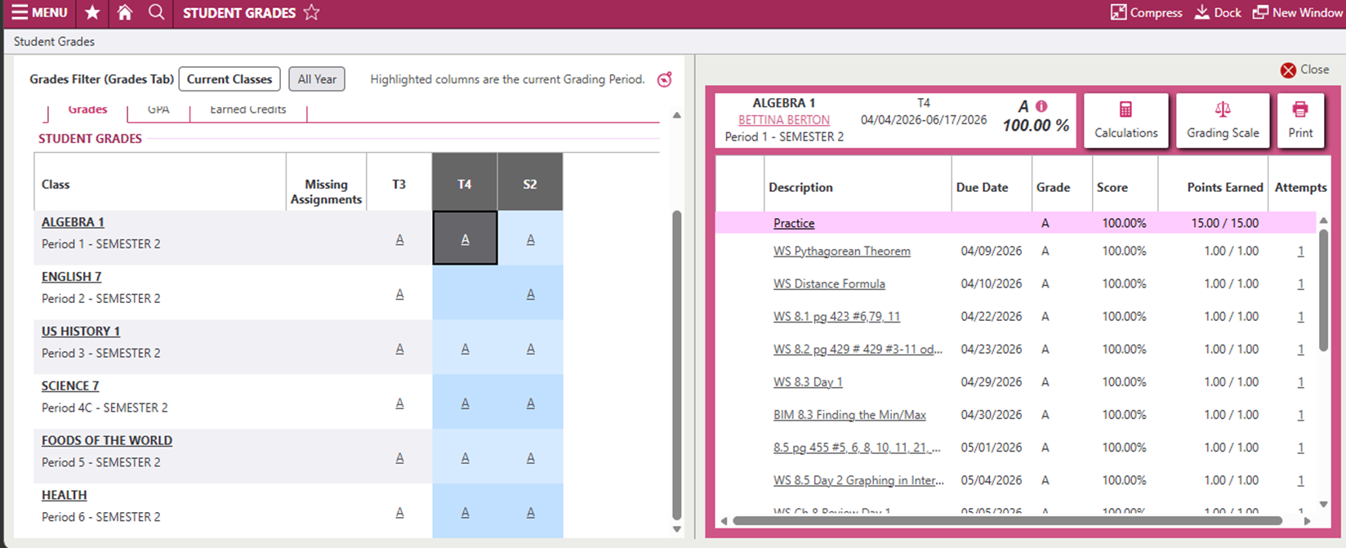
Skyward

Slide 7




Other Apps
There are a wide variety of apps and sites that students will use throughout the school year, and most can be found on ClassLink.
Information regarding class-specific apps and textbooks will be introduced to students as needed by teachers.
Amplify

Slide 8
How does EMS support your student at school?
Eagle Time
Two 40 min periods with same 20 students
Engages students in social emotional learning
Builds class and school community
All school events (Fun Run, Assemblies)
FLEX
Time built into the school day for:
  Academic Intervention
  Enrichment
  Clubs/Activities
Students sign up for two 40-minute sessions each week or teachers may request students to their FLEX to catch-up missing work, take a tests etc.

Slide 9
Sarah Parnell (Last Names A-I)
(sparnell@lwsd.org)
Dylan Slatton (Last Names J-N)
(dslatton@lwsd.org)
Denise Ozeri (Last Names O-Z)
(dozeri@lwsd.org)
Stephanie Lundquist (Y.E.S. Counselor)
Counselors
Help with…
Academic planning and success
Conflict resolution
Crisis intervention
Community and counseling referrals
Preparation for high school

Slide 10

Extracurricular Activities & Clubs
Provides students with opportunities to make new friends and explore interests and build community.
  during school (during Flex)
  after school
    EMS sponsored activities
    PTSA sponsored activities
    No transportation after school

Slide 11
During School: EMS Sponsored Clubs & Interest Clubs
Clubs
Anime
Battle of the Books (BOB)
Chess
Pride Club
Table Tennis
Yearbook
Green Team
Dungeons & Dragons
Cost $
None or Minimal.
Registration
During the school year.
Students sign up when they attend the respective Flex session.

Slide 12
After School: EMS sponsored sports 2025-2026
Cost $
There will be fees for ASB and individual sports
Scholarships available!
Sports offered throughout the year
Badminton
Basketball
Cross Country
Soccer
Tennis
Track
Volleyball
Wrestling
Registration
Students need their physical done during the summer! Check your email in July as all forms are digital
Physical is good for up to 2 years

Slide 13

After School: PTSA Sponsored Clubs offered in 2025-2026
Cost $
Fees vary
Sometimes travel & hotel cost
Scholarships available!
Theater Club
Robotics Club
Math Club
National Science Bowl Club
Science Olympiad Club
Chess Club
Reflections National Arts Competition
Spelling Bee (Scripps National Spelling Bee)
Coding Club
Registration
Starts before school starts
Closes about 1-2 weeks into school
Register and check deadlines at www.Evergreenptsa.org

