Slide 1
USPS
FYE Closing Procedures
2026

Slide 2
Pre-Closing Procedures

Slide 3
Process Life Insurance Premium Payments
  For employees retiring as of 6/30 with life insurance coverage > $50,000
  Process Life Insurance Premium Payment by final June Pay
  Reference IRS Publication 15-B (Pages 15-16)
  SSDT Life Insurance Premium Taxable Amount
Notes:
Note - Can do an adjustment afterwards if forgotten

Slide 4
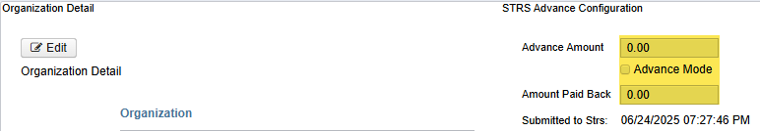
Verify STRS Advance from 2025 is Cleared
Core > Organization > Advance Amount & Amount Paid Back are both $0 and “Advance Mode” box is unchecked

Slide 5
Run STRS Advance Reports
Go to Reports > STRS Reporting > STRS Advance > Date Range 7/1/25 – 6/30/26
Advance Fiscal Year to Date Report
Advanced Positions Report
Non-Advance Positions Report

Slide 6
Advance Fiscal Year to Date Report
Report of all STRS employees. Also includes service credit, STRS days, earnings, STRS employee amount, advance amount, and rehired retiree.

Slide 7
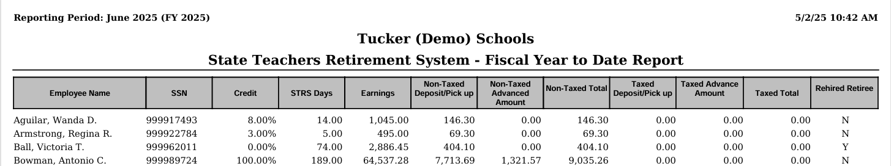
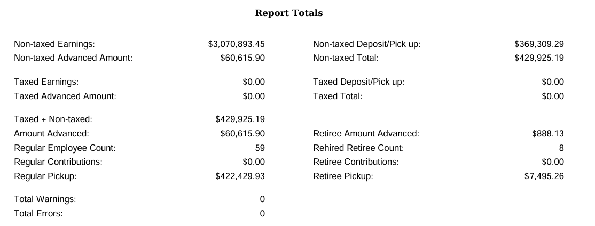
Advanced FYTD Report Example
Notes:
Note – Attendance Days must have Pay Dates stamped, show on grid how to filter

Slide 8

Advanced FYTD Report ctd.
Verify Service Credit:
Full time employees that have 120+ work days receive 100% credit.
Employees with less than 120 days receive credit based on STRS decision tree.
Employees flagged as part-time receive service credit based on STRS decision tree.
  450 Payroll Item > Full Or Part Time selection
(Please contact STRS will questions regarding full or part time status.)
STRS Decision Tree
STRS Calculating Service Credit

Slide 9

Advanced FYTD Report ctd.
Retire/Rehire:
Rehired Retiree box on 450 Payroll Item should be checked.
Re-employed retirees will always have 0% Service Credit and their Rehired Retiree flag = Y.
Calculated service credit > 0% for an employee flagged as a rehired retiree will flag a warning.
Notes:
Note – If R/R box was not checked, check it & adjustments will need done. If R/R box was checked late, adjustments will need done.

Slide 10
Advanced Positions Report
Report of all positions advancing. Also includes service credit, contract amount due, advanced amount, and rehired retiree.
Days Worked = Contract Work Days
Pays Paid ≠ Pays in Contract

Slide 11
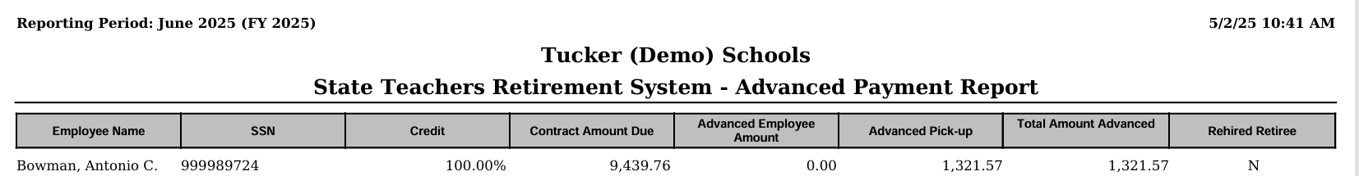
Advanced Positions Report Example

Slide 12
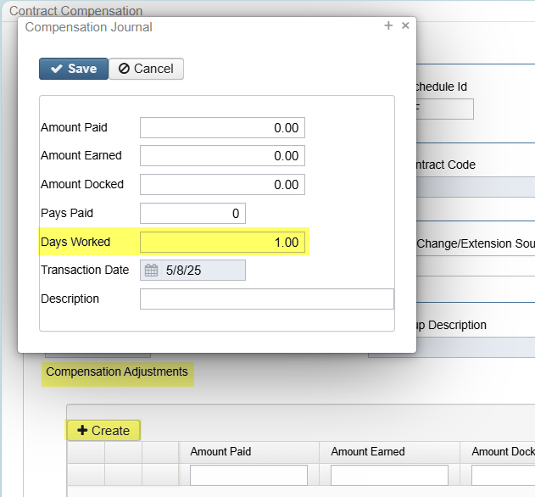
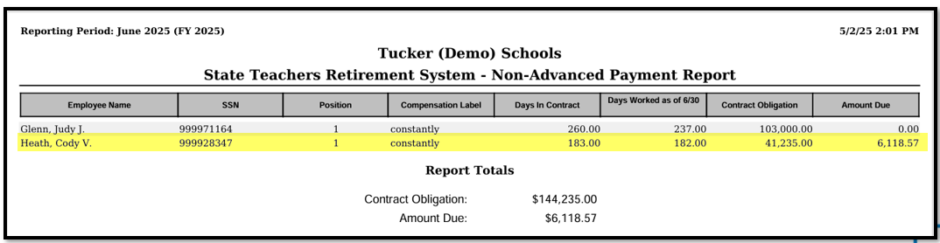
Advanced Positions Report Ctd.
  If an employee is on the Non-Advanced Report and needs to advance, go to the Compensation screen and use the Compensation Adjustment > Days Worked to adjust 'Days Worked as of 6/30’
Notes:
Note – if multiple people need adjusted, add days to weekends on job calendar

Slide 13
Non-Advanced Positions Report
Report of positions not advancing. Also includes days in contract, days worked as of June 30, contract obligation, and amount due.
Days Worked ≠ Contract Work Days
Pays Paid ≠ Pays in Contract
(Employees not on either report: Days Worked = Contract Work Days & Pays Paid = Pays in Contract)

Slide 14
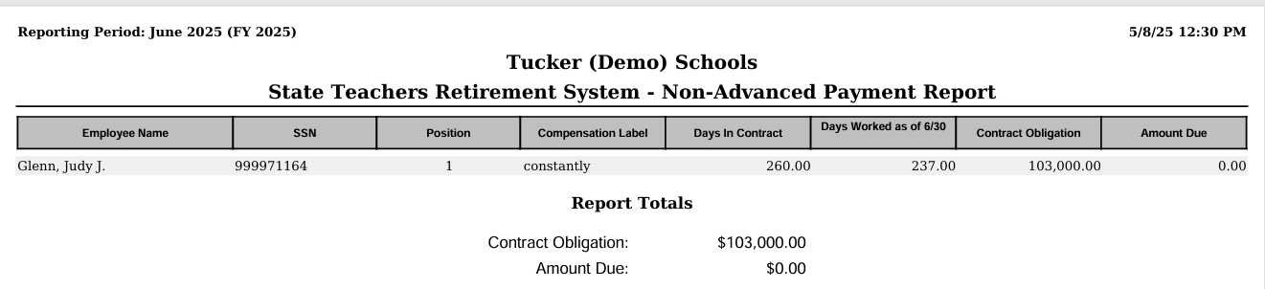
Non-Advanced Positions Report Example

Slide 15
Month-End Closing

Slide 16
Month-End Closing
Balance payroll clearance account
Process any monthly outstanding payables
Verify all outstanding payables
Run STRS Monthly (Optional)
Run SERS Monthly (Optional)
Run CENSUS Report (Optional)
Run AFFORD (Affordable Care Act) Report (Optional)
Process benefit accruals
Verify if any adjustments need to made for weeks, days, or hours for ODJFS, SERS, and STRS
SSDT Month-End Checklist

Slide 17
Quarter-End Closing

Slide 18
Quarter-End Closing
Balance Quarter Report
Balance W2 Report
Verify all outstanding payables
Balance all board paid payroll items
Complete and file all quarter submission forms
Balance and submit ODJFS
SSDT Quarter-End Checklist

Slide 19
Fiscal Year-End Closing

Slide 20
Run Following Reports
Wage Obligation Reports
  Reports > Wage Obligation Reports > both reports, both PDF & CSV
Benefit Obligation Reports
  Reports > Benefit Obligation Reports > both reports, both PDF & CSV
SERS Surcharge Report
  Reports > SERS Reporting > SERS Surcharge Report
Notes:
Note – Treasurer’s use these for auditors

Slide 21
STRS Advance
After all June pays are completed and before processing STRS Advance, consider:
  Early contract payoffs – calculate and update Compensation screen
  Any docks over the summer
    Enter the dock information in Payroll Payments - Future. After the advance has been processed, the dock should be deleted from Future and processed at the appropriate time

Slide 22
STRS Advance ctd.
Run and balance all STRS reports:
Go to Reports > STRS Reporting > STRS Advance > Date Range 7/1/25 – 6/30/26
Advance Fiscal Year To Date Report
Advance Positions Report
Non-Advanced Positions Report

Slide 23
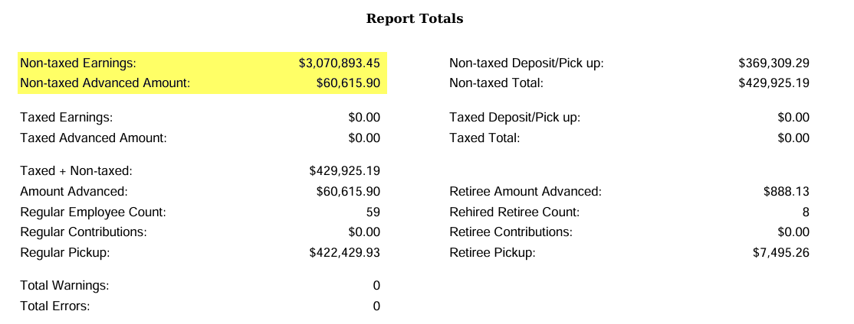
Balancing Advanced FYTD Report
Non-taxed Earnings – FYTD gross amounts from the 450 Payroll Items + Accrued Wages.
Non-taxed Advanced Amount –
Retirement amount that will be withheld on summer pays on a per pay per compensation basis.

Slide 24
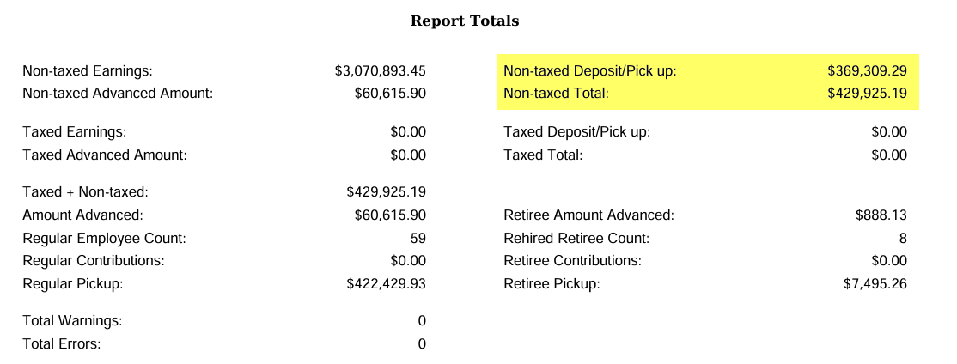
Balancing Advanced FYTD Report
Non-taxed Deposit/Pick up =
Payments to STRS for the 591 and 691 for the FY (minus Advance Payments from previous FY)
Non-taxed Total = Non-taxed Deposit/Pick up + Total Advance Amount

Slide 25
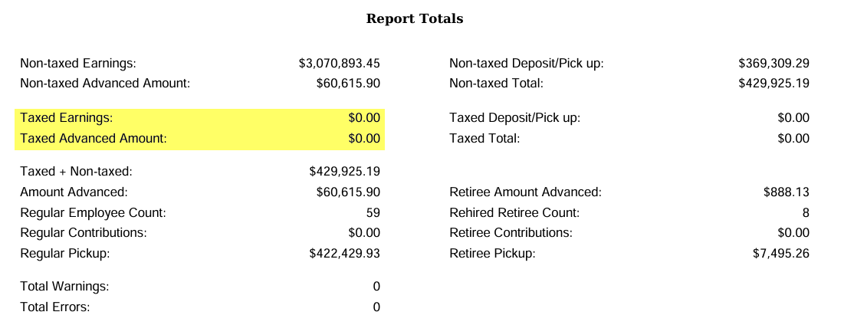
Balancing Advanced FYTD Report
Taxed Earnings = Not common. Most STRS contributions are annuitized.
Taxed Advanced Amount = Not common. Most STRS contributions are annuitized

Slide 26
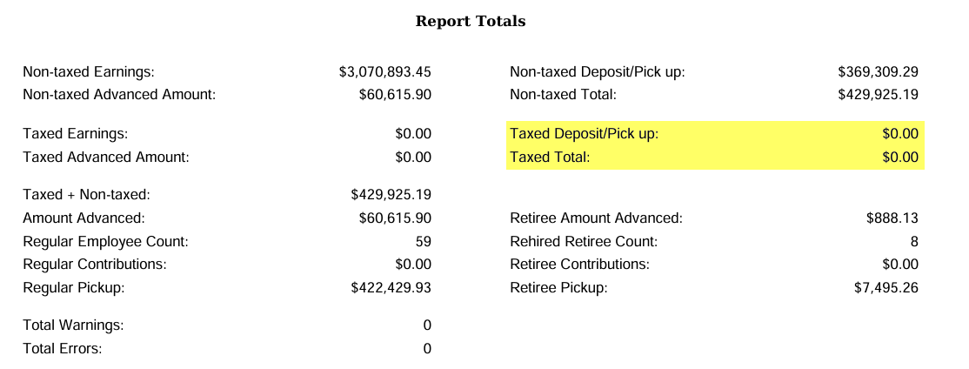
Balancing Advanced FYTD Report
Taxed Deposit/Pick Up = Not Common. Most STRS
contributions are annuitized
Taxed Total = Not Common. Most STRS contributions are annuitized

Slide 27
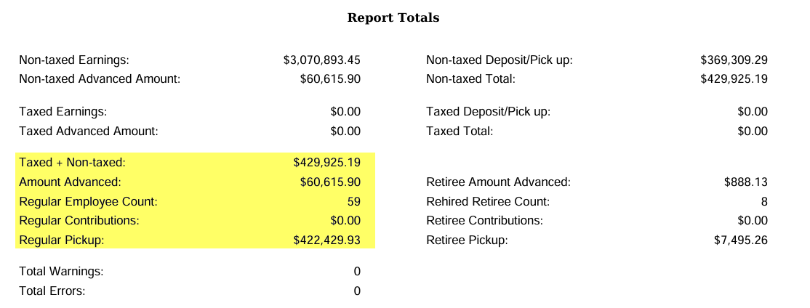
Balancing Advanced FYTD Report
Taxed + Non-taxed = Amount paid to STRS during the fiscal year + Amount Advanced.
Amount Advanced = Retirement amount that will be withheld on summer pays on a per pay per compensation basis.
Regular Pickup = Taxed + Non-taxed – Retiree Pickup

Slide 28
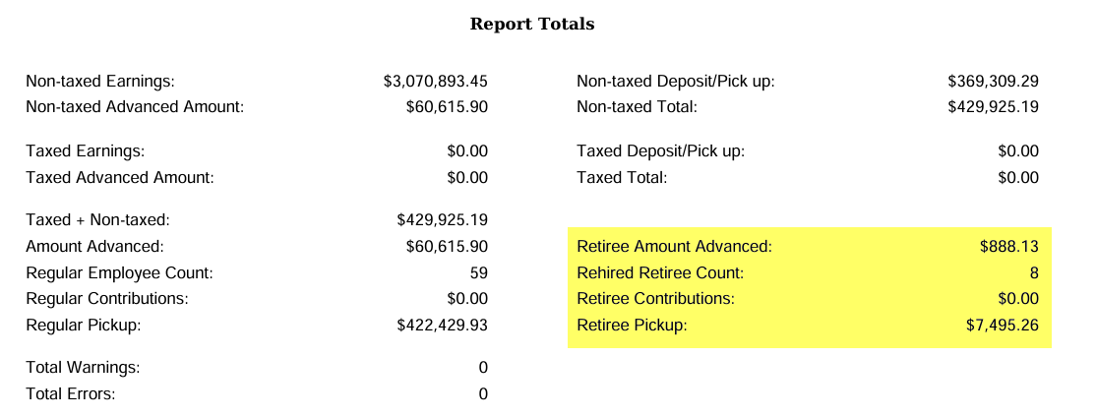
Balancing Advanced FYTD Report
Retiree Amount Advance, Rehired Retiree Count, Retiree Contributions, and Retiree Pickup = Specific to those employee’s whose 450 Payroll Item > Rehired Retiree checkbox is checked.

Slide 29
Sample Advanced Pick-Up Calculation
Obligation = $61,358.00
Pay Per Period = $2,359.92
Pays paid/Pays in Contract = 22/26
23rd pay $2359.92 x 14% = $330.39
24th pay $2359.92 x 14% = $330.39
25Th pay $2359.92 x 14% = $330.39
26th pay
Obligation = $61,358.00
- Paid 25 pays = $58,998.00
Remaining = $2,360.00 x 14% = $330.40
Totaled Amount Advanced:
330.39 + 330.39 + 330.39 + 330.40 = $1,321.57

Slide 30
STRS Advance Processing
Once the STRS Advance Reports have been verified and balanced, print final copies of all reports (if desired).
Create the STRS Advance Submission file:
Go to Reports > STRS Reporting > STRS Advance > Generate Submission File > Date Range 7/1/25 – 6/30/26 > Generate Submission File

Slide 31
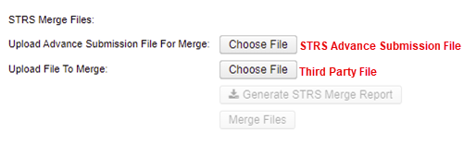
STRS Advance Merge (if applicable)
If a third party file needs to be included with your STRSADYY06.TXT file:
Go to Reports > STRS Reports > STRS Advance > STRS Merge Files > choose STRS Advance submission file that was generated and Third Party file
Generate STRS Merge Report > Merge Files

Slide 32
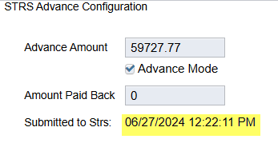
STRS Advance Processing ctd.
Once the submission file has been generated, click “choose file” next to Upload Submission File AND Submit Uploaded File to STRS. (If you have a merge file, that is the file that will be submitted)
Under Core > Organization
This should match Advance Amount from STRS Advance Reports
This should be updated to date & time file was Submitted to STRS

Slide 33
Post Fiscal Year End
When the STRS Advance Submission file is created, the following STRS reports are created in the FYE report bundle found in Utilities > Document Storage – YYYY – Fiscal Year Reports
STRS Advance Fiscal Year-to-Date Report
STRS Advance Positions Report
STRS Non-Advance Positions Report
STRS Employee Merge Report (If applicable)
STRSADMERGED.TXT (If Applicable)
STRSADYY06.TXT

Slide 34
Post Fiscal Year End
Close June Posting Period under Core > Posting Periods
When the June posting period is closed, the following reports are created in the FYE report bundle found in Utilities > Document Storage– YYYY - Fiscal Year Reports:
Attendance Journal Report
Benefit Obligation Report by Account Report
Benefit Obligation Report by Employee Report
Leave Balance Report
Payment Transaction Status Report
Earnings Register Report
Wage Obligation Report by Account
Wage Obligation Report by Employee
Notes:
Note – if they have multiple posting periods open, close furthest to most recent and give them time to run

Slide 35
Post Fiscal Year End
Items to Consider While in the STRS Advance:
  Regular and Irregular Pay Types cannot be used
  Dock (if not included prior to closing), Retro, Termination, and Pay off accrued wages can affect STRS Advance balancing
  Modifying the number of Pays Paid can affect STRS Advance balancing
  During the payroll process, the FYTD amounts on the 450, 591, and 691 payroll items will list both the Advance amounts and New Earnings
  The Pay Report lists the Advance amount processed for that pay
  The STRS Per Pay Report shows if employees are in Advance

Slide 36

Post Fiscal Year End
As summer pays are processed, you will see the Advance Amount Paid Back increase after each pay under Core > Organization
After all summer pays are complete, verify STRS Advance is balanced.
If the Amount Paid Back is equal or greater than the Advance Amount, the district will be taken out of Advance Mode. When the Advance Mode box is unchecked, the Amount Paid Back will be zero.

Slide 37
Post Fiscal Year End
The District Audit Job for AOS that has already been scheduled to run annually by ACCESS in your USPS instance.
When this job runs, it will generate reports for the PREVIOUS FISCAL YEAR based on the current period which is why we ask that all districts be closed by Friday, July 24, 2026.
When the Audit Job runs, it will send reports to the Document Storage > Audit Reports
section AND it will securely file transfer a copy of the reports directly to AOS.

Slide 38
Important Dates
FY26 Posting Periods closed by Friday, July 24, 2026
STRS Annual Report Due by Friday, August 7, 2026
Save the Date for Site Review – October 22 & 23, 2026
Notes:
Note – if cannot be closed by 7/24/26, please let us know
Note – STRS Annual Report is submission file

