Slide 1

.
Audit Presentation
Year Ended June 30, 2025

Slide 2
Agenda
Audit scope and process
Audit opinions and communications
Financial statement highlights

Slide 3




Audit Scope
Report on the District’s financial statements
Report on internal control
Required governance communications letter
Report on internal control over compliance with major program requirements (federal awards)

Slide 4


Audit Process
RISK-BASED APPROACH
Internal Controls
Revenue Recognition
Significant Estimates
General Obligation Debt
OPEB/Pension
Capital Assets
Expense/Expenditures
Federal and State Grants

Slide 5



AUDIT OPINIONS
AUDIT RESULTS
Financial statement
Financial statement audit opinion is unmodified.
Federal awards
Unmodified opinion on compliance.
Financial Statement and Federal Awards
No material weaknesses or significant deficiencies noted.
Major programs = Child Nutrition Cluster and Education Stabilization Fund (ESSER)

Slide 6
Governance Communications
Overall
Significant Accounting Policies included in Note 1
Implementation of GASB 101 “Compensated Absences”
No unusual transactions or transactions that lack authoritative guidance
Difficulties
No difficulties noted
No significant audit entries
No uncorrected misstatements
No disagreements with management
Estimates
Self-insurance incurred but not recorded claims
Actuarially determined liabilities for pension and OPEB
Other
Management has provided representations to us
No consultations with other auditors
No other significant items discussed with management
Annual Financial Report (PDE-2057) filed with Pennsylvania Department of Education

Slide 7






GASB 101 Compensated Absences
Text
Text
District effective date
June 30, 2025
CLA can help by
evaluating the standard related to compensated absences and assisting with or evaluating financial statement disclosures
Updated framework
Revaluate leave policies
Liability must include any accumulated leave that is unused or used but unpaid
Footnote disclosures will be enhanced
Examples include
Sick leave not paid at termination
Parental leave
Military leave and jury duty that has commenced
©2025 CliftonLarsonAllen LLP
Notes:
101
Practical Consideration: We have to ask the questions and document our conclusion regarding applicability
Impact and Procedures:
7 hours/$1,500 small entity with limited benefits – 12 hours/$2,500 for larger entities – more if programs are applicable and amounts are material.
Evaluate client’s accounting memo/implementation documentation
Determine completeness of population (this will take the most time for most entities)
Reperform computations to support balance and determine reasonableness of estimates
Propose journal entries if applicable
Propose footnote modifications

Slide 8
GASB 102 Certain Risk Disclosures
Text
Text
Effective date
June 30, 2025
Increased footnote disclosures surrounding risk:
Limitations on raising revenues
Concentrations related to tax revenue or vendors
Debt or mandated spending — especially unfunded mandates
Impact of major employer leaving the community
Collective bargaining agreements
©2025 CliftonLarsonAllen LLP
Notes:
102
Practical Application: Applies to all entities who have limitations on taxable revenue growth or areas where risk is concentrated.
Procedures and Impact:
8 hours/$3,000 if statement prepared by CLA; 4 hours/$1,500 for PBC financial statements
Evaluate client’s accounting memo/implementation documentation
Determine completeness of population:
Concentration Risk Examples:
Tax Revenue Concentration: A local government heavily relies on a single industry (e.g., tourism, manufacturing) for tax revenue. If that industry faces a downturn, the government’s financial stability could be at risk.
Vendor Concentration: A government relies significantly on a single vendor for critical services (e.g., waste management, IT). If that vendor fails or experiences disruptions, it could impact service delivery.
Constraint Risk Examples:
Debt Covenant Constraints: A government has debt covenants that limit its ability to take on additional debt. Violating these constraints could lead to penalties or affect credit ratings.
Legal Constraints: A court order restricts a government from using certain funds for specific purposes. Failure to comply with legal constraints may have legal and financial consequences.
Evaluate/propose footnote modifications

Slide 9



Budget to Actual – General Fund
Fund Balance Composition
Governmental Funds
Food Service and Healthcare Fund
Financial Statement Highlights and Trends

Slide 10
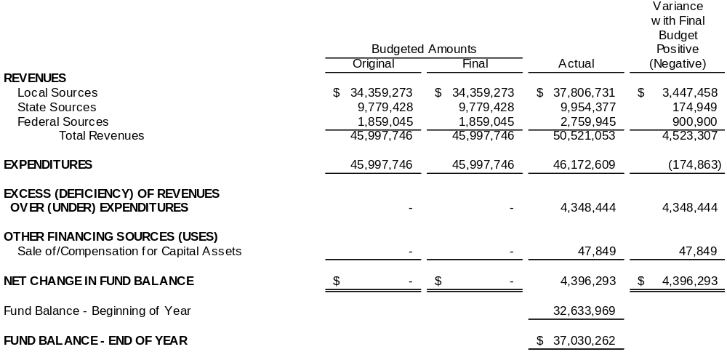
Budget to Actual – General Fund – June 30, 2025

Slide 11
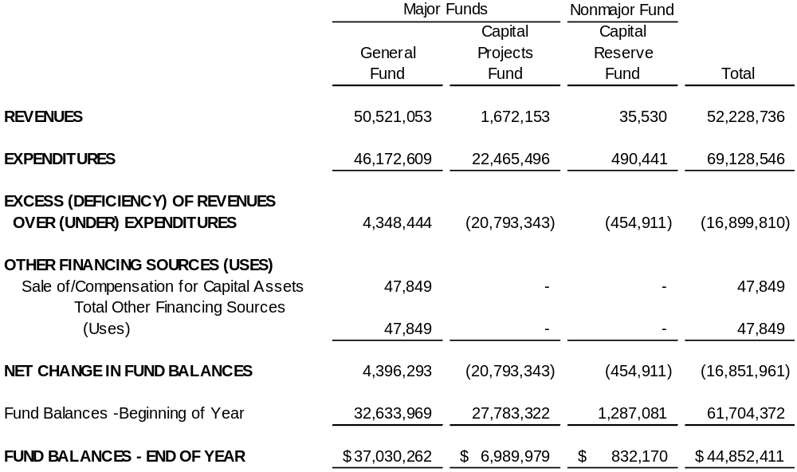
Governmental Funds – June 30, 2025

Slide 12
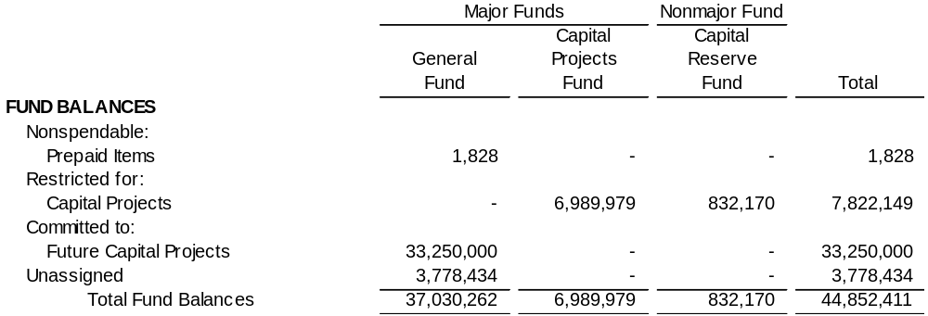
Fund Balance Composition – June 30, 2025

Slide 13
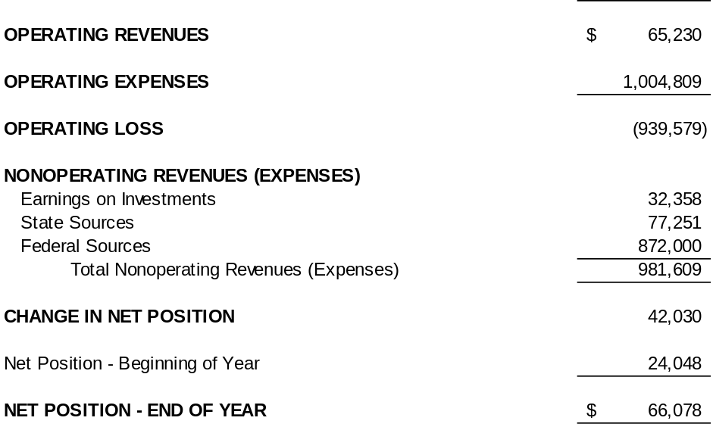
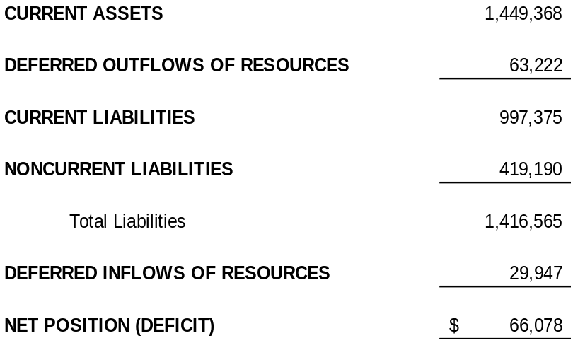
Food Service Fund – June 30, 2025

Slide 14
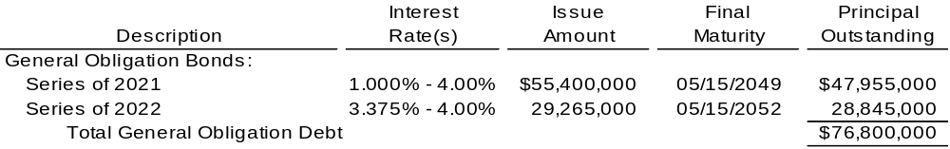
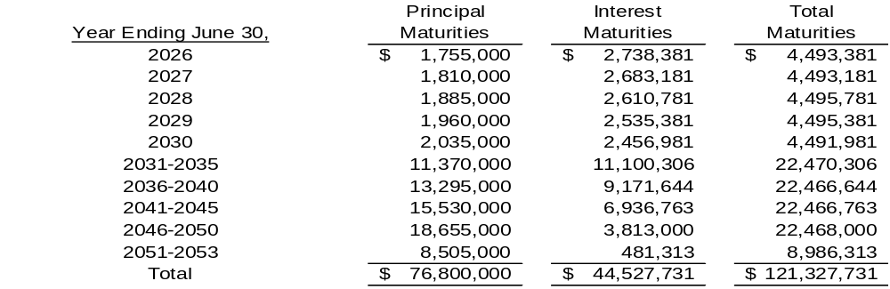
Debt Service – June 30, 2025

Slide 15

Carl Hogan, CPA
Principal
Carl.Hogan@claconnect.com

