Slide 1
Finalsite Overview
Dallas ISD

Slide 2


Agenda
01
Navigating your site
02
Managing Resources and Galleries
03
Posts
04
Calendars
05
Editing Interior Pages
Notes:
To replace photos inside the shapes, right click on the image > Replace Image

Slide 3
Logging In
● The link for Dallas ISD admin user is
https://www.dallasisd.org/admin
● Your username is your full @dallasisd.org email address
● You will then be directed to your EAD to log in
Notes:
To replace photos inside the shapes, right click on the image > Replace Image

Slide 4
Navigating Your Site

Slide 5
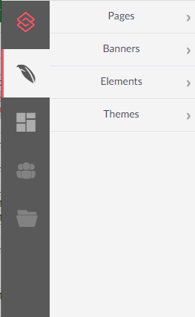
Return to Dashboard
Composer
Modules
Resources
The editor used to build pages
Pages: Add and edit content to your site
Posts
Calendars
Resources: The filing cabinet for files and media
  A folder structure for organizing files
Galleries: Groupings of resources for display
Note: Options will vary according to your user permissions.

Slide 6
Resources

Slide 7
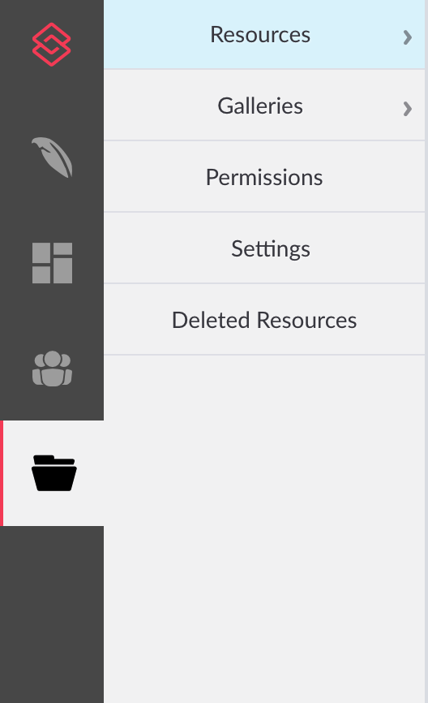
Resources sections
Resources: The filing cabinet for files and media
Images, videos, files, PDFs
Galleries: Groupings of resources for display
Event pictures
List of files such as Board meeting minutes, or handbook policies

Slide 8
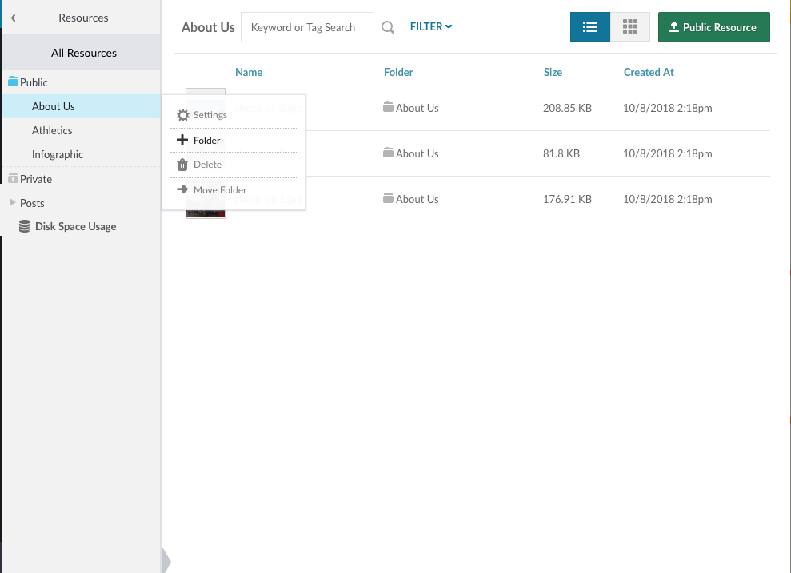

Resources
Folders can be nested (indefinitely).
Permissions can be set on individual folders.
Create a folder structure that mimics your page structure
Upload using
A resource can only exist in one folder
at a time.

Slide 9
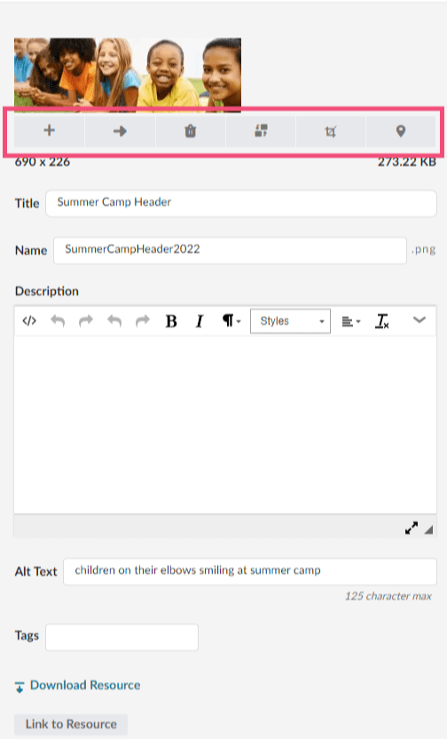
Image Tools
1 2 3 4 5 6
Add to Gallery - add file to an existing gallery
Move to Folder - move file to an existing folder
Delete Resource - moves file to Deleted Resources (30 days)
Replace Resource - replaces the file in all instances where it is displayed on the site
Edit Image - only cropping available; use image ratios
Where Used - see where the file is used throughout the site

Slide 10
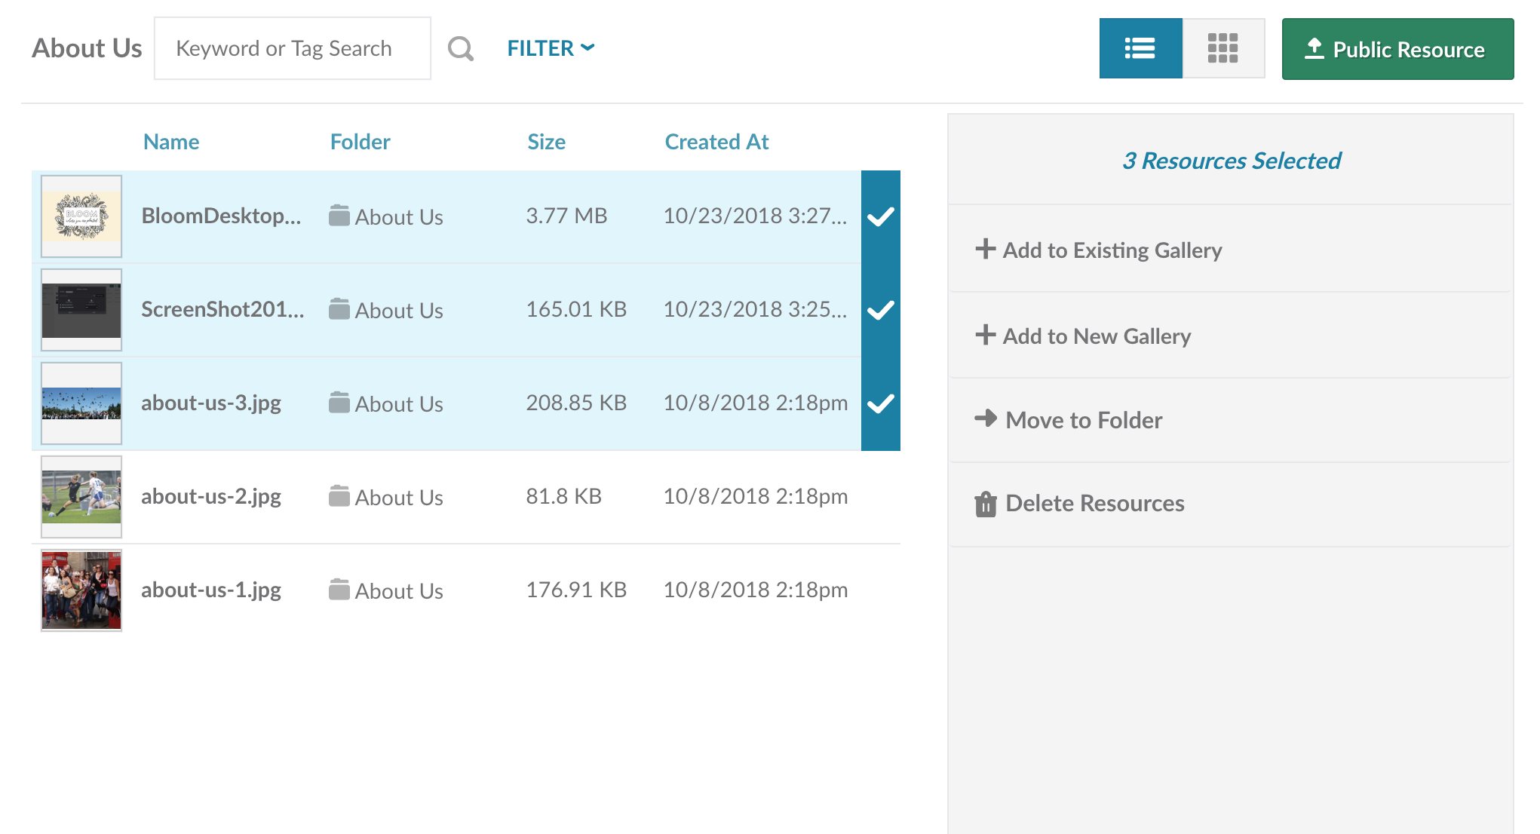
Bulk actions
Hover over the resource and select the blue checkmark to the right of the resource.
Once you select one, you will have the option to move the items between folders or between galleries or delete resources.

Slide 11
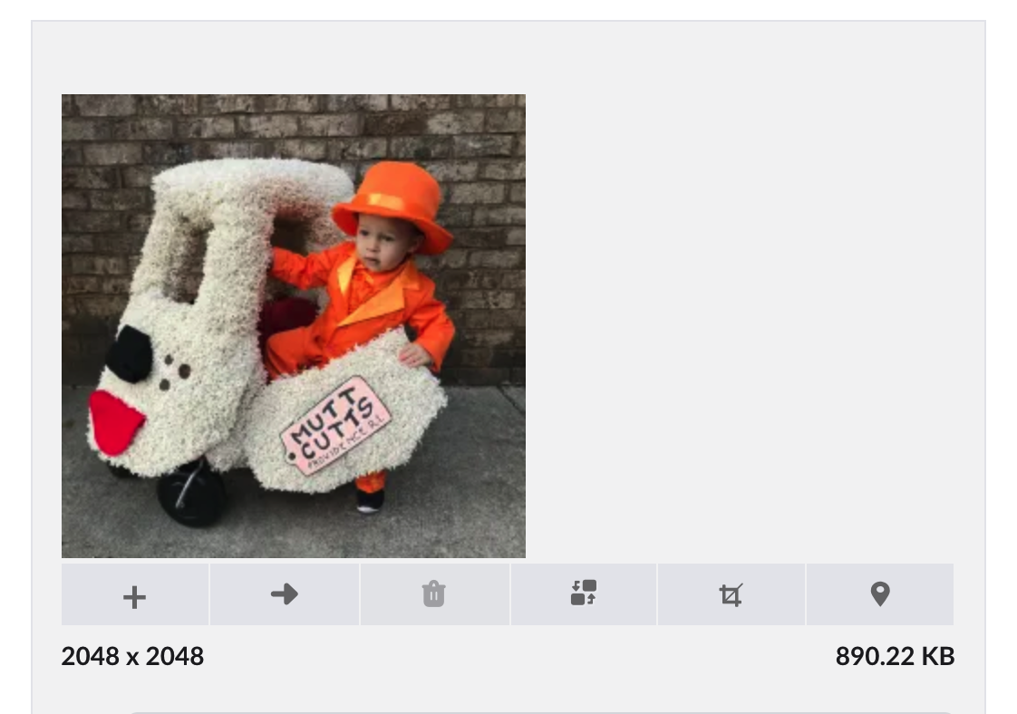
Best Practice: File Sizes
File size limits in Resources are based on the file type.
Image files/PDFs can be up to 100 MB.
Video files can be up to 3.51 GB.
All other files can be up to 3.91 GB.
Pro Tip: Refer to your Instructions page for specific dimensions for your site

Slide 12
Galleries

Slide 13
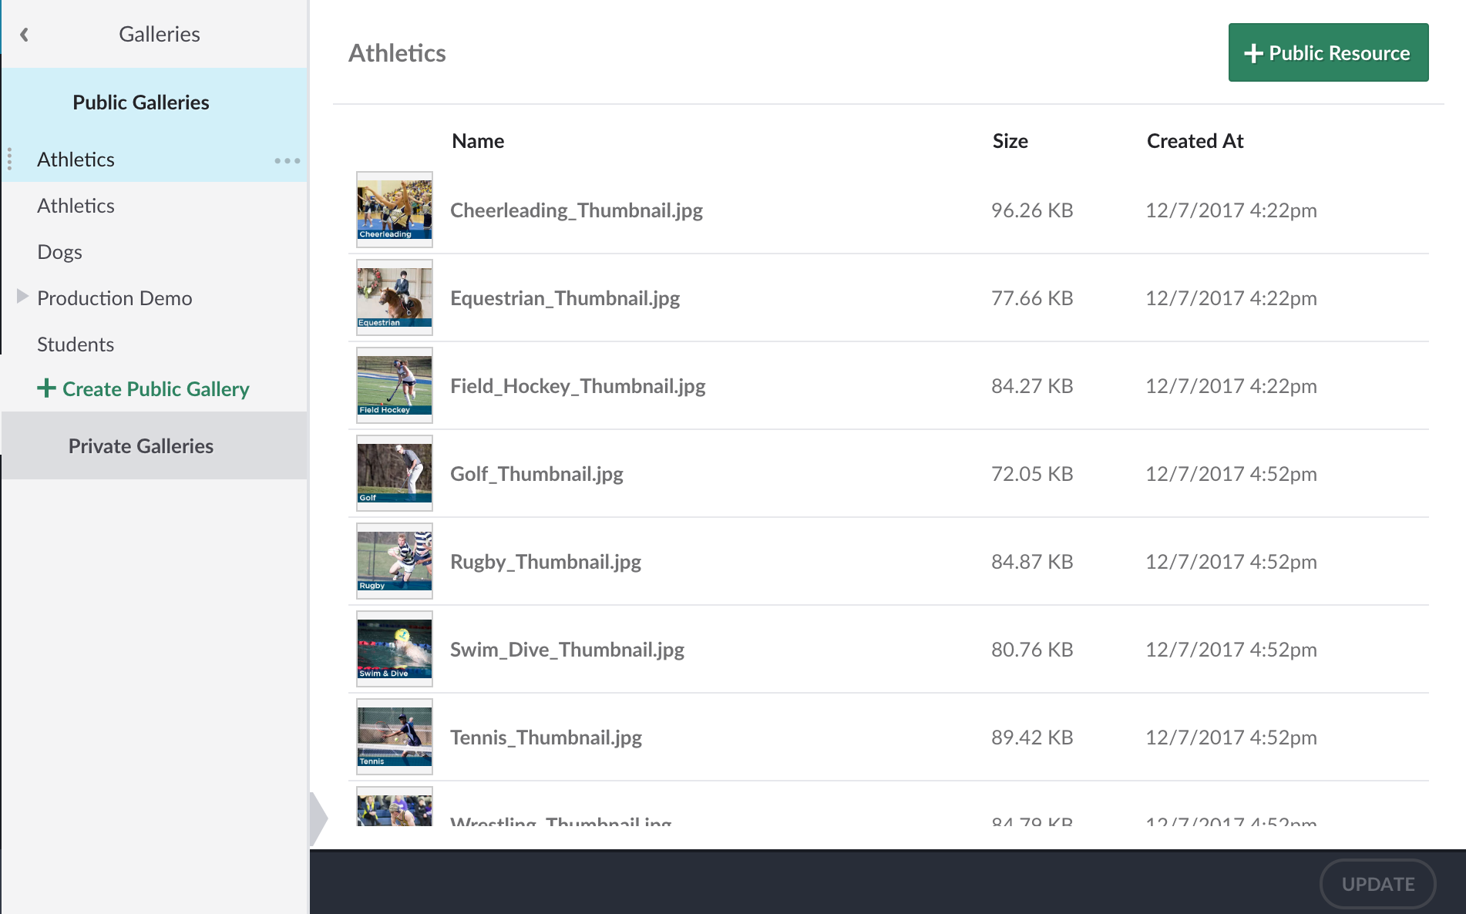
Galleries
Grouping your resources is easy with galleries. Use galleries to create:
Slideshows
File display groups
Photo galleries
Anything you can think of!
A resource can exist in multiple galleries.

Slide 14
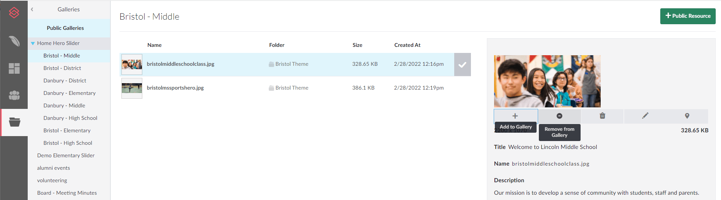
Managing Galleries
Add to gallery
Remove from Gallery
Hover over files to rearrange order
1
3
2

Slide 15
Posts Module

Slide 16
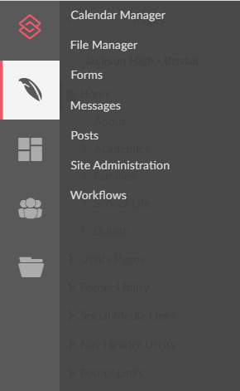
Modules
You can add and edit posts here
Calendar settings are located here
Note: Options will vary according to your user permissions.

Slide 17

What can you do with Posts?

Slide 18
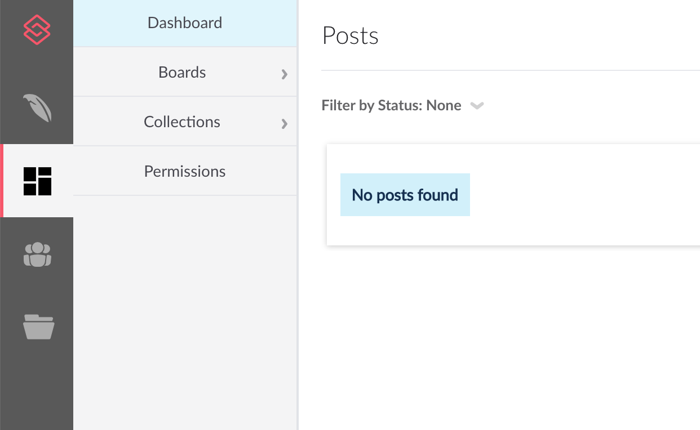
Organization of Posts
Dashboard
Boards: Contain Posts of a specific subject, such as District News

Slide 19
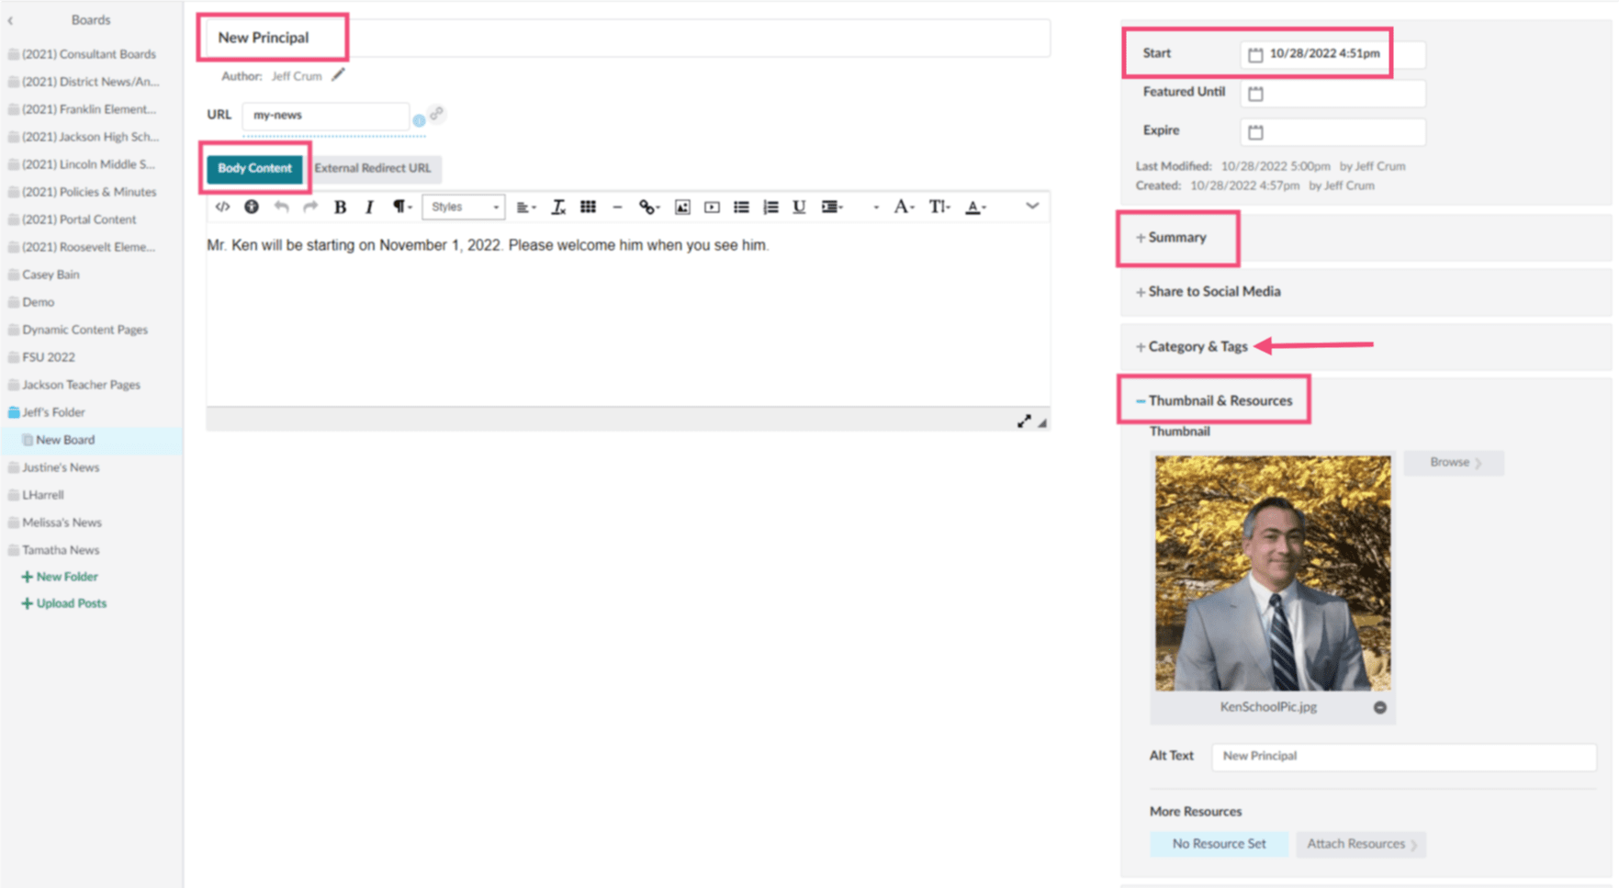
Elements of a Post
Click on a board
Click on an existing post
Locate the following:
  Title
  Body Content
  Summary
  Thumbnail
  Start date

Slide 20
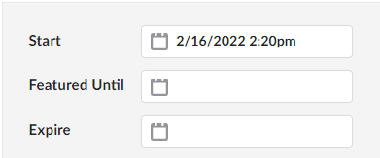

Create a Post
Select on a board
Click Create Post
Complete all post details
  Title, body, summary, thumbnail
  Tags (if used)
Save > Do you want to publish immediately?
  Yes - a start date/time will be entered and the post will publish
  No - the post stays in draft mode until you schedule the start date/time
Featured Until: the post remains at the top of the news list until this date, then it will fall in order with all posts (Note: This may be how posts appear as a “Featured News Story”)
Expire: the post will be removed from the page, but will remain in posts

Slide 21
Posts Best Practices
Do
separate different subject types of content by Board
Don’t
over complicate things!
Don’t
use long Board or Post Titles to keep the post URL short as possible
Do
clone a post instead of creating from scratch

Slide 22
Calendars
Managing events

Slide 23
Event Source
Events are managed in Calendars in one of two ways:
Standard
Events are manually entered into calendars
Can be imported with a datasheet
All edits are managed here
Site admins need access
Live
Events are synced from an ics feed (such as Google Calendar)
All edits are managed in the original source
ICS file must be less than 3 MB
Site admins don’t need access

Slide 24
Basic Composer Navigation

Slide 25
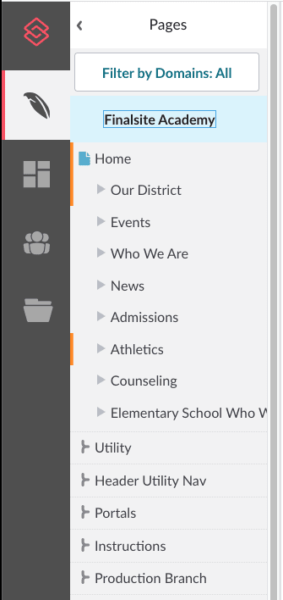
Page navigation
At the top of your Pages panel, you’ll find your domain - your school’s site. The first section beneath the domain is your site’s main content pages. Below your main pages are branches, folders that allow you to organize site content without impacting the site’s structure.
Branches are used for links/buttons in the header and footer, portals, instructions, and production notes, but they are also great for storing your practice or test pages separate from live pages.

Slide 26
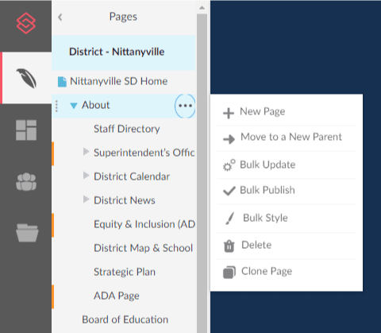
Managing Pages
Pages are updated by using the three dot menu to
Add new page
Move to a new parent
Delete
Clone
Or change the page name in the Page Settings (more on this later)
Note: If you don’t have this menu, you may not have permissions to perform these actions.

Slide 27
Reference Branches
Production
Style Guide page Contains what each element should look like with your site’s theme.
Contains the elements which are utilizing custom classes.
Contains elements which can be copied and pasted onto other parts of your site.
Instructions
This section walks through how to update the content of your site, including the home page and headers and footers.
This section also includes information about image sizes and preferred styles of cropping for each type of element.
Notes:
Class of 2022 Top Ten

Slide 28
Composer - Page Basics

Slide 29

Bottom Bar
Page Settings
Publish Status
Publish button
View options
Publish Now: Page is live immediately
Publish Later: Choose a date and time for the page to be published
Comment: Make an admin-only note about why you are publishing
Know your page statuses:
Green = Published Yellow = New
Orange = Draft Light blue = Scheduled
Select the gear icon to access the page settings.
Note: Looking for a preview? Turn off Compose mode!

Slide 30
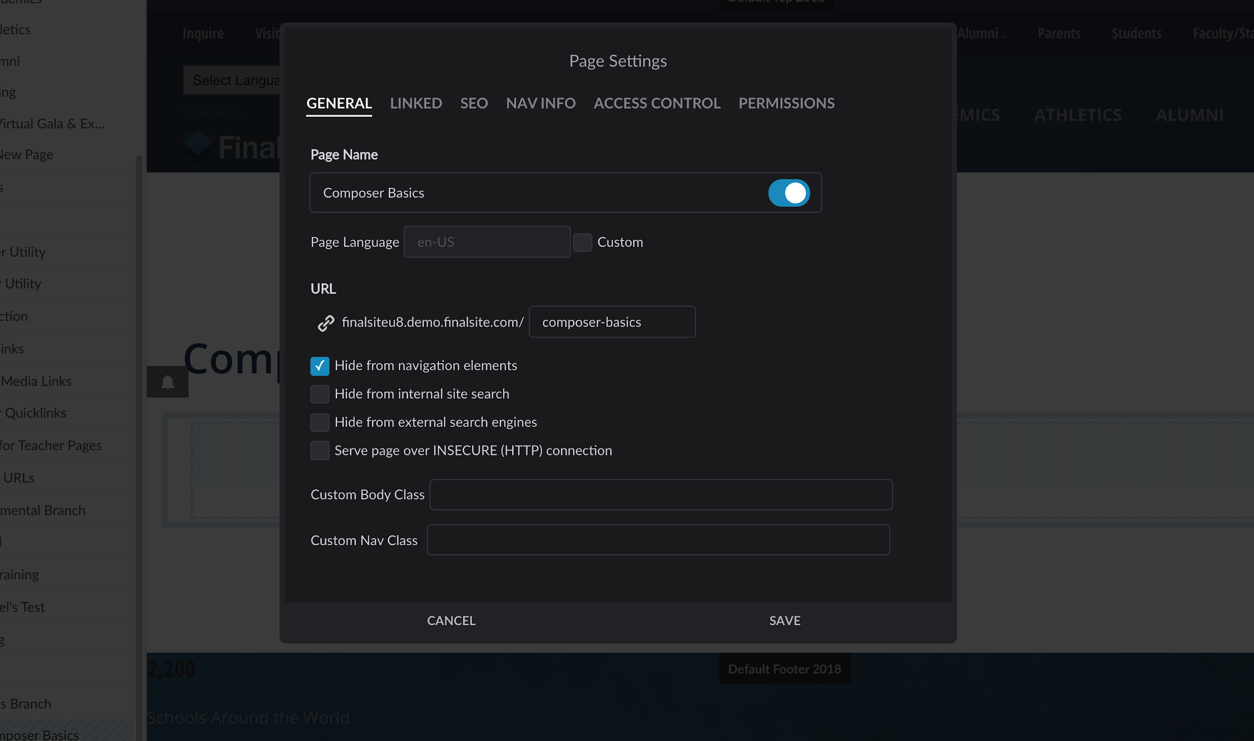


Page Settings
General
Set page name, choose to hide or show this page title
Adjust URL as needed
Hide from navigation
Hide from searches
Custom styling added by your Finalsite designers or the CSS savvy
Hidden pages have gray lines through the page name.

Slide 31
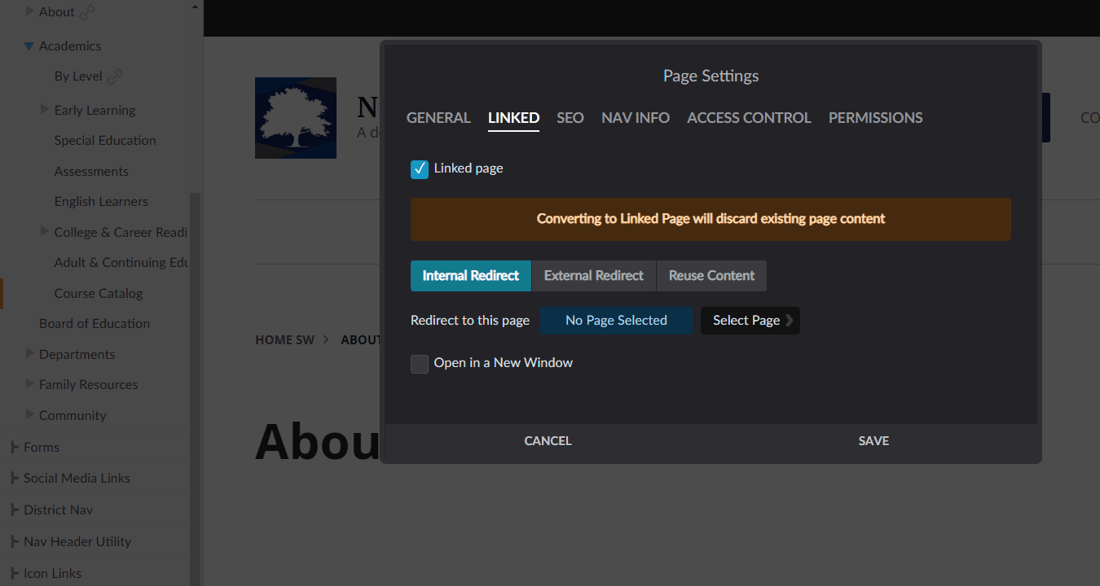

Page Settings
Linked
Internal Redirect
  Select another Composer page
External Redirect
  Insert a URL
Reuse Content
  Pull content from one page to display on another page
  You’ll see a link icon next to the name of any pages that have been linked to another page.

Slide 32

Additional page options
Use this button to view
TIER TWO
1 2 3 4 5 6 7
TIER TWO
Page History: Log of edit/publish history
Clone: Make a clone of the page
Delete: Remove the page
Unpublish: Remove the page from the public-facing website only
5. Move: Move the page under a new parent
6. Add: Add a new page below this page
7. Restore: Revert to last published version
Tier 1 Features, plus
Feature Name
Feature Name
Feature Name
Tier 1 Features, plus
Feature Name
Feature Name
Feature Name

Slide 33
Composer - Editing Interior Pages

Slide 34

Compose mode
The Compose toggle enables page editing, adding new or editing existing content.
Changes from gray to blue when you can edit
If you don’t see a Compose toggle, you don’t have permission to edit this page.
Pages are built with “elements.”
With Compose mode ON, you can also edit your page’s layout, banners, and theme in Page Layout & Appearance.

Slide 35
What are elements?
Elements are the fundamental building blocks of your Composer website.
Some elements add static, page-specific content.
Others add dynamic content from modules like Calendar Manager, Posts, etc.
Use elements to create a unique layout and organize content.

Slide 36
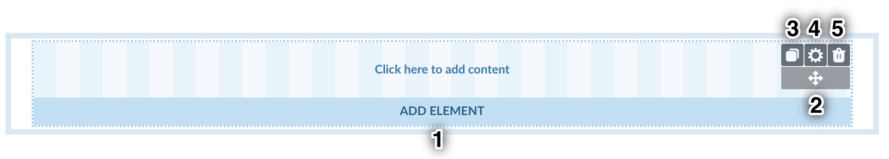
Element actions
Hover over an element to:
Add a new element to the page
Move the element on the page
Copy the element to paste elsewhere
Access the element settings
Delete the element

Slide 37
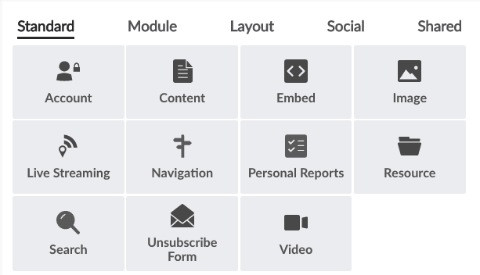
Standard elements
Content: Text, photos, etc.
Image/Resource: Resources content
Navigation: Tree of site pages for menus

Slide 38
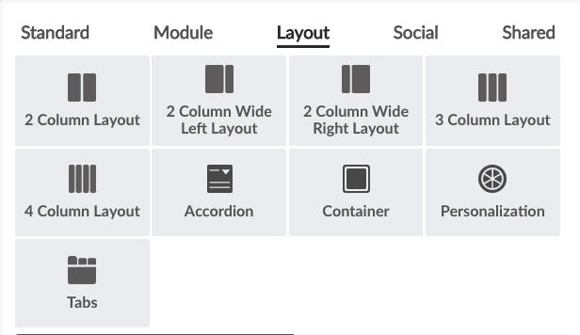
Layout elements
In addition to the full-page layouts in the Page Layouts & Appearance menu, Layout elements further customize the arrangement of elements on your pages.
Easily switch between column layout elements by hovering over the element and clicking the layout icon.
For pages with lots of content, consider using Accordions or Tabs to condense and organize.

Slide 39
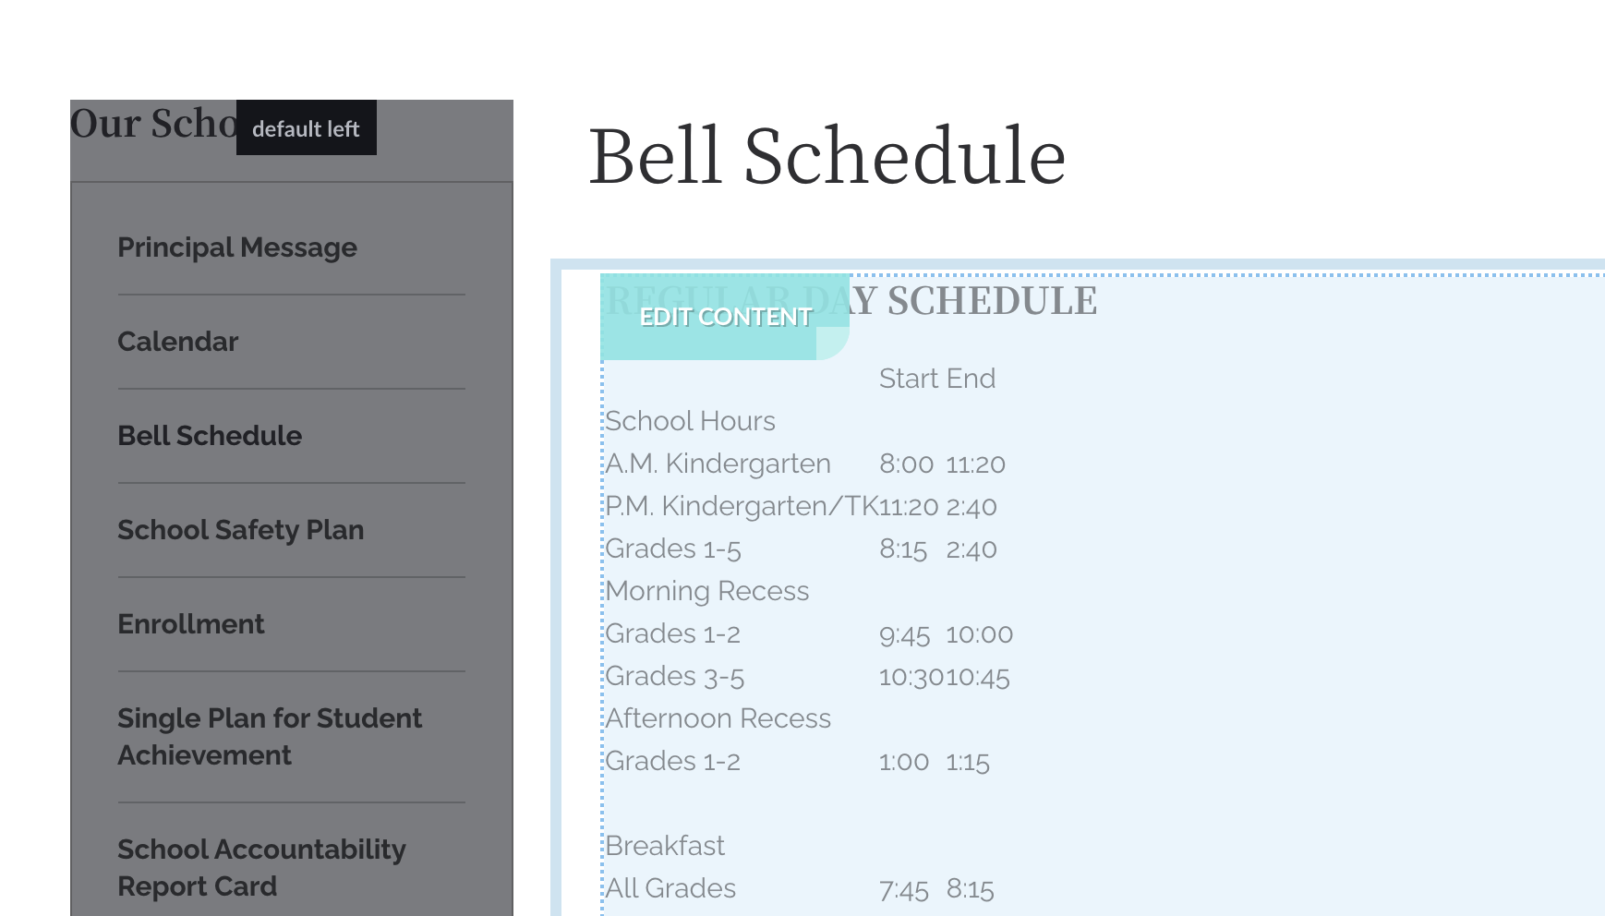
Content element
The most basic element is called the Content element. Content elements can be used to add text, images, embeds, links, and more to your page.
In Compose mode, hover over the element until you see “Edit Content.”
Click anywhere inside to access the content editor.

Slide 40
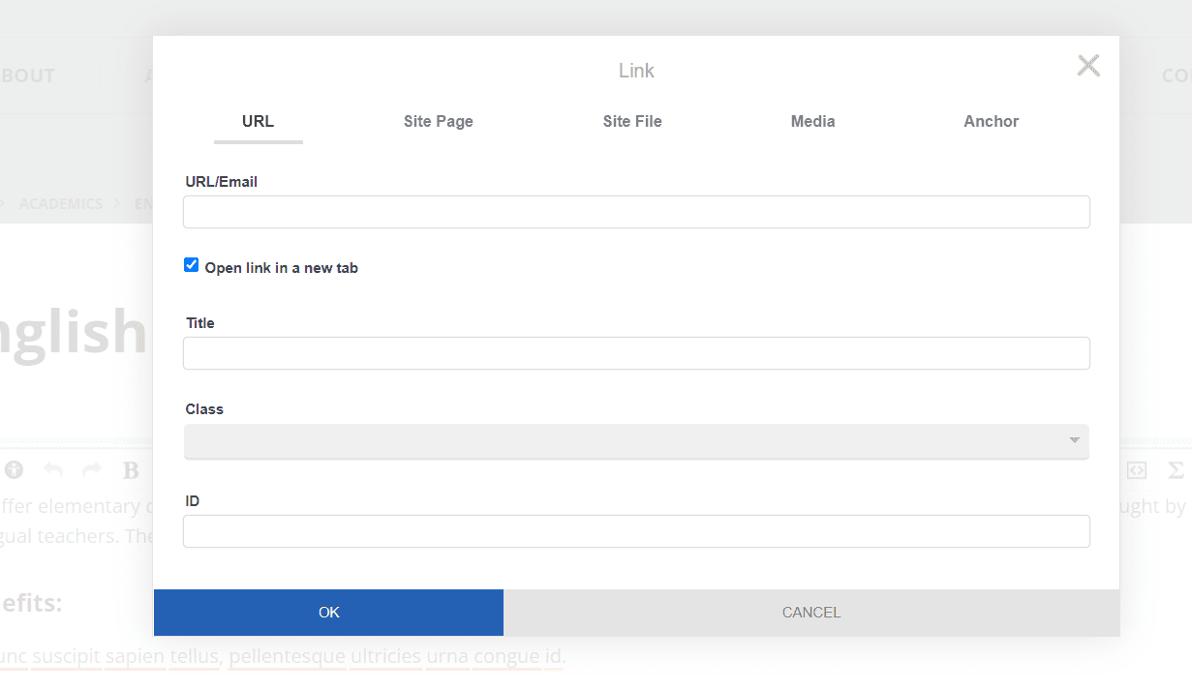
Add a link
Content Elements - Buttons
URL
  Add a direct URL to another site
Site Page
  Browse Composer to link to another page
Site File
  Browse Resources to link to a file/image

Slide 41
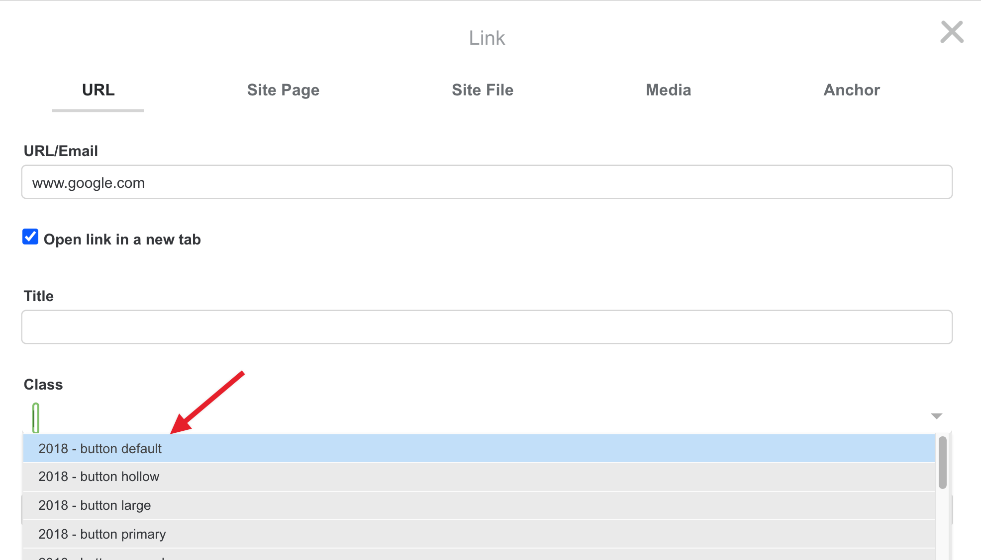
Add a button
Content Elements - Buttons
Select the text
Click “Add Link”
Add the appropriate link
Use the “Class” field to select the styling
Note: Even though it is possible to use the Styles menu in the editor and apply a button style that way, we recommend this method for best results.

Slide 42
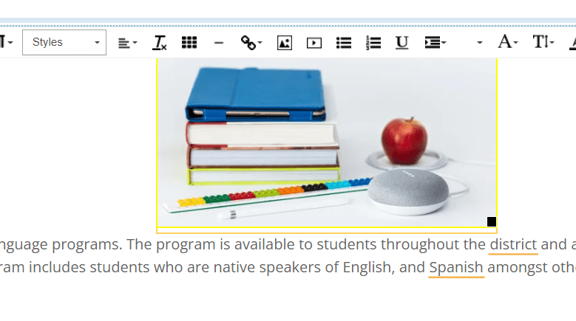
Add an Image
Content Elements - Buttons
Insert image from Resources
Can resize in the content element
Apply alignment to wrap text around the image

Slide 43
Tips for editing content
Use the Accessibility Checker like a spell checker to help stay in compliance.
Paste plain text with formatting removed for best results.
Use Cmd (or Ctrl) + Shift + V
Remember: Headers are for structure, not styling.
Use the styles in the dropdown instead of making your own. These were created for you to make your site look awesome!
Notes:
A speaker note in response to "But it clears out links.." While yes, it does, it behooves you to use the "Site Page" linking option so that links do not break over time.

Slide 44
Displaying resources on your site

Slide 45
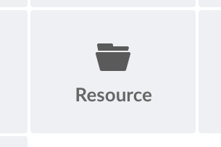
Resource element
Quickly make lists, slideshows, or photo galleries by grouping together your resources in a quick gallery and using the Resource element to display these.
The List and Grid formats can show resources only, galleries only, or both.
If you configure this element to show only galleries, you can link it to another Resource element to display the individual resources in that gallery.
In Grid format, you can display resources inline or as thumbnail links that open in a lightbox or element.
Use the Audio, Image, Video, Document, and Other buttons to filter the resource types displayed.
Use for: Photo slideshows, lists of documents, and any other times you want to display files as a group

Slide 46
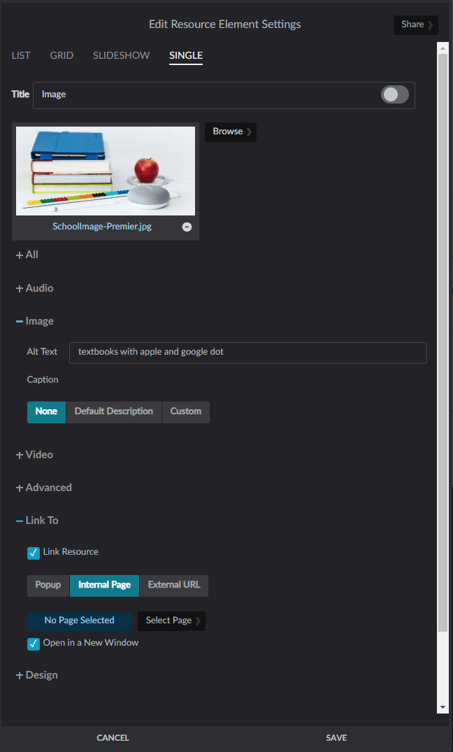
Add images with a Resource element:
Fills the space of the element (cannot be resized)
Provides other options in the element settings such as displaying captions and linking to a URL, page, or file

Slide 47
Display events on your site

Slide 48
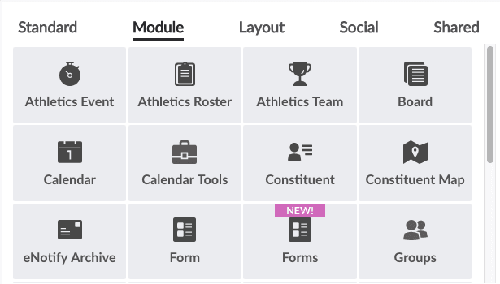
Calendar elements
Calendar: Displays full calendars in list, grid, slideshow, or single view
Calendar Tools: Displays a legend, search feature, or mini grid

Slide 49
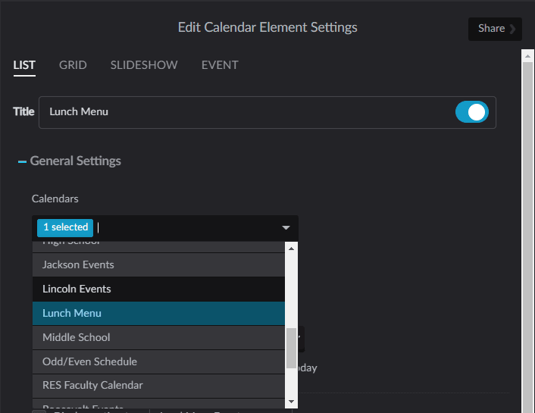
Events / Calendar
Which calendar(s) are displaying?
Use the element settings to learn which calendar(s) are displaying.
Go to Modules > Calendars
Open the Calendar and edit
Note: The calendar may be a live calendar synced to a Google calendar feed. In this case, it would only be edited in Google.
Learn more about Calendar Manager

Slide 50
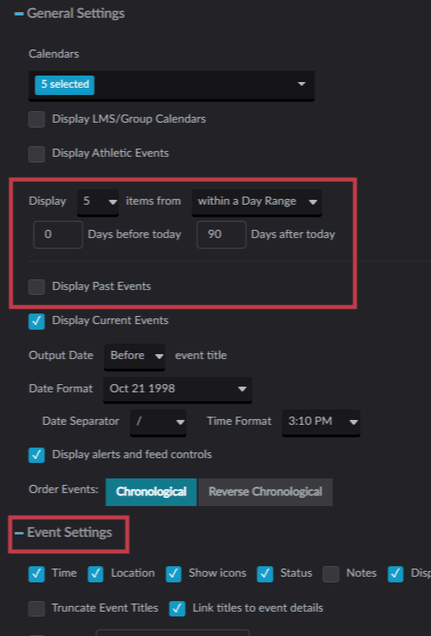
Calendar Element Settings
General Settings
Display 0 days before today
Uncheck Display Past Events
Event Settings
Check what you what displayed

Slide 51
Thank you!

