Slide 1


Slide 2

Goals:
Introductions
Kindergarten Orientation is 9/3
Getting Ready for Kindergarten
Questions and Answers
Tour of the School

Slide 3
Meet the Principal
Amy.Stueber@sayrevillek12.net
Ms. Stueber
732-525-5215

Slide 4
Kindergarten Teachers
Ms. Anderson
Ms. Josiah
Mrs. Barry
Mrs. Makely & Mrs. Marchetta
Mrs. Bednarz
Notes:
-Some of our kindergarten teachers were able to be here tonight.
For those that are here please give a wave when I get to your name.
- Read Names

Slide 5
Truman Staff
Ms. Goodman
School counselor
Barbara Droulette
Secretary
Cindy O’Brien
School Nurse
Virginia Culley
Secretary

Slide 6
Truman PTO
Antonella Leverett
PTO President
Amanda Kutcher
Corresponding Secretary
Shadia Ghanem
Vice President
Jennifer DeForge
Treasurer
Caitlin Arvanites
Recording Secretary

Slide 7
Kindergarten…It’s not what it used to be.
This is where the journey begins
New Jersey Student Learning Standards
Fun yet challenging
What can you do now?

Slide 8
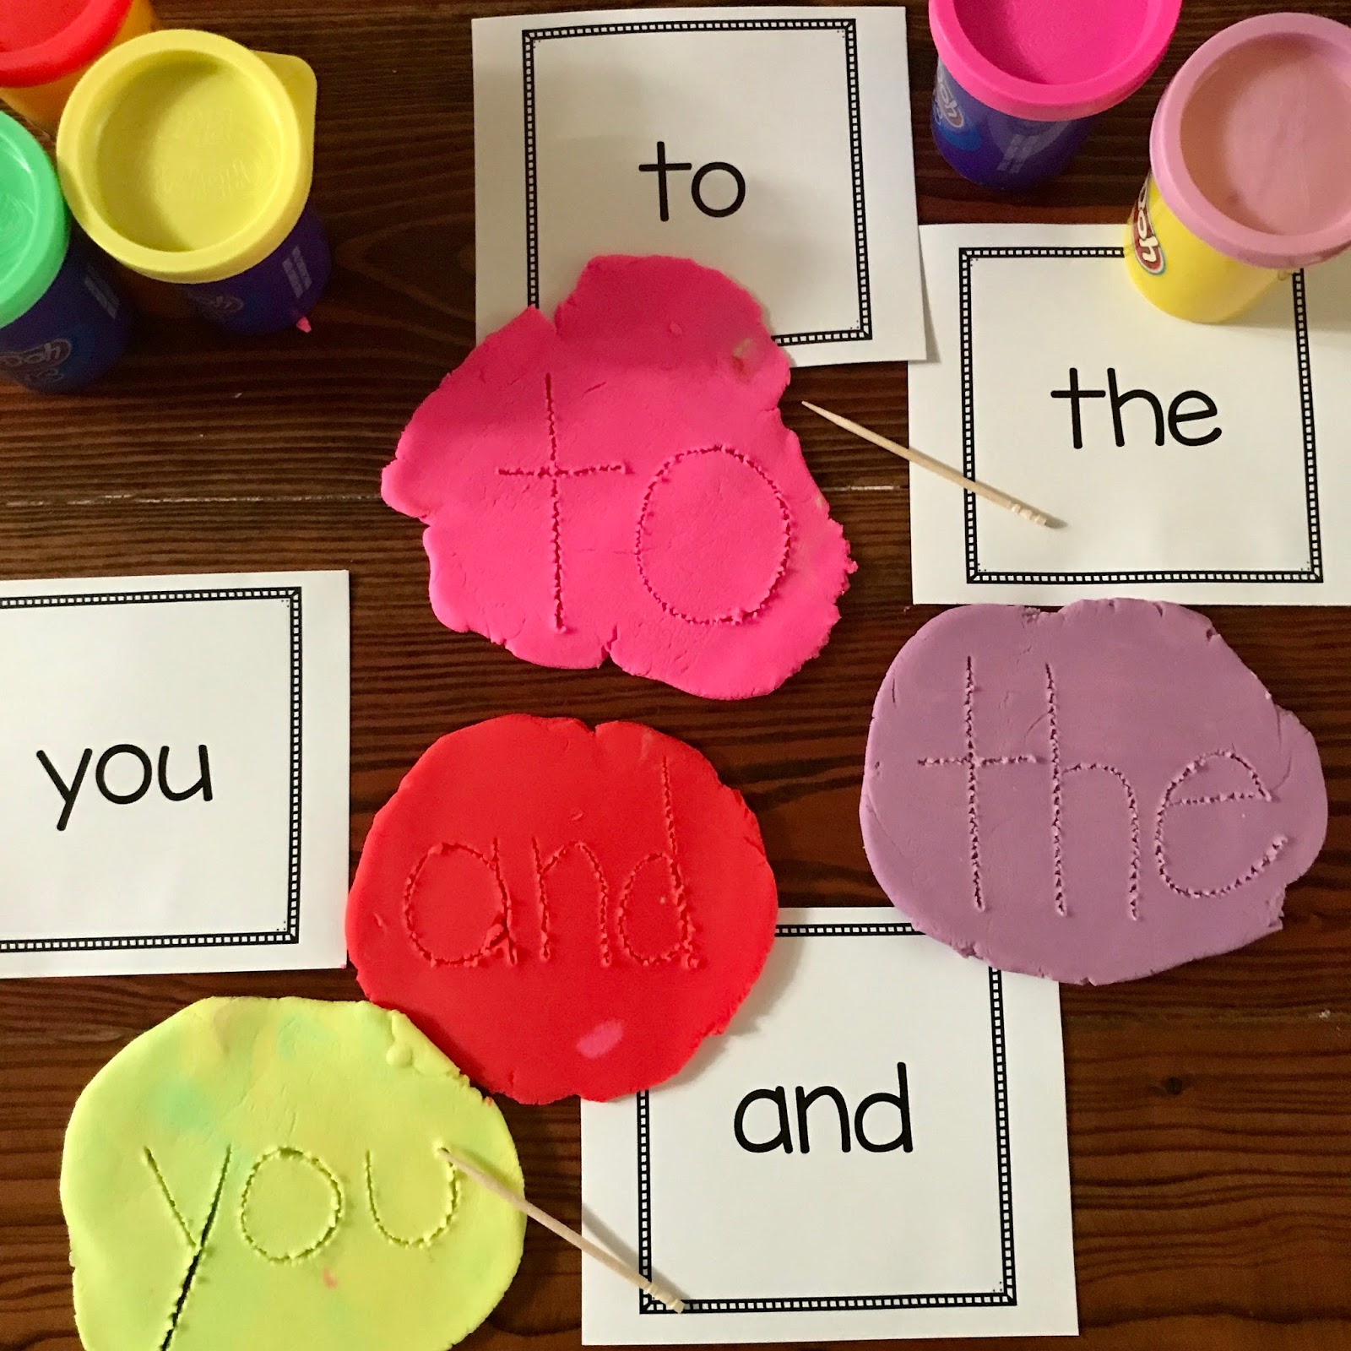
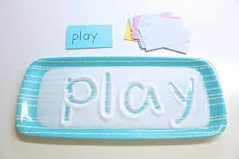
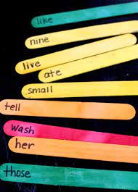
Support at Home: Sight Words
Using salt, sugar, or sand, trace words
Pull out popsicle sticks to read… see how many you read correctly to keep!
Using a toothpick, write words in play-doh

Slide 9
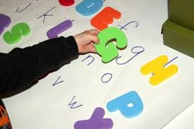
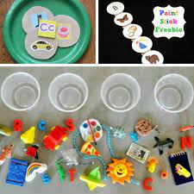
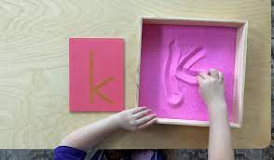
Support at Home:
Phonics (letters and sounds)
Using salt, sugar, or sand, trace letters
Lowercase and uppercase letter match
Find objects in your home to sort. Find objects that start with the B sound, etc.

Slide 10
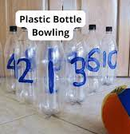
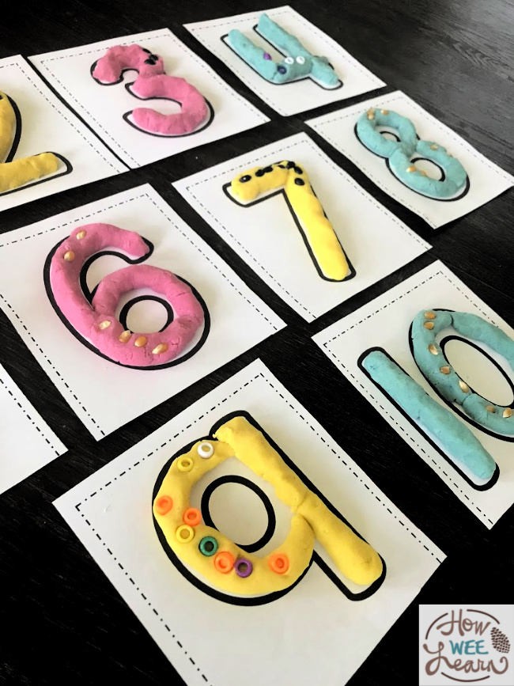
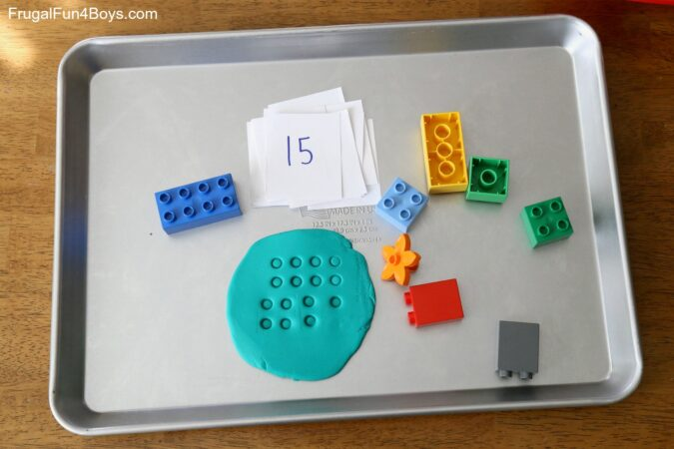
Support at Home: Math
Identify numbers when they are knocked over
Use legos to form dots in play-doh to practice counting
Play-doh numbers

Slide 11





What Else Can You Do?
First-Hand Experiences

Slide 12
What Else Can You Do?
Opportunity for PLAY!
Parallel Play | Play in Small Groups
Open-ended play (encourage the use of imagination!) Sand and water activities Play-Doh | Take turns, sharing, making negotiations Problem solving Make discoveries

Slide 13
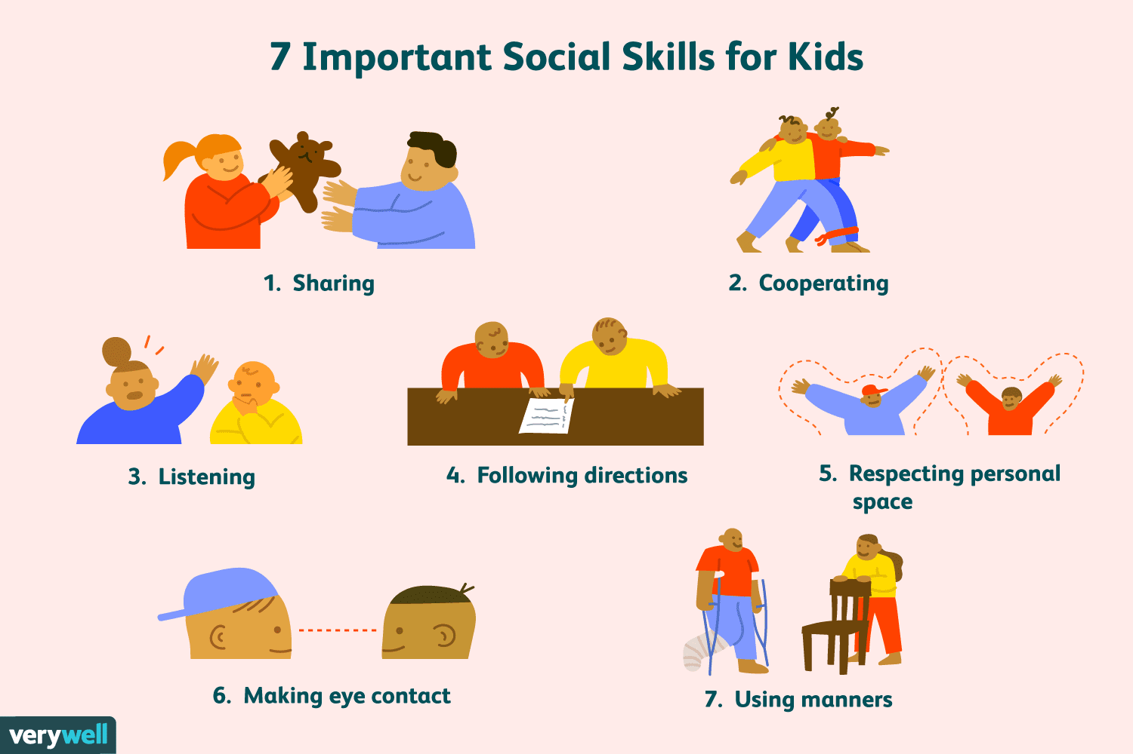
Independence/Socialization

Slide 14
Independence/Socialization
Understanding right and wrong
Respecting the rights and feelings of others
Share, take turns, use kind words
Playing without needing constant supervision
Make decisions independently

Slide 15
Independence/Socialization
Can your child:
Tie shoes?
Take off/put on coat?
Zipper/button?
Use the bathroom independently?
Open lunch?
Buckle seatbelt?
Blow nose?

Slide 16
Looping
In the past, we’ve used a looping model, where teachers stayed with the same group of students for more than one year. After careful consideration and feedback, we will be moving away from that model beginning next school year.

Slide 17
Looping
This change allows us to:
  Facilitate a smooth and successful transition into kindergarten. Kindergarten teachers will be able to work closely with the pre-school teachers and collaborate more effectively.
  Place students based on their current academic and social-emotional needs each year. This will create more balanced and flexible classroom groupings.
  Ensure all students have access to a broader range of teaching styles and expertise. Teachers can become grade level experts.
  Create opportunities for students to build relationships with more teachers

Slide 18

Partnerships

Slide 19
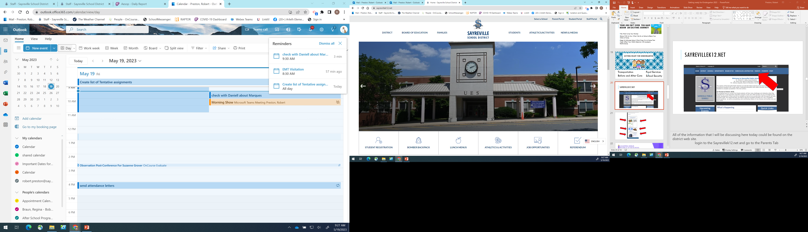
District Website
Sayrevillek12.net

Slide 20
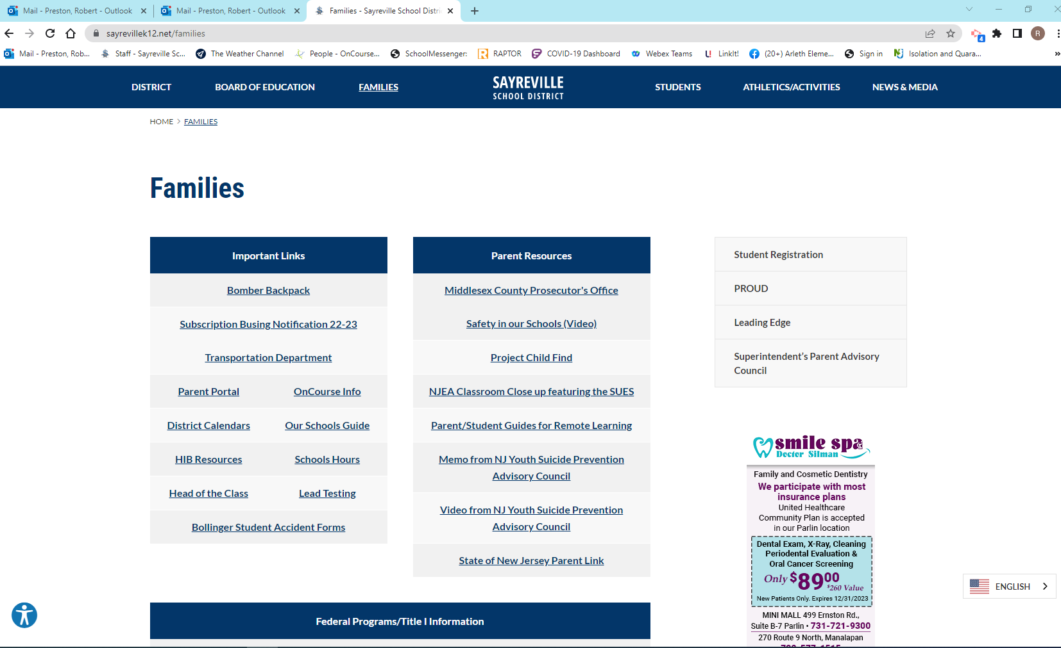

Slide 21
Food Services
What’s for lunch?
How do I pay for lunch?
What if my child forgets their lunch?
What if my child has food allergies?

Slide 22
Food Services

Slide 23
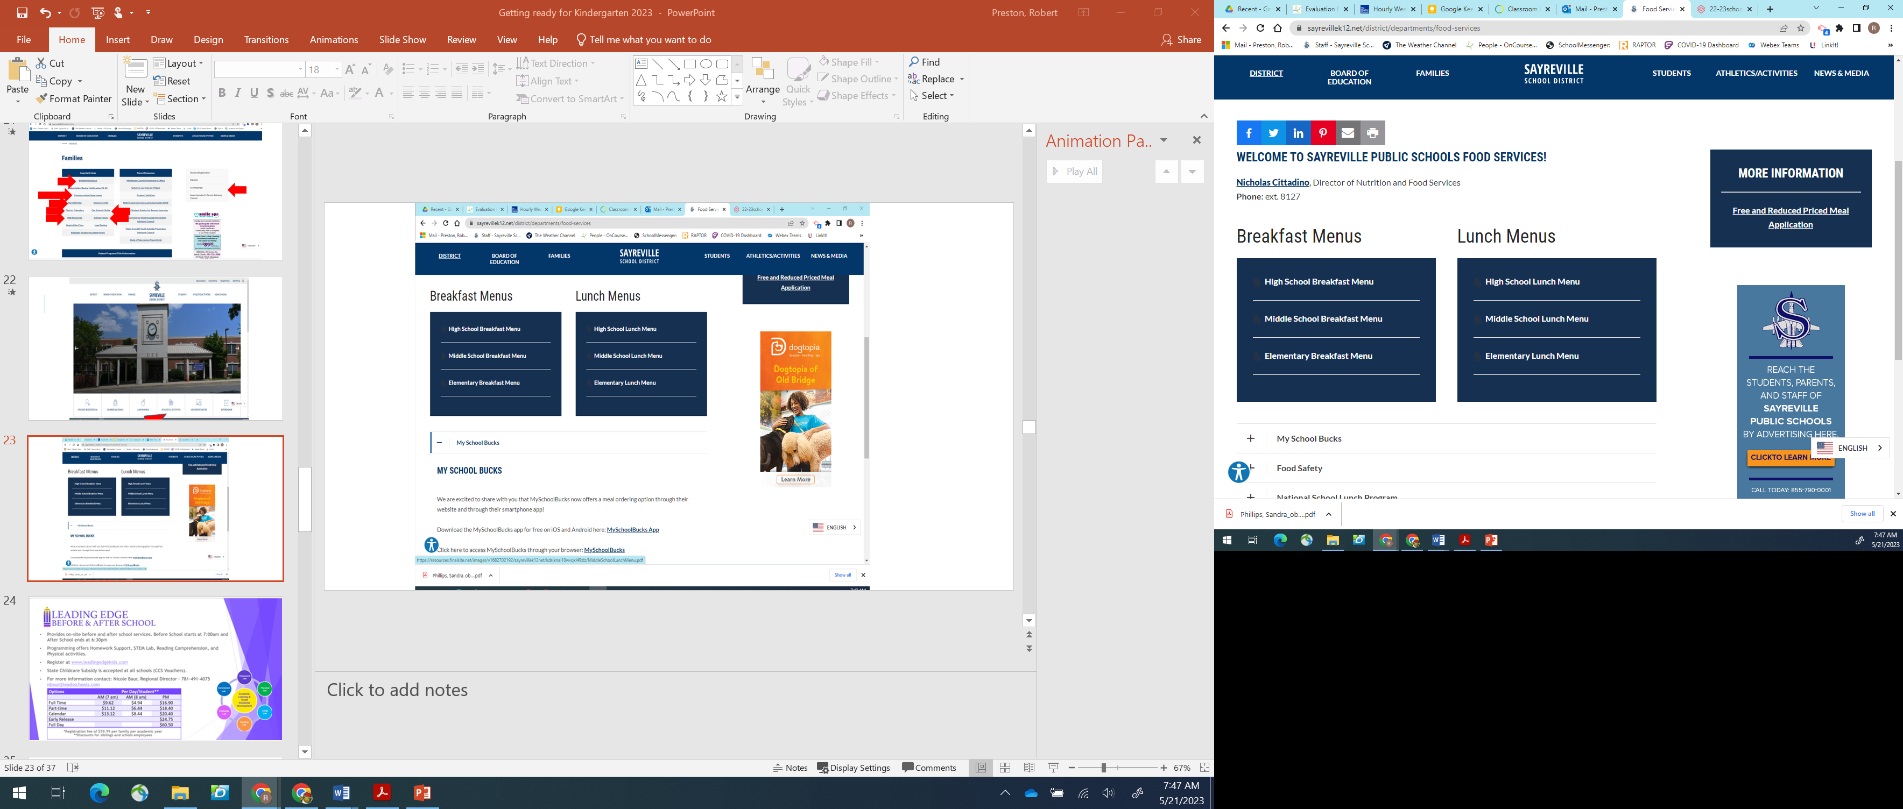
Food Services

Slide 25
Safety and Security
Campus Monitors
ID Required
Raptor
Drop Box
Student Pick-Up Forms
Security Vestibule
Bags Subject to Search

Slide 26
Safety and Security
Police in schools
  Share services agreement
  Security
  Patrol the building
  Assist with drills

Slide 27
Transportation
School Bus
Where is my bus stop?
Which bus does my child take?
My child has never been on a bus before…
If you reside within .7 miles of the school, your child is not eligible for a school bus. The .7 miles is measured using the shortest walking path.

Slide 28
School Bus Safety
Be there 10 minutes prior to bus arrival
Wait at designated bus stop in a safe place
Do not board the bus until it has stopped, and the bus driver has indicated to board
Remember never to stand in the danger zone that surrounds the bus. The danger zone is 10’ from all sides of the bus
All Kg-3rd grade students must be met at the bus stop by a parent. Please do not wait in your car or house

Slide 29
School Bus Safety
Take your seat and sit properly, facing forward at all times. The driver or principal will assign seats as necessary
Students must stay in their seats and seatbelt must be buckled at ALL times
Remove your backpack and place it under your seat or on your lap
Keep the aisle clear at all times
Always keep your head, hands and arms inside the bus
Talk quietly; the driver needs to concentrate to safely drive the bus.

Slide 30
School Bus Safety
Be absolutely quiet when approaching a railroad crossing
Please do not bring any toys on the bus and keep cell phones and other electronic devices in your backpack
Eating and drinking is not allowed on the bus at any time. This rule protects students or drivers that have food allergies, prevents choking, and maintains bus cleanliness.
Always follow the bus driver’s instructions

Slide 31
Transportation Contact Information
Questions?
Please feel free to reach out the Transportation Department
732-316-4045
TransDept@SayrevilleK12.net
patrick.cerniglia@sayrevillek12.net

Slide 32
Next Steps…
Finalize Registrations
      Annual Enrollment Update
      Vaccinations / Physical
September Orientation 9/3/2026
Reach out to your principal with any questions

Slide 33


