Slide 1
USAS
Fiscal Year End
Closing Procedures
2026
ACCESS
493 Bev Rd
Boardman, OH 44512

Slide 2
Things to consider prior to FYE
Closing out all possible purchase orders
FAQ Purchase Orders
Review old outstanding disbursements
FAQ Disbursements
Add/Customize Monthly Report Bundle
Scheduling a Custom Monthly Report Bundle
Maintenance of Effort (MOE)
Budget Summary MOE

Slide 3
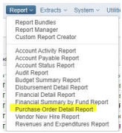

Closing Purchase Orders
If you have purchase orders that will no longer be needed or used, you may want to close these purchase orders so that the account encumbrances are not carried forward into FY2027. Depending on the Rules of your district, there are different options to close purchase orders.
  First locate your open Purchase Orders by running a
  Purchase Order Detail in the Canned Reports
  Users may create an AP Invoice in the current/open posting period to cancel the remaining encumbrance amounts. Select PO item(s) and select Cancel_Full for Item Status

Slide 4
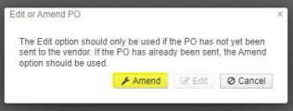
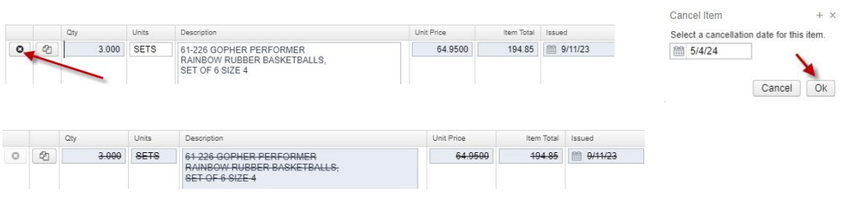
Closing Purchase Orders
  Open purchase orders that have never been invoiced may also be Amended
  Go to Core>Purchase Orders>Edit
  By Amending the PO, the user may cancel the PO line item(s) by clicking on the Cancel button and selecting a date in an Open posting period

Slide 5
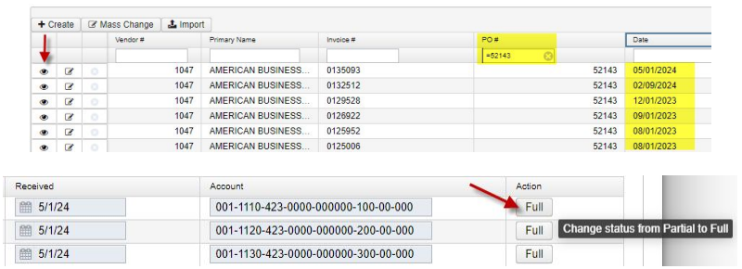
Closing Purchase Orders
You may also have the option to change the Status on a previously paid AP Invoice if the last partially paid invoice is dated in an open posting period, or if the posting period can be reopened per district rules
To do this, locate the last partially paid invoice by sorting the AP Invoice grid, viewing that invoice and clicking to update the Status from Partial to Full

Slide 6
Maintenance of Effort
Why important ?
Prior to funding, ODE/DEW annually compares the district’s local or state & local expenditures to ensure that the district budgets & expends at least the same amount of funds as the previous year
SSDT Budget Summary MOE Report
You can review the expenditures prior to these being reported to EMIS by running this report under Report>Report Manager which contains the account filter : ssdt-moe

Slide 7
Things you can do now
Verify Data
    District & Building information
    Accounts are valid
    OPUs for district
Prepare next year budgets & revenue estimates
          Training, Thursday, June 25
Prepare requisitions for next Fiscal Year

Slide 8
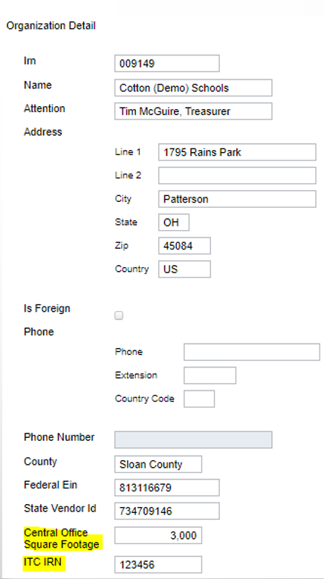
Pre-Closing Procedures
Organization Detail
  Used for Financial Reporting Period H
  Core > Organization
    Central Office Square Footage
    ITC’s IRN - No longer required for
    EMIS Extract

Slide 9
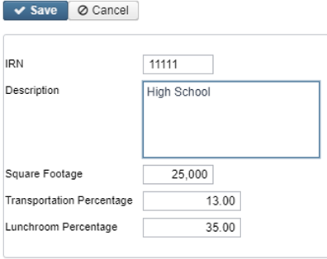
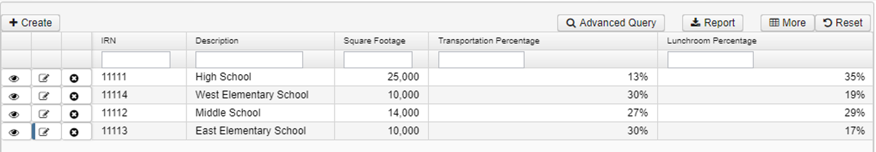
District’s Building Profiles
Periodic Menu > Building Profiles
Review & Update
    IRN number
    Square footage
    Transportation Percentage=100%
    Lunchroom Percentage=100%

Slide 10
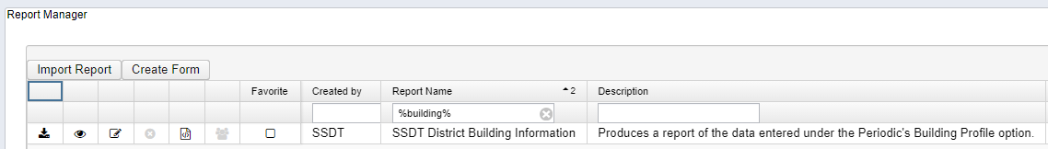
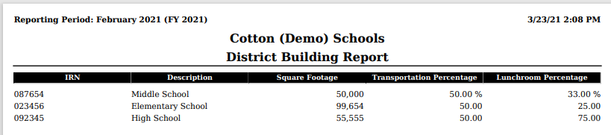
Verifying with Report
SSDT District Building Information Report

Slide 11
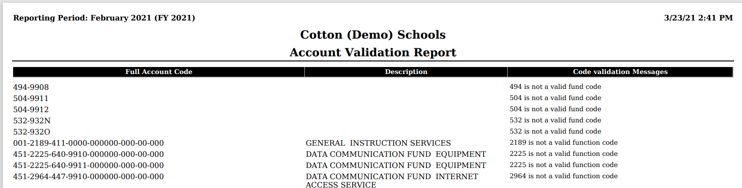
Account Validation
SSDT Account Validation Report
Ensures District has no invalid account dimensions prior to using the data collector to check for Level 1 / 2 errors

Slide 12
Examples of EMIS Errors
XXX is not a valid fund code
XXXX is not a valid function code
XXX is not a valid object code
XXXXXX is not a valid subject code
Receipt code XXXX is not at a valid level of detail
Receipt code XXXX is invalid as of (date)

Slide 13
Level 1 / Level 2 Validation Reports
Other warning messages that are validated in the data collector.
  Function, Object and/or Receipt must be defined at higher level of detail
  DEW requires SUBJ or IL to be entered for this func/obj in most cases
  DEW requires OPU to be entered for this func/obj per EMIS Guide
If district receives Level 1 or Level 2 fatal error(s) and has closed the fiscal year, June can be reopened to make any necessary changes.

Slide 14
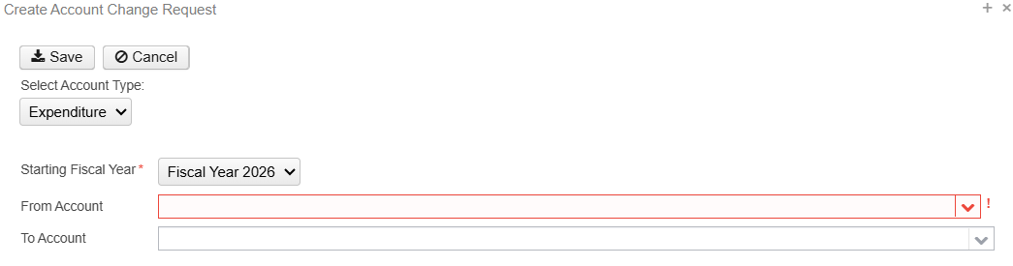
Account Validation Errors
Any accounts with Invalid Validation Errors that have amounts in the reporting fiscal year must be cleaned up by using Account Change under Utilities.

Slide 15
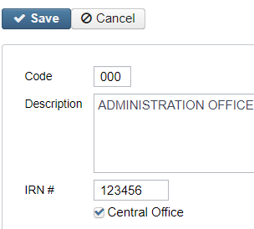
Review Operational Units
Review under Core menu or by running the SSDT OPU Listing Report under Reports
Verify IRN Numbers and Entity Types are accurate.
  OPU of 000 must be the reporting district IRN.
  All OPU’s must have an IRN defined within your district.
  The OPU for Central Office should be checked

Slide 16
Appropriations
Use the BUDGETING > SCENARIOS option to enter next year proposed Budgets and Revenue estimates.
Refer to Appendix > Useful Procedures for steps
    Budgeting Scenario Steps for creating Proposed Amounts for the Next Fiscal Year
    Training /Worksession Thursday, June 25

Slide 17
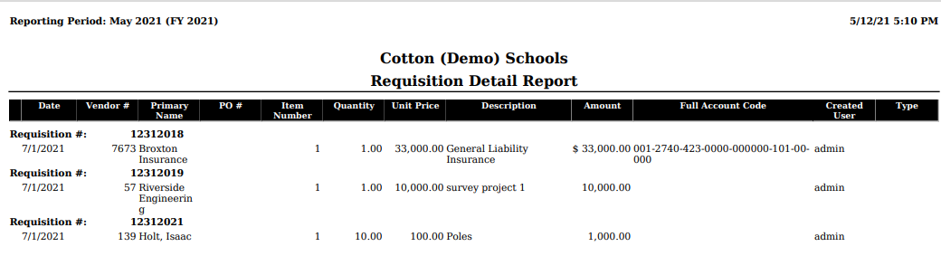
Prepare Requisitions/Purchase Orders
Requisitions/Purchase can be entered for July 2026
  Posting Period must be open for July
  July 2026 does NOT need to be current posting period

Slide 18
Month End Closing
Proceed with closing out for the month of June
Enter all transactions for the current month
Attempt to reconcile USAS records with your bank(s)
  Perform Bank Reconciliation Procedure (link is provided in the CYE checklist)
  Under Periodic menu, select ‘Cash Reconciliation’ to enter your cash reconciliation information for the month
Generate the SSDT Cash Summary report and the SSDT Financial Detail report
  The detail report may be run for the month in order to compare MTD totals to the Cash Summary report for June. Totals should match.
If totals agree . . . You are balanced and may proceed

Slide 19
Monthly Reports
Manually run & review any desired reports not included in the Monthly Reports Archive.
Monthly Reports Archive will automatically run when Period is closed.
Wait until the bundle is complete before closing another month
Reports can be viewed under Utilities>Document Storage

Slide 20
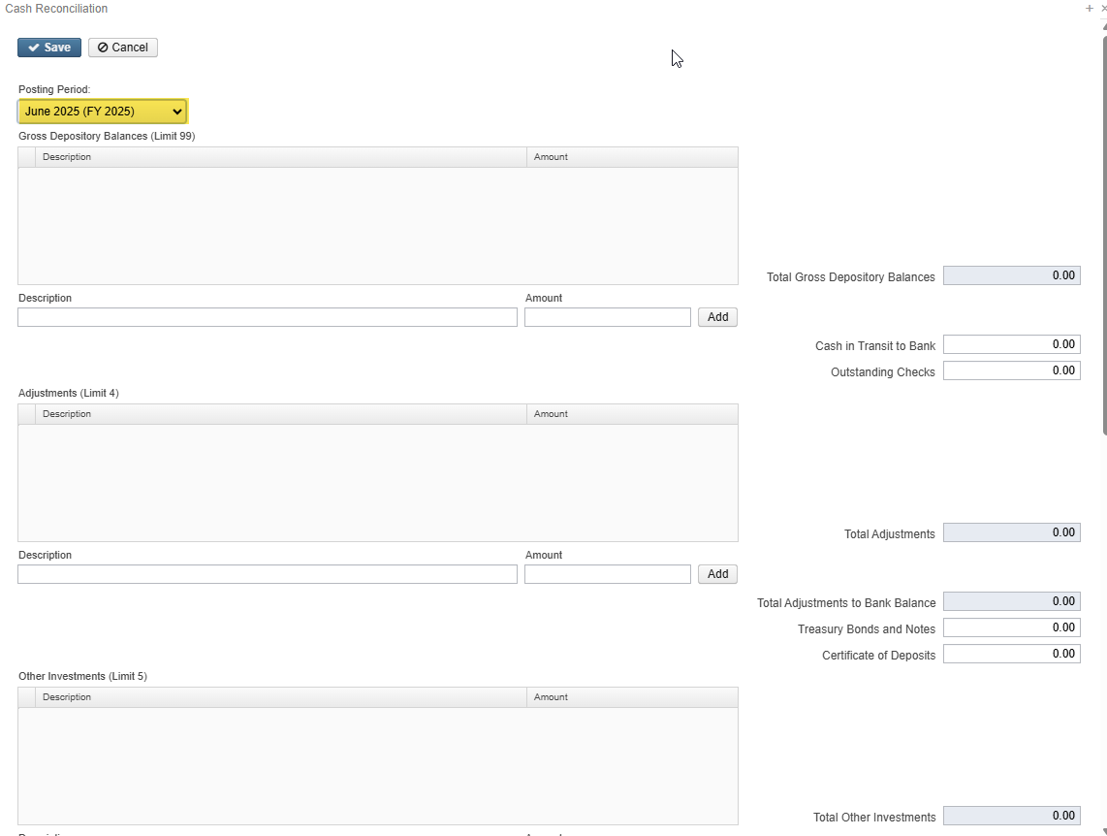
Fiscal Year End Closing
Under Periodic Menu:
  Confirm the CASH RECONCILIATION for June has been completed
  Periodic>Cash Reconciliation >Create
  Select the CIVIL PROCEEDINGS program to create/update civil proceedings

Slide 21
Fiscal Year End Closing
Note: Periodic > Federal Assistance
  FEDERAL ASSISTANCE is no longer required for EMIS Reporting.
    These steps are no longer needed prior to running the FYE Close or EMIS Extract
  After SSDT had reviewed this page for removal we received feedback that districts were using these pages to track their Federal Schedules for their auditors. These pages remain in the software due to this request and are optional to use at the district’s discretion.
  When using the Federal Assistances pages, the Federal Assistance Summary must be entered first to indicate the Fiscal Year. Then, Detail records can be added to
  that year.
Notes:
NOTE !!!! For FY22 check status of USASRFB-687 (FY bundle report parameters updated??) Suggestion to remove old FY if you don’t want bundle to include all years

Slide 22
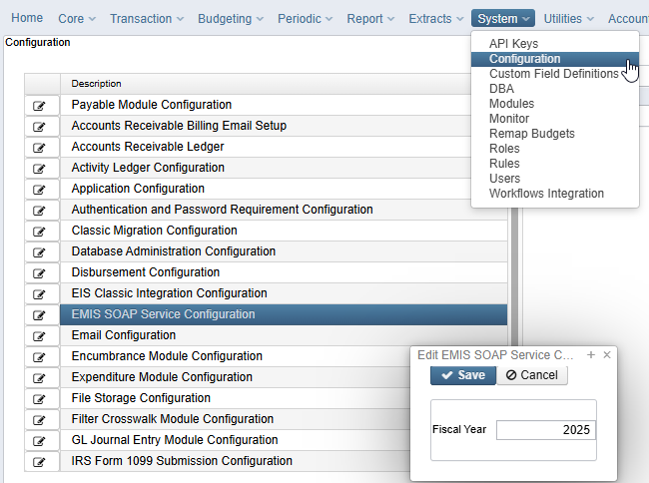
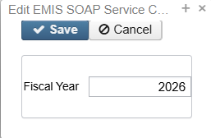
EMIS Extract
ACCESS has made sure the EMIS SOAP Service Configuration under SYSTEM/CONFIGURATION is update to reflect the Fiscal Year the district is reporting for Period H

Slide 23
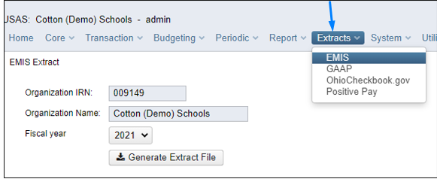
EMIS Extract
Under the Extracts Menu , Select EMIS and click on Generate Extract File to create a USAEMS_2026.SEQ file to be uploaded into the Data Collector for Period H reporting
Once the .SEQ file is uploaded into the Data Collector, it will be used
along with the USAS SIF Agent for EMIS-R collections.

Slide 24
EMIS Extract
EMIS Extract contains the same data as Classic’s partial file (USAEMS_EMISR.SEQ)
    CASH RECONCILIATION
    CIVIL PROCEEDINGS
    DISTRICT AND BUILDING PROFILE INFORMATION
    WILL EXCLUDE THE ACCOUNT AND OPERATIONAL UNIT RECORDS.
SIF Agent will pull other Period H files:
    CASH, EXPENDITURE, REVENUE ACCOUNTS
    ACCOUNT DATA
    OPERATIONAL UNITS

Slide 25
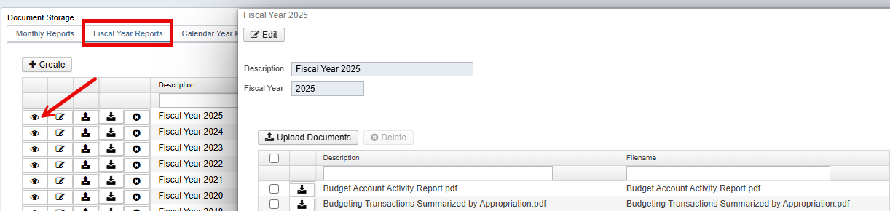
Fiscal Year End Reports
Manually run & review any desired reports not included in the Fiscal Year Reports Archive Bundle.
Fiscal Year Reports Bundle will automatically run when Period is closed.
Wait until the bundle is complete before changing the current posting period to a new period if there are custom report bundles scheduled to run on the PostingPeriodCloseCompleted or the FiscalPeriodCloseCompleted event.
Reports can be viewed under Utilities > Document Storage by clicking on the View Icon

Slide 26
Fiscal Year Report Bundle
Budget Account Activity Report (BUDLED)
Disbursement Summary Report (CHEKPY)
Financial Detail Report (FINDET)
Purchase Order Detail Report (PODETL)
Receipt Ledger Report (RECLED)
Void Refund Ledger Report (RECVOD)
Fund to Fund Transfer Ledger Report (RECTRN)
Reduction of Expenditure Report (RECEXP)
Refund Ledger Report (RECREF)
Error Corrections & Supplies Distributions (RECCOR)
Budgeting Transactions Summarized by Appropriation (RECAPP)
Transaction Ledger – Vendor Activity (TRNLED)
Revenue Account Activity (RECLED)
Civil Proceedings (USAEMSEDT)
Federal Assistance Summary (USASEMSEDT)
Federal Assistance Detail
USAS Auditor Extract – Account (USASAUD)
USAS Auditor Extract – Transaction (USASAUD)
USAS Auditor Extract – Vendor (USASAUD)

Slide 27
Close the Fiscal Year
            Create July 2026 (FY 27) Posting Period
              Click on CREATE, select July, enter 2026 for the Calendar Year, but do not make current
            To close June and the Fiscal Year, go to Core > Posting Periods
Click to close June.
  Both the Monthly Reports and Fiscal Reports bundles will automatically run when the last posting period of the fiscal year is closed
      NOTE: If there are custom report bundles scheduled to run on the PostingPeriodCloseCompleted or the FiscalPeriodCloseCompleted event, users should allow the custom bundles to complete before changing the current posting period to a new period.
Once Report Bundles are complete, make July 2026 current.
You are now closed for the month and fiscal year

Slide 28
  POST CLOSING PROCEDURES

Slide 29
District Audit Job for AOS
Schedule District Audit Job
  SSDT USAS AUDITOR EXTRACT – ACCOUNT
  SSDT USAS AUDITOR EXTRACT – TRANSACTIONS
  SSDT USAS AUDITOR EXTRACT – VENDOR
  SSDT CASH SUMMARY
  GAAP Extract
Utilities > Job Scheduler > Create
  When this job runs, it will generate reports for the PREVIOUS FISCAL YEAR based on the current period which is why we ask that all districts be closed by July 24, 2026
  When the Audit Job runs, it will send reports to the Document Storage Audit Reports
  section AND it will securely file transfer a copy of the reports directly to AOS.
ACCESS has already scheduled these jobs to run, so you do not need to do anything

Slide 30

FINANCIAL DATA REPORTING
Financial Data Submission to DEW
  Process is done through EMIS-R
  Responsibility of the District
  Authorized person in district (i.e. EMIS Coordinator, Treasurer) will UPLOAD flat file, run the data collection process & submit the data to DEW
  Must be sent to DEW before Period H closes for fiscal year (8/31/2026)
  Reminder: As of FY20, capital assets are no longer needed and are NOT to be included in the data collection

Slide 31
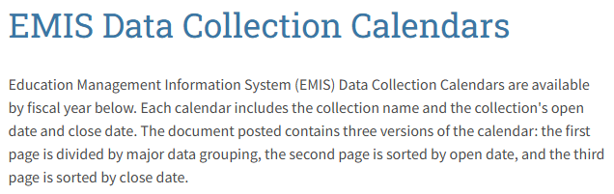
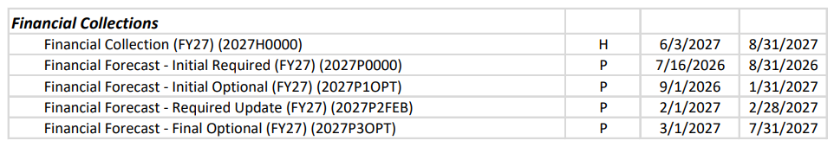
PERIOD H - Financial Reporting

Slide 32
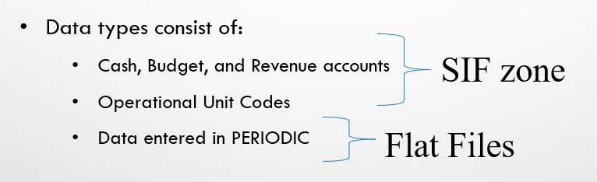
Financial Reporting Special Notes
Districts only needs to upload the sequential file (from the EMIS EXTRACT) in the “financial” data source in EMIS-R. When they are ready to run a collection in the data collector, they will select the USAS SIF agent and the “financial” data source.
The “EMIS Soap Service Configuration” tells the SIF if it should pull account information from the history records or the current account file

Slide 33
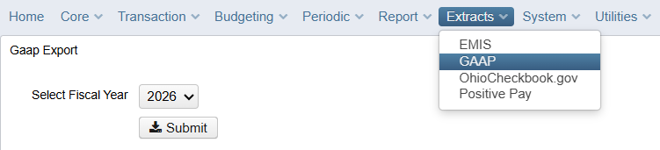
GAAP EXTRACT
Run GAAP from Extracts menu to create necessary file for GAAP reporting
  Select the Fiscal Year and click on ‘submit’ to generate the GAAPEXPORT.TXT file
  Attach file in an email to person(s) responsible for uploading the file into WEBGAAP.

Slide 34
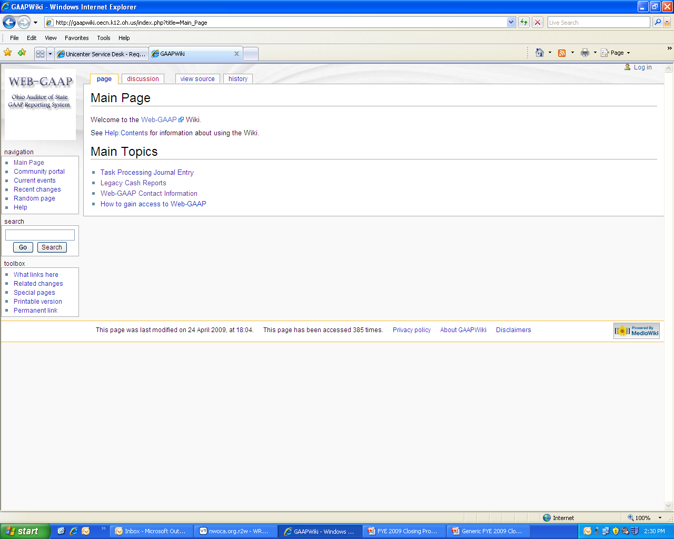
Web-GAAP
Web-GAAP Link
  https://webgaap.ohioauditor.gov/webgaap/
GAAP Wiki
https://webgaapwiki.ohioauditor.gov/

Slide 35
AOS USAS Manual
Uniform School Accounting System User Manual updated May 2026
USAS Options
  Mass Load can be used to add expenditure and revenue accounts
  Mass Change to inactivate all accounts associated with inactive cash accounts
  Distribution/Error Corrections to re-assign expenditures originally charged to a different account
  Cash Account Change when moving an entire fund to a new one that doesn’t exist.
    To Fund/SCC Cannot previously exist
    From Fund/SCC and all underlying accounts will be made inactive

Slide 36

Questions
Upcoming Trainings
Thursday, June 25, 2026
    Account Change, Budgeting and Certification Worksession
Thursday, July 9, 2026
    Fiscal Staff Final L EMIS Training and Worksession
October 22/23, 2026
    ACCESS Site Review *SAVE THE DATE*
Fiscal Worksessions every Thursday thru the end of July

