Slide 1




Palmetto
Community School Steering Committee
April 6, 2026

Slide 2



Agenda
• Welcome and snacks
• Review the four pillars
• Palmetto Community School updates
• Student draft survey review
• Staff draft survey review
• Next steps

Slide 3
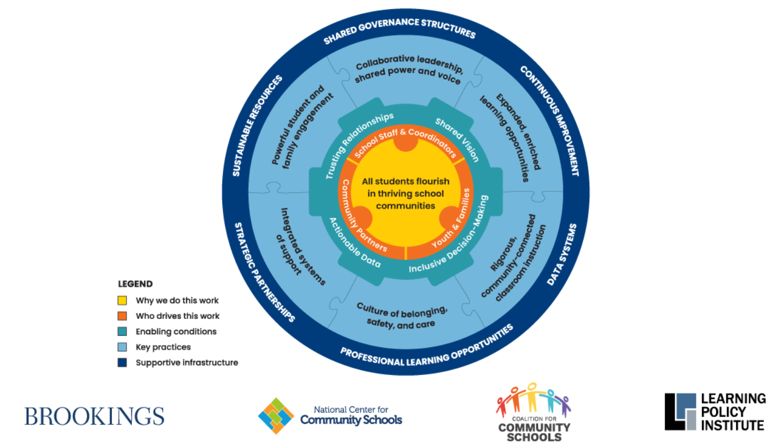




Slide 4
Palmetto Community School Updates
  Services
  Parent Workshops and School Events
  Interest in Focus Group
Notes:
Services: food pantry, mental health and health clinics
Parent workshops: Nutrition, cooking, helping with homework, managing child's behavior, computer skills
School events: Conflict with work and need time frames of events
Focus Group: Over 100! (110)

Slide 5


  Review Draft Student Survey individually
Student Survey
  Discuss in small groups
  Whole group discussion

Slide 6

  Review Staff Survey independently
Staff Survey
  Discuss in small groups
  Whole group discussion

Slide 7

What’s Next
May 4th Initial Data Review
Focus Groups
Empathy Interviews
Analysis of completed ANA

Slide 8

Happy Spring!

