Slide 1

Palmetto Community School Steering Committee
February 10, 2026

Slide 2
Agenda
Welcome and snacks
Get to know each other activity
Four pillars review
Palmetto Community School updates
Parent/Guardian draft survey review
What's next
Fire drill

Slide 3
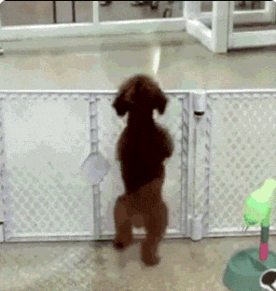

Get to know each other activity
Find a picture on your phone which brings you joy
Share why it brings you joy with at least one other person

Slide 4

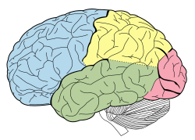






Four Pillars
Integrated Student Supports
Expanded and Enriched Learning
Active Family and Community Engagement
Collaborative Leadership
This Photo by Unknown Author is licensed under CC BY-SA
This Photo by Unknown Author is licensed under CC BY-ND

Slide 5
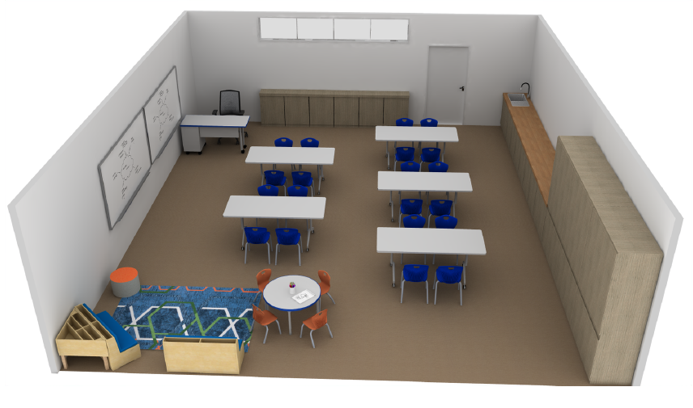
Updates
Parent Center

Slide 6

Student Wellness center

Slide 7
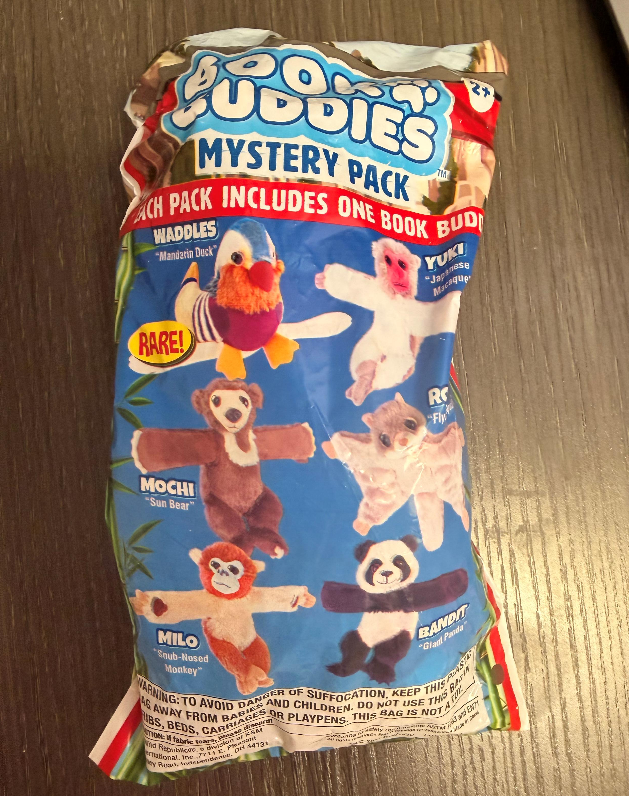
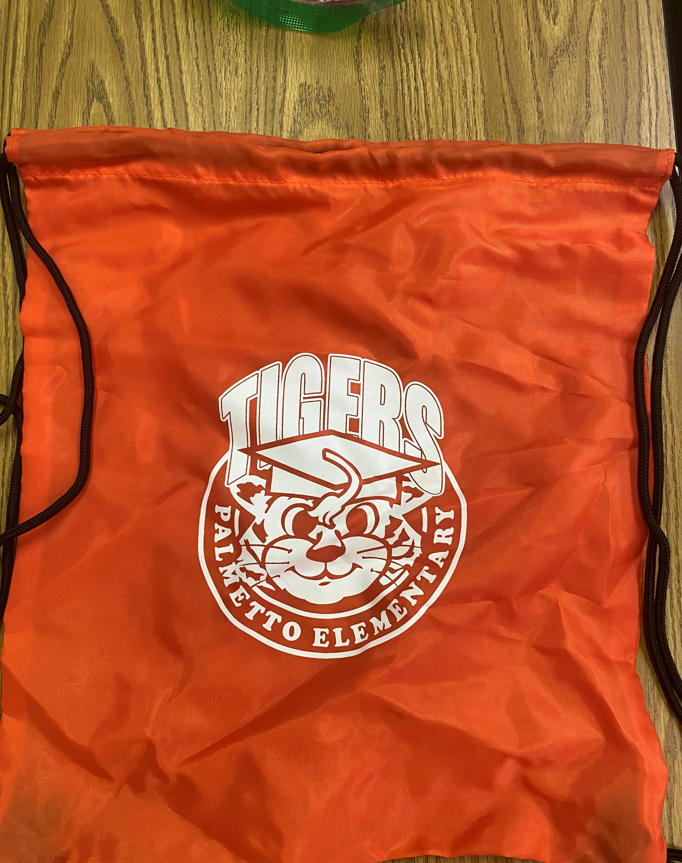
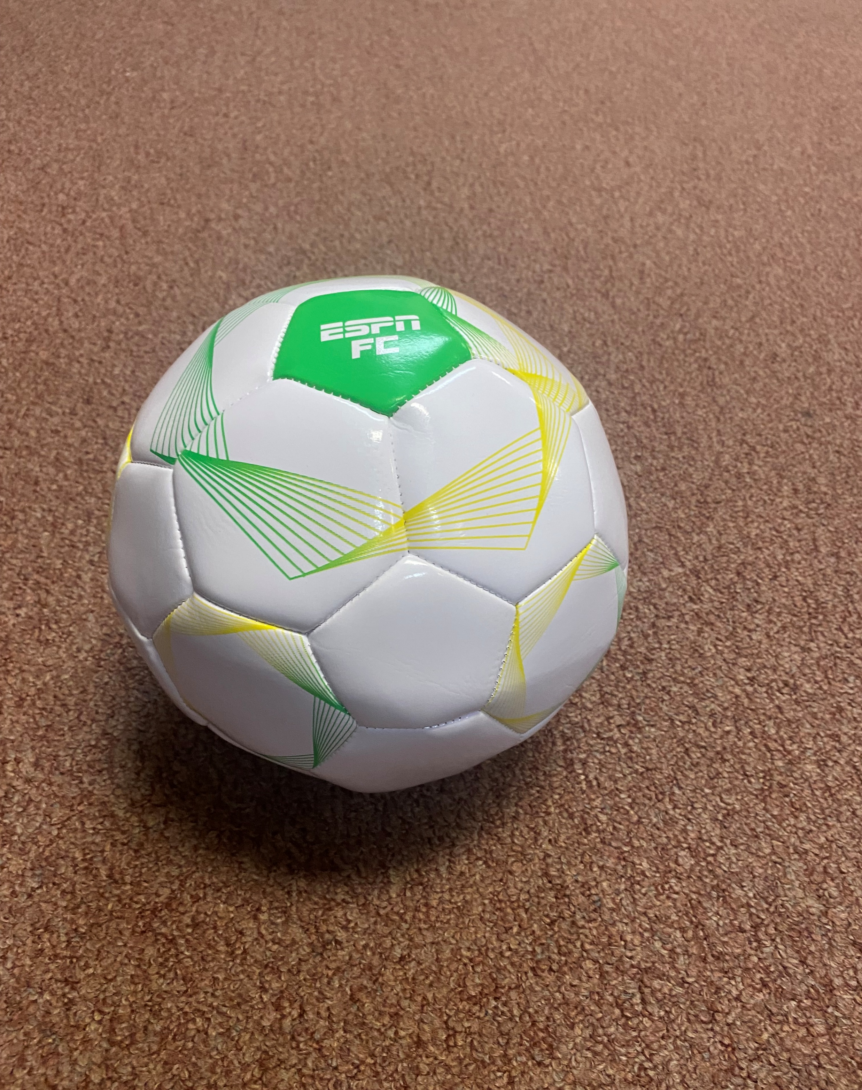
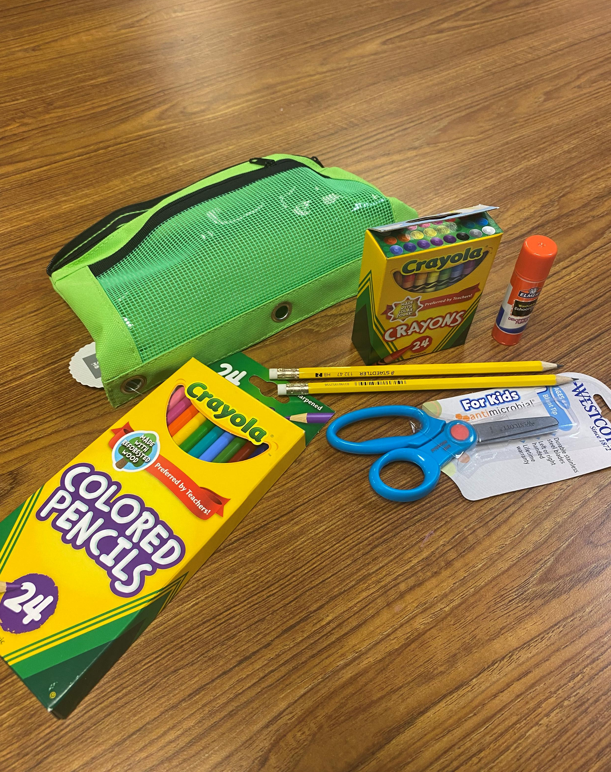
5 star rewards

Slide 8


Slide 9
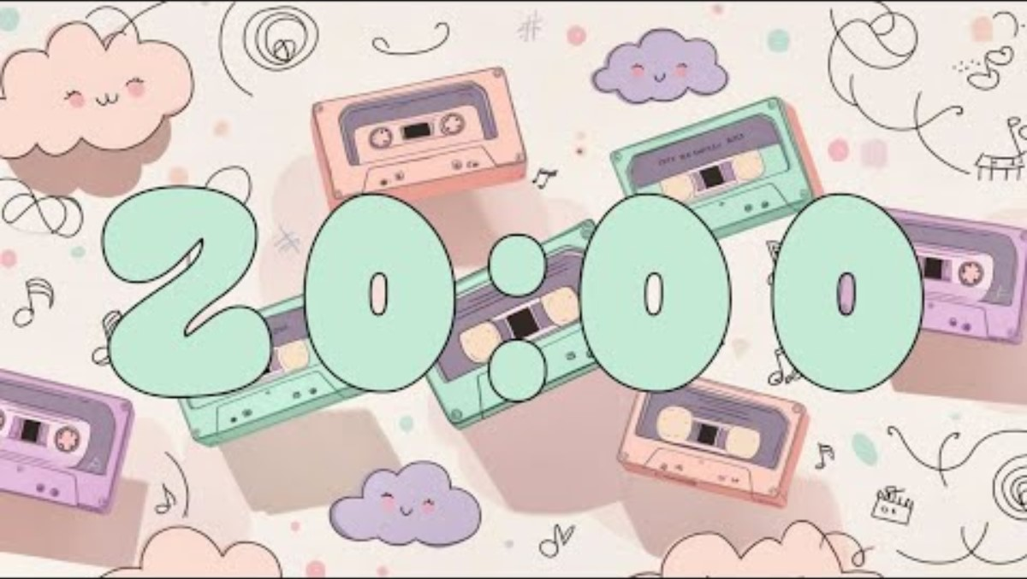

Parent/Guardian Survey
Review draft questions individually
Discuss in small groups
Whole group discussion
Notes and feedback will be collected
Looking for comments and suggestions
3 groups of 4 or more (parent, teacher/staff, student)
Identify the following:
  Most helpful 😁
  Least helpful ☹️
  Confusing 😵‍💫
Draft ANA Survey Questions Parents.docx

Slide 10
What’s Next?
Meet Monthly
  First Monday each month @ 1:00
Review draft student survey (March 2nd)
Review draft staff survey (April 6th)
Data analysis (May 4th)

Slide 11


