Slide 1







PALMETTO COMMUNITY SCHOOL STEERING COMMITTEE
October 16, 2025

Slide 2


AGENDA
What is a Community School? Why?
Where are we in the process?
What’s next?
Questions, comments, feedback, addtions

Slide 3





WHAT IS A COMMUNITY SCHOOL?
  Whole Child Approach
  Serves as a ‘hub’ for both students and our neighborhood community
  Academic, health and social services
  Equity driven practices
Nea.org

Slide 4















FOUR PILLARS
Integrated Students Supports
Expanded and Enriched Learning
Active Family and Community Engagement
Collaborative Leadership
CTA.org

Slide 5
WHY A COMMUNITY SCHOOL?
Key Findings
How?
Meets the needs of diverse learners
Significantly reduces chronic absenteeism
  Eliminates barriers
  Provides equal opportunities for all students
  More time focused on academics
  Strengthens family commitment to school
  Increased community support
Reduction in suspension rates
Improved student test scores
Largest gains for historically underserved st.
Attendance gains lead to improvements in test scores
Learning Policy Institute report 9/15/2025
For each $1 invested in the Coordinator returns approximately $7 in net benefits.
Social Studies
Return on Investment of a Community School Coordinator

Slide 6



PALMETTO
Implementation Year 1
School Plan for St. Achievment
  Building relationships
  Building community partnerships
  Mapping
  Assests and Needs Assessment
  Implementation Plan
    Community School Coordinator (TOA)
    PLC hours (CBL project)
    Classified hours
    Wellness Room (Zen Den)
    Field trips
  Family Resource Center
Expanded Learning
  Braided funding source

Slide 7



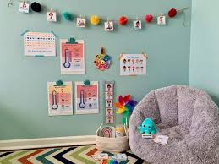
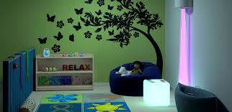
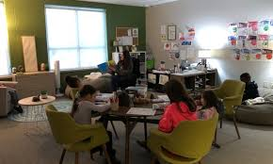
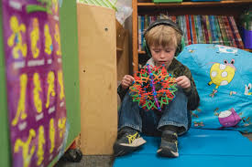
ZEN DEN WELNESS ROOM

Slide 8
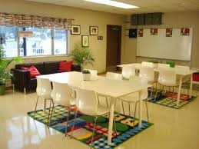
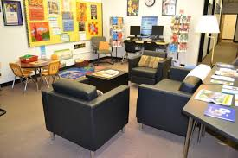
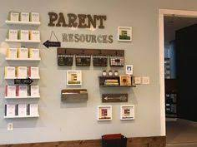
FAMILY RESOURCE CENTER

Slide 9


WHAT’S NEXT?
Asset and Needs Assessment
Who?
  Palmetto Staffulty
  Parents and Guardians
  Community Members
What is an ANA?
  Systematic process of collecting information to better understand priorities and challenges
  Shows our unique strengths, resources, and expertise
  Informs the Implementation Plan
How?
75%
  Survey
  Focus Groups
  Interviews
  School Reports
Community Schools Learning Exchange

Slide 10


QUESTIONS
COMMENTS
FEEDBACK
ADDITIONS

Slide 11
THANK YOU!

Slide 12
PRESENTATION MODE
Press the following keys while on Present Mode for some fun with Canva Presentation
B for Blur
Q for Quiet
D for Drumroll
U to Unveil
C for Confetti
M for Mic Drop
O for Bubbles
0-9 for a Timer

