Slide 1
Fixed Assets
ACCESS
493 Bev Rd
Boardman, OH 44512
District Inventory
Fiscal Year-End
Closing Procedures
2026

Slide 2
Pre-Closing Procedures
Finish all current year processing.
  Add new items
  Enter Acquisitions and Dispositions
  Use Transfers to update items Fund, Function, or Asset Class
Items received on or prior to June 30^{th,} 2026 should be added to Inventory for FY 2026.
Items received after June 30th can added to the Inventory pending file for FY 2027.

Slide 3
Pre-Closing Procedures
Generate and review the Acquisition/Original Cost Mismatch Report
  Identify items that have an original cost value on the item different than the total qualifying acquisitions
    Transactions > Item > Original Cost
    Transactions > Acquisitions> Total of all acquisitions marked true to “Update Original Cost”

Slide 4
Pre-Closing Procedures
Generate and review the Acquisition/Original Cost Mismatch Report
  This can only happen for Items migrated from Classic software without corresponding acquisitions
    Pre Data Extract Procedures Acquisitions Prior to System Start-up amount
    Option to add ‘historical’ acquisition records to prevent (may have been cleaned up)
  For any items created or imported to Inventory, the Original Cost will be calculated based on acquisitions so it's not possible going forward

Slide 5
Pre-Closing Procedures
Acquisition/Original Cost Mismatch Report
  Select Report Type: Can choose Fund, Function, or Asset Class
  Select Item Statuses: Active, Excess Asset Held For Sale, Excess Asset Not in Use, New Item. (Disposed of items for the current fiscal year may also need to be reviewed but starting with the active items may help determine if these transaction types exist)

Slide 6
Pre-Closing Procedures
Acquisition/Original Cost Mismatch Report
  Why this is important: Prior to November 2025, the Schedule of Change in Fixed Assets used the item’s original cost to calculate totals, now it uses acquisition totals.
  Calculation change allows beginning balance to calculate more accurately - Accounts for Payment Acquisitions, can generate for prior year dates and accurately calculate balances when acquisitions have been added to existing items in later years.

Slide 7
Pre-Closing Procedures
Acquisition/Original Cost Mismatch Report
  The Original Cost and Acquisitions to update the Original Cost should be the same. However, if these were not cleaned up on migration, they could be different. That is what the report will help identify.
  Differences occur between Schedule of Change reports generated in current instance and saved FYE Bundle reports generated prior to November 2025.
  Correction Procedures

Slide 8
Item Organization
Item Groups
  Each item is designated a Fund, Function, and Asset Class
  These groupings are used to sort and group items on reports in the software
    Fund
    Function
    Asset Class

Slide 9
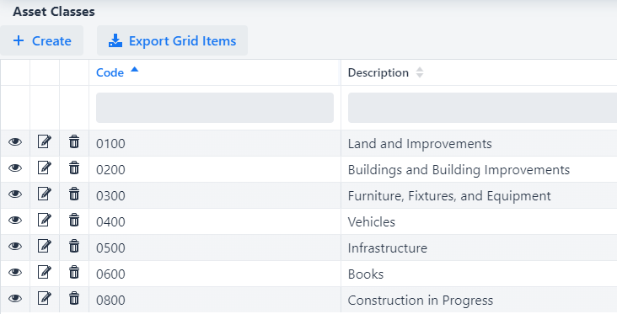
Item Organization
Core Menu
  The different options for each of these groups is defined in the Core menu. These are configured by the district so the setup and details will vary

Slide 10
Item Organization
Core > Funds
  Funds are used to define the item's current fund for which an item is currently being used.
  The fund code is not necessarily the source from which the item was purchased.
  The Fund code is also attached to a fund Type: Governmental, Proprietary, Fiduciary
Source vs. Fund Code
  Each item will only be linked to ONE fund code, regardless of how many acquisitions it could have been purchased from
  Most reports that sort by “Fund” are using the fund code from the item
  Exceptions to this are reports that reference “Source”
    Source reports will look at the acquisition account code from the PO

Slide 11
Item Amounts
Original Cost
  The cost of the item as given on the purchase order(s) or the sum of all acquisition amounts for the tag number.
  This cannot be manually changed, this will always be the total of the existing acquisitions
  Part of what determines the Capitalization of the item
LTD Depreciation
  The Life-to-date depreciation. This is the total amount of depreciation for the item from the beginning depreciation date until the last fiscal year closed.

Slide 12
Fiscal Year-End Closing Procedures
When all assets have been entered for the FY, district can run the recommended list of reports (this includes all necessary GAAP reports if GAAP is enabled for the entity).
All recommended FYE reports are explained in the upcoming slides.

Slide 13
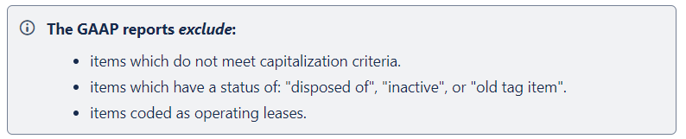
GAAP Reports
GAAP Reports
  All GAAP reports are canned reports and are located under the Reports menu. They are generated in PDF format only. The reports contain separate sections for each fund type (governmental, proprietary, fiduciary).
  GAAP reports only show Items that meet certain criteria

Slide 14
GAAP Reports
Fixed Assets by Source…..summary of the original cost of capitalized items by their source (or fund) the items were charged to on the purchase order
  Source means “the fund the items were originally charged to when purchased”
  uses the PO information from the acquisition record to identify the source fund used in purchasing the items.
  Report Filename: FixedAssetBySourceReport.pdf

Slide 15
GAAP Reports
Fixed Asset by Function and Class….schedule of fixed assets by function and class.
  May generate up to three different report formats:
    Schedule by Function & Class - displays original cost & book value
    Schedule by Class - displays original cost & book value
    Summary by Function and Class - choose to summarize by 2-digit function and may report on original cost or book value
      For FYE, it is recommended to generate the report for all three formats
  Book Value is the Original Cost minus Total Depreciation
  Report Filename: FixedAssetByFuncClassReport.pdf

Slide 16
GAAP Reports
Schedule of Change in Fixed Assets
Contains “changes” in capital assets during the current fiscal year
Ability to generate a summary or detail report
Ability to generate the report by asset class, fund or function.
  For FYE, it is recommended to generate the report for all three types
Report Name: ScheduleOfChangeReport.pdf
Summary report lists the beginning balance, acquisitions, dispositions, transfers in/out, adjustments and the ending balance in column format.
Detailed report lists individual tags that make up the acquisitions, dispositions, transfers, or adjustments amounts that happened in the year.

Slide 17
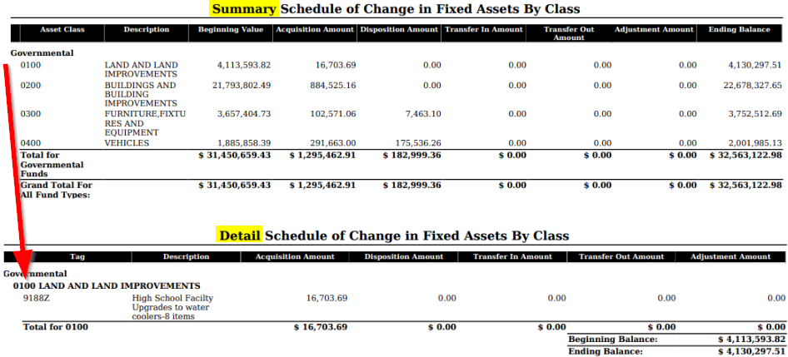
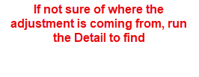
GAAP Reports

Slide 18
GAAP Reports
Totals on the
  Fixed Assets by Source
  Fixed Asset by Function and Class
  Schedule of Change in Fixed Assets
Original Cost amounts should match when balancing out for fiscal year-end.

Slide 19
GAAP Reports
Schedule of Changes in Depreciation
Contains “changes” in depreciation of capital assets during the current fiscal year
Ability to generate a summary or detail report
Ability to generate the report by asset class, fund or function
  For FYE, it is recommended to generate the report for all three types
Report Name: ScheduleOfChangeInDepreciationReport.pdf
Summary report lists the beginning depreciation, continuing items, acquisitions, dispositions, transfers, adjustments and ending depreciation balance in column format.
Detailed report lists individual tags that make up the acquisitions, dispositions, transfers or adjustment amounts.

Slide 20
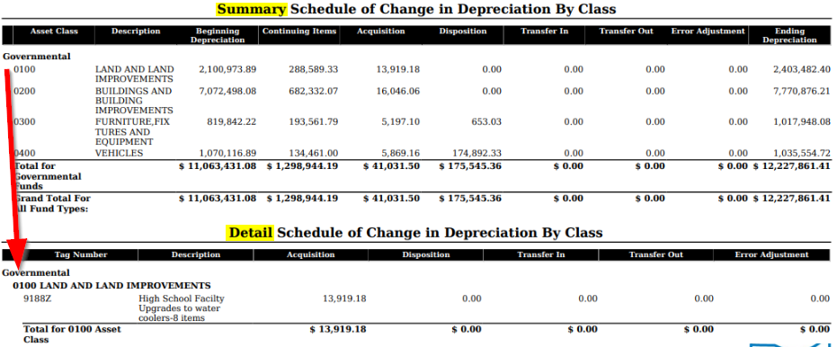

Slide 21
Suggested Non-GAAP Reports
Asset Listing by Grant/Source listing of acquisition transaction data by source account code and/or grant identifier
Brief Asset Listing brief listing (one line per item) of all assets or a subset of them.
  Recommended 5 versions of the Brief Asset generated at FYE
    Include capitalized items only and Status codes of “Active, New, Excess Asset Held for Sale, and Excess Asset Not in Use (with the exception of the disposition report)
      Brief Asset Listing by fund
      Brief Asset Listing by function
      Brief Asset Listing by asset class
      Acquisitions for current fiscal year
      Dispositions for current fiscal year
ed Non-GAAP Reports

Slide 22
Suggested Non-GAAP Reports
Book Value Report displays depreciation information listing original cost, salvage value, book value, % of depreciation, and last year of useful life.
  The current FY is used for the reporting date.
  Recommended 4 versions generated at FYE
    Include capitalized items only and Status codes of Active, New, Excess Asset Held for Sale, and Excess Asset Not in Use (with the exception of the disposition reports below).
      Book Value Report by function
      Book Value Report by class
      Depreciation for current FY dispositions by function
      Depreciation for current FY dispositions by class

Slide 23
Suggested Non-GAAP Reports
  Audit Report
  tracks changes made in the application
Depreciation Posting Report
  contains the projected FTD depreciation and Book Value amounts, sorted and subtotaled by asset fund with a grand total at the bottom of the report
Fiscal Year Ending Balances Report
  contains the projected ending (original cost) balances for the current fiscal year (displayed in 'Current Fiscal Year' field).

Slide 24
Fiscal Year-End Closing Procedure
Close the current fiscal year by clicking the Close Icon in Core>Fiscal Years
  Advances ‘Last Closed Fiscal Year’ date in Core>Configuration by one year
  Adds one year’s worth of depreciation to LTD depreciation field
  Updates beginning balance fields for new FY on the item record
  Generates Inventory FYE Bundle
    Generates the necessary reports and sends them to Document Storage

Slide 25
FYE Bundle
  FYE Bundle zip file will no longer be emailed now that Document Storage is setup and connected to the District’s Inventory.
  This will now be seen under System>Document Storage

Slide 26
Fiscal Year-End Closing Procedure
  In Core>Fiscal Years, create FY2027, open the year and make it current to start processing inventory for the new year

