Slide 1
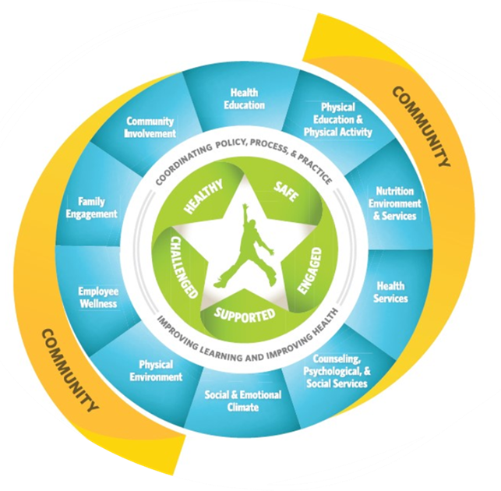
School Health Advisory Council
October 23, 2025

Slide 2

SHAC Meeting #2 of the 2025-2026 School Year

Slide 3
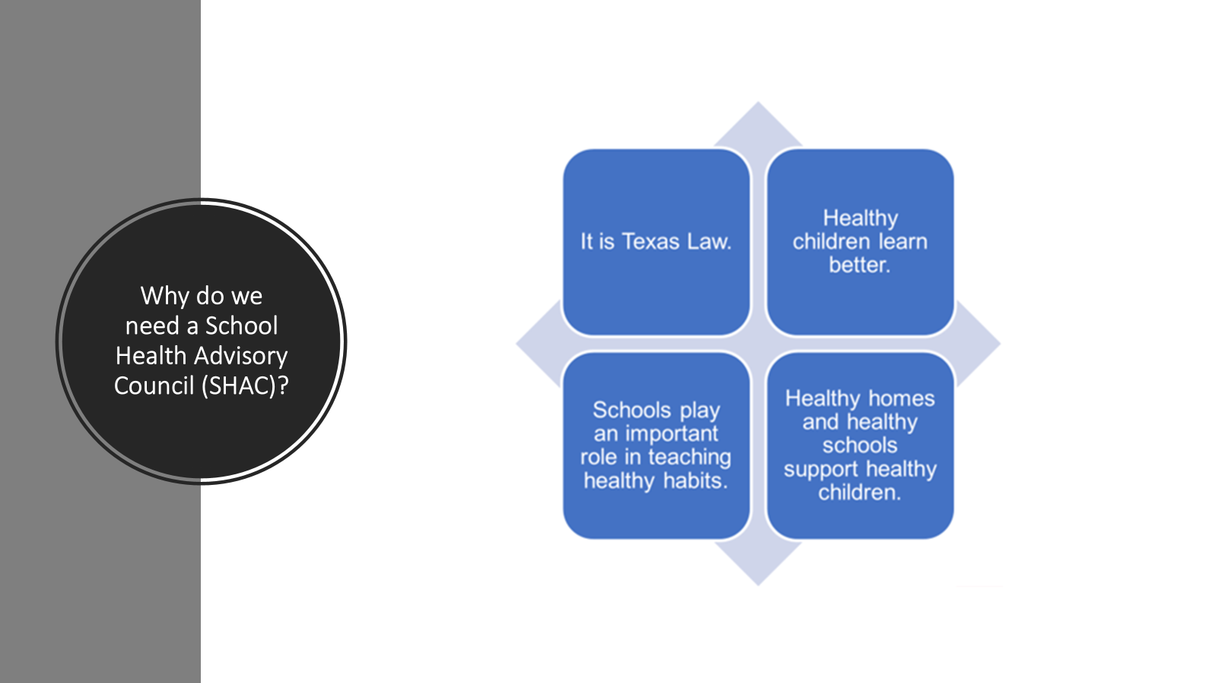

Slide 4
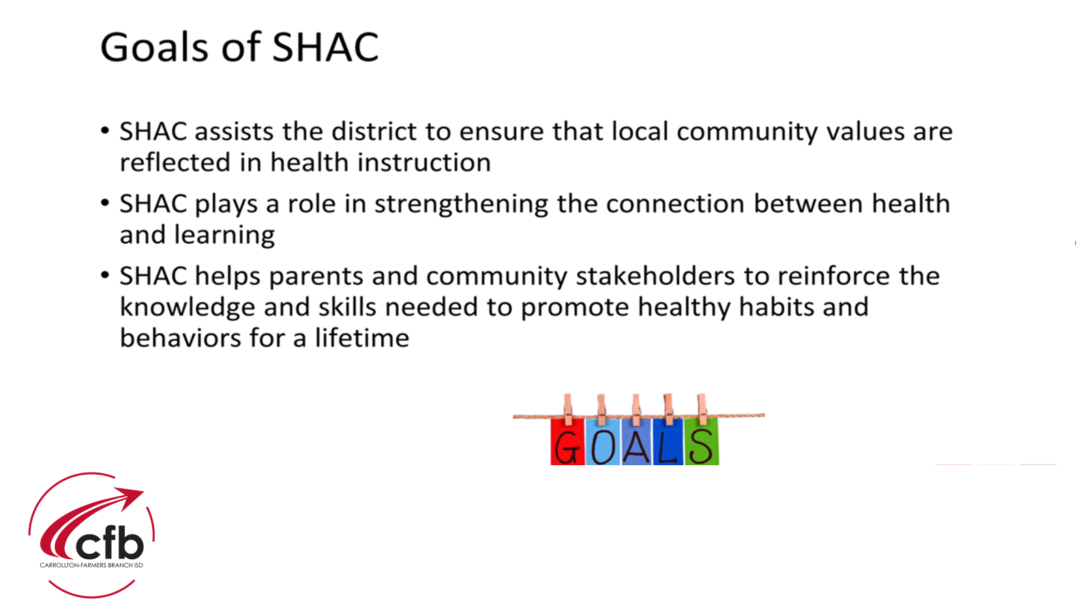

Slide 5
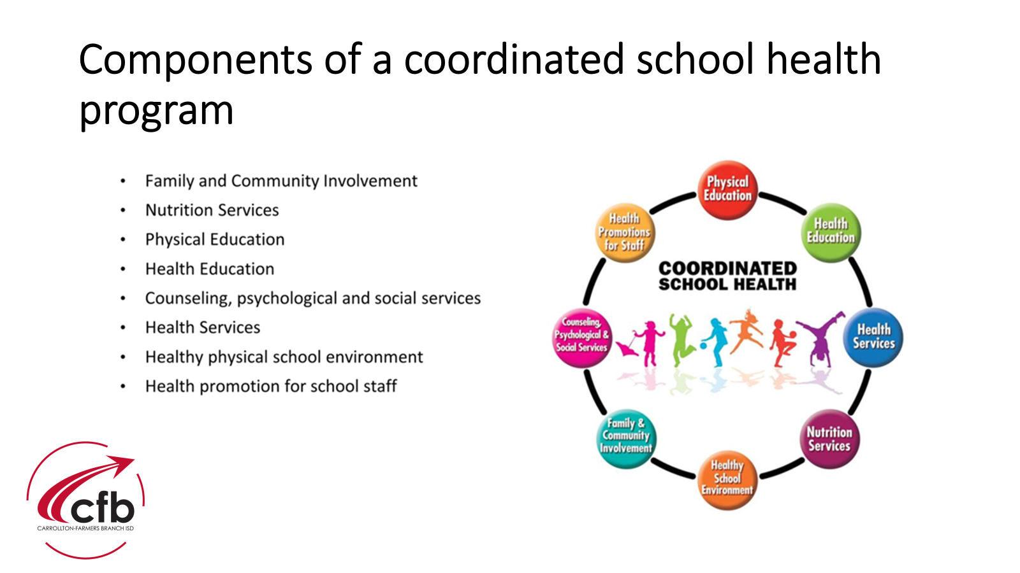

Slide 6
Appointed SHAC Members for
2025-2026 School Year
Parents/Community Members
April Hooper-Christenson
Zoher Bharmal
Lyat Mizrahi
Maria A Retiz
Caleb Rosier
Lacey Tomanek
Elizabeth Aviles
Gwen Perkins
Melissa Munoz
Jaclyn Poole
Josh Carter
Dr. Lakshmi Ananthakrishnan
CFBISD Staff
Leon Sulak
Rachael Freeman
Sandra Lieck
Sylvia Mazuera
Laura Brookover – Ybarra
Renee Putter
Jonathan Wilk
Kim Graham
Linda Villemarette
Veronica Morales
Board of Trustee Representative
Ileana Garza Rojas

Slide 7


Slide 8
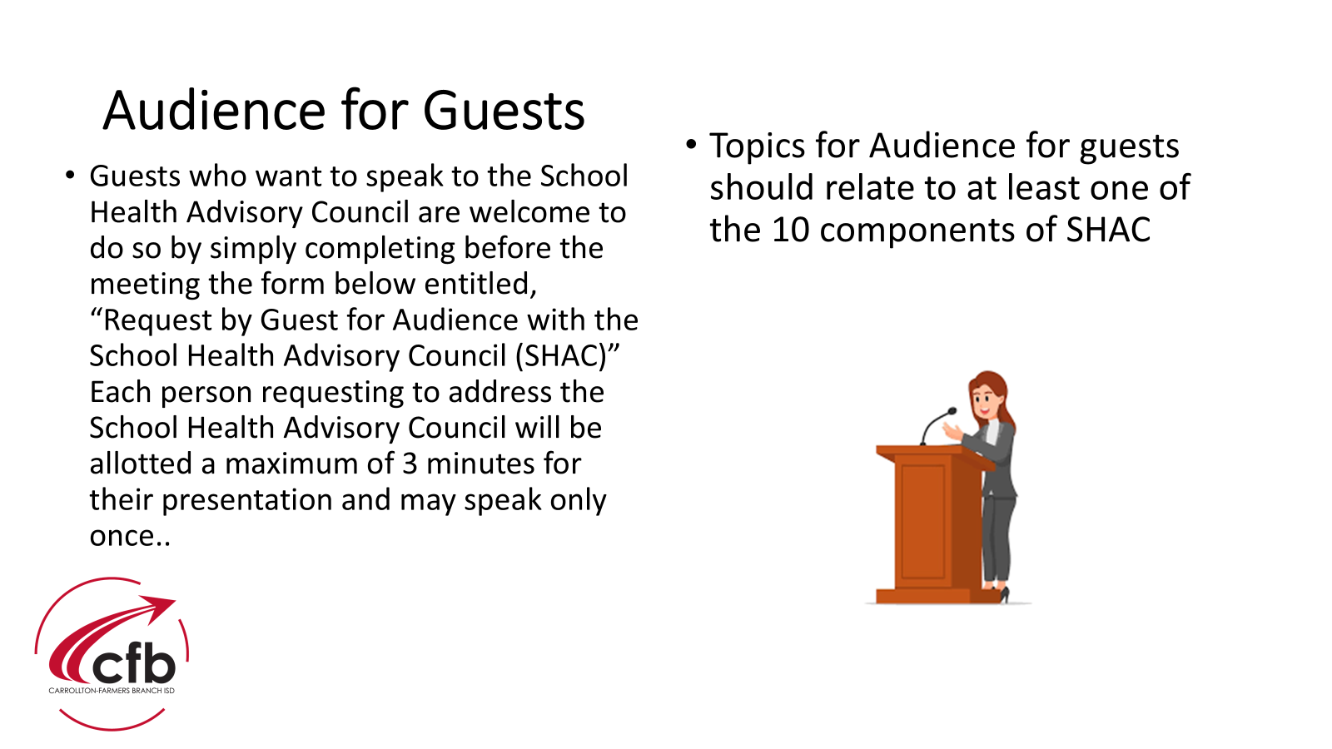

Slide 9


Slide 10


Slide 11



Slide 12
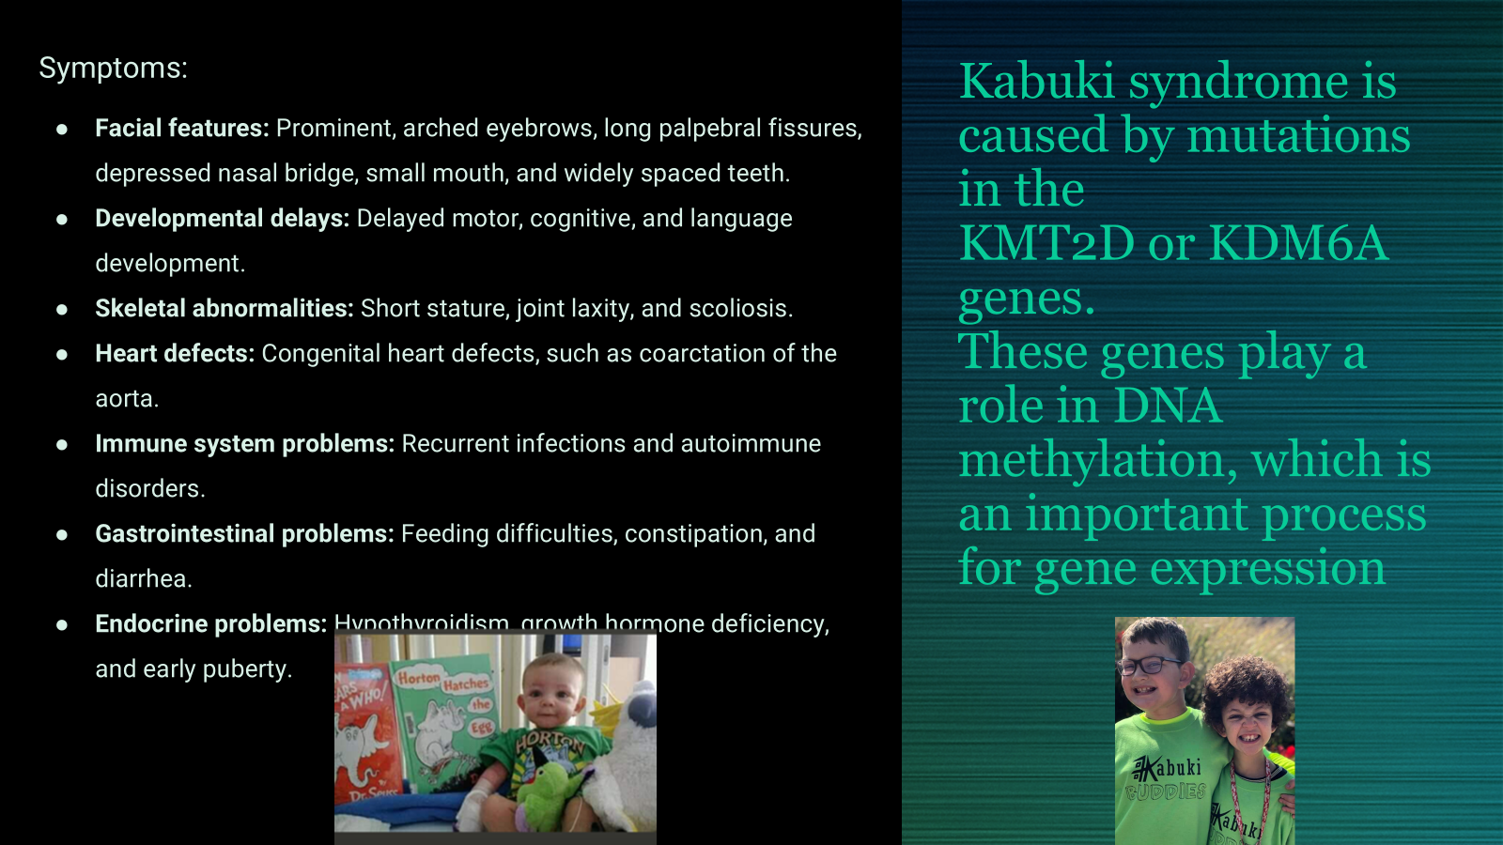

Slide 13
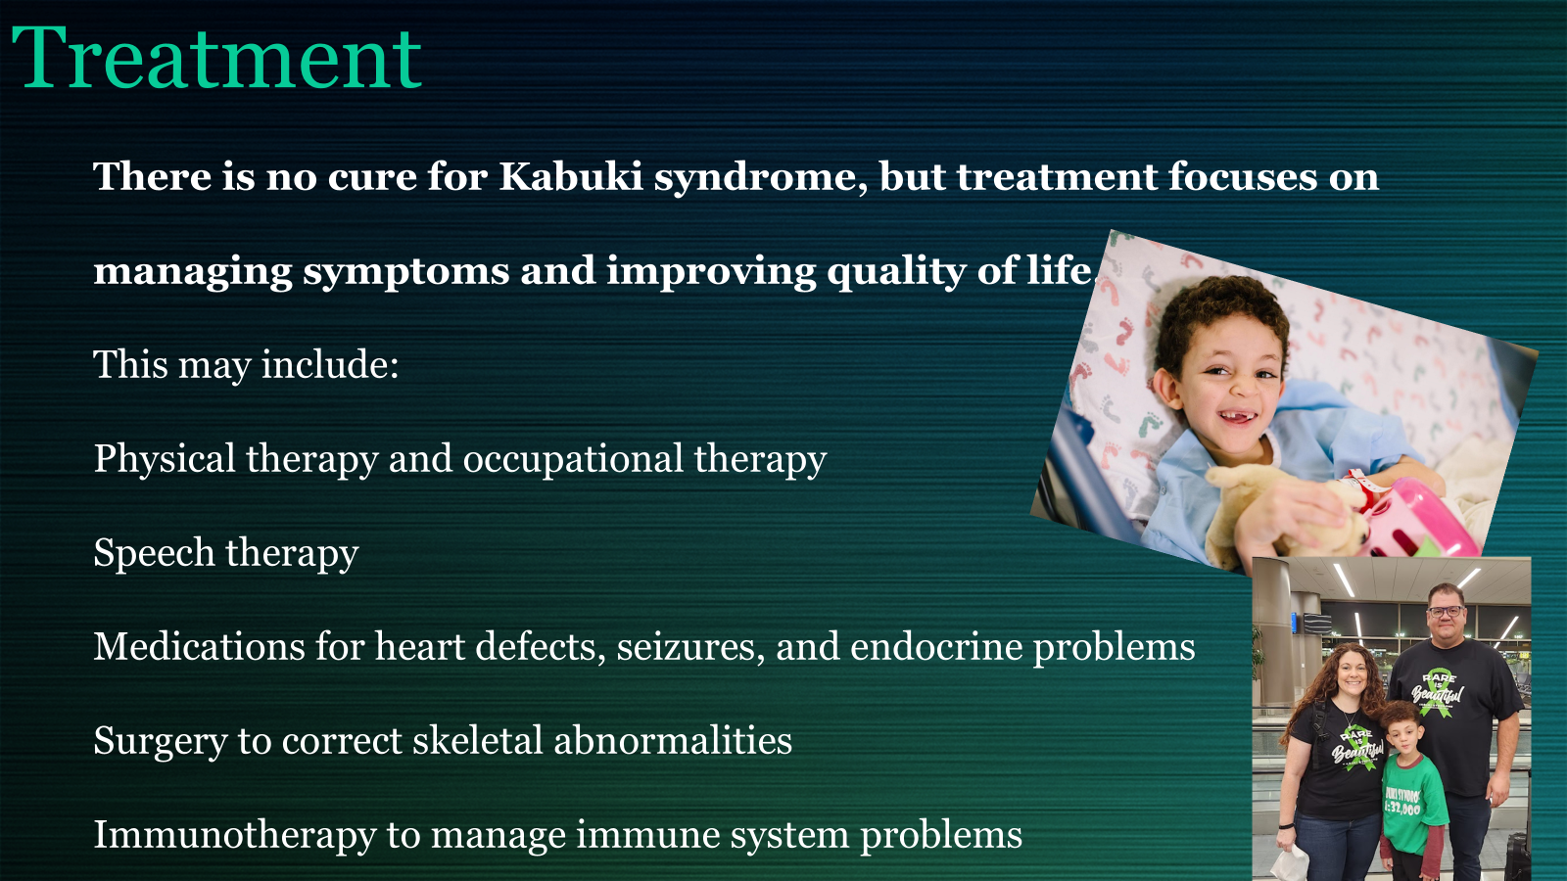

Slide 14


Slide 15


Slide 16


Slide 17


Slide 18


Slide 19
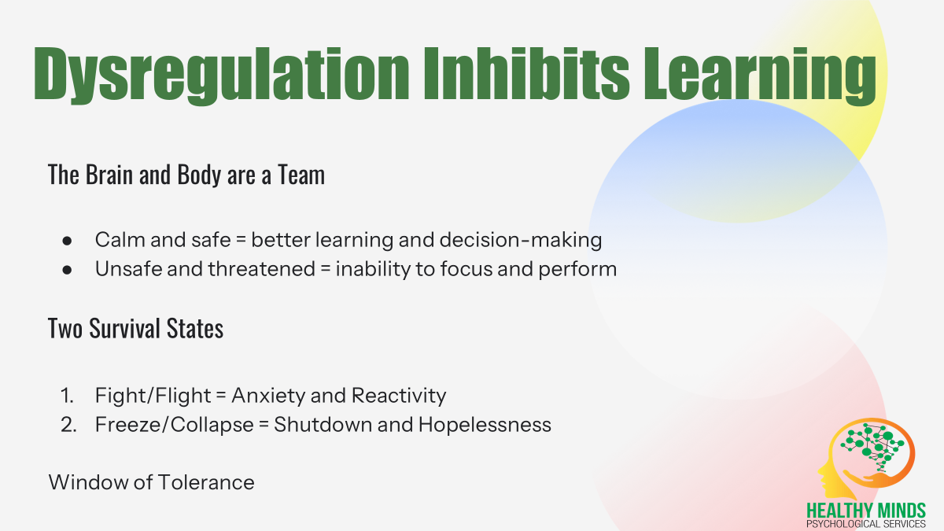

Slide 20


Slide 21


Slide 22


Slide 23
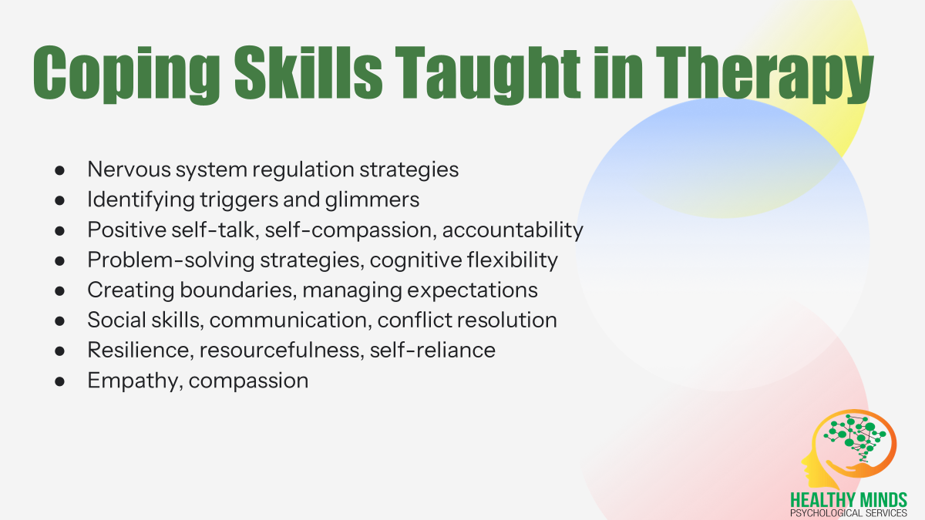

Slide 24
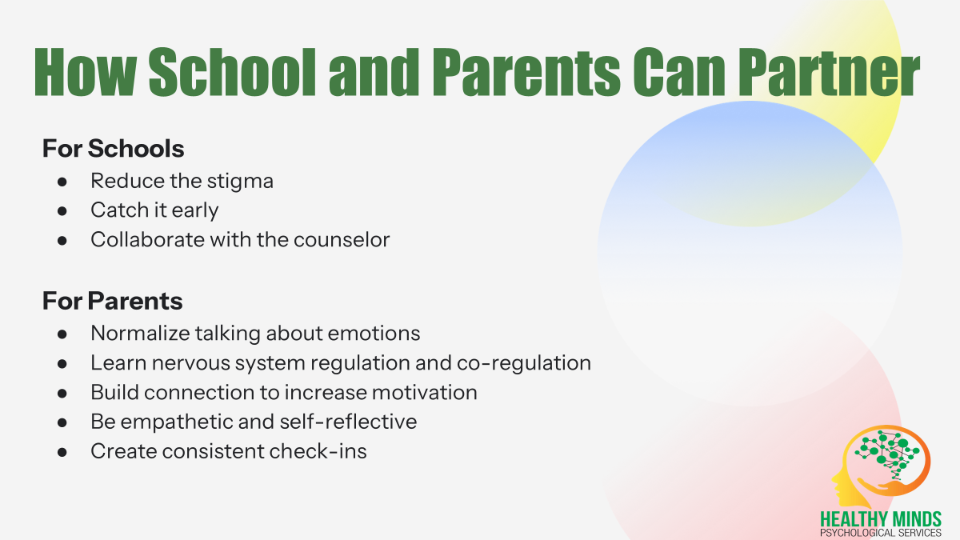

Slide 25
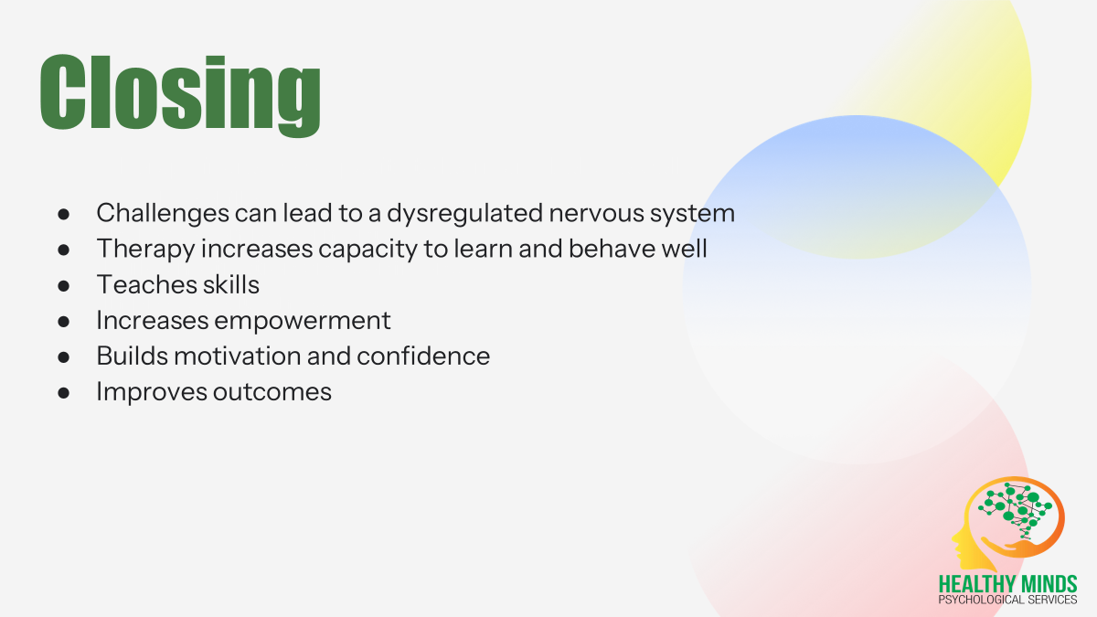

Slide 26


Slide 27

Update on the CFBISD SB12 Consent Rollout
Leon Sulak, Executive Director Student Services

Slide 28


Slide 29
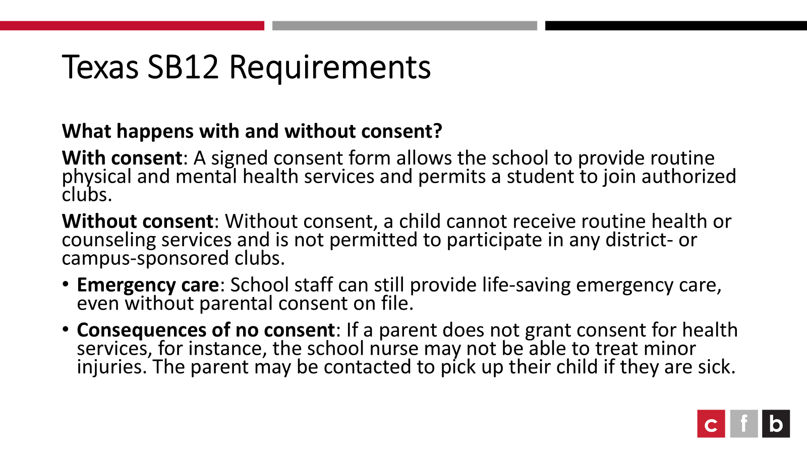

Slide 30
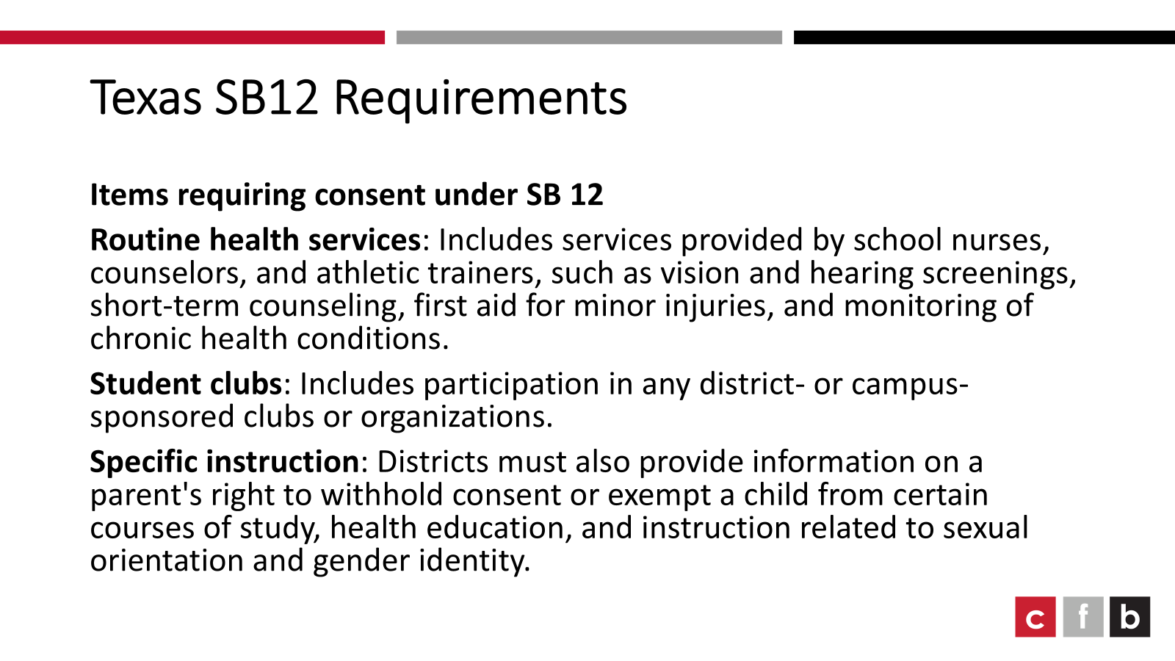

Slide 31
Texas Senate Bill 12 Requirements
How to videos and step-by-step instructions are on the website - cfbisd.edu/sb12 (parent information is available in English and Spanish)
The parent step-by-step guide is located in the FAQ - linked here for easy sharing (ENGLISH and SPANISH)

Slide 32
Health Services Provided in CFBISD with parental consent:
Administration of medication (with written parent request and physician order)
Medical procedures (with written parent request and physician order)
First Aid (bandages, bloody nose, checking temperature)
Assessment (for a specific complaint or concern)
Routine screenings (vision, hearing, spinal, and Texas Risk Assessment for Type 2 Diabetes in Children)
Wellness promotion and education (nutrition, hygiene, prevention, wellness) beyond what is taught through grade level or course instruction
Dental Screenings and Clinics (with parental written consent)
School based telehealth (with parental written consent)
Vaccination clinics for state mandated vaccines for school attendance i.e. polio, DTP, etc. (with parent in attendance and parental written consent)

Slide 33

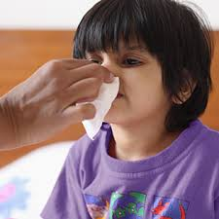
Health Services
Always Provided regardless of consent:
Care in a medical emergency or services required by law
General caretaking- wiping a nose, tying a shoe, providing a sanitary napkin, changing a shirt/pants, actions a mother would provide that do not require a nursing license.

Slide 34


