Slide 1





Safe Space Squad
GUARDIANS OF RIGHTS, CHAMPIONS OF RESPECT
DECISION MAKER TRAINING
Your Space. Your Rights. Our Mission
GUARDIAN IX
Notes:
Don’t worry—this isn’t your required annual Title IX training. Today’s session is designed to go beyond the basics. We’ll tackle some of the most frequently asked questions, clarify a few must-know definitions, and break down the nuts and bolts of your responsibility—no matter your role in the building. Whether you're a classroom teacher, custodian, coach, or counselor, you’re part of the team that helps protect equity and safety in our schools. Let’s suit up and get into it.

Slide 2




Kim Fletcher Bowden As...
Kim Possible
Chief Compliance Officer

Slide 3

dr titania singh As...
sentinel singh
Compliance and System Title IX Coordinator

Slide 4
and you as...
defender ix
School-Based Coordinators

Slide 5







INTRODUCTION
The why behind the shield:
Protect, prevent, empower
DEFENDER
IX
SEMINOLES - THE CRIMSON SCOUT

Slide 6



FAQ 1
WHY ARE WE TALKING ABOUT TITLE IX IN A K-12 ENVIRONMENT?
Because respect, safety, and fairness won’t wait for college

Slide 7
























TOP 5 OF T9
01
05
Protection
Access
Ensures no one faces discrimination based on sex, gender, or orientation in our instituation,
Advances fairness and equal opportunity, helping everyone thrive academically and personally.
02
04
Safety
03
Empowerment
Responsibility
Prevents and addresses harassment, assault, and other misconduct to keep our district safe and supportive.
Encourages individuals to speak up, seek help, and know their rights, fostering a culture of respect.
Compliance is required by law! Violations can lead to serious consequences and can be costly.

Slide 8



TITLE IX
ORIGINS
POWERS
KIM POSSIBLE
POLICY PARTNERSHIPS

Slide 9





What is Title IX?
No person in the United States shall, on the basis of sex, be excluded from participation in, be denied the benefits of, or be subjected to discrimination under any education program or activity receiving Federal financial assistance.
DISCRIMINATION
SEXUAL HARASSMENT
SEXUAL ASSAULT
RETALIATION

Slide 10






What is the specific code of federal regulations?
Question 1
20 U.S.C. § 1681(a)
“No person in the United States shall, on the basis of sex, be excluded from participation in, be denied the benefits of, or be subjected to discrimination under any education program or activity receiving Federal financial assistance...”
The implementing regulations for Title IX are found in:
34 CFR Part 106
This part of the Code of Federal Regulations (CFR) outlines how Title IX is to be enforced by federal agencies, including definitions, procedures for complaints, and specific provisions related to areas like athletics, admissions, and sexual harassment

Slide 11







WAIT, WHAT?
Think of It Like This:
  Congress makes the laws (like saying “schools must be safe”).
  Federal agencies write the rules to explain how to follow those laws (like saying “schools must have emergency exits and safety drills”).
  Those rules are published in the CFR.
What Is the Code of Federal Regulations?
The Code of Federal Regulations (CFR) is like a big rulebook for how federal laws are carried out in real life. It’s made up of all the official rules created by U.S. government agencies to explain and enforce laws passed by Congress.

Slide 12









OCR Findings in K–12: Why We Must Get Title IX Right
01
02
03
04
05
06
Rhinebeck Central School District
Chicago Public Schools
Metro Nashville Public Schools
New York City Public Schools
Loudoun County Public Schools
Cedarville University
Deliberately Indifferent No proper investigations or documentation were maintained. Victims were not supported.
Outcome: A consent decree required training, policy reform, and $152,500 in compensation.
Key Issue: Lacked a consistent and trained Title IX response system.
Consequence: OCR required them to enter a Resolution Agreement, rescind suspensions, issue apologies, and revise its Title IX procedures.
Details: Someone was informally handling complaints, it was not publicized, and students were unaware of their rights.
Outcome: The university entered a resolution agreement requiring documentation, training, and climate assessments.
Details: OCR found missing documentation, lack of supportive measures, and inadequate investigations.
Outcome: The district lost $4 million in federal funding.
Details: The district had actual knowledge but did not investigate or take meaningful action.
Legal Standard: Courts emphasized that schools must respond in ways “reasonably calculated” to stop harassment.
Violation: Missed a compliance deadline related to Title IX transgender policy updates.
Consequence: Risked losing $50 million in federal funding.

Slide 13











OCR ON THE DOORSTEP: HOW TITLE IX VIOLATIONS TRIGGER INVESTIGATIONS
01
02
03
04
05
06
Deadlines
Documentation
Designation
Definitions
Deliberate Indifference
Professional Development
Missing a compliance deadline
No documentation of a fair process. No documentation of consent.
Failure to designate and/or publicize a Title IX Coordinator
Misunderstanding what constitutes a possible violation
Failing to act on known or reported misconduct - actual knowledge
Failure to train employees

Slide 14





Lessons from Yakima
Initial Focus: OCR began a compliance review to examine how Yakima handled harassment based on race, color, national origin, sex, and disability.
Additional Findings
Initial Resolution
  No designated or trained Title IX Coordinator.
  Lack of grievance procedures for Title IX, Section 504, and Title II.
  Failure to provide nondiscrimination notices.
  Inadequate training for staff and students.
  Poor recordkeeping and tracking of harassment incidents.
  No system-wide climate checks or task force to address harassment.
  No direct fines were issued as a result of the OCR investigation.
  However, the district was required to:
  Enter into a Resolution Agreement.
  Implement district-wide reforms.
  Submit to ongoing federal monitoring.
Funding Freeze
Separately, Yakima faced a $3.7 million federal funding freeze in 2025 due to broader compliance and budgetary issues, though this was not directly tied to the OCR case.

Slide 15


Status of Title IX
"Every hero has an origin story—so does Title IX. Let’s rewind the tape and uncover the major power-ups and quiet evolutions that have shaped it over the years."
DEFENDER
IX

Slide 16

1999
2024
1975
Davis v. Monroe County Board of Education – Supreme court ruled that schools can be held liable for student-on-student harassment under Title IX if the harassment is severe, pervasive, and objectively offensive.
The U.S. Department of Education releases final Title IX regulations -LGBTQ+ students and a broader definition of sexual harassment. Several injunctions are filed by states - including Georgia
Jan 31, 2025
Discrimination in Athletics - Regulations first issued by Department of Health, Education and Welfare to address discrimination in athletics. Did not address sexual harassment.
USDE announced that it will enforce the Trump Administration’s 2020 Title IX Rule
2
4
6
8
1
3
5
7
9
1972
1997
2020
Jan 9, 2025
Coming Soon
The Law - Title IX is signed into law.
Dear Colleague Letters - From 1997-2017 the Department of Education addressed the topic through a series of guidance documents - "Dear Colleague Letters
The new regulations are the first time the Department has addressed sexual harassment as a form of sex discrimination via regulations.
A federal judge in Kentucky struck down changes made to Title IX by the Biden administration ruling that the new regulations violate the Constitution.

Slide 17


KNOW YOUR CODE
THE TITLE IX GLOSSARY
Every hero needs to speak the language of justice. Knowing the key terms under Title IX isn’t just about definitions—it’s about understanding your powers, your responsibilities, and how to spot trouble when it shows up.
When we understand the language, we can take action, protect others, and make sure our schools are safe for everyone. Definitions aren’t just words—they’re the tools in every hero’s utility belt.
DEFENDER
IX

Slide 18



Title IX
Discrimination
Sexual Harassment
Retaliation
SEX/GENDER DISCRIMINATION
PROGRAM EQUITY
QUID PRO QUO
HOSTILE ENVIRONMENT
BIG FOUR
RETALIATION
Any adverse action taken against a person for reporting a Title IX violation, participating/not participating in an investigation, or asserting their rights under Title IX
Sexual Assault
Access to courses and programs, employment practices, pregnancy and parental status, etc.
Typically where were we see athletics come into play
This for That
Severe, Pervasive, AND Objectively Offensive
Dating Violence
Domestic Violence
Stalking

Slide 19

Question 7
What is new?
The definition of fondling..
Reminder, fondling is considered a sexual assault and does not require SPOO.
It is considered per se harassment (Latin phrase for “in and of itself”):
Just one incident is enough to be a violation—no need to prove it was part of a pattern or that it created a hostile environment.

Slide 20




FONDLING IN FOCUS: NEW STANDARDS AND IMPLICATIONS
🗓️ When ?
  The update was issued in June 2025 as part of the FBI’s annual revision to the NIBRS User Manual
FBI new Term: “Criminal Sexual Contact”
This term replaces “fondling” and is now used in federal crime reporting systems that inform Title IX and Clery definitions.
Sexual contact:
The intentional touching of the clothed or unclothed body parts without consent of the victim for the purpose of:
  Sexual degradation
  Sexual gratification
  Sexual humiliation
It also includes:
  Forced touching by the victim of the actor’s body parts (clothed or unclothed), without consent.
  Situations where the victim cannot give consent due to age, mental or physical impairment, or intoxication

Slide 21



Fondling (Old) | Criminal Sexual Contact (New)
Touching of private body parts | Touching of any body part
Purpose: sexual gratification | Purpose: gratification, degradation, or humiliation
Did not include forced touching by victim | Includes forced touching by victim
Focused on lack of consent | Still includes lack of consent, but broader
COMPARISON

Slide 22



Sexual Assault Defined
  Fondling
01
02
03
05
  Rape
  Statutory Rape
  Incest
The touching of the private body parts of another person for the purpose of sexual gratification, without the consent of the victim, including instances where the victim is incapable of giving consent because of his/her age or because of his/her temporary or permanent mental incapacity.
The penetration, no matter how slight, of the vagina or anus with any body part or object, or oral penetration by a sex organ of another person, without the consent of the victim
Sexual intercourse with a person who is under the statutory age of consent.
Sexual intercourse between persons who are related to each other within the degrees wherein marriage is prohibited by law.

Slide 23







DATING VIOLANCE
SNOW FANG - THE WHITE TIGHER
Dating Violence: Violence committed by a person who is or has been in a social relationship of a romantic or intimate nature with the victim. The existence of such a relationship shall be based upon the reporting party's statement with consideration of the following factors:
  The length of the relationship
  The type of relationship
  The frequency of interaction between the persons involved in the relationship
  Dating violence includes, but is not limited to, sexual or physical abuse or the threat of such abuse.

Slide 24

DOMESTIC VIOLENCE
A felony or misdemeanor crime of violence committed
  by a current or former spouse or intimate partner of the victim;
  by a person with whom the victim shares a child in common;
  by a person who is cohabitating with, or has cohabitated with, the victim as a spouse or intimate partner;
  by a person similarly situated to a spouse of the victim under the domestic or family violence laws of the jurisdiction in which the crime of violence occurred;
  or by any other person against an adult or youth victim who is protected from that person's acts under the domestic or family violence laws of the jurisdiction in which the crime of violence occurred.
THE IRON PATRIOT

Slide 25

STALKING
Engaging in a course of conduct directed at a specific person that would cause a reasonable person to:
  fear for the person’s safety or the safety of others
  or, suffer substantial emotional distress

Slide 26

FAQ 2
They are so young, what kind of violations could possibly occur?
SHADOW PANTHER
"Think it’s all playground squabbles? Think again, K-12 Title IX covers more than you’d expect, from bullying that includes sexual inappropriate or discriminatory behavior to inappropriate adult behavior."
SENTINEL SINGH

Slide 27












Four (4) the Win: Title IX Trivia

Slide 28


AHA!
Name the top four answers to the following Title IX questions.
You know your stuff I see

Slide 29



Round 1
Name a type of behavior that is often seen in K-12 schools and could be considered sexual harassment under Title IX.
Unwelcomed Touching
Repeated sexual jokes or comments
Sending photos or text messages of a sexual nature.
Pulling someone’s pants down as a joke “pantsing”

Slide 30



Round 1
Who is protected under Title IX in a K-12 setting?
School employees and staff
LGBTQ+ individuals
All students regardless of gender
Any person participating or attempting to participate

Slide 31


Round 1
What should you do immediately after receiving a Title IX complaint at your school?
Offer supportive measures
Take statements from all parties and witnesses
Notify the Title IX Coordinator
Save any video, text, or other evidence

Slide 32

Round 1
Name a place or situation where Title IX might apply outside of the classroom.
School-sponsored trip or field trip
School bus
Athletic program or practice
Online learning environment

Slide 33








Don’t Forget!
The same behavior that warrants a Title IX referral might also require a referral to DFCS as a mandated reporter.

Slide 34
FAQ 3
How would I know if it it’s a Title IX issue?
"Is it awkward? Is it unfair? Does it involve gender, sex, or sexual behavior? If your gut says 'uh-oh,' it might just be Title IX knocking. If in doubt, report"

Slide 35




Mandatory Response Obligation
SNOW FANG - THE WHITE TIGHER
Deliberately Indifferent
Respond
Process
Manner that is NOT deliberately indifferent means a response that is not clearly unreasonable in light of the known circumstances.
Promptly contact the complainant confidentially to discuss supportive measures and explain process for filing formal complaint.
Follow a grievance process that complies with the 2020 regulations before the imposition of any disciplinary sanctions.

Slide 36
The Compliance Carousel: Heroes in a Loop
Just when we thought we had the rules figured out, the legal universe hit the rewind button yet again. Buckle up, heroes of compliance… it’s regulation déjà vu with a twist!
DEFENDER
IX

Slide 37






Before - 2024 Regulations
Now - 2020 Regulations
Severe or pervasive and objectively and subjectively offensive
Severe and pervasive and objectively offensive
01
01
Regardless of where an underlying incident occurs
02
02
inside the U.S. and participating or attempting to participate
Carousel of Changes
Participating or attempting to participate at the time of the incident
03
03
Participating or attempting to participate at the time of the filing of the complaint
All employees must report possible sex-based harassment
04
04
All employees must report if they have actual knowledge
Informal Resolution can be offered without a formal complaint
05
05
Informal resolution permitted only after a formal complaint
Must offer individualized and voluntary “reasonable modifications” to pregnant students or those with a related condition
06
06
Must offer services and benefits to pregnant students or those with a related condition if they are offered to other temporarily disabled students

Slide 38
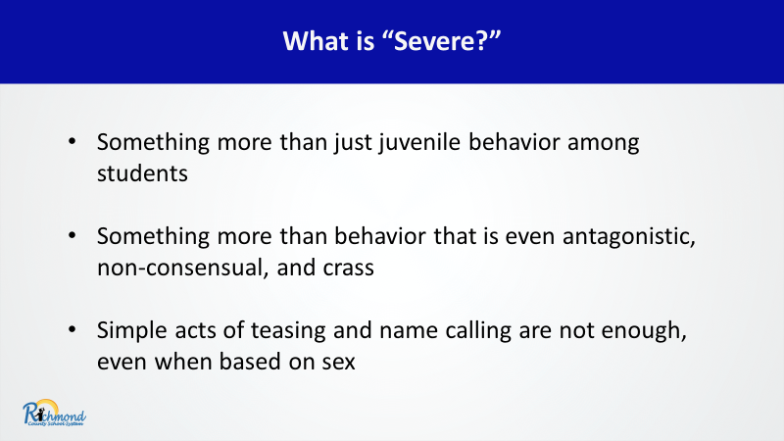

Slide 39
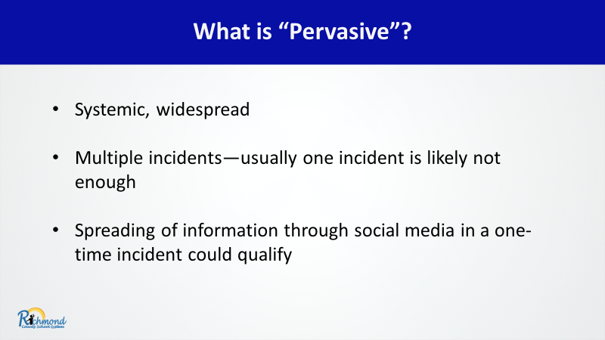

Slide 40
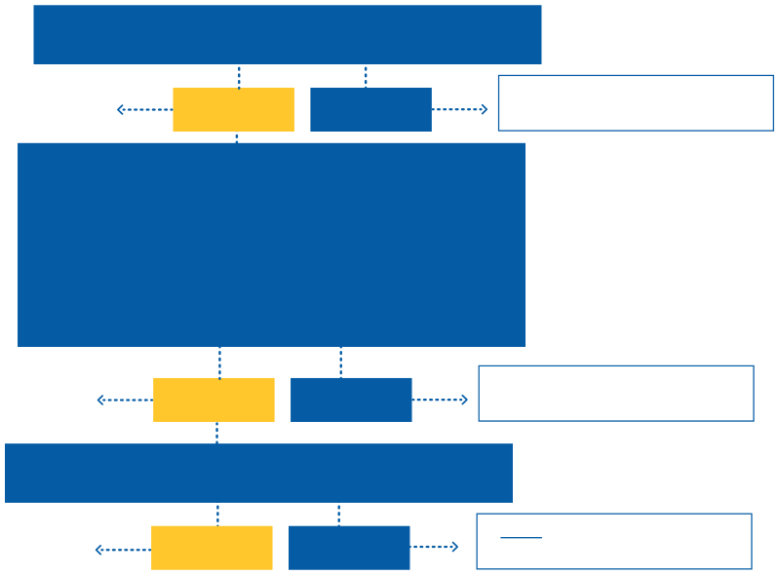

Education Program or Activity/Jurisdiction
DOES THE DISTRICT HAVE SUBSTANTIAL CONTROL OVER THE RESPONDENT?
Title IX
YES
NO
Not Title IX
DOES THE DISTRICT HAVE SUBSTANTIAL CONTROL OVER THE CONTEXT IN WHICH THE SEXUAL HARASSMENT OCCURRED?
Against a Complainant in the U.S. AND 1) On district property/In or during online class, or 2) At building owned or controlled by district, or 3) Off campus, district sponsored event
Title IX
YES
NO
Not Title IX
IS THE COMPLAINANT STUDENT/EMPLOYEE OR ATTEMPTING TO BE ONE?
Complainant or Title IX Coordinator May File/Sign Formal Complaint
ONLY Title IX Coordinator May File/Sign Formal Complaint
YES
NO

Slide 41
TITLE IX APPLIES TO
STUDENT TO STUDENT
EMPLOYEE TO EMPLOYEE - HR (NO IR)
STUDENT TO EMPLOYEE
EMPLOYEE TO STUDENT - HR (NO IR)
THE IRON PATRIOT

Slide 42
The Safe Space Squad: Heroes Behind the Shield
Every great mission needs a powerful team. These are the heroes working behind the scenes (and on the front lines)to protect access, respond to concerns, and ensure every student and staff member feels safe and supported. Get to know your Title IX team: their roles, their responsibilities, and how they help keep our schools justice-ready
DEFENDER
IX

Slide 43








Title IX Team
Complainant
Respondent
Parent/Guardian
Advisor
Investigator
Building Level Coordinator
System Title IX Coordinator
Informal Resolution Facilitator
Decision Maker
Appellate Decision Maker

Slide 44



Title IX Team Cont.
Parent/Guardian
Complainant
Respondent
Person who has allegedly been sexually harassed and/or discriminated against.
Person who has allegedly committed sexual harassment or discriminated against another person.
Advisor
The advisor can be an attorney. RCSS policy defines how they can be involved in the process.

Slide 45



Title IX Team Cont.
Building Level Coordinator
System Title IX Coordinator
Informal Resolution Facilitator
Investigator
  Ensure students, employees are trained
  Develop, implement, and monitor supportive measures
  Receives complaints and completes reports
  Contact for parties
  Maintains records
  Track the process
  Ensures fidelity and compliance
  Facilitates investigation process
  Arrange for appeals process
  Ensures all training occurs
  Maintains records
  Track the process
  Monitor patterns/trends
  Update policies and procedures
  Facilitates process between complainant and respondent
  Can be the Building Level Coordinator
  It is not recommended that an individual who has or will serve as an Investigator in the same case serve as the Informal Resolution Facilitator.
  Investigates alleged misconduct
  Completes investigation report preliminary and final
  Can be the System Title IX Coordinator

Slide 46

Title IX Team Cont.
Decision-Maker
Appellate Decision Maker
  Makes a decision based on the Title IX Investigator’s investigative report.
  Cannot be the System Title IX Coordinator or Title IX Investigator.
  Makes a decision based on the Title IX Investigator’s investigative report after a party or parties have appealed.
  Cannot be the System Title IX Coordinator or Title IX Investigator.

Slide 47
Justice in Motion: From Report to Resolution
Every team needs a playbook.
In this section, we’ll walk through the key steps of the Title IX process (from the moment a report is made to the final resolution). Knowing the sequence helps ensure fairness, clarity, and support for all involved. Whether you’re reporting, supporting, or responding, understanding the process equips you to take action when it counts most.
DEFENDER
IX

Slide 48

FAQ 4
I just received a report, what is my next move?
"You’ve heard something that makes your ears perk up—now what? Hint: It’s less about solving, more about reporting."
WISKER STRIKE

Slide 49











I received a report, now what?
Wait for determination?
Should I call other departments/agencies?
No
Implement Supportive Measures
YES
It is best practice to include parents/guardians/SST
Dismissal of Formal Complaint
Does the student have disabilities?
Complete the Determination Form
Report to DFCS and/or RCSS Police
YES
Submit form and all evidence.
Report to System Title IX Coordinator
You will receive an email w/further directions.
Include a member of the student’s IEP team.

Slide 50

SUPPORTIVE MEASURES
THE LONE MAVERICK
They may not
unreasonably burden any party
They may not
be for punitive or disciplinary reasons
Definition
They are individualized measures designed to:
  Restore or preserve access
  Protect safety of parties or education environment
  Provide support during Resolution Process
Must be without
fee or charge to either party
THEY ARE OFFERED WITH OR WITHOUT A FORMAL COMPLAINT!

Slide 51






ROLE
DECISION MAKER
Conduct an objective evaluation of all relevant evidence - including both inculpatory and exculpatory evidence
  Review evidence collected during the investigation
  Must render a sound, reasoned decision on every charge
  Determine what evidence to believe, the importance of evidence and the conclusions to draw from the evidence

Slide 52
CONT.
DECISION MAKER
Facilitates written cross examination
  Allows both parties to submit relevant, written questions that they want asked of any party or witness prior to final determination
  Explain to the party proposing the questions any decision to exclude a question as not relevant

Slide 53
CONT.
DECISION MAKER
  Make relevancy determinations
  Determines whether District policy has been violated
  Make independent judgment on responsibility and sanctions
    Determines appropriate sanctions/discipline when a policy violation is found
    Sends our a written determination letter to the involved parties which outlines the rationale for their decision

Slide 54




APPELLATE DECISION MAKER
  Review written determination
  Review appeal document(s)
  Grant parties opportunity to respond
  Review party responses
  Make independent judgement on appeal

Slide 55

Let
us
Talk
Conflict of Interest
Bias

Slide 56
CONFLICT OF INTEREST & BIAS
• Watch for conflicts of interest or bias throughout the process - Title IX Regulations prohibit conflicts of interest or bias with Coordinators, Investigators, and Decision-Makers against parties generally or an individual party.
• A conflict of interest occurs when personal or private interests may compromise one's judgment, decisions, or actions.

Slide 57
CONFLICT OF INTEREST & BIAS
• Watch for conflicts of interest or bias throughout the process - Title IX Regulations prohibit conflicts of interest or bias with Coordinators, Investigators, and Decision-Makers against parties generally or an individual party.
• A conflict of interest occurs when personal or private interests may compromise one's judgment, decisions, or actions.

Slide 58








SUPPORTIVE MEASURES
Academic
Personal Safety
01
rescheduling assessments, change in scheduling, change in academic or advisement teams
no contact order, escorted transitions, temporary removal/reassignment,
04
Employment
Mental/Emotional
02
05
change in assignment, modified work schedule, training/education
school counseling, referrals, check-ins, trauma informed practices
Social
Physical Health
03
06
access to safe space, peer mediation, guidance counseling
restroom breaks, modified physical education, access to medical services

Slide 59


KEY QUESTIONS TO ANSWER
Needs
Barriers
Access
Options
Practical/
Burden Free
Free
What needs exist?
Is there a cost?
What barriers exist?
How can access be maintained or restored?
What options exist?
What is reasonable and does not burden either party?

Slide 60


It meets the definition, now what?
Investigation Reports
Notice of Investigation including witnesses
Investigation
Notice of Allegations - call first
Does the complainant want to file a formal complaint?
System Title IX Coordinator
Preliminary and Final
10-day Review
Complete Signed Verification Form
Yes
No
Explain grievance process
Provide the complainant with a copy of the grievance procedures
Discuss Informal Resolution

Slide 61
Notice of Allegations
CALL HOME 1ST
Notice of Allegations
  Notice of Grievance Process (also included in informal resolution process if one exists)
  Allegations potentially constituting Sexual Harassment
  Identities of the parties
  Conduct constituting Sexual Harassment
  Date of incident (if known)
  Location of incident
  Statement: Respondent presumed not responsible and responsibility is determined after Grievance Process
  Right to Advisor of Choice
  Code of Conduct provision(s) prohibiting false statements or false information in process
Send notice to both parties the same day
Careful with addresses

Slide 62
Informal Resolution
  Meet with students, parents, advisors and facilitate resolutions after Formal Complaint and before determination regarding responsibility
  Informal Resolutions CANNOT be used when the Respondent is an employee, and the complainant is a student.
TITAN VIRTUOSO

Slide 63
Informal Resolution
  Cannot be offered to resolve employee on student allegations
  After a Formal Complaint is filed and prior to decision regarding responsibility
  Provide written notice disclosing allegations, requirements of the informal resolution process including circumstances under which it preclude the parties from resuming a Formal Complaint arising from the same allegations
  Allow any party the right to withdraw from the informal resolution process and resume grievance process with respect to Formal Complaint
  Provides consequences resulting from informal resolution
  Obtain both parties voluntary, written consent to the informal resolution process

Slide 64
WHY IR?
FASTER RESOLUTION
MAINTAIN POSITIVE RELATIONSHIPS
processes are often quicker than formal investigations, which can take weeks or months to complete. This allows students, parents, and staff to move forward without prolonged uncertainty.
Unlike a formal investigation, which can feel legalistic and confrontational, informal resolution focuses on dialogue and finding mutually acceptable solutions. This can help maintain positive relationships within the school community.
MORE CONTROL
CONFIDENTIALITY
Parties involved in an informal resolution process typically have more say in the outcome, rather than leaving the decision entirely up to administrators or hearing officers.
Informal resolutions can provide more privacy than formal proceedings, reducing the risk of public scrutiny or reputational harm for the involved students.

Slide 65
WHY IR?
RESTORATIVE APPROACH
REDUCED TRAMA AND STRESS
Schools can use informal resolution to implement educational interventions, counseling, mediation, or restorative justice practices that address harm without resorting to punitive measures.
A formal Title IX investigation can be stressful for all involved, especially in sensitive cases.
FLEXIBLE OUTCOMES
ENCOURAGES COMMUNICATION
Informal resolutions allow schools to craft creative and individualized solutions that meet the needs of the parties involved, such as safety agreements, no-contact agreements, training, or behavioral interventions.
A well-facilitated informal resolution process can promote mutual understanding and prevent future conflicts by addressing the underlying issues in a constructive manner.

Slide 66
Informal Resolution Process
Signed Outcome Template and Checklist
Conduct Meeting
Signed Consent Forms Required
Informal Resolution Procedures
Grievance Procedures
Notice of Allegations- call first

Slide 67


Formal Investigation
Decision Maker Determination - 20-day appeal
Final Report -10 days comments/questions
Preliminary Report - 10 days response
Investigation
Grievance Procedures
Notice of Allegations- call first

Slide 68
choose your move
react/defer or respond/respect

Slide 69
#1
A 4th grader tells a teacher that classmates are calling them “gay” and making fun of how they dress.

Slide 70
  Contact the Title IX Coordinator (determination/next steps).
  Provide age-appropriate supportive measures.
  Educate students and staff on inclusive behavior and reporting.
  Document all steps taken.
#1
  Contact guardian and notification of rights.

Slide 71
#2
A high school student shows a counselor text messages from a teacher that seems overly personal and include compliments about their appearance.

Slide 72
  Contact the Title IX Coordinator (determination/next steps).
  Take the report seriously and document it.
  Ensure the student’s safety and support.
  Provide supportive measures.
  Document all steps taken.
#2
  Notify administration/HR.
  Contact guardian and notification of rights.

Slide 73
#3
A new teacher reports that a veteran staff member has been making sexually suggestive jokes in the break room.

Slide 74
#3
  Contact the Title IX Coordinator (determination/next steps).
  Take the report seriously and document it.
  Offer supportive measures.
  Speak to the complainant regarding their options.
  Document all steps taken.
  Notify administration/HR.

Slide 75
#4
An anonymous note is left in the assistant principal’s mailbox alleging sexual harassment by a coach.

Slide 76
#4
  Contact the Title IX Coordinator (determination/next steps).
  Take the report seriously and document it.
  Try to gather more information.
  Follow Title IX protocols.
  Document all steps taken.
  Notify administration/HR.

Slide 77
#5
A parent insists that their child not be interviewed for a Title IX investigation, even though the child is a key witness.

Slide 78
#5
  Contact the Title IX Coordinator.
  Acknowledge the parent’s concern.
  Explain the school’s legal obligations.
  Offer supportive options
  Proceed according to policy.
  Maintain focus on safety, access, and respect.

Slide 79
After a Title IX complaint is filed, students begin posting about it on social media, naming the alleged respondent.
#6

Slide 80
  Contact the Title IX Coordinator.
  Document the social media activity (save it).
  Address retaliation concerns (if appropriate).
  Communicate with involved students.
  Offer supportive measures.
  Continue gathering information.
#6

Slide 81
Great job!

Slide 82
FAQ 5
So, what exactly is my responsibility?
"Wondering if these are your weeds, or even your garden? If you work for RCSS, the short answer is—yes, it absolutely is."

Slide 83
Obligation Activation
RESPOND. RESPECT. RESOLVE.

Slide 84
SUPPORTIVE MEASURES, REPORT, AND TRIAGE
Obligation to Respond
In a manner that is not deliberately indifferent
  In the US
  Possible Violation
  Jurisdiction
  Knowledge
Directed against a person in the United States
Maybe a violation if proven
Within the educational program or activity
Within the knowledge of the TIXC or an official with the authority to institute corrective measures
01
02
03
04

Slide 85
Barriers to Reporting
  Mistrust of authority
  Doubts about information remaining private
  Shame and/or guilt
  Process concerns
  Lack of social network and support
  Not wanting to share or retell the experience
  Lack of information about what happens next

Slide 86
Our Responsibility
01
02
03
Report to Title IX Coordinator
Offer Supportive Measures
Mitigate Barriers

Slide 87
WHAT IS IN THE FOLDER?
THANK
YOU

