Slide 1
MANIFEST DESTINY & EXPANSION
American History I - Unit 7
Ms. Brown

Slide 2
Review
Define Manifest Destiny.
What was the MAJOR reason a person would want to move westward?
What was the MAJOR danger when traveling west?
What were the 2 main trails used to travel west?
What did Polk’s campaign slogan “54-40 or Fight” refer to?
.

Slide 3
Review
Define Manifest Destiny.
  The belief that it was America’s destiny and right to expand westward
What was the MAJOR reason a person would want to move westward?
  New economic opportunities (escape debt, get land, new markets, gold, etc)
What was the MAJOR danger when traveling west?
  Native American attacks
What were the 2 main trails used to travel west?
  Santa Fe Trail and Oregon Trail
What did Polk’s campaign slogan “54-40 or Fight” refer to?
  His willingness to fight the British for the Oregon Territory’s northern border at 54-40.
  The border was eventually established at the 49th parallel (current border with US and Canada).

Slide 4
7.3 – EXPANSION INTO TEXAS
AH1.H.3.2 Explain how environmental, cultural, and economic factors influenced the patterns of migration and settlement within the US before the Civil War.
AH1.H.3.3 Explain the roles of various racial and ethnic groups in settlement and expansion through Reconstruction and the consequences for those groups.
AH1.H.3.4 Analyze voluntary and involuntary immigration trends through Reconstruction in terms of causes, regions of origin and destination, cultural contributions, and public and governmental response.
AH1.H.6.1 Explain how national economic and political interests helped set the direction of US foreign policy.

Slide 5
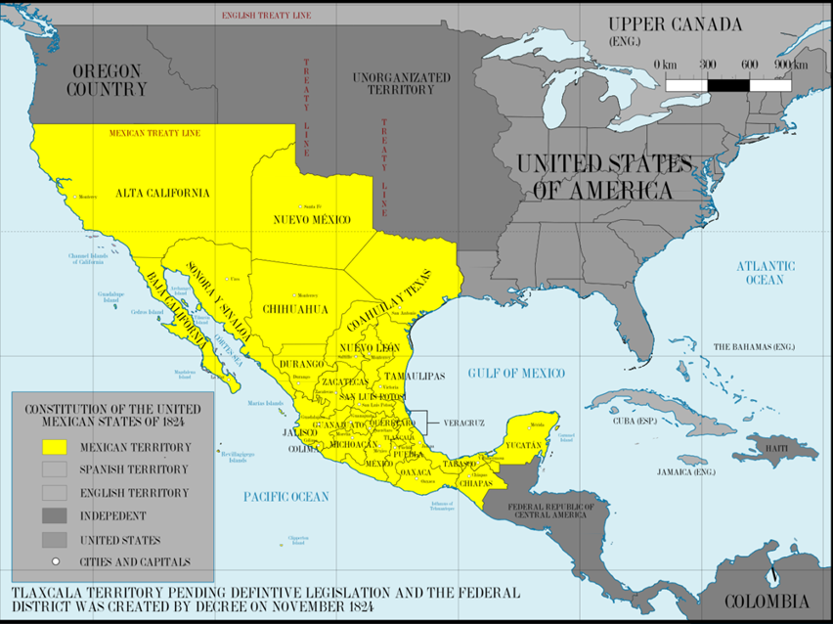
Mexican History
Until 1821, Mexico was owned by Spain.
  Rich natural resources
  Good climate for agriculture
  Catholic missionaries from Spain established forts in Mexican land → growth of Catholicism among Mexicans.
1821 – Mexico became independent

Slide 6
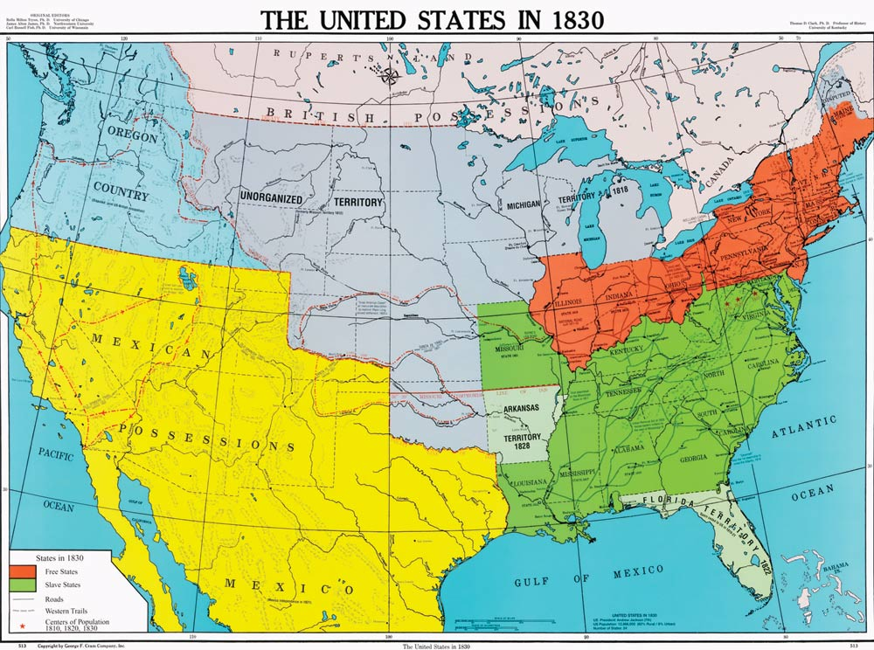
Mexican History
Independent Mexico wanted to grow their economy.
  Trade between Mexico’s northern territories and the US increased.
Soon, the Mexican government in central Mexico could not control the activities in the northern territories.
  Americans began to
  move to these areas
  even though the land
  was owned by Mexico
  (Manifest Destiny…
  remember)

Slide 7
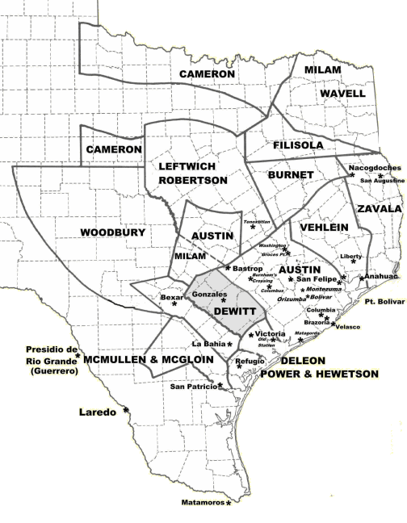
Mexico Invites US Settlers
Mexico began to encourage American settlements in northern Mexico using land grants.
  Areas of land sold given to settlers to encourage settlement of an area
Empresarios – Americans who accepted Mexican land grants and worked to attract/recruit other settlers to Mexico
  Promised to obey Mexican laws
  Practice Roman Catholicism
  NO slavery

Slide 8
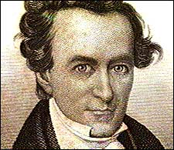
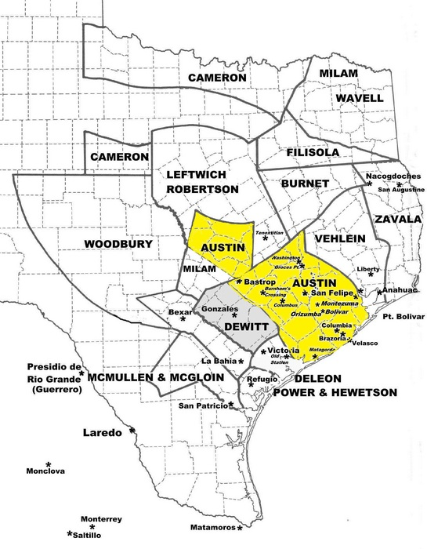
Austin in Texas
Stephen E. Austin
  Most successful empresario
  Established a colony in Mexican-owned Texas where “no drunkard, no gambler, no profane swearer, and no idler” would be allowed.
  By 1825, Austin had granted almost 300 land grants (177 square acres each)

Slide 9
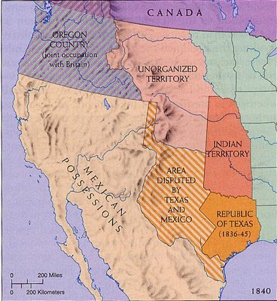
Disputes over Texas
Settling in Texas soon became very popular and Americans wanted the land for America.
  Proposed new border = Rio Grande River
More American settlers = more tensions with Mexicans
  Spoke English, not Spanish
  Protestant, not Catholic
  Brought slaves for cotton and sugar fields

Slide 10
Disputes over Texas
By 1830, Mexico attempted to stop American settlements in Texas
  Stopped granting land to American settlers
  Closed the border with the US
  Placed heavy tariffs on American goods coming into Mexico
BUT Mexican police could not enforce the restrictions on the entire US-Mexico border → American population in Texas grew

Slide 11
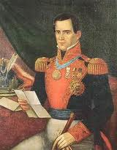
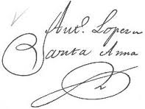
Disputes over Texas
1833 – Austin traveled to Mexico City to ask Dictator Santa Anna for greater self-governance in Texas.
Santa Anna refused to allow for more independence
  Revoked the Mexican Constitution
  Arrested Austin for “inciting a revolution”
  Revoked local powers in Texas and other Mexican territories
  Sparked several rebellions in these areas

Slide 12
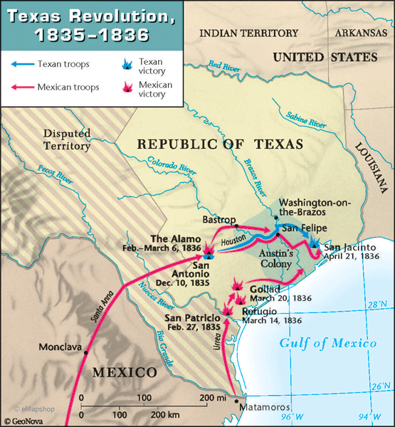
Texas Revolution
Austin formed a militia of Texans and Americans.
Santa Anna called on the Mexican Army
Texas Revolution - 1836, fight for Texas independence from Mexico

Slide 13
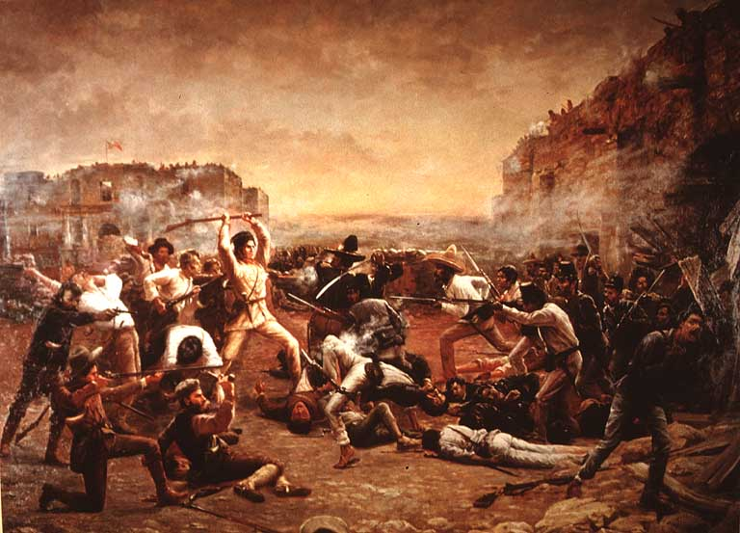
Texas Revolution
  1836 - Battle at the Alamo
    Austin’s militia and Santa Anna’s army marched toward San Antonio
    Austin’s militia captured the Alamo, a Mexican fort, and set up camp inside
  Santa Anna’s troops responded by storming the Alamo → killing all 187 Texans (mostly Americans fighting for Texas) in the fort.
  Mexican victory

Slide 14
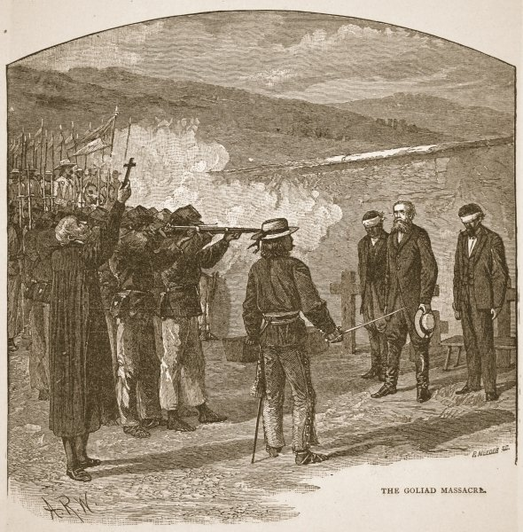
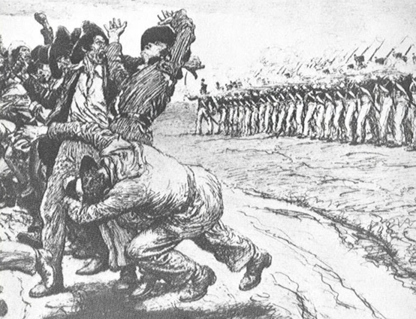
Texas Revolution
1836 – Goliad Massacre - Santa Anna executed 445 Texans
Texans led by Sam Houston struck back with a victory at the Battle of Jacinto
  “Remember the Alamo!”
  Captured Santa Anna

Slide 15

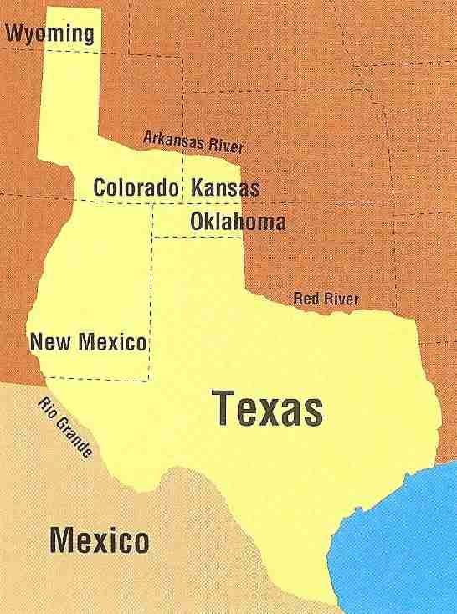
The Republic of Texas
1836 - Santa Anna signed the Treaty of Velasco which gave signaled Texan independence from Mexico
Republic of Texas – after the Texas Revolution, Texas became its own nation
  Not part of Mexico OR the US
  “Lone Star Republic”
  Its own army, navy, and flag
  President = Sam Houston
  Constitution written based on US Constitution

Slide 16
Texas Annexation
1838 – Houston and US consider Texas annexation
  Annex – to add a territory to a nation
Worries about annexation of Texas…
  Slavery: allow or ban?
  Provoke Mexico into war?
Polk’s 1844 presidential campaign favored adding Texas to US
1845 – Texas = 28th state!
  Mexico furious…

