Slide 1
MANIFEST DESTINY & EXPANSION
American History I - Unit 7
Ms. Brown

Slide 2
What was the Market Revolution? What factors made it possible?
Elias Howe invented the __________ which was later used in factories to mass produce clothes and shoes quickly and cheaply.
What is the significance of the telegraph’s impact on communication?
What were the benefits of using railroads to ship goods?
Which two inventions made farming possible and profitable in the Mid-West?

Slide 3
Review
What was the Market Revolution? What factors made it possible?
  Shift to buying and selling goods (consumerism) – Industrial Revolution, specialization, capitalism, inventions, communication, transportation
Elias Howe invented the __________ which was later used in factories to mass produce clothes and shoes quickly and cheaply.
  Sewing machine
What is the significance of the telegraph’s impact on communication?
  Allowed people to communicate instantly
What were the benefits of using railroads to ship goods?
  Could operate in the winter
  Faster than canal shipping
  Reliable when on schedule
  Shipped goods to people who didn’t live near water
Which two inventions made farming possible and profitable in the Mid-West?
  The steel plow and the mechanical reaper

Slide 4
7.2 – MANIFEST DESTINY
AH1.H.3.2 Explain how environmental, cultural, and economic factors influenced the patterns of migration and settlement within the US before the Civil War.
AH1.H.8.1 Analyze the relationship between innovation, economic development, progress and various concepts of the American Dream.

Slide 5
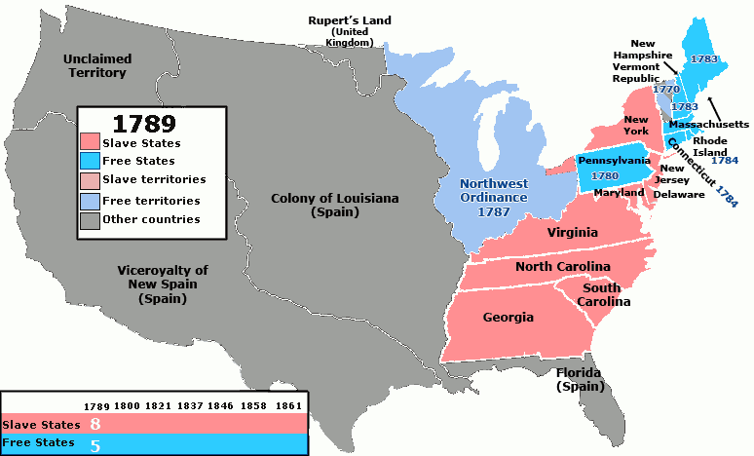
Interest in the West
1803 – TJ bought the Louisiana Territory → Doubled the size of the US
  Dreamed the US would become “an empire for liberty with enough room for our descendants to the thousandth and thousandth generation.”
Many Americans began to believe that westward expansion was necessary and even ordained by God.

Slide 6
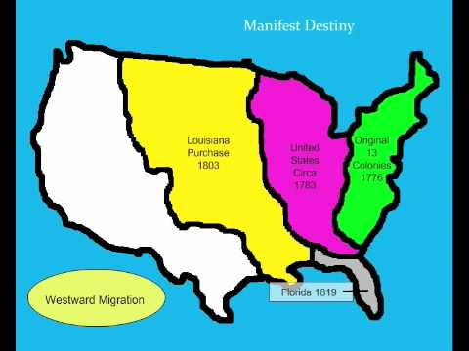
Manifest Destiny
The belief that it was America’s destiny (ordained by God) to expand westward to the Pacific Ocean
  Manifest = obvious or inevitable
  Destiny = fate or calling

Slide 7
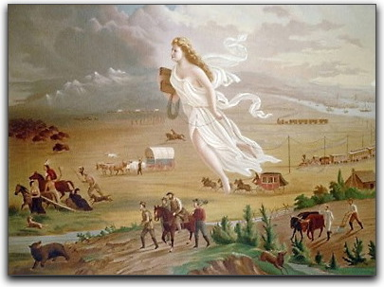
WEST

Slide 8
Reasons to Move West
MAJOR reason to move west – NEW ECONOMIC OPPORTUNITIES
Escape debt and start fresh
  Panic of 1837 left many people looking for a new beginning
  Escape criminal past
Open land up for claiming
  Land ownership = investment in the future
More space for growing population

Slide 9
Reasons to Move West
New markets to make money
  New ports and harbors on the west coast (Pacific Ocean) to trade with Asia
  Mining and farming in new lands
  Maybe find gold
Spread Christianity and education to Natives
Escape religious persecution
  Mormons moved westward and settled in Utah to escape religious discrimination in the east.
Spread democracy across the nation!

Slide 10
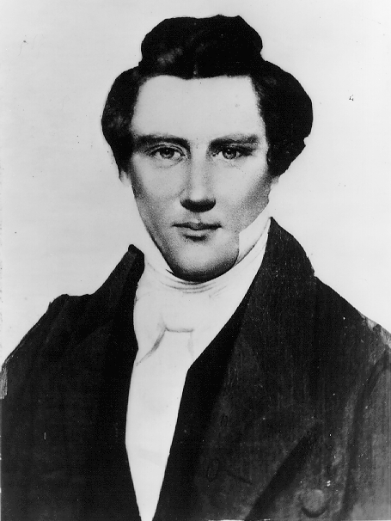
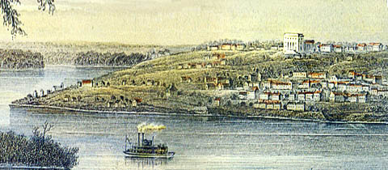
Case Study: Mormon Migration West
Mormons - members of the Church of Jesus Christ Latter-Day Saints, founded by Joseph Smith and his associates in 1830
  Reflective of the 2nd Great Awakening religious movement
Mormons established largely self-sufficient communities in NY, OH, and IL
  Essentially utopian, but successful
  Constant movement due to discrimination – fear of growing Church and economic prosperity

Slide 11
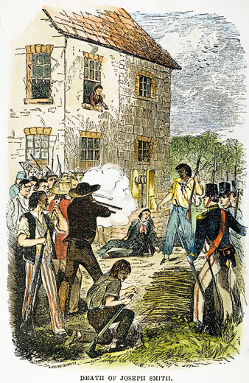
Case Study: Mormon Migration West
1844 - Navuoo, IL
  Disagreements within the church and surrounding community resulted in Smith’s arrest and jailing.
  Charges of polygamy, perjury, and inciting riots
An anti-Mormon mob broke into the jail and murdered Smith and his brother, Hyrum.

Slide 12
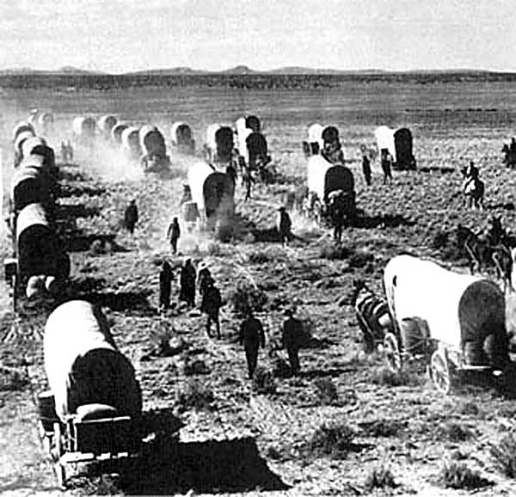
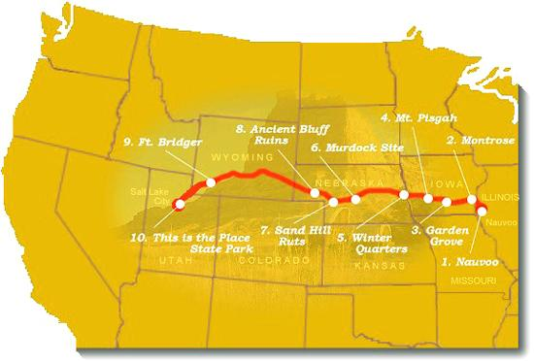
Case Study: Mormon Migration West
Brigham Young – Smith’s successor as leader of the LDS church, decided to move further west to escape religious persecution.
  Created the “Mormon Trail”
1847 – Young and the Mormons settled near the Great Salt Lake in (modern day) Utah.
  Led to the development of Salt Lake City

Slide 13
Dangers of Moving West
MAJOR danger when moving west - Native American attacks
Unfamiliar seasons
  One group called the “Donner Party” tried to take a shortcut and ended up stranded in the winter → resorted to cannibalism
Mountains and dangerous terrain
  Difficult for wagons to cross mountains and streams
Disease and illness
  Drinking bad water (cholera), eating spoiled food
  Measles
Running out of supplies or wagon breaking

Slide 14
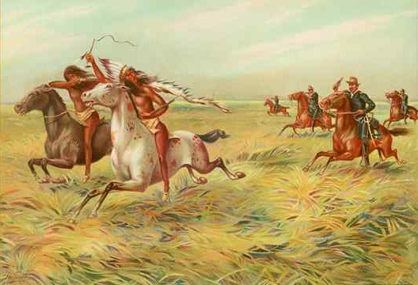
Conflicts with Native Americans
As Americans moved westward, Native Americans viewed them as unwelcome invaders of their lands.
  Some tribes assimilated into American culture.
  Other tribes tried to fight to keep their land and culture.

Slide 15
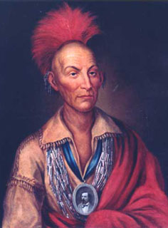
Conflicts with Native Americans
Early 1830s – white settlers in Illinois and Iowa pressured Native Americans to move west of the Mississippi River.
Representatives of the tribe convinced Chief Black Hawk of the Sauk Tribe to lead a rebellion against the US.

Slide 16
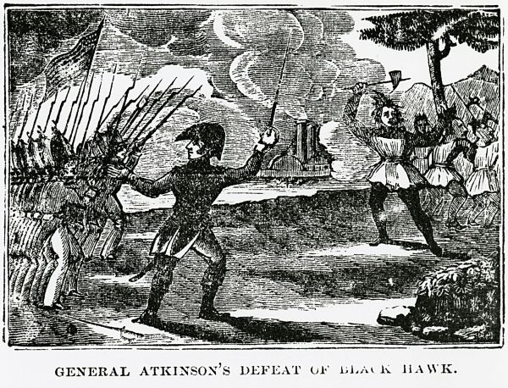
Conflicts with Native Americans
1831-32 – Black Hawk War
  Natives attacked Illinois militia members
  Over 200 Native Americans were killed
  Sauk and Fox tribes were forcibly moved west of the Mississippi River

Slide 17
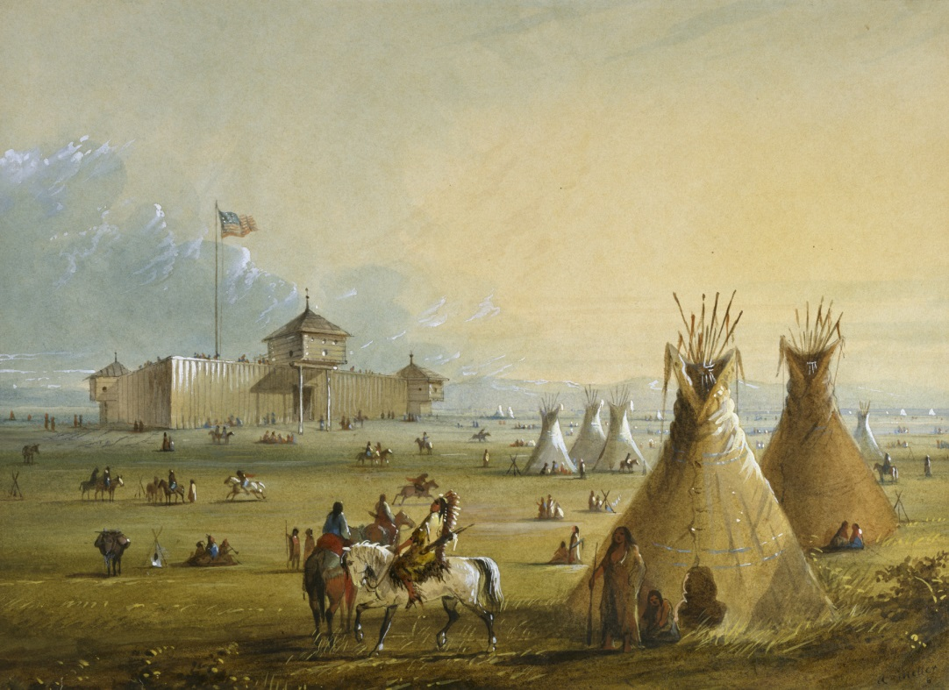
Compromises with Native Americans
1851 - The US government responded to settlers’ complaints about Native American attacks by calling a conference in Fort Laramie, Wyoming.
  US representatives met with members of the Cheyenne, Arapaho, Sioux, and Crow tribes

Slide 18
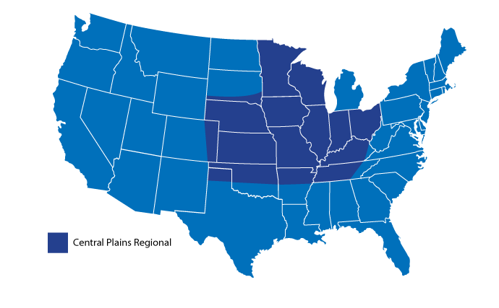
Compromises with Native Americans
Treaty of Fort Laramie (1851)
  Native American tribes given control of parts of the Central Plains and promised annual payments
  Native Americans promised to stay away from white settlers moving west and government railroad projects

Slide 19
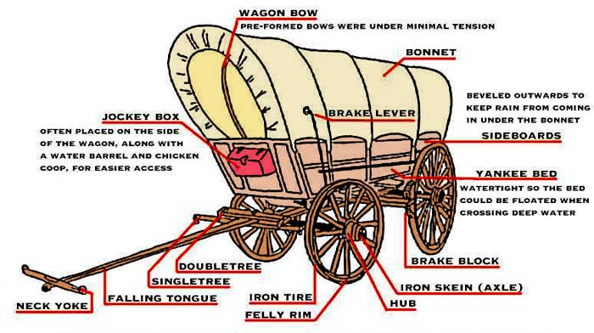
How to Move West
Covered wagon
  Furs/cloth (for cold seasons)
  Food (as much as you could carry)
  Weapons, knives, guns (kill food and protection)
  Basic medicine and first aid
  Maps
  Toolbox and grease bucket (for repairs)
  Horse or mule to pull the wagon

Slide 20
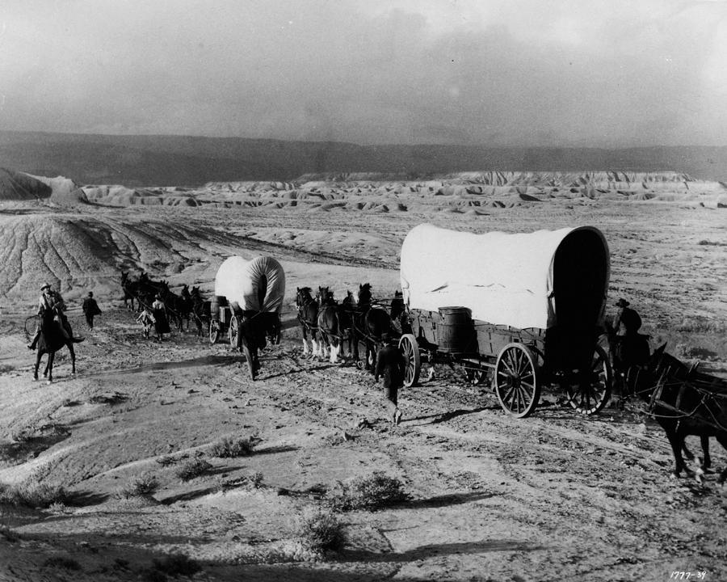
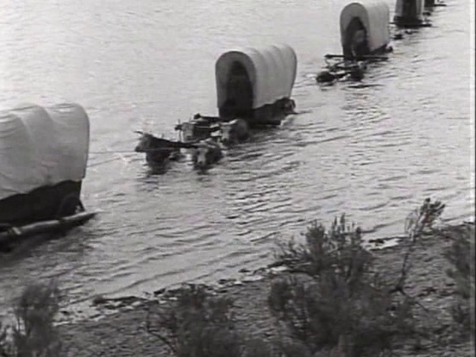

Slide 21
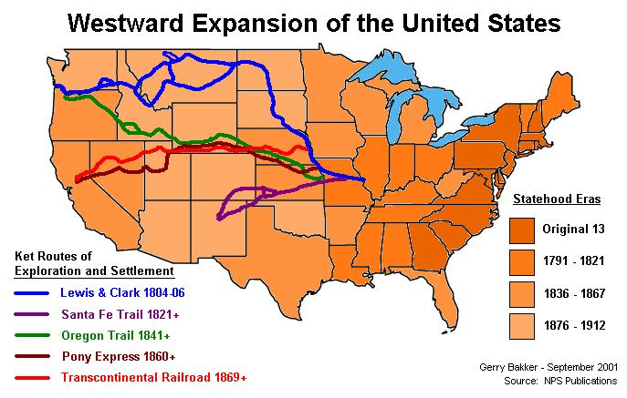
How to Move West
Santa Fe Trail
  Missouri to Santa Fe, New Mexico, used by many Americans to travel west
  780 miles
Wagons usually traveled in groups to avoid Native American attacks.
  At night, wagons would circle-up to form a camp for security.

Slide 22
How to Move West
Oregon Trail
  Missouri to Portland, Oregon, used by many settlers to move westward

Slide 23
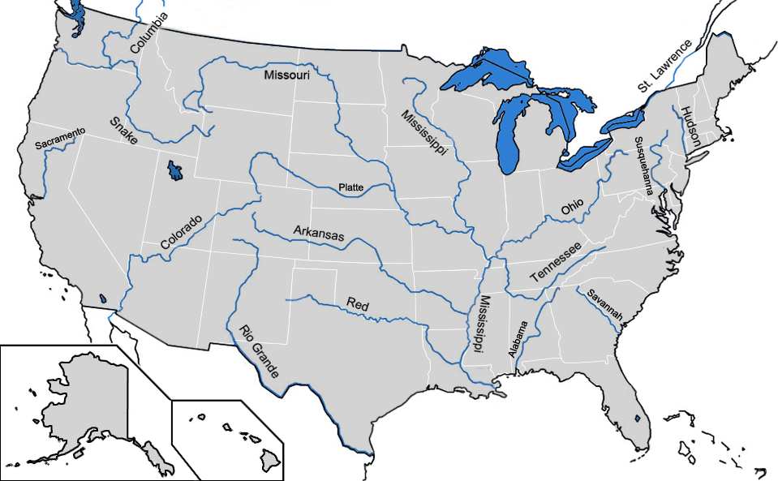
How to Move West
Steamboats on rivers
  Mississippi
  Missouri
  Arkansas
  Colorado

Slide 24
How to Move West
Railroads (constantly being built and expanding west)
  1869 – Transcontinental Railroad finished
  Dropped the price of traveling west from $1,000 to $150.

Slide 25
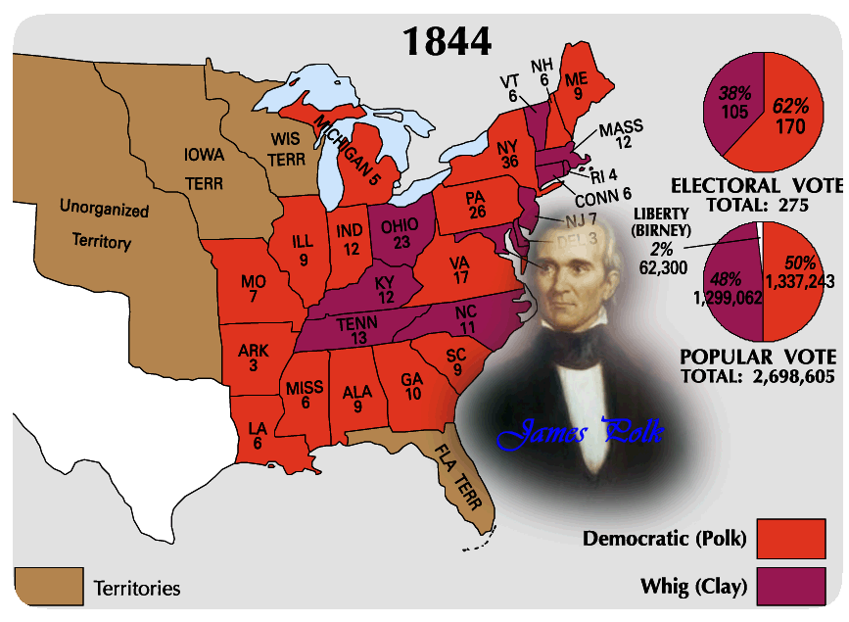
Disputes in the Oregon Territory
Election of 1844 – James K. Polk (Democratic, Expansionist) vs Henry Clay (Whig)
Polk = 11th POTUS!

Slide 26
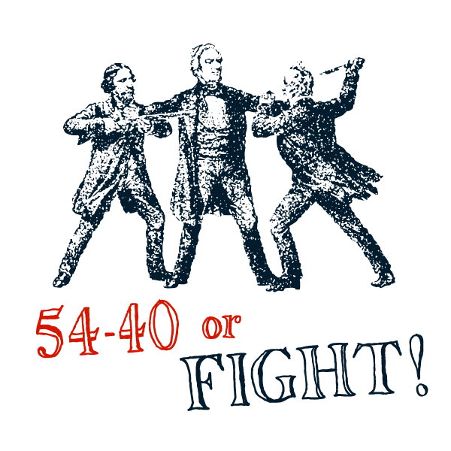
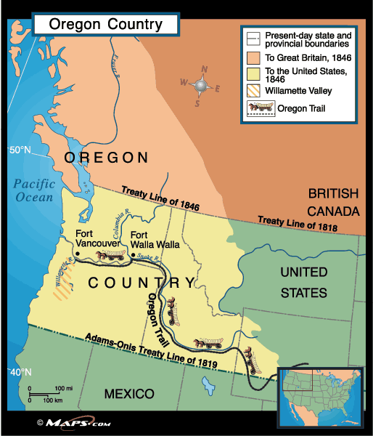
Disputes in the Oregon Territory
US and Great Britain jointly occupied the Oregon Territory.
Polk’s campaign focused on gaining the land from GB.
  54º40’ or Fight! – slogan adopted by the Polk campaign, referred to the latitude line 54º40’ which created the northern border of the Oregon Territory

Slide 27
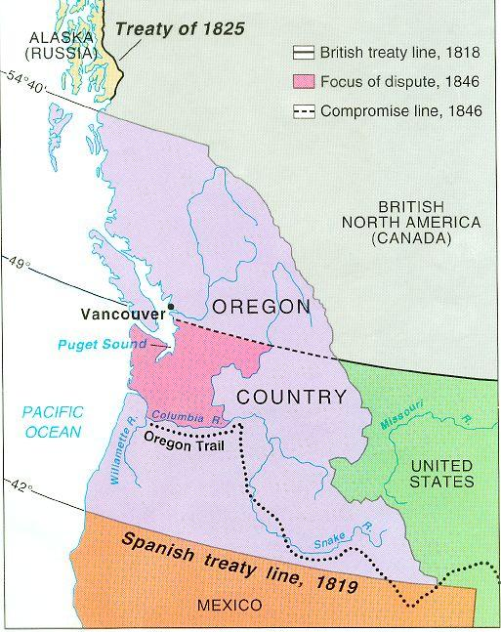
Disputes in the Oregon Territory
Mid-1840s – GB lost interest in keeping the land
  Fur trade declining
  Didn’t want to spend money protecting the land
Polk decided land above the 49th latitude line was not good for farming.
1846 – US and GB agreed that the 49th latitude line would be the US-Canada border.

