Slide 1
NATIONALISM, SECTIONALISM, & THE AGE OF JACKSON
American History I - Unit 5

Slide 2
Review
What did Calhoun nickname the Tariff of 1828? Why?
What theory did Calhoun’s South Carolina Exposition propose? What did it state?
What did the Force Bill give Jackson the permission to do?
What did SC threaten to do if forced to pay the tariff taxes?
How was the SC Nullification Crisis calmed?

Slide 3
Review
What did Calhoun nickname the Tariff of 1828? Why?
  The Tariff of Abominations because it hurt the economies of Southern states
What theory did Calhoun’s South Carolina Exposition propose? What did it state?
  Nullification theory – states could nullify (ignore) a federal law that they believed was unconstitutional
What did the Force Bill give Jackson the permission to do?
  Send the military and navy to SC to enforce the tariff if SC refused to pay taxes.
What did SC threaten to do if forced to pay the tariff taxes?
  Secede from (leave) the Union
How was the SC Nullification Crisis calmed?
  Henry Clay helped Congress devise a plan to lower tariffs over 10 years

Slide 4
5.5 – JACKSON VS THE BUS
AH1.H.4.1 Analyze the political issues and conflicts that impacted the US through Reconstruction and the compromises that resulted.
AH1.H.4.2 Analyze the economic issues and conflicts that impacted the US through Reconstruction and the compromises that resulted.
AH1.H.5.2 Explain how judicial, legislative, and executive actions have affected the distribution of power between levels of government.

Slide 5
Vetoing the BUS
1832 – Jackson vetoed (cancelled) the bill to re-charter (extend) of the Bank of the United States
The BUS was originally chartered for 20 years in 1816
BUS not due to expire until 1836, but Clay and Daniel Webster wanted to re-introduce it early.
  They knew Jackson would oppose the extension of the BUS, thus hoping to make him lose support in the Election of 1832.

Slide 6
Jackson’s View of the BUS
Believed the BUS benefited only the rich in North at the expense of the “common man” in the South and West.
  Received all federal tax revenue from tariffs which was used to pay interest to private investors (rich people) instead of dividing it evenly among the American taxpayers.
The BUS’s President = Nicholas Biddle
  Biddle gave loans to US Congressmen at much lower interest rates than loans given to average citizens.
Jackson argued that the bank was a “privileged institution” for wealthy Americans, not average citizens.

Slide 7
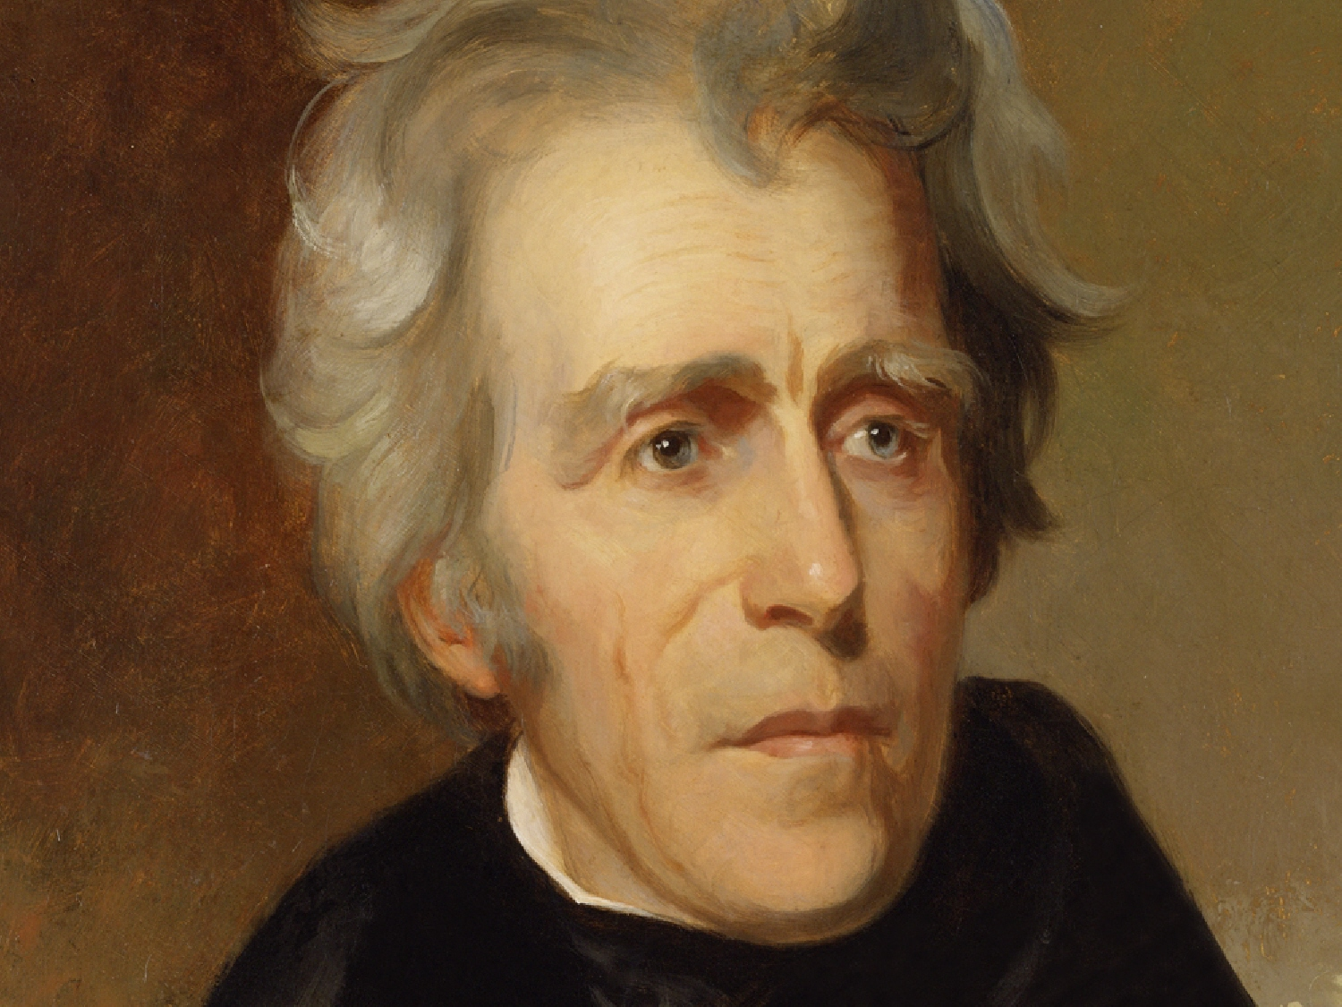
“The bank is trying to kill me… but I will kill it!”
The BUS is a “monster” that corrupts our “statesmen” and wants to “destroy our republican institution.”

Slide 8
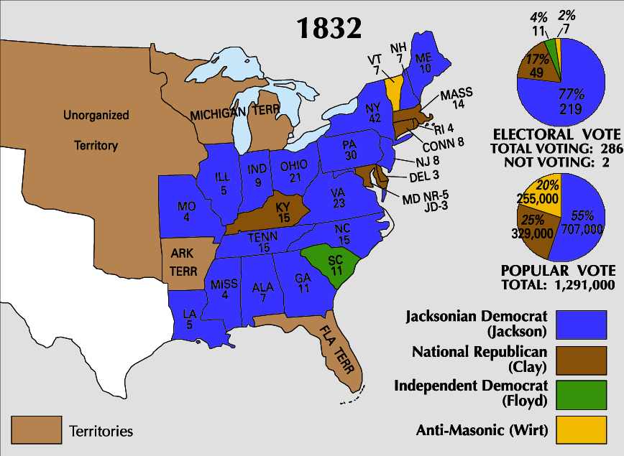
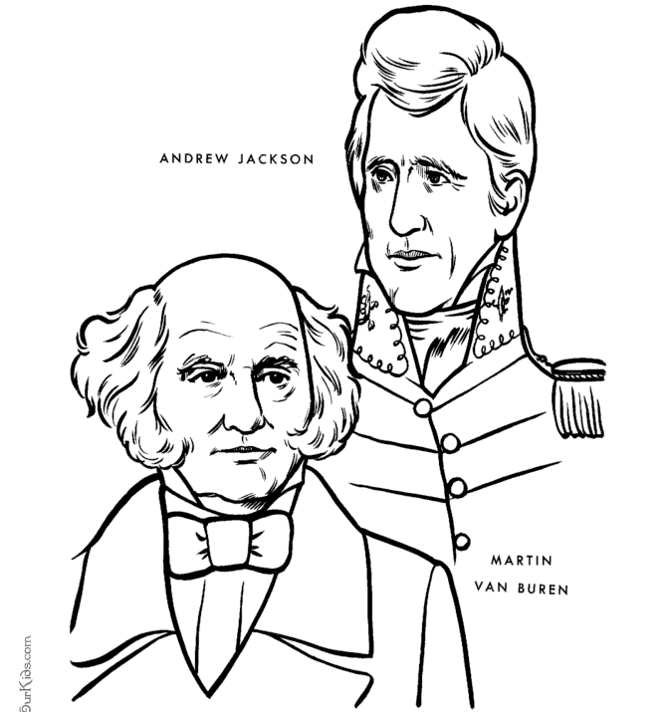
Pet Banks
Election of 1832
  POTUS – Jackson (2nd term)
  VP – Martin Van Buren
Jackson vetoed the bill to re-charter the BUS, but it still had 4 years until its first charter ran out… wanted to cause the BUS to FAIL and CRUMBLE!
Appointed a Secretary of the Treasury who put all the federal money from the BUS into state owned banks called “pet banks.”
  “Pet” because they were loyal to Jackson (think of a “teacher’s pet”)

Slide 9
Biddle Tried to Save the BUS
Biddle tried to save the bank!
  Demanded that all loans owed to the BUS be paid immediately
  Refused to issue new loans
  Hoped that this would frustrate the public enough to basically force Jackson to renew the BUS’s charter
Businessmen and citizens rushed to DC to express anger about the BUS’s actions.
  Jackson – “Go to Nicholas Biddle”

Slide 10
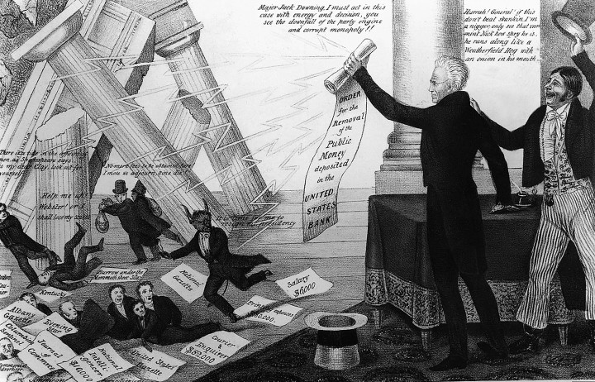
Failure of the BUS
Jackson
“Jack Downing” – represents the common man
Biddle’s plan backfired and the BUS failed.
  In 1836, the BUS’s charter expired.
  The BUS went out of business.
BUS crumbling
Declaration to move $ to pet banks
Biddle, BUS President, running around trying to collect loans

Slide 11
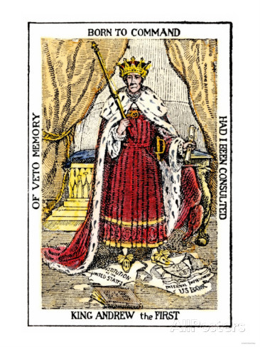
Jackson is standing on a ripped up copy of the Constitution and the BUS charter. What does this represent?
Examples of Jackson ignoring the Constitution?
Why would Jackson’s opponents say he was like a King?

Slide 12
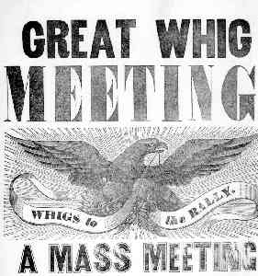
Whig Party
Jackson’s actions during his 2 terms angered many people → formed a new political party
The Whigs
  Clay, JQ Adams, Webster
  Pro American System (unifying US)
  Pro national bank and common currency
  Use federal money to pay for roads and
  canals to move goods between regions
  Pro tariffs
Democratic Republicans (aka Republicans or Jacksonians) vs. Whigs

Slide 13
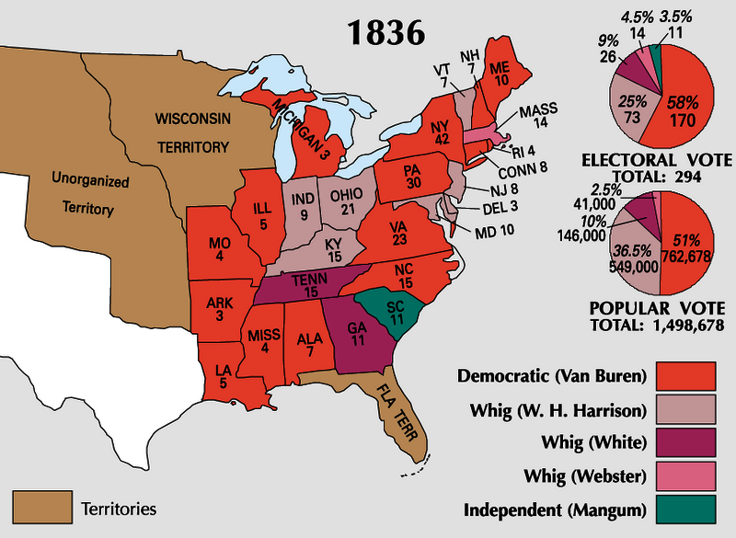
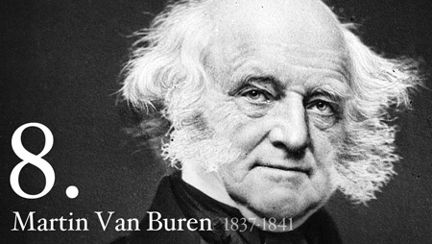
Election of 1836
Martin Van Buren = 8th POTUS
  Democratic Republican
  Jackson’s 2nd term VP
  Whig party was not stable enough to decide on a single candidate
Van Buren inherited Jackson’s messes
  Indian Removal (Trail of Tears – 1838)
  Extreme sectionalism
  BUS Crisis
  Failing economy

Slide 14
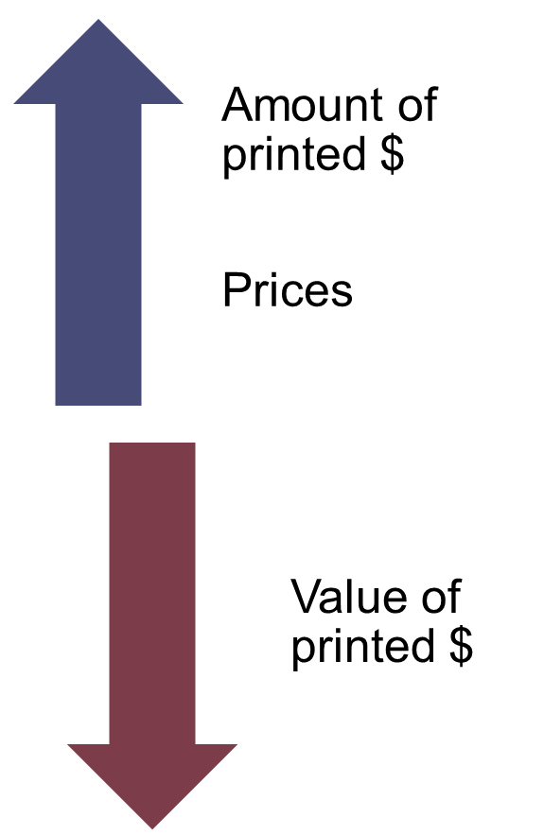
Panic of 1837
Pet banks around the country held all of the federal money.
Pet banks started to print their own currency but didn’t communicate to each other about how much they were printing.
Currency printed exceeded the actual amount of gold/silver the US owned → Inflation!
INFLATION

Slide 15
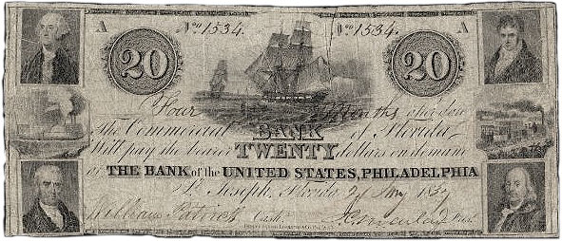
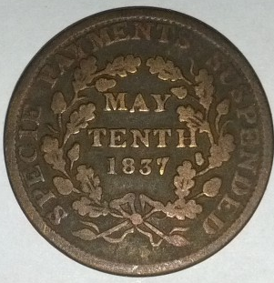
Panic of 1837
People were using the worthless paper money to buy western land from the federal government → federal government LOSING money in land sales.
Jackson (still POTUS until March 1837) declared that paper money would no longer be used.
Everyone must use actual gold and silver (specie) for currency.

Slide 16
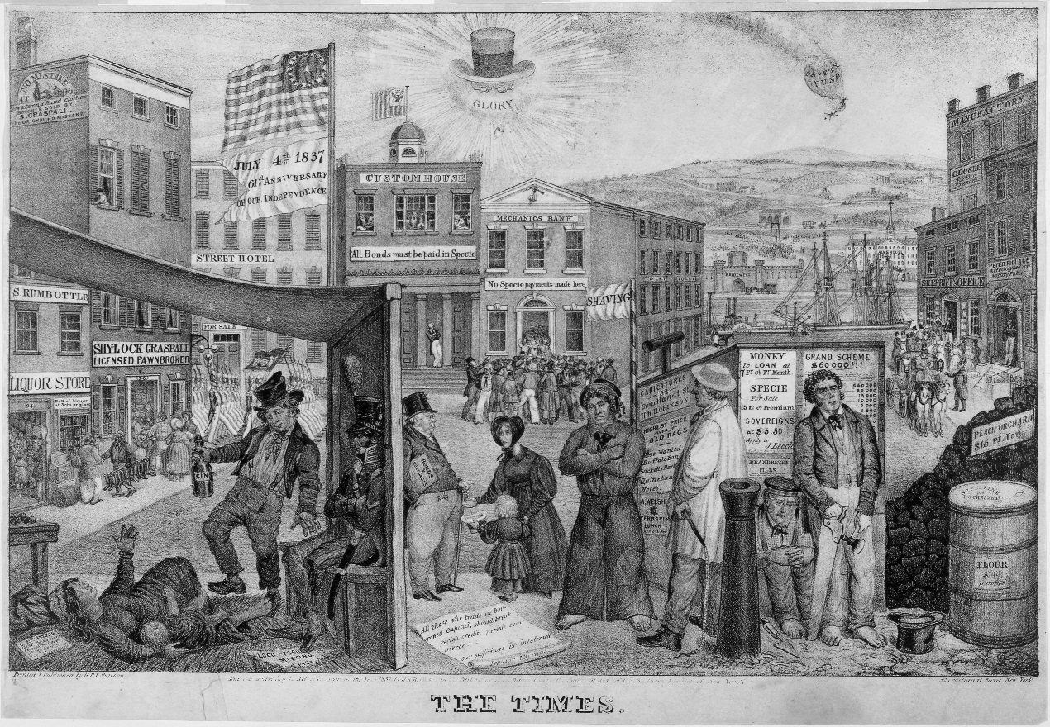
Panic of 1837
People rushed to the banks to exchange their cash for gold/silver coins → the banks ran out of coins!
  Banks closed
  Savings became
  worthless
  Businesses went
  bankrupt
  Unemployment
  rose (1/3 out of work)

Slide 17
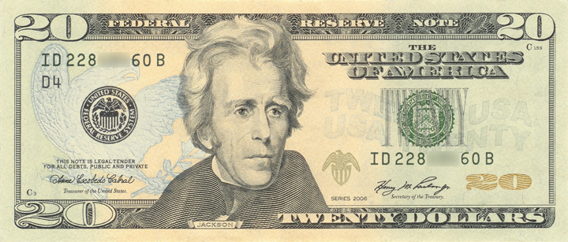
Why is Jackson on the $20?
Jackson HATED paper currency. He preferred specie.
He committed terrible acts against Natives.
He caused the failure of the BUS.
He was uncompromising with SC on tariffs.

Slide 18
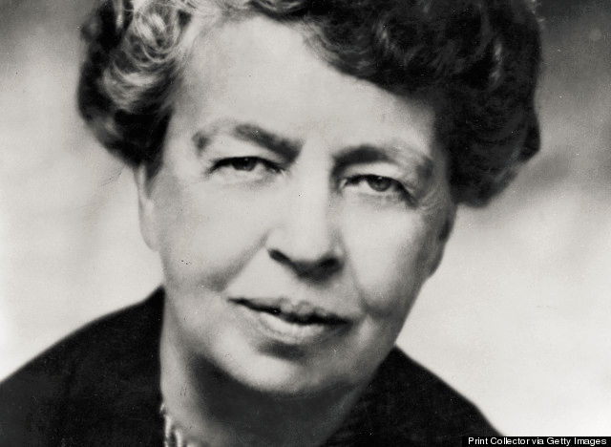
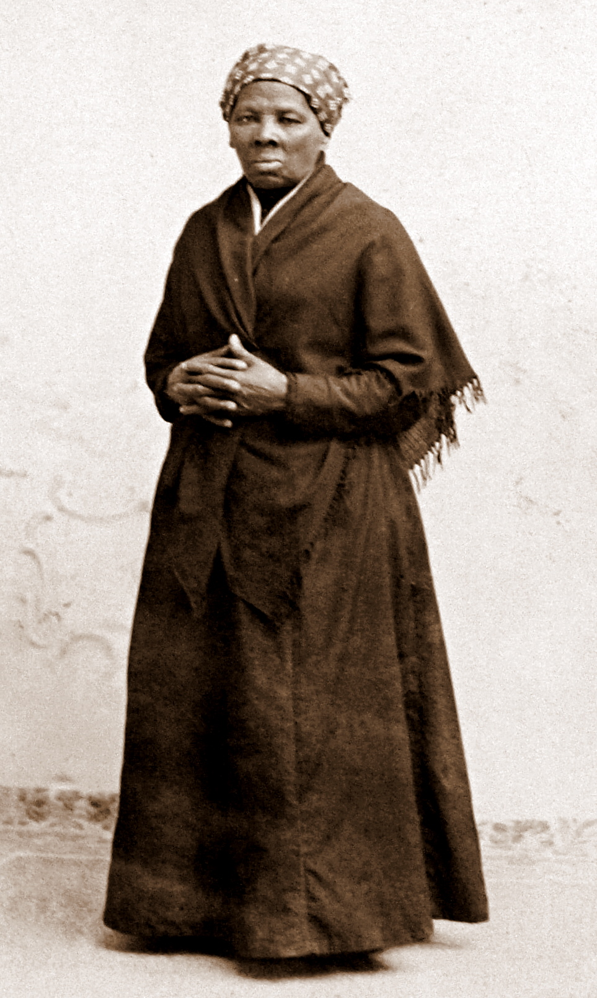
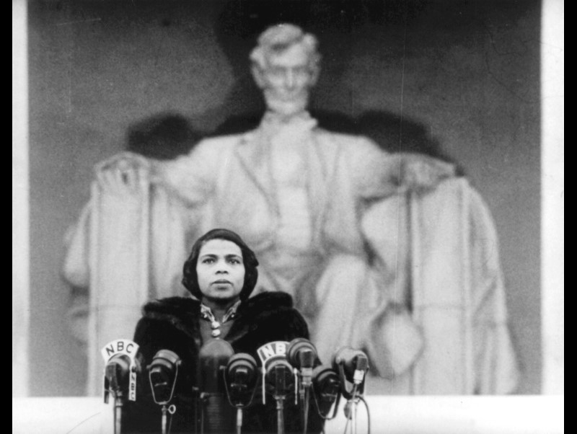
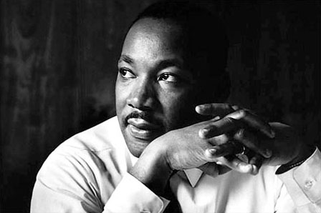
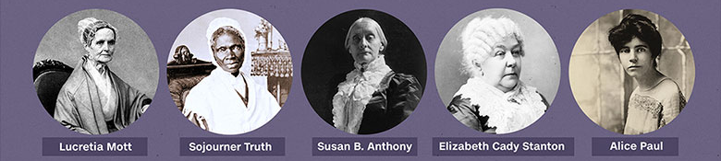
The New $20, $10, and $5

Slide 19
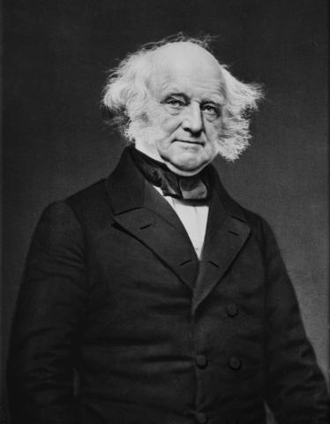
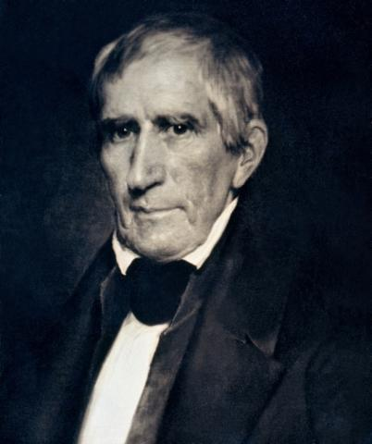
Election of 1840
VS
William Henry Harrison
Whig
Van Buren
Democratic Republican

Slide 20
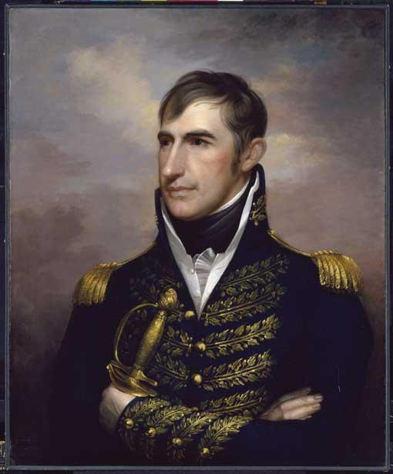
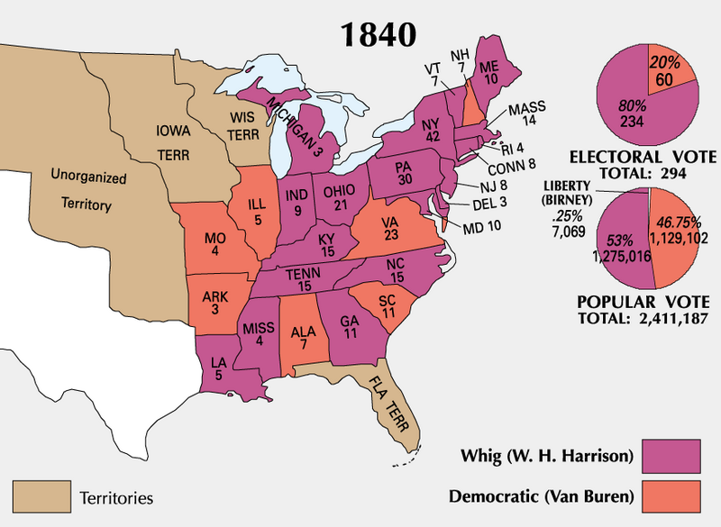
Election of 1840
Harrison = 9th POTUS
  Old war hero at Battle of Tippecanoe and War of 1812
  False portrayal as a “common man” (he was actually very wealthy)
  John Tyler = VP
  “Tippecanoe and Tyler too!” – campaign slogan
Planned to take action to end the economic depression caused by the Panic of 1837.

Slide 21
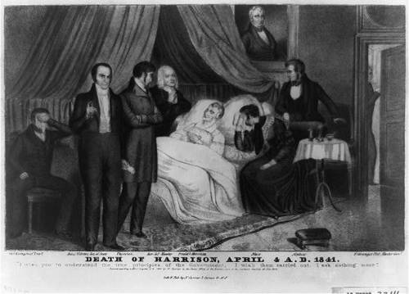
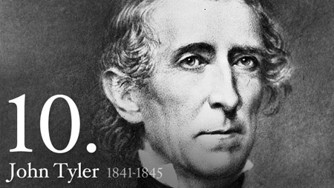
Tyler as POTUS
Harrison died in April 1841
  One month after Inauguration
  Cause of death was thought to be pneumonia
  Recent research shows he probably died from an infection caused by infected water/food (poor sewer system = feces in water supply)
Tyler = 10th POTUS
  Whigs only put Tyler on the ballot as VP to pick up votes in Southern states
  Tyler actually opposed Whig policies
  Not prepared to be POTUS – nicknamed “His Accidency”

Slide 22
Final Thoughts…
Nationalism was reflected in Monroe’s Era of Good Feelings, the American System, and the Missouri Compromise of 1820.
Sectionalism was reflected in the growing debate over slavery, Tariff of 1828 (Abominations), and the South Carolina Nullification Crisis.
The nation experienced its first depression due to the destruction of the BUS and the Panic of 1837.
As of 1840… the future of the Union is uncertain!

