Slide 1
NATIONALISM, SECTIONALISM, & THE AGE OF JACKSON
American History I - Unit 5

Slide 2
Review
Define nationalism.
Who was Monroe’s Secretary of State?
What did the US gain in the Adams-Onis Treaty with Spain?
What topic caused much debate in Congress in 1820?
What did the Missouri Compromise do?

Slide 3
Review
Define nationalism.
  The belief that the nation’s interests should be valued over the interests of regions OR other countries
Who was Monroe’s Secretary of State?
  John Quincy Adams
What did the US gain in the Adams-Onis Treaty with Spain?
  Florida
What topic caused much debate in Congress in 1820?
  Slavery – allow/ban in new territories and states?
What did the Missouri Compromise do?
  Maine – 12th free state and Missouri – 12th slave state (Kept balance in Congress)
  Missouri Compromise Line – slavery banned above the line, slavery allowed below the line.

Slide 4
5.3 – THE AGE OF JACKSON
AH1.H.3.3 Explain the roles of various racial and ethnic groups in settlement and expansion through Reconstruction and the consequences for those groups.
AH1.H.3.4 Analyze voluntary and involuntary immigration trends through Reconstruction in terms of causes, regions of origin and destination, cultural contributions, and public and governmental response.
AH1.H.5.2 Explain how judicial, legislative, and executive actions have affected the distribution of power between levels of government.
AH1.H.8.3 Evaluate the extent to which a variety of groups and individuals have had opportunity to attain their perception of the American Dream.

Slide 5
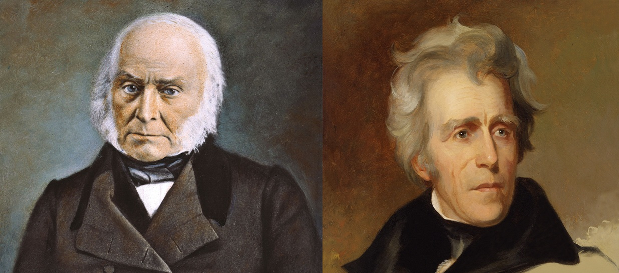
Election of 1824
J. Q. Adams VS Andrew Jackson
Jackson won the popular vote with 43% (not a majority, but the popular vote doesn’t matter anyway).
No clear majority in the Electoral College → House of Representatives
voted on POTUS

Slide 6
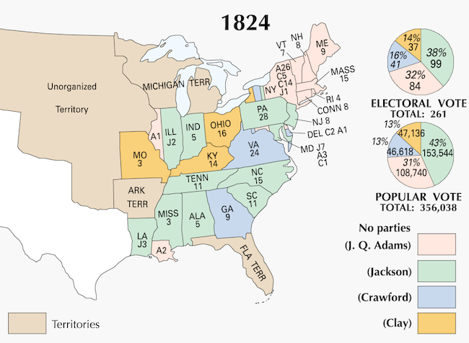
Election of 1824

Slide 7
Election of 1824
No parties?
The Federalists are gone.
The Democratic- Republican Party is the largest, but has many “factions” - subgroups - and couldn’t agree on just 1 candidate… so 4 Dem. Reps. ran for POTUS.

Slide 8
Election of 1824
House of Representatives, under Henry Clay’s direction, voted for Adams.
  Henry Clay (the Speaker of the House) had the power to sway the votes in the House of Representatives to his chosen candidate.
  Clay ran for POTUS, but received the least electoral votes,so he couldn’t choose himself… but he chose a close ally…
J.Q. Adams = 6th POTUS!
  Chose Henry Clay to be his Secretary of State… hmmm
“I cannot believe, that the killing of twenty-five hundred Englishmen at New Orleans qualifies him for the various difficult and complicated duties of the presidency.”
- Henry Clay speaking about Jackson

Slide 9
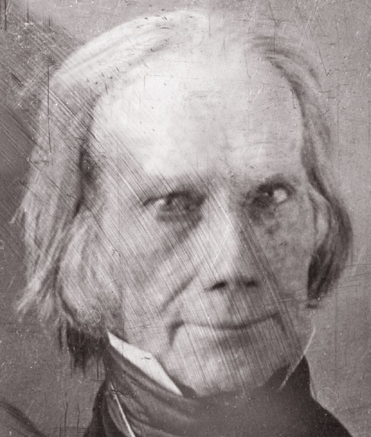
The Corrupt Bargain
Jacksonians (Jackson’s followers) believed that Adams made a “deal” with Clay and stole the presidency from Jackson → called the Election of 1824 “The Corrupt Bargain.”
Jacksonians formed a large faction in the Democratic- Republican Party.
  Main goal – sabotage Adams’s presidency and oppose all of his policies.
  Adams and Clay would eventually lead the Whig Party which would be devoted to opposing Jackson.
X
J.Q. Adams
POTUS
Clay
Sec. of State

Slide 10
Expanding Voting Rights
By 1828, many states decreased voting requirement → larger voting population
  Most states dropped the property-ownership requirement → universal white male suffrage
1824 – 350,000 white males voted
1828 – over 1,000,000 white males voted
Free blacks, slaves, and women = no voting rights

Slide 11
Election of 1828
Expanded voter rights → more “average” and “common” people voting
Election of 1828 – J.Q. Adams vs Jackson
Jackson’s 1828 POTUS Campaign
  Wanted to appeal to the common man
  Claimed man of humble origins (even though he was actually a wealthy plantation owner)
  Called Adams an “intellectual elitist” who didn’t understand the troubles of the common American.

Slide 12
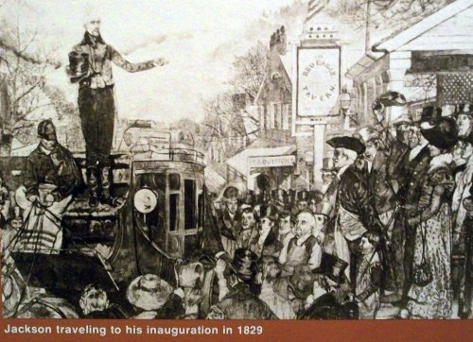
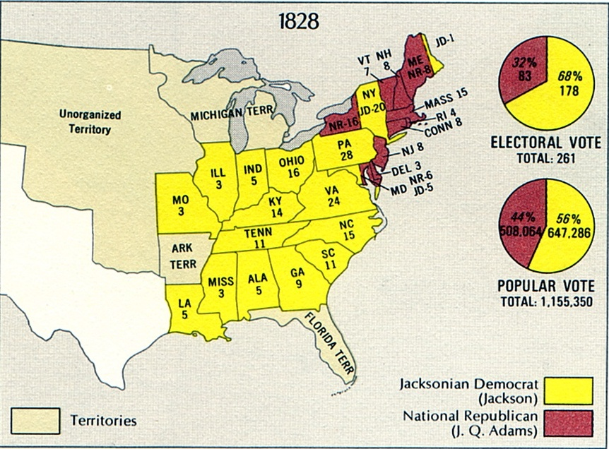
Election of 1828
Jackson = 7th POTUS!
  Won by a landslide

Slide 13
The Spoils System
“To the victor belong the spoils of the enemy.”
  The winner gets everything that goes with the victory, including anything the loser had.
  Jackson = victor → gets all the presidential power to change anything the Adams administration did
Spoils system – giving jobs and appointments to supporters and followers rather than to qualified people
  Jackson fired nearly 10% of Adams’s federal workers
  Gave the jobs to his own supporters and friends, even if they weren’t qualified for the jobs
Created the “kitchen cabinet” – Jackson’s close group of friends who gave him advice and acted like a cabinet
  “snuck in to the White House through the kitchen”

Slide 14
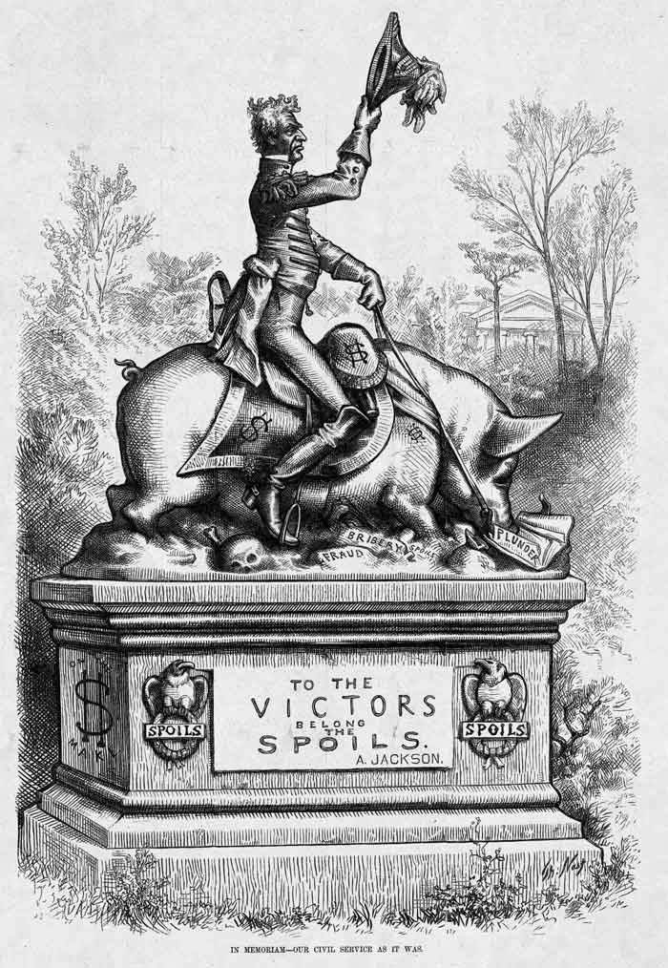
The White House
Jackson
Pig = the “spoils”
“Fraud,” “Bribery,” “Plunder”
“To the Victor belong the Spoils”

Slide 15
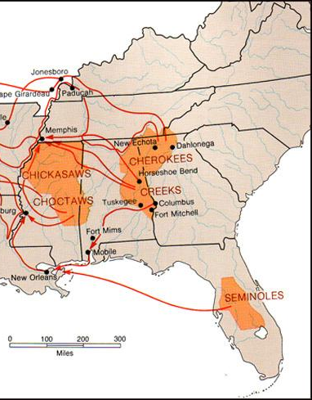
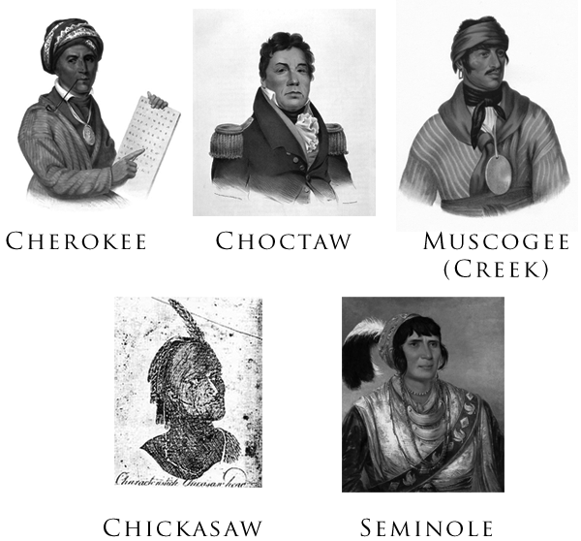
Jackson and Native Americans
After War of 1812, some Native American tribes assimilated into American culture.
  Learned English, wore American fashion,
  But still retained some NA customs
  “5 Civilized Tribes”
  Lived in the southeast US

Slide 16
Indian Removal Act of 1830
Jackson did not like Native American assimilation.
  Jackson didn’t think it was “right.”
  Believed protecting the original tribal areas from American settlers would require too many federal troops and money
Jackson’s plan – Indian Removal Act of 1830 - forced movement of Native Americans to western areas with government funded treaties
  Some tribes quickly agreed to the treaties and moved west voluntarily
  Some tribes resisted and were forcibly moved by US troops

Slide 17
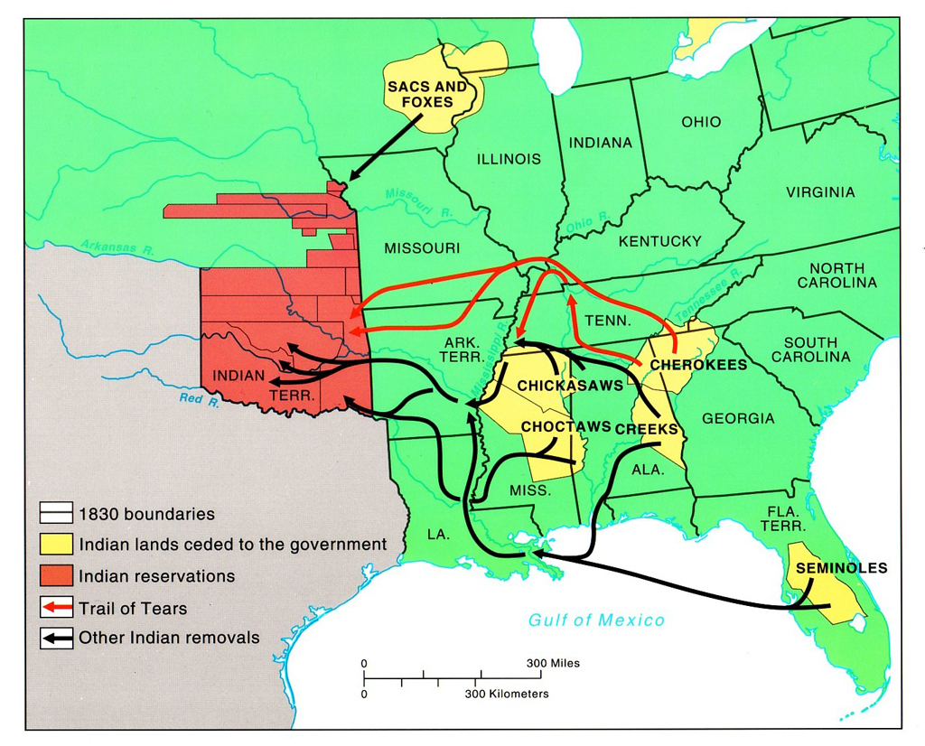

Slide 18
Worcester v. Georgia (1832)
Following the Indian Removal Act, Georgia passed its own state laws forcing the removal of Native tribes within the state borders.
Cherokee members refused to move and claimed that they were a “nation” that could not be removed without their consent.
Instead of fighting back violently, the Cherokee decided to fight back using the American legal system.

Slide 19
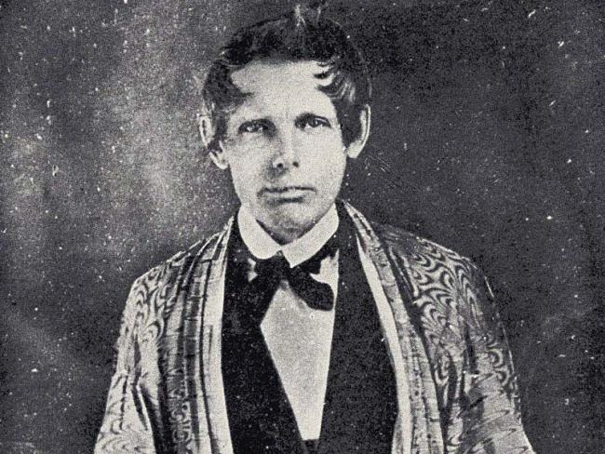
Worcester v. Georgia (1832)
The Cherokee tribe teamed up with Samuel Worcester, a teacher who had been jailed for teaching Natives English without a state issued license.
Worcester = a US citizen → the legal system would HAVE to honor the rights of a citizen to be heard in court.
Worcester sued Georgia on behalf of the Cherokee.

Slide 20
Worcester v. Georgia (1832)
Chief Justice John Marshall and the SCOTUS ruled in favor of WORCESTER and the Cherokee.
  Cherokee = a distinct and independent nation that is NOT subject to Georgia’s OR the US’s laws.
Jackson REFUSED to obey the SCOTUS’s decision.
“ John Marshall has made his decision,
now let him enforce it.”
- Jackson on the Worcester v. Georgia ruling

Slide 21
The Trail of Tears
A small group of Cherokee stopped resisting the relocation and signed a treaty with Jackson, agreeing to move for money.
  The small group was not at all representative of the entire Cherokee population.
Jackson (and later Van Buren, 8th POTUS) forced the rest of the Cherokee from their land.

Slide 22
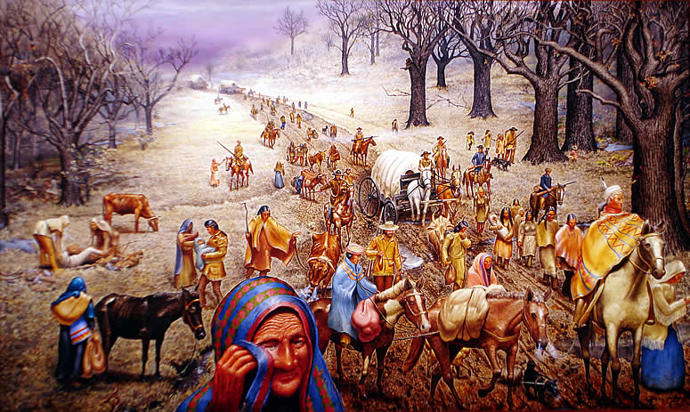
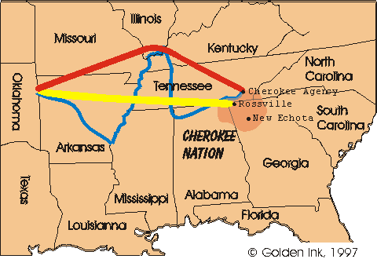
Trail of Tears
Oct-Nov 1838 (winter), Jackson no longer POTUS
Groups of Cherokee natives forced to relocate to western land
800 miles – mostly by foot
Harassed and abused by US troops and outlaws
¼ died along the way
“Children cry and many men cry, and all look sad like when friends die but they say nothing and just put heads down and keep on go towards West. Many days pass and people die very much.”
- Trail of Tears survivor

