Slide 1
NATIONALISM, SECTIONALISM, & THE AGE OF JACKSON
American History I - Unit 5

Slide 2
Review
What event prompted the US to begin developing domestic industries?
Where did industrialization take place in the US?
What impact did the cotton gin have on slavery in the south?
What were the 3 pieces of the American System?
What were the regional reactions to the Tariff of 1816 highlight growing sectionalism in the US?

Slide 3
Review
What was the Industrial Revolution?
  A period of social and economic change that occurred as factories and mass production developed.
What two events prompted the US to begin developing domestic industries?
  Embargo of 1807
  War of 1812
Where did industrialization take place in the US?
  The Northern states
What impact did the cotton gin have on slavery in the south?
  Easier/faster cotton production = more cotton demand = expanded slavery
What were the 2 goals of the American System?
  To unify the north and south AND make the US self-sufficient
What were the 3 pieces of the American System?
  Infrastructure improvements, tariffs, new National Bank (the BUS)
How did the regional reactions to the Tariff of 1816 highlight growing sectionalism in the US?
  North liked the tariff and South did not like the tariff… each region was putting their regional interests over the interests of the nation as a whole (sectionalism)

Slide 4
5.2 – NATIONALISM AT CENTER STAGE
AH1.H.6.1 Explain how national economic and political interests helped set the direction of US foreign policy.
AH1.H.4.1 Analyze the political issues and conflicts that impacted the US through Reconstruction and the compromises that resulted.
AH1.H.4.2 Analyze the economic issues and conflicts that impacted the US through Reconstruction and the compromises that resulted.

Slide 5
Sectionalism vs Nationalism
Sectionalism
Nationalism
Placing the interests of the region over the interests of the nation
North vs. South (and west)
Placing the nation’s interests ahead of regional interests or the interests of other countries
Accomplished by expanding the power of the federal government.

Slide 6
The SCOTUS Boosts National Power
McCulloch v. Maryland (1819)
  Maryland’s state government taxed the federal branch of the BUS in Baltimore, without taxing state run banks.
  McCulloch, the head of the BUS in Baltimore, refused to pay the state tax saying it was unconstitutional for states to interfere with federal laws (a federal law created the BUS).
  Maryland sued McCulloch - in state court, Maryland won
  McCulloch appealed to the Supreme Court
  Questions at hand…
    Is the law that established the BUS constitutional?
    Does Maryland have the ability to interfere with federal laws?

Slide 7
The SCOTUS Boosts National Power
McCulloch v. Maryland (1819)
  Chief Justice John Marshall (Federalist) delivered the SCOTUS’s opinion...
    In favor of MCCULLOCH (head of the BUS)
    Declared the BUS constitutional because of the “necessary and proper clause” in the Constitution (the federal government can do all things that are necessary and proper to the survival of the nation)
    Maryland cannot tax the BUS because federal laws are more powerful than state laws (the supremacy clause)
  IMPORTANCE – Marshall re-emphasized that federal laws are greater than state laws → more power to federal government

Slide 8
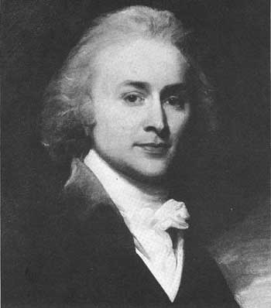
Nationalism and Foreign Policy
John Quincy Adams
  Secretary of State in Monroe’s cabinet
  Belief in nationalism guided his foreign policies
  Interested in the security of the nation by establishing and securing the nation’s borders
  Wanted to expand US territory

Slide 9
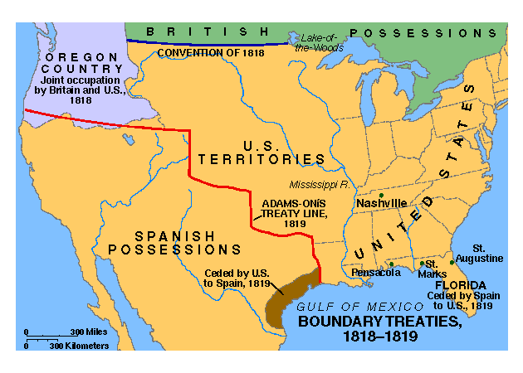
Compromises with the British
1817 - Adams negotiated the Rush-Bagot Treaty with England
  Agreement to reduce the number of US and British navy ships in the Great Lakes
  Demilitarization (removal of troops) of the US-Canada border
  Increased US security by decreasing nearby British troops
Convention of 1818
  Adams established the northern US border with Canada at the 49th parallel
  US and England would jointly own the Oregon territory for 10 years
  Start of expanding US territory

Slide 10
Adams-Onís Treaty
1819, treaty with Spain
  US gained Florida
  Spain gave up land claims in the Oregon Territory

Slide 11

Monroe Doctrine
Spain, Russia, and England wanted to establish colonies in North and South America
  Scared Monroe – other nations’ colonies could be threatening if too close to American borders
1823 – Monroe issued the Monroe Doctrine
  US would stay out of European affairs if European powers stayed out of the western hemisphere
  Any European act in the western hemisphere would be deemed an act of aggression and “dangerous to our peace and safety.”
  We will stay out of your part of the world if you stay out of ours.
  Guided US foreign policy for almost 100 years (until World War I)
Doctrine – a set of beliefs
Monroe’s Presidency

Slide 12
Nationalism Pushes West
Why move westward? → NEW ECONOMIC OPPORTUNITIES
  Cheap and fertile land
  Change occupations
  Escape debts
  Escape the law
  (fugitives)
  Later, gold?

Slide 13
Slavery in the West?
Once a territory’s population = 60,000 → apply for statehood
New states – Free (no slavery) or Slave (slavery)
1818 – 2 states added
  Illinois – 11th free state
  Alabama – 11th slave state
1819 - Missouri Territory wants to become a state
  Free or Slave?
History of slavery and presidents – it’s a tricky issue

Slide 14
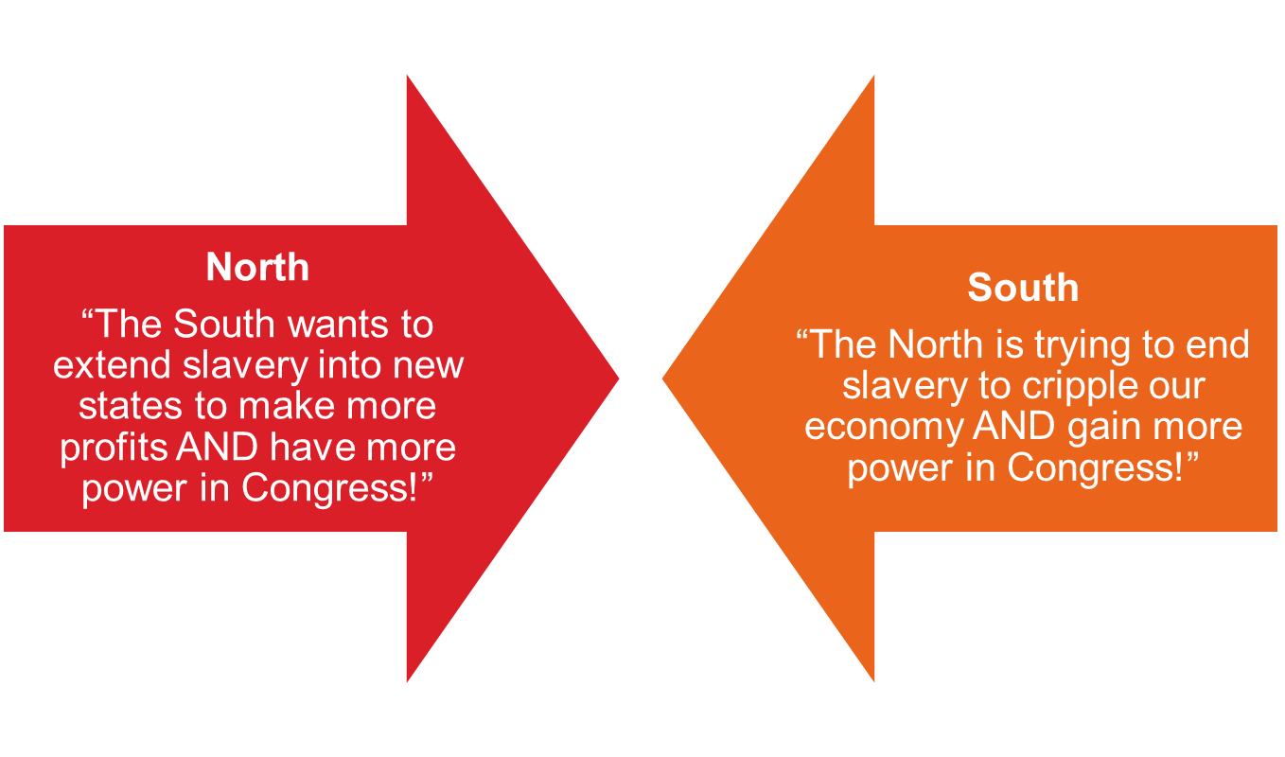
Debates over slavery in Missouri were SO intense that Congressmen from Northern and Southern states threatened WAR against each other… foreshadowing events in the future?

Slide 15
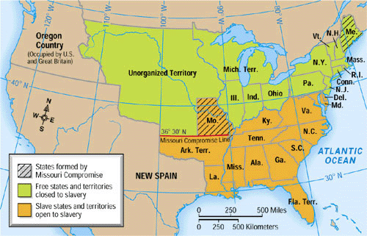
The Missouri Compromise
1820, proposed by Henry Clay
  Maine = 12th free state
  Missouri = 12th slave state
  Louisiana Territory split into 2 parts along the 36°30’N latitude - Missouri Compromise Line
    Above line – slavery banned
    Below line – slavery allowed

Slide 16
The Missouri Compromise
The Missouri Compromise was a TEMPORARY fix to a major problem: What will be the future of slavery in the US?
“This momentous question, like a fireball in the night, awakened and filled me with terror. I considered it at once as the knell of the Union. It is hushed, indeed, for the moment. But this is a reprieve only, not a final sentence.”
- Thomas Jefferson, 1820

Slide 17
How did westward expansion contribute to NATIONALISM?
  More land = bigger more powerful nation
How did westward expansion contribute to SECTIONALISM?
  More land = more debates over slavery (north and south have VERY different ideas on slavery)

