Slide 1
NATIONALISM, SECTIONALISM, & THE AGE OF JACKSON
American History I - Unit 5

Slide 2
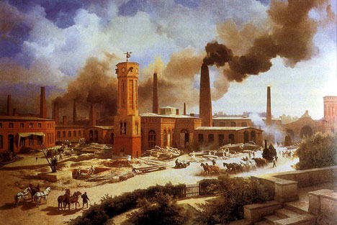
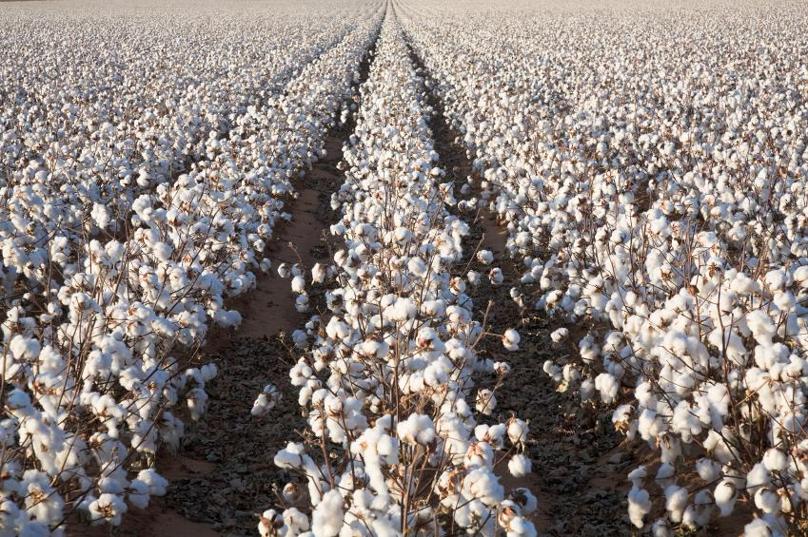
5.1 – DIFFERENCES IN REGIONAL ECONOMIES
AH1.H.3.2 Explain how environmental, cultural, and economic factors influenced the patterns of migration and settlement within the US before the Civil War.
AH1.H.4.2 Analyze the economic issues and conflicts that impacted the US through Reconstruction and the compromises that resulted.

Slide 3
THE ECONOMY OF THE NORTH

Slide 4
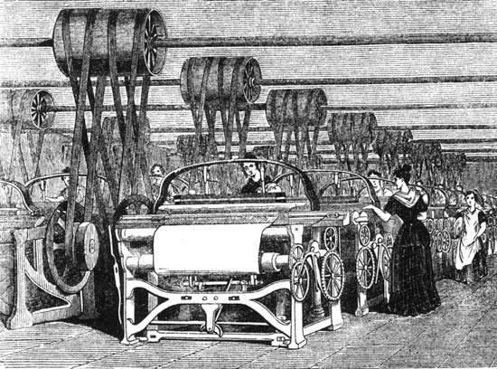
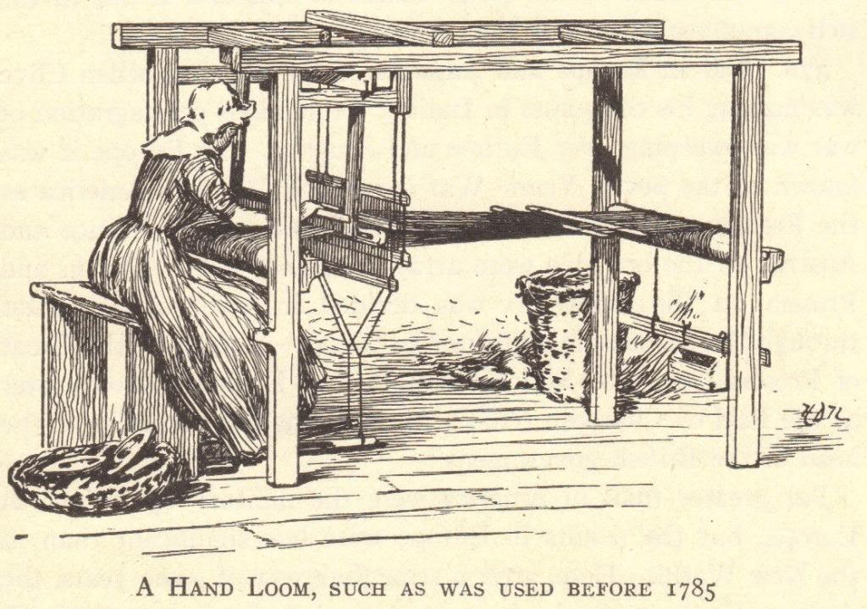
Industrial Revolution
Late 1700s - early 1800s, a period of social and economic change that took place as machines and large scale factory production developed.
  1 person making 1 thing by hand → factory mass production (the production of goods in large quantities)
  Industrialization – the process of developing an economy based on factory production

Slide 5
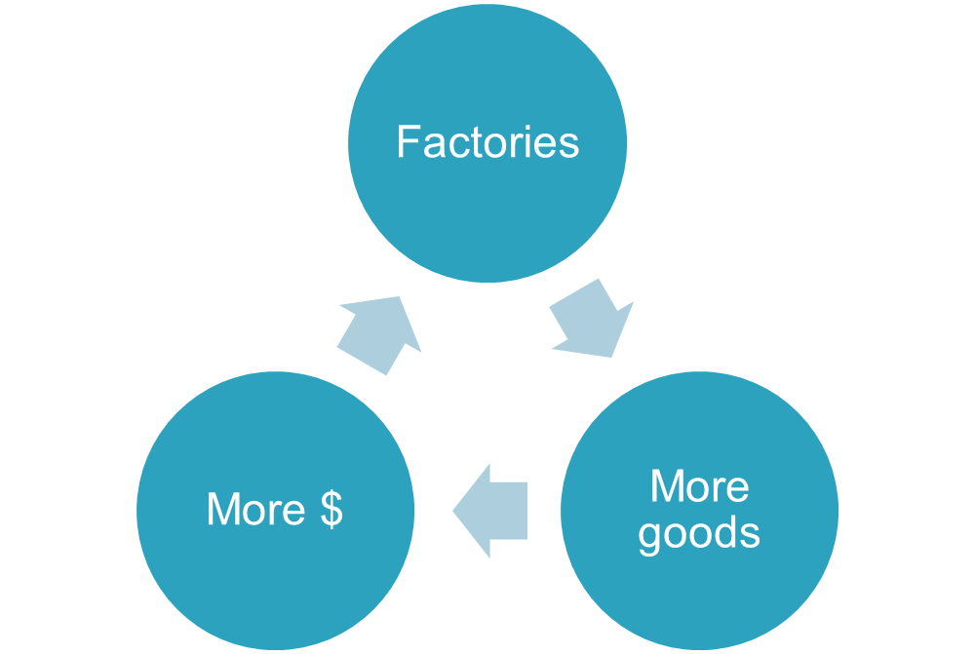
Origins of the Industrial Revolution
18th century (1700s) – Great Britain
  Invention of machines that ran off steam or coal energy
  Machines made many manufactured goods and textiles (cloth goods)
  1st factories built containing machines
What spurred the Industrial Revolution in the US?
  Embargo of 1807
  War of 1812 (British blockade)
  US had to be self-sufficient (produce their own goods) if it couldn’t rely on trade with other countries.
Spread of Industrialization

Slide 6
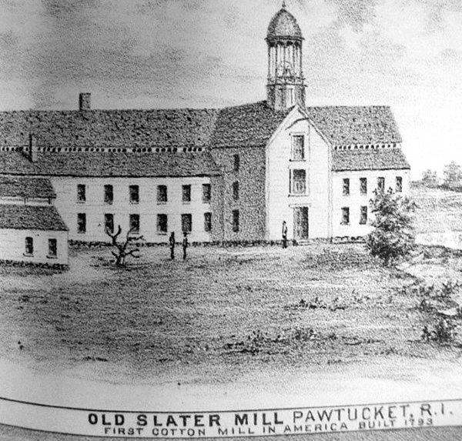
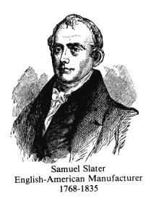
Industrialization in the US
1793 – Samuel Slater developed America’s 1st factory system in Rhode Island
  British immigrant
  Snuck in British industrial technological knowledge
  Produced thread from cotton

Slide 7
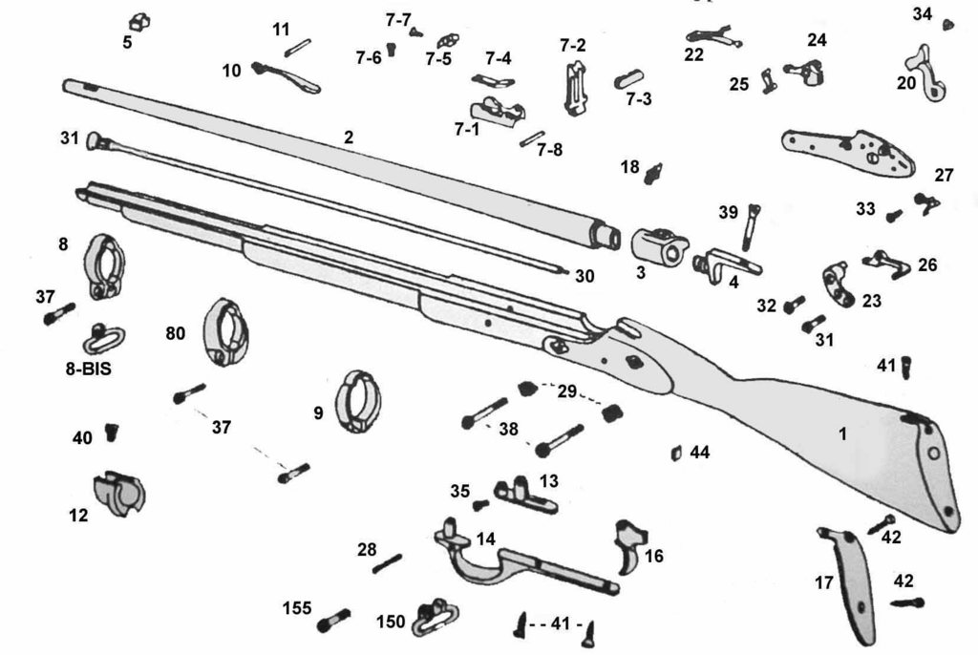
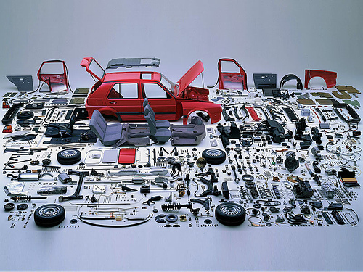
Industrialization in the US
1800(ish) – Eli Whitney developed interchangeable parts AND the cotton gin
Interchangeable parts - parts that are exactly alike and designed to fit in any device of the same type
  Made it possible to quickly produced many similar goods (ex: guns)
  When your car breaks down, the mechanic can quickly order the needed part rather than wait for someone to individually make it.
  When a soldier’s gun failed in battle, he could change the broken part right then, rather than send the gun to be fixed.

Slide 8
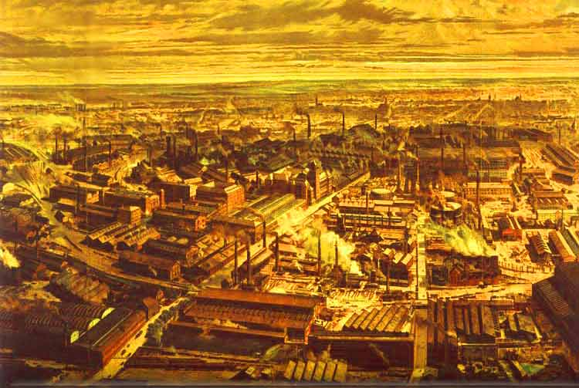
Industrialization in the US
As factories were built, people moved from rural areas to be closer to the factories → rise of urban areas and cities!

Slide 9
Case Study in Industrialization:
Lowell, Massachusetts
1813 – Lowell, Appleton, and Jackson invented a way to mechanize all the stages in the manufacture (making) of cloth.
  Opened a small factory in Massachusetts.
  Started making $$$
1822 – opened a larger factory in a town they named Lowell
  Triggered the growth of factories in New England
  Mostly employed young Northern women because their family farms were on the decline and they could make more $ working in a factory.
Factories would soon employ unskilled workers of all kinds… men, women, and CHILDREN!

Slide 10
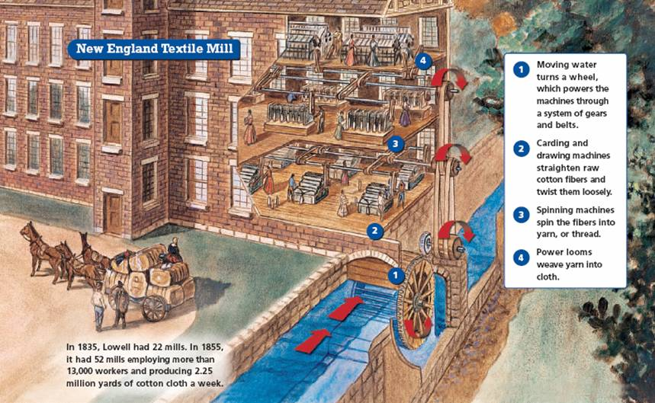

Slide 11
Industrial Revolution Video
Where are northern factories getting the cotton they need to make textiles?
THE SOUTH!!!

Slide 12
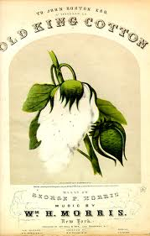
Agriculture in the South
Farms in the North were smaller, less labor intensive, and dying out… no need for slaves
  Nearly all northern states had voluntarily abolished slavery by 1804.
In the South, the plantation system ruled – “King” cotton
  Cotton crops were made very profitable by Eli Whitney’s cotton gin – simple machine that separated the seeds from cotton

Slide 13
Agriculture in the South
Demand for cotton thread in the north made slavery seem a “necessary evil.”
Even though northern states had abolished slavery, they recognized slavery was essential in cotton production that they needed.
Even if some southerners were against slavery from a moral standpoint, they needed slave labor to make money.

Slide 14
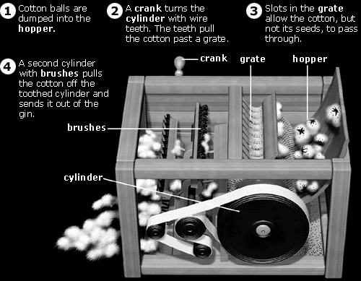

Slide 15
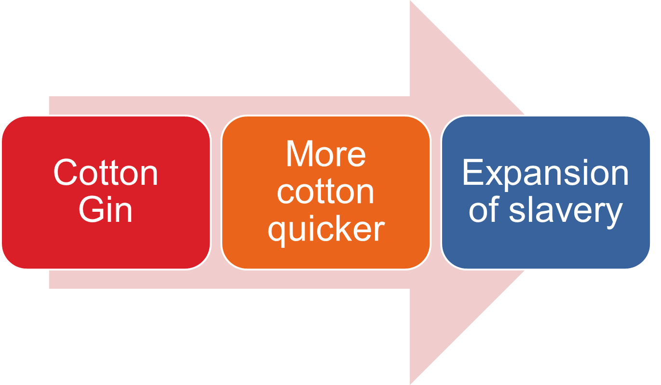
Agriculture in the South

Slide 16
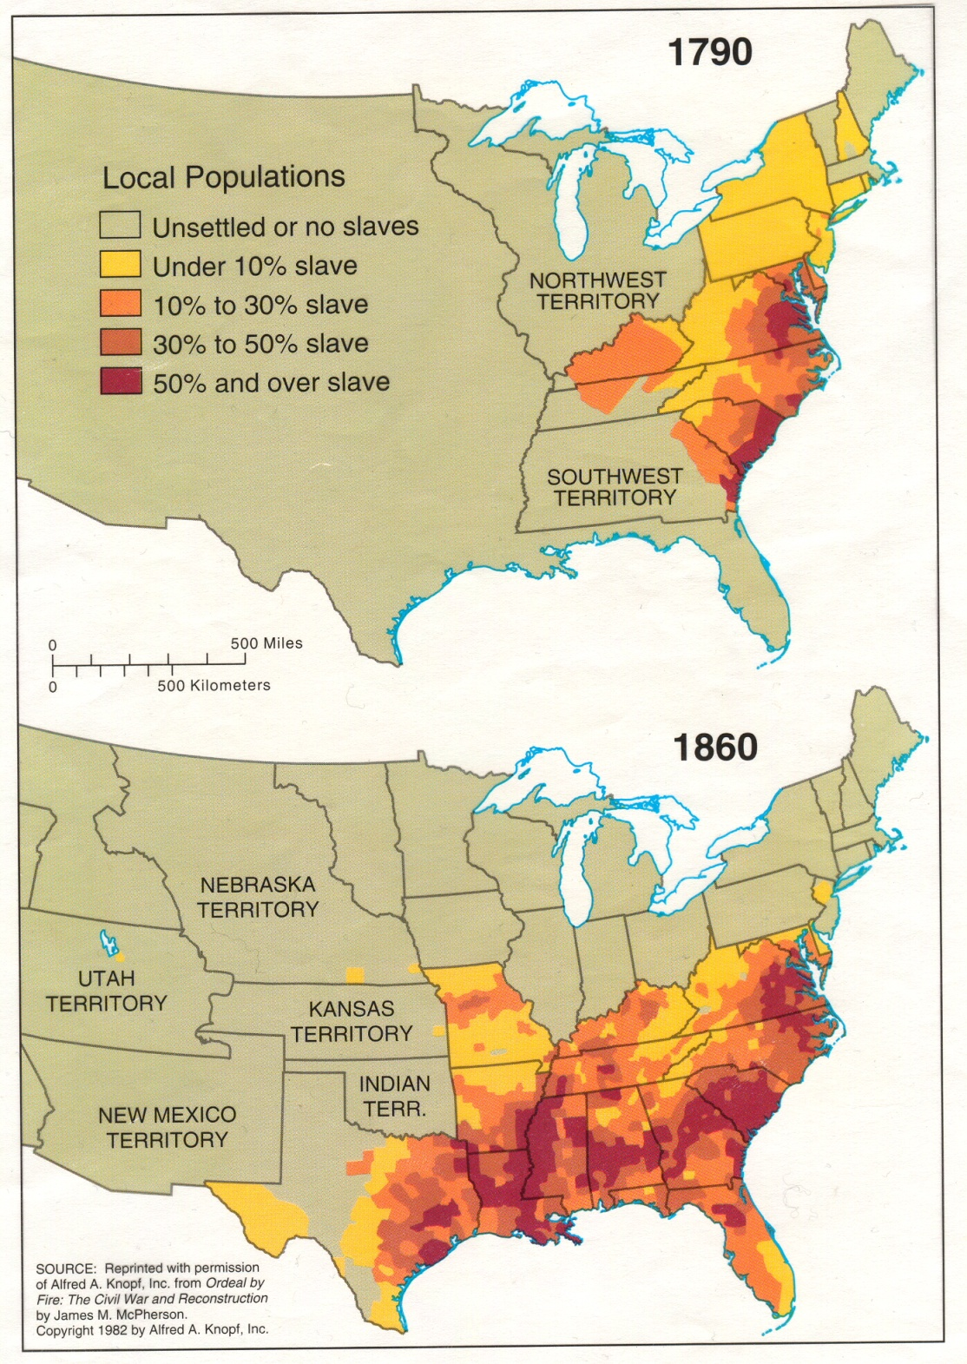
What has happened to the slave population in the NORTH by 1860?
  Why?
What has happened to the slave population in the SOUTH by 1860?
  Why?

Slide 17
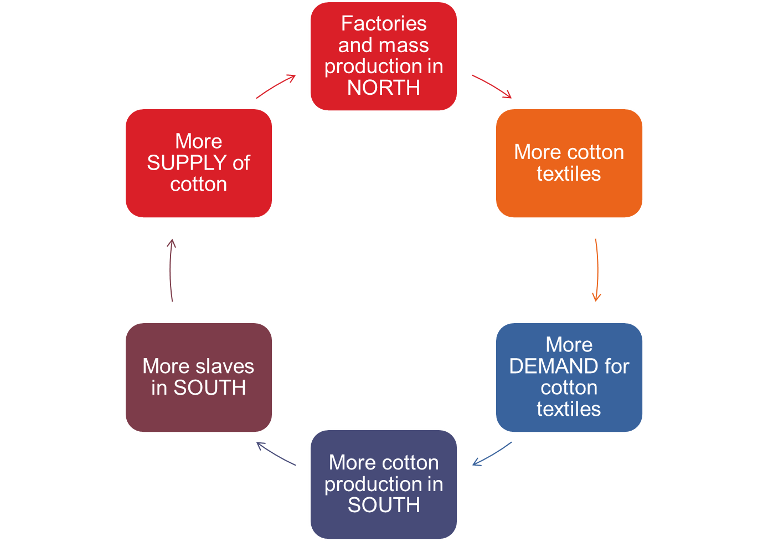
Connection of Northern and Southern Economies

Slide 18
Pause…
How did the economies of the North and South differ?
How did the invention of interchangeable parts contribute to the growth of factories?
How did the invention of the cotton gin affect cotton production in the south?
What is meant by calling slavery a “necessary evil?”

Slide 19
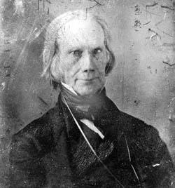
Connecting the North and South
POTUS Madison realized that the North and South were developing in very different ways… need a way to connect the two regions!
  Avoid sectionalism!
1815 – Madison and Henry Clay (Speaker of the House) developed the American System.
  Speaker of the House – the presiding officer of the House of Representatives who is voted on by the Representatives

Slide 20
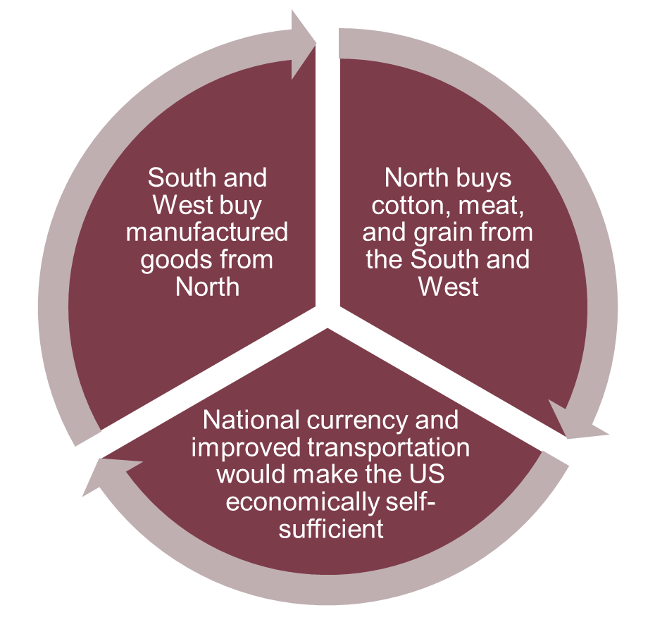
The American System
1815, developed by Madison and Clay to unify the nation economically and make the US economically self-sufficient
  Develop infrastructure (transportation systems) to transport goods between regions
  Establish a protective tariff to encourage Americans to purchase US made goods
  Strengthen the National Bank to unify the economy
Notes:
b

Slide 21
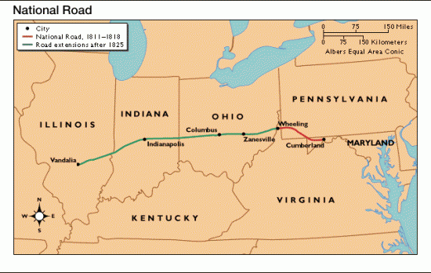
American System – Infrastructure Improvements
Infrastructure – the facilities that make everyday life in the US possible (ex: roads, highways, etc)
Infrastructure improvements helped to make the movement of goods between the North and South easier
  Turnpikes – toll roads to
  make $$$ for the federal
  government
  National Road – built
  between 1811-1833,
  the first federally funded
  highway in the US,
  ran from Maryland
  to Illinois

Slide 22
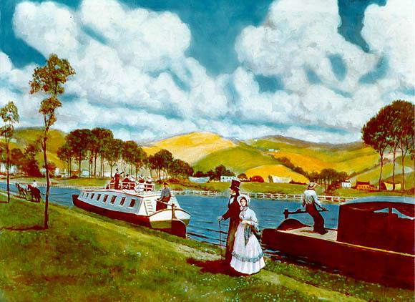
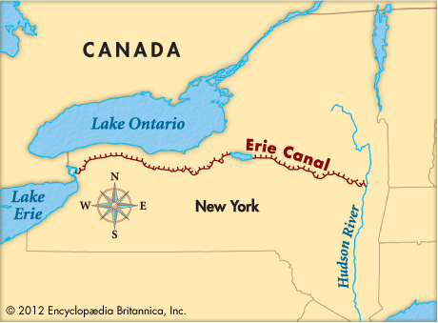
The American System – Infrastructure Improvements
Erie Canal – finished in 1825, man-made waterway to connect Atlantic Ocean to the Great Lakes.
  Made is easier to transport goods by water
  Didn’t have to rely on natural waterways… make your own!
  Tolls along the canal made $$$ for the federal government
  Eventually, several other canals would be built to connect the Great Lakes to the Mississippi River

Slide 23
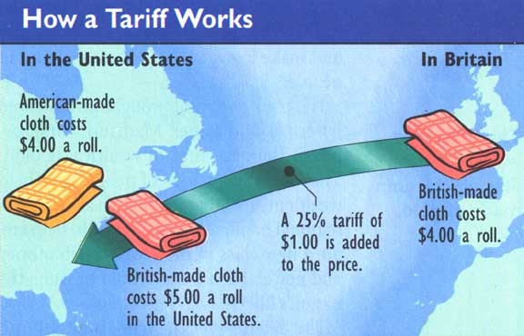
American System – Protective Tariffs
Tariff – tax on imported goods to encourage the sale of US goods instead

Slide 24
American System – Protective Tariffs
When trading with European nations resumed after the War of 1812, foreign goods were cheaper than American made goods
The US was new to industrialization so US goods were more expensive than foreign goods.
People bought foreign goods → US industries not getting profit!
Tariff of 1816 – protective tariff proposed to encourage the sale of American goods after the War of 1812
  Increase the price of foreign goods to make American goods cheaper
  Money made from tariff would pay for internal improvements (roads, canals, etc)

Slide 25

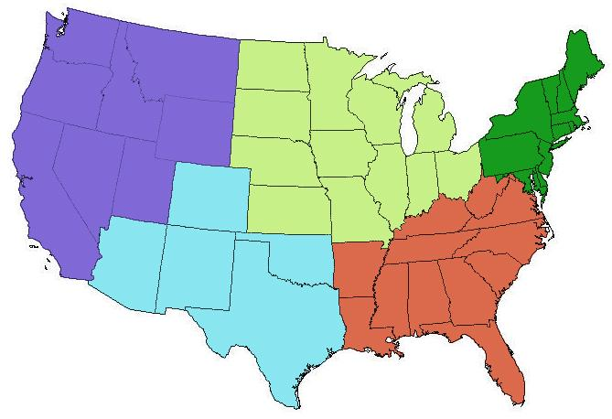

Northeast
South and West
Relieved
Could make more $ if American products were being sold
Frustrated
Livelihoods did not depend on manufacturing
Didn’t like any government interference in business
Didn’t like rising prices

Slide 26
American System – National Bank
Not all laws are meant to last forever - some have expiration dates.
Hamilton’s original National Bank was approved and “chartered” (created) for only 20 years in 1791.
In 1811, the law that created the National Bank expired and the bank lost all of its power.

Slide 27
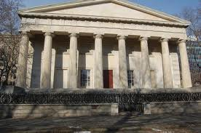
American System – National Bank
North and South agreed that a national bank would benefit everyone.
  A common national currency → make trade between regions easier
  Stabilize national economy
  Manage the $ coming from tariff
  Budget $ for infrastructure
1816: Second Bank of US (BUS) created
  Chartered for another 20 years until 1836.

Slide 28
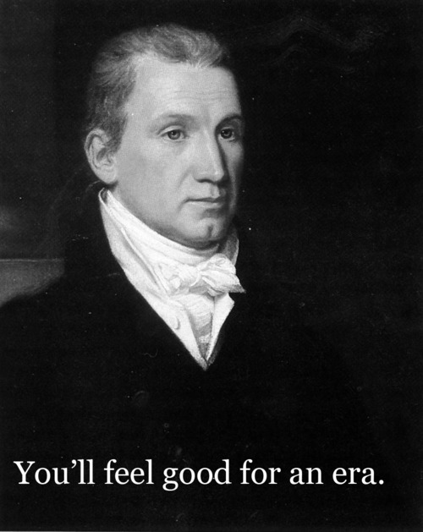
Election of 1816
5th POTUS = James Monroe
  Democratic Republican
  From Virginia
  Less sectionalism - received a warm
  welcome in Boston - northern city
  welcoming southern POTUS
Era of Good Feelings
  1816-1825
  Monroe’s presidency
  Rise in nationalism, decrease in sectionalism
  General positive sentiments in the nation
  More bipartisanship in Congress (political parties getting along and passing laws together)

Slide 29
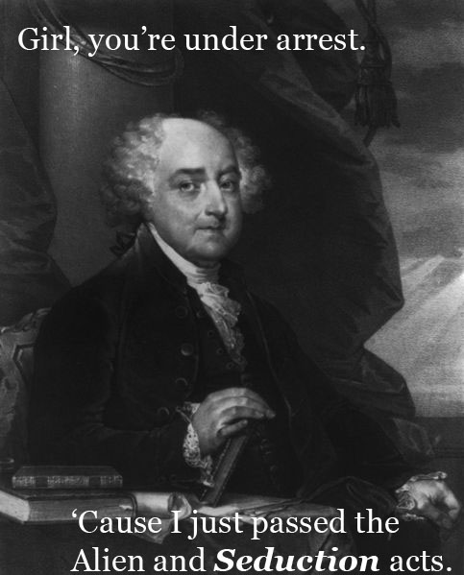
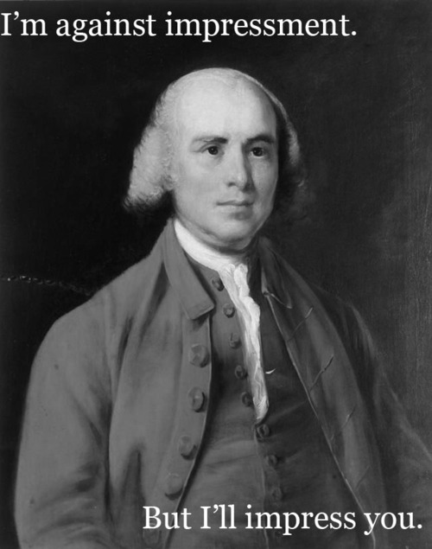
More Presidential Pick-Up Lines… Name the POTUS!
Madison
Adams

