Slide 1
Unit 1 Part III
The American Colonies

Slide 2
Warm-up 8/30/2012
Would you willingly leave your home to start a new life if the government did not respect your basic rights? Explain why.

Slide 3
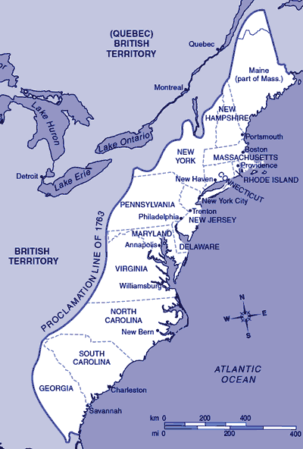
What is a colony?
A group of people in one place who are ruled by a parent country elsewhere

Slide 4
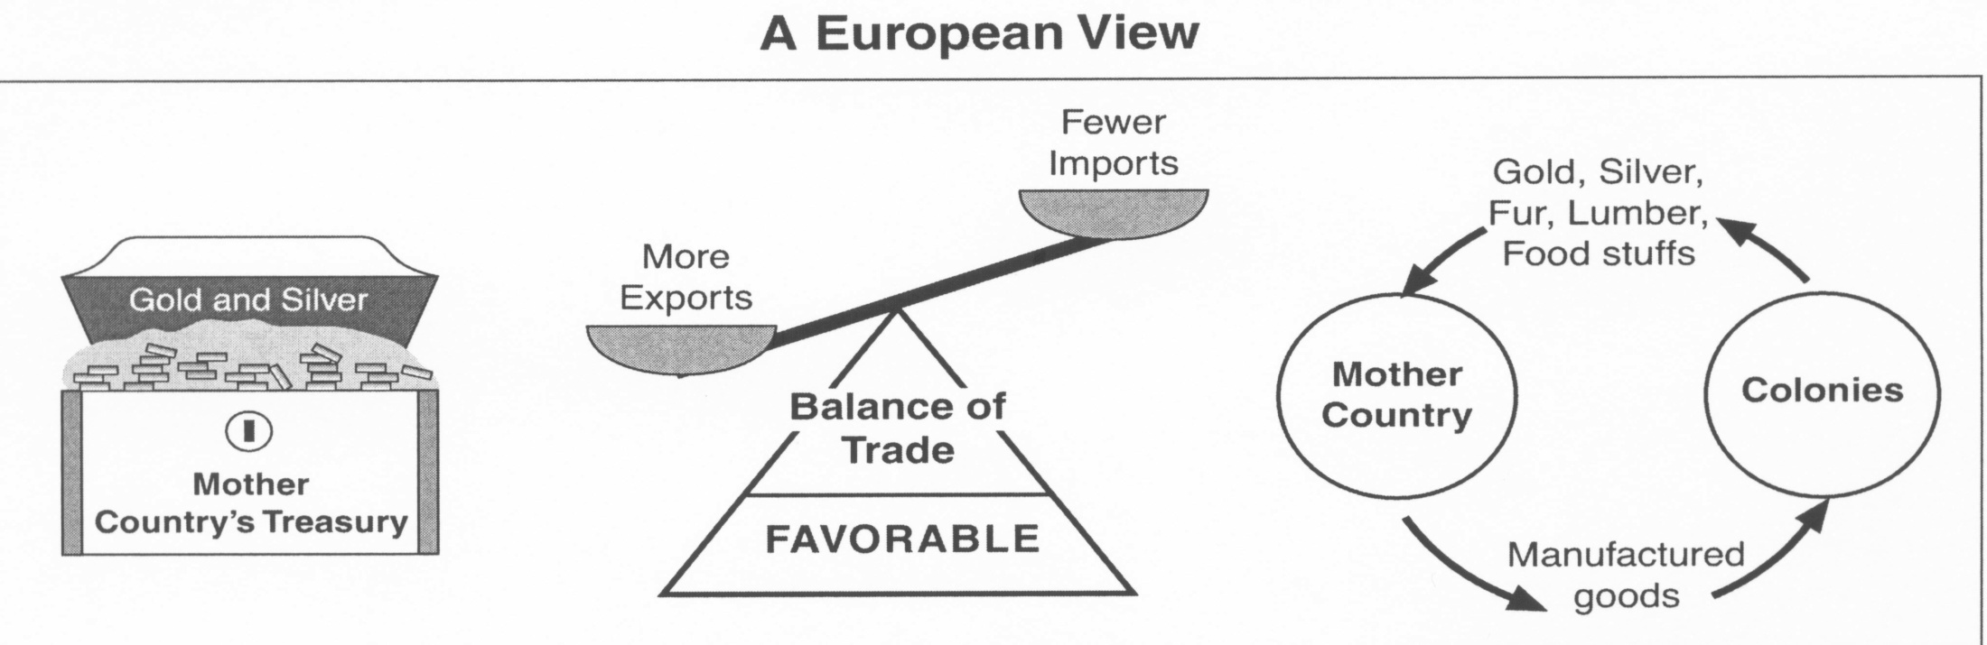
What is mercantilism and how did it motivate colonialism?
Theory that a country’s power depended on its wealth
Encouraged countries to export more than import
Colonies where a source of raw materials for the mother countries industries and markets for finished products
Hurt colonial economies.

Slide 5
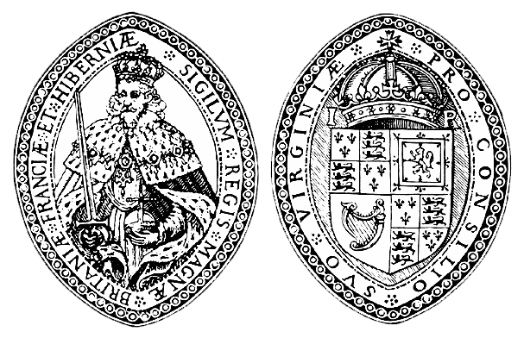
Joint Stock Company
Colony in which investors could have part ownership and share in any profits
Virginia, North and South Carolina

Slide 6
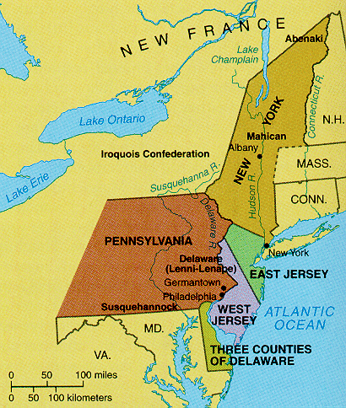
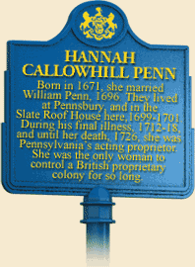
Proprietary Colony
Colony owned and controlled by an owner
New York, New Jersey, Pennsylvania, Maryland, Delaware, Connecticut, Rhode Island, New Hampshire, Massachusetts

Slide 7
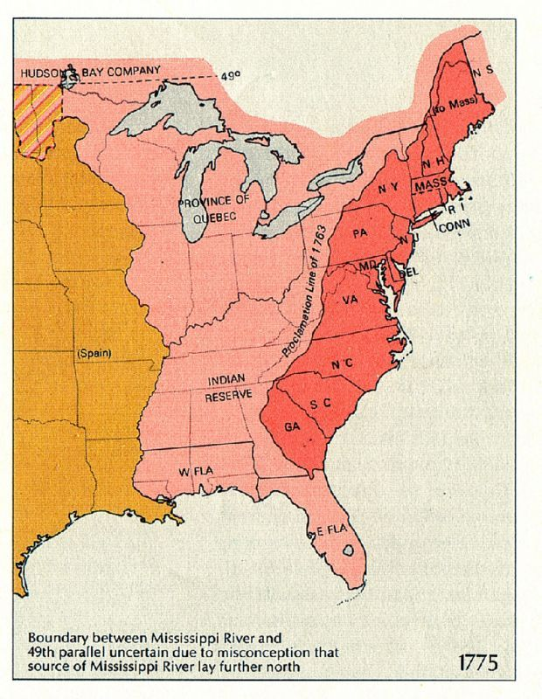
Royal Colony
Colony owned and ruled by the King
Eventually all the colonies were reclaimed by the King

Slide 8
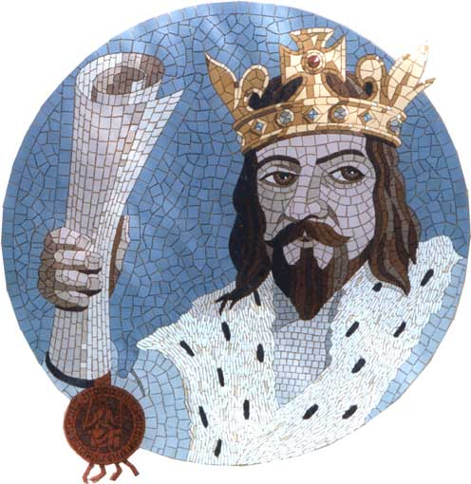
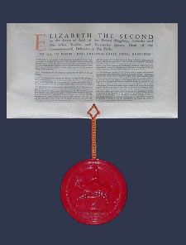
Charter
Written document granting land and the authority to establish a colonial government

Slide 9
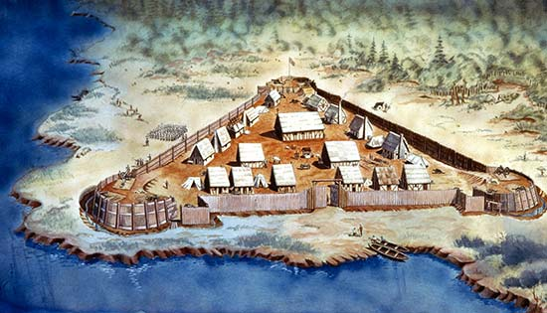
Where was the first permanent English settlement in North America?
Jamestown, Virginia in 1607

Slide 10
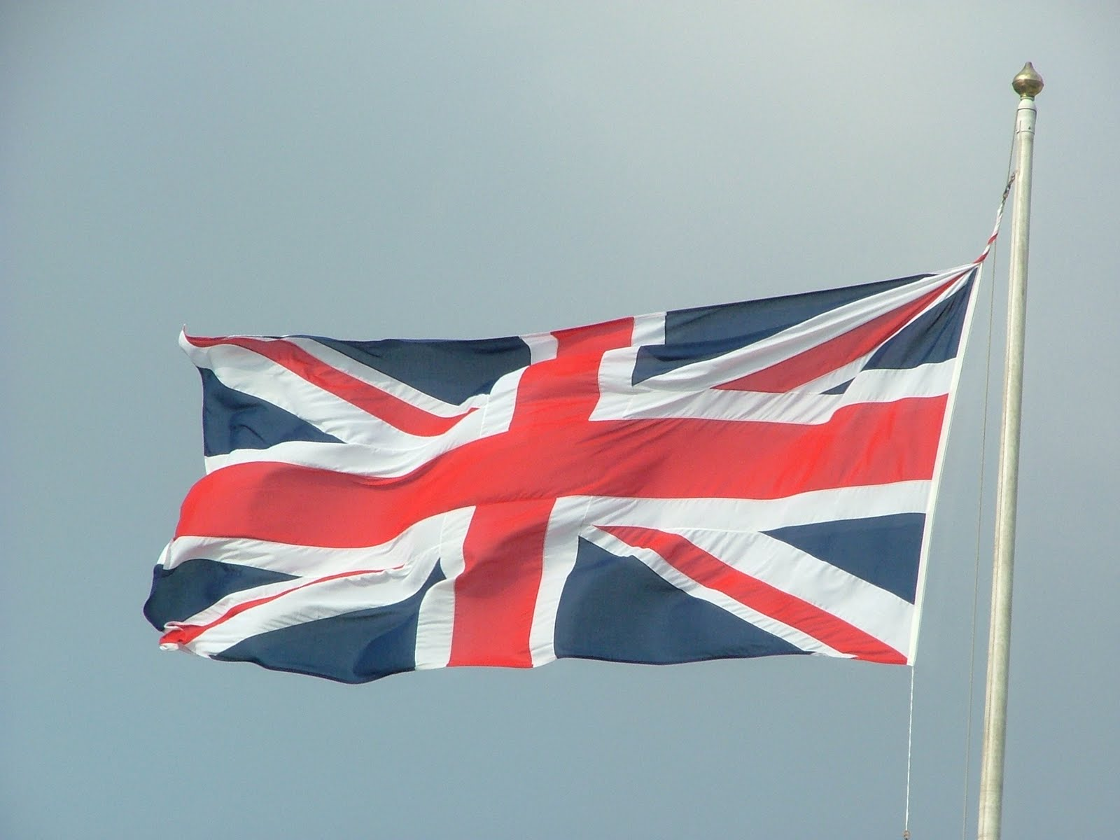
For what reasons did people come to the colonies?

Slide 11
Economic Opportunities
Potential to acquire land and wealth
Cash Crops – agricultural products that could be sold (i.e. tobacco)
Indentured Servants – people who promised to be servants for a time in exchange for passage to the colonies

Slide 12

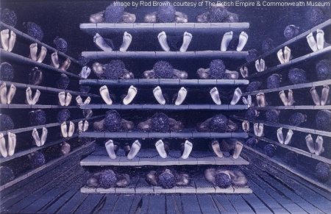
Forced
Africans were enslaved to be cheap labor
Plantation System – agricultural system in southern colonies for mass producing cash crops
Middle Passage – the journey from African to the Americas

Slide 13
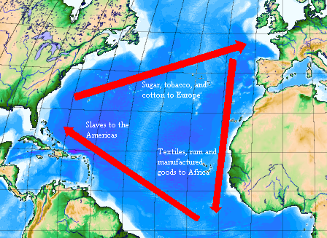
Triangular Trade Route
The Pattern of trade between Africa, Europe and the Americas

Slide 14
The Triangular Trade Route
From Europe to Africa – alcohol and iron products (weapons)
From Africa to the Americas – African men, women and children
From the Americas to Europe – tobacco, rice, indigo, rum, and other raw materials

