Slide 1
Warmup 3/2/12
What kind of judgments do you have to make in your daily life?
How do you make these judgments?
How do you think this parallels what judges do in our court system?

Slide 2
Unit IV Part III
The Judicial Branch

Slide 3
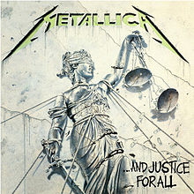
What is the primary goal of the federal courts?
“Equal Justice For All”
To treat every person the same

Slide 4
Why is this goal difficult to accomplish?
Prejudice and unequal wealth lead to inequalities in the law

Slide 5
What other courts coexist with the federal courts?
50 State Court Systems

Slide 6
What does Jurisdiction mean?
A courts authority to hear and decide a case

Slide 7
Exclusive Jurisdiction
Only the federal courts may hear and decide the case

Slide 8
Concurrent Jurisdiction
When a case may be heard in either state or federal courts

Slide 9
Original Jurisdiction
The authority to hear a case for the first time

Slide 10
Appellate Jurisdiction
The authority to review a case appealed from a lower court

Slide 11
How long is the term for a federal court judge?
For Life

Slide 12
What is the benefit of this?
Removes the judges from popular and political pressure

Slide 13
What does this do for the President who gets to appoint the judges?
Allows his influence to last long after his time in office

Slide 14
What decisions are made by each of the lower federal courts?
U.S. District Courts – Determine guilt or innocence
U.S Courts of Appeals:
Overturn – reverse the lower courts decision
Uphold – keep the lower courts decision
Remand – send case back to be tried again

Slide 15
What other court officials help the judges do their jobs?
Magistrates – judges who do routine work: issue warrants and bail, hear preliminary evidence
U.S. Attorneys – government lawyers who prosecute cases
U.S. Marshals – make arrests, issue subpoenas (order to appear) and keep order in court

Slide 16
Warmup
How does the court system change the way laws are applied?

Slide 17
The United States Supreme Court

Slide 18
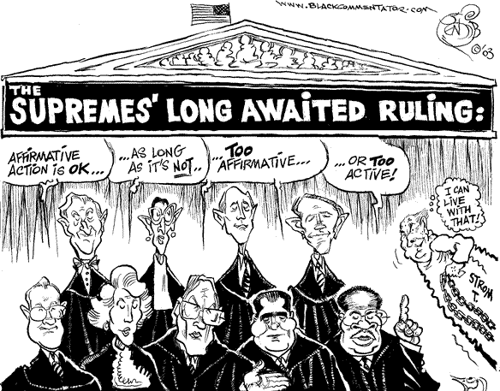
What can you infer about the Supreme Court from this cartoon?

Slide 19
In what types of cases does the U.S. Supreme Court have original jurisdiction?
Involving diplomats from foreign countries
In disputes between states

Slide 20
How many cases are appealed to the U.S. Supreme Court each year?
Between 7,000-10,000
About 75-100 get heard each year

Slide 21
What types of cases does the U.S. Supreme Court generally choose to hear?
Ones that involve a Constitutional question
Involve a real conflict
Involve legal rather than political question
Issues that affect entire country

Slide 22
What does a decision by the U.S. Supreme Court mean?
Determines the meaning of the law

Slide 23
Judicial Review
The power of the Supreme Court to review any federal, state, or local law to see if it is constitutional

Slide 24
Marbury v Madison (1803)
First time the court ruled an act of Congress unconstitutional
Established the principle of Judicial Review

Slide 25
Three principles of Judicial Review
Constitution is supreme law of land
If any law conflicts with the Constitution, the Constitution rules
It is the duty of the judicial branch to uphold the Constitution

Slide 26
Precedent
Supreme Court decisions become the example to follow in future cases

Slide 27
What limits exist on the power of the Supreme Court?
Depend on the executive branch to enforce decisions

Slide 28
Worcester v Georgia (1832)
Pres. Andrew Jackson refuses to support Supreme Courts decision to protect Native American lands

Slide 29
Can only hear and make rulings on cases that
Come to it

Slide 30
Congress can get around court decisions by
Amending the Constitution or changing laws to fit the Constitution

Slide 31
Court Procedures: How do cases come to the Supreme Court?
Cases to be considered for selection are placed on the court calendar called the docket

Slide 32
If the case is selected the court will issue a Writ of Certiorari
Order for lower court to send its records to SC for review

Slide 33
What are the steps in a US Supreme Court Decision?
Lawyers for each side prepare a brief – written explanation of their side
Oral Arguments – lawyers give 30 minute summary
Conference – justices get together to discuss and vote (majority decides)
Written Opinion – One justice writes the courts decision and reasoning

Slide 34
Written Opinions
Majority Opinion – presents views of the majority of the justices on a case
Concurring Opinion – justice who agrees with decision but for different reason
Dissenting Opinion – justice(s) who oppose decision
Unanimous Opinion – all justices vote the same way

Slide 35
5. Announcement
Court reports its decision

Slide 36
What affects the decisions of the Supreme Court?
The Law
Stare Decisis – following previous decisions made by courts (precedents)

Slide 37
Changing Social Conditions
As our social values change so does our interpretation of the law
Plessy v Ferguson (1896) – determined segregation was legal, established the “separate but equal” doctrine
Brown v Board of Education (1954) – overturned Plessy, segregation in public education was inherently unequal

Slide 38
Personal Beliefs
“We may try to see things as objectively as we please. Nonetheless, we can never see them with any eyes except our own.” – Benjamin Cardozo (1921)

Slide 39
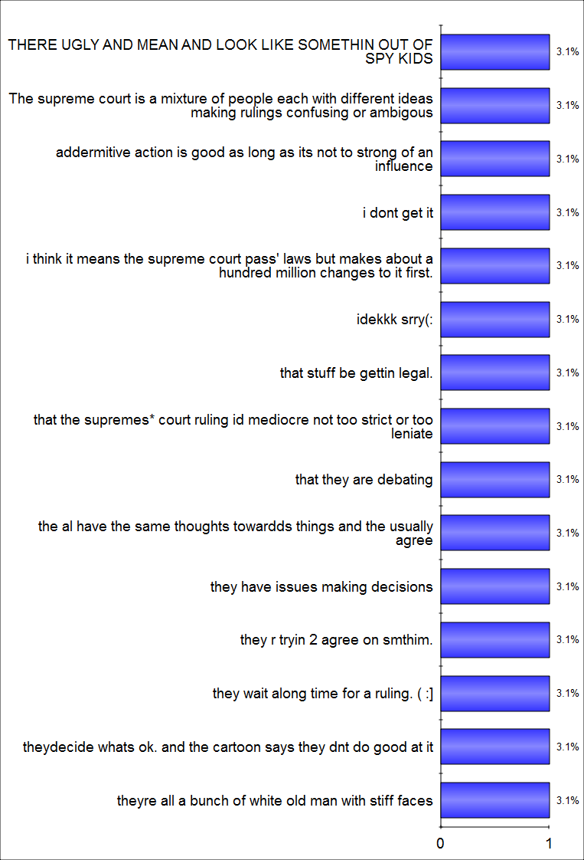
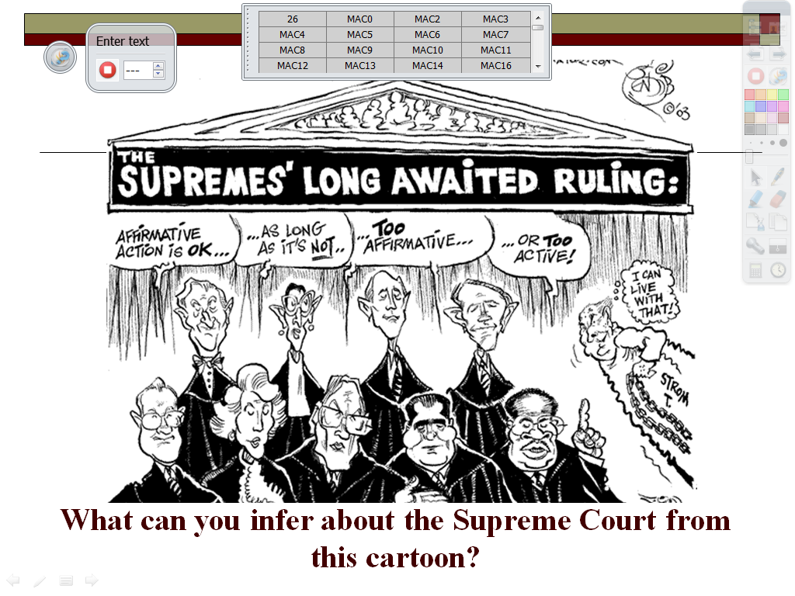
ExpressPoll 3/5/2012 10:30:22 AM

