Slide 1
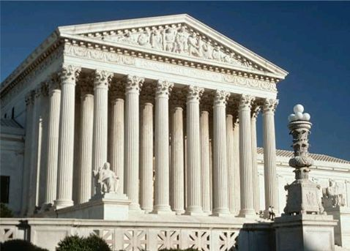
U.S. Supreme Court

Slide 2
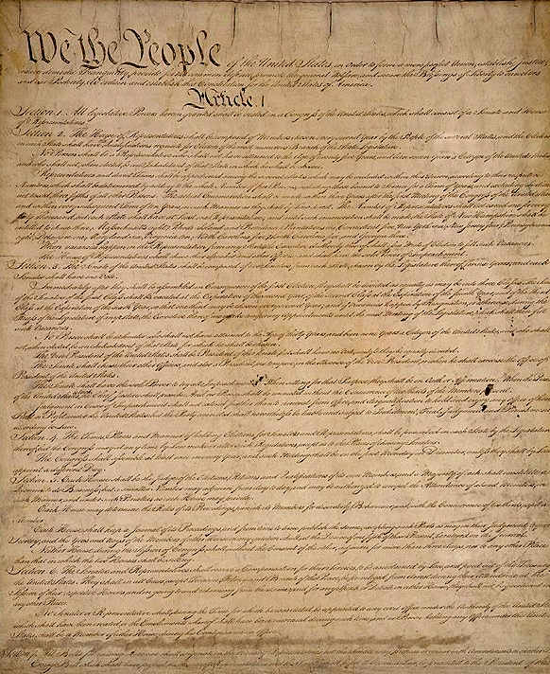

Court’s Power
-Constitution is the Highest Law
Supremacy Clause, Article 6
-Constitution is the Supreme Law when there is a conflict with other laws
-Court is responsible for upholding the Constitution
Article III of Constitution
-Judicial Review
Power of the Supreme Court to examine a law and determine its constitutionality
If laws go against the Constitution, the court can cancel the law
-Limiting the Court’s Power
-Constitutional Amendments
-Selection of Judges
According to the court case of Marbury v. Madison in 1800, the Supreme Court has the power of judicial review. According to this principle, the Supreme Court has the final say on the constitution, and they have the power to examine all laws (state and federal) to see that they follow the Constitution. If they do not, the court has the power to make that law null and void. This gives the Supreme Court a major check.

Slide 3
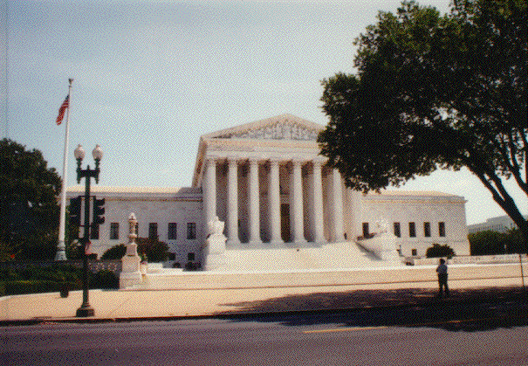
The Judicial branch
The Supreme Court is the highest court is the U. S., and is the system of courts to settle questions about the laws.
The nine justices can serve for as long as they live, or wish to retire.
Each justice is chosen by the president and confirmed by the Senate.

Slide 4
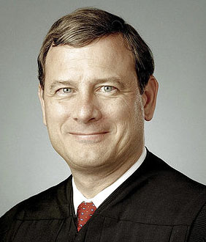
The Supreme Court
There are 9 Justices (1 Chief & 8 Associate Justices)
John Roberts is the Chief Justice
They serve for life
They are appointed by the President
And approved by the Senate
How is that an example of Checks and Balances?
John Roberts

Slide 5
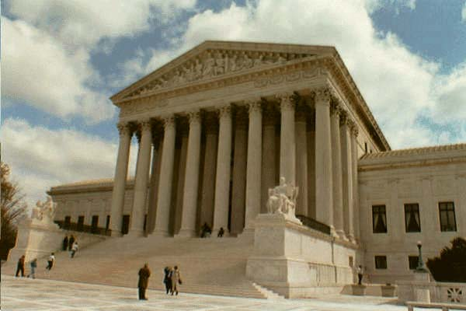
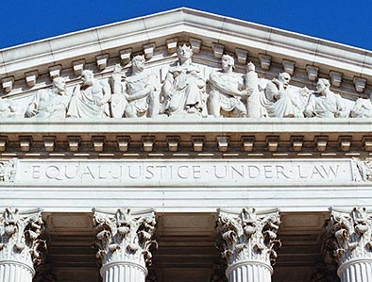
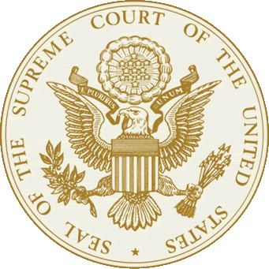
Supreme Court Cases
-Highest Court in the Nation
-All Decisions are Final
No more appeals after the Supreme Court
-Usually Appellate Jurisdiction Only
Has original jurisdiction in:
  Cases involving diplomats from other countries in the U.S.
  Cases involving disputes between the states
-Only hears about 150 of thousands of appeals
The U.S. Supreme Court is the highest court in the entire nation. All decisions made in this court are final, since there are no more appeals after the Supreme Court.

Slide 6
Appellate Jurisdiction
This is the right for courts to Review a case that has already been decided.
If you lose your case, you can appeal it to a higher court.
It will go to the Court of Appeals, then you can appeal it to the Supreme Court.
It is highly unlikely that the Supreme Court will hear your case.

Slide 7
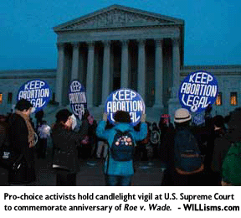
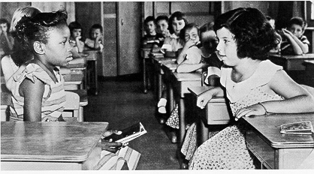
Which Cases?
-Justices discuss and must agree on the merits of a case for it to be heard
4 out of 9 justices must agree to hear a case
-Only hears certain kinds of cases
Involving constitutional issues
Involving equal protection of the law (14th Amendment)
Involving civil liberties
-Usually hears just appellate cases
Coming from lower courts
Apply for the Supreme Court to hear their gain by gaining a petition for a writ of certiorari

Slide 8
Court at Work
-In session from Oct to June/July each year
-Each month follows a pattern
-1st 2 weeks the court hears cases, make announcements, and discuss current cases
-2nd 2 weeks the justices are writing opinions, deciding what cases to hear, and researching cases

Slide 9
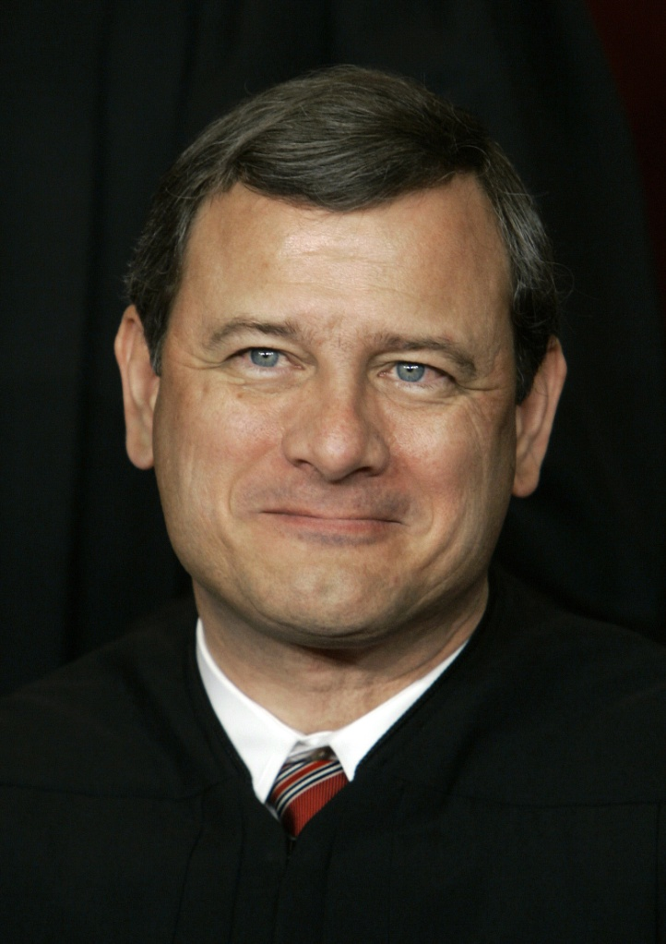
Court Decisions
-Justices discuss cases with each other
6 justices must be present to make a decision
-Make one of three decisions
Uphold
Overturn
Remand
-Each decision is accompanied with a written opinion explaining the law about the case
Opinions made public to set precedent for future cases
-Majority Opinion--the written decision of the justices on the winning side
-Concurrent Opinion-- the written opinion of a justice who agrees with the majority but may have slightly different reasons
-Dissenting Opinion-- the written opinions of a justice who disagreed with the majority
Once the Supreme Court reaches a decision, they write down their decision and the reasoning behind it in what is called an opinion. The opinion explains why the decision was made, and all opinions are made public for future use.

