Slide 1
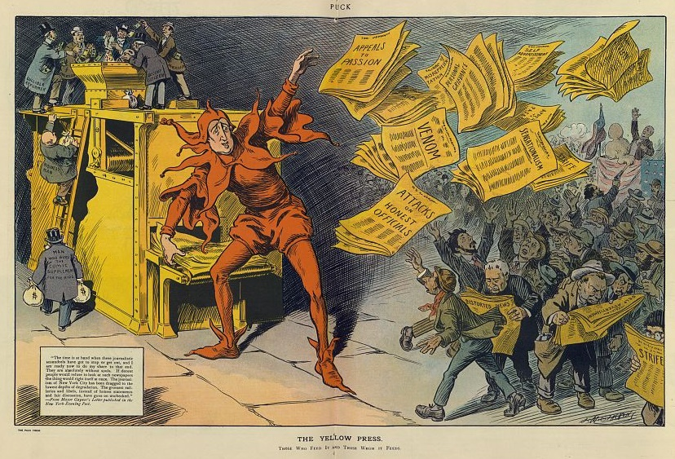

Notes:
Photo: The yellow press , 1910 - https://www.loc.gov/resource/ppmsca.27675/

Slide 2
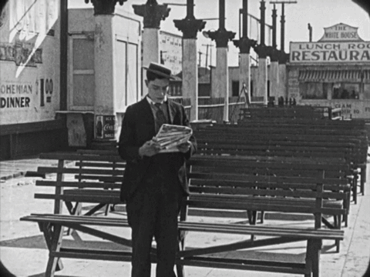
Public Opinion: the complex collection of the opinions of many different people; the sum of all their views.
Mass Media: Those means of communication that reach large audiences
Media is often considered the “4th branch of the government”
  Ex. Richard Nixon and the Washington Post

Slide 3

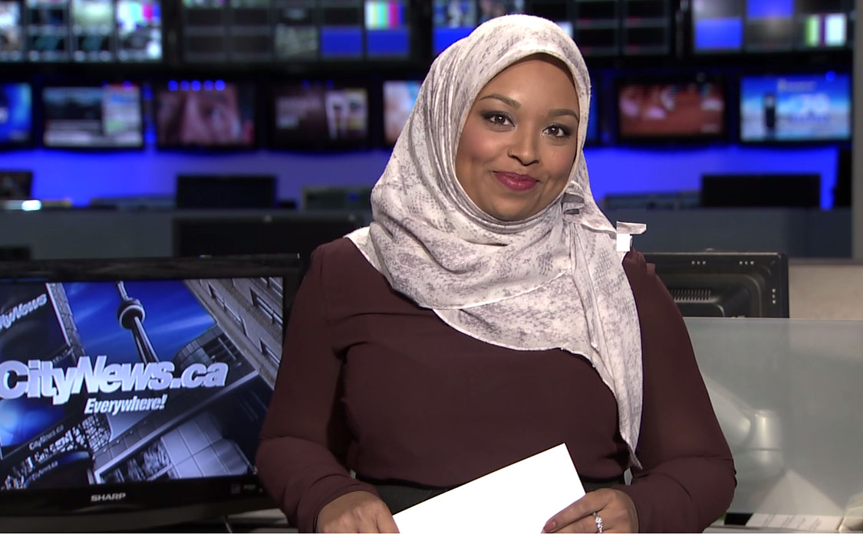
Gatekeeper - introducing or keeping a topic in the national mindset (ie: climate change)
Watchdog - checks corruption within the government (ie: Watergate)
Scorekeeper - making or breaking politicians depending on the coverage given to them (ie: John Edwards)
Notes:
* If you don’t remember disgraced VP Candidate, you can find info here: https://en.wikipedia.org/wiki/John_Edwards_extramarital_affair

Slide 4

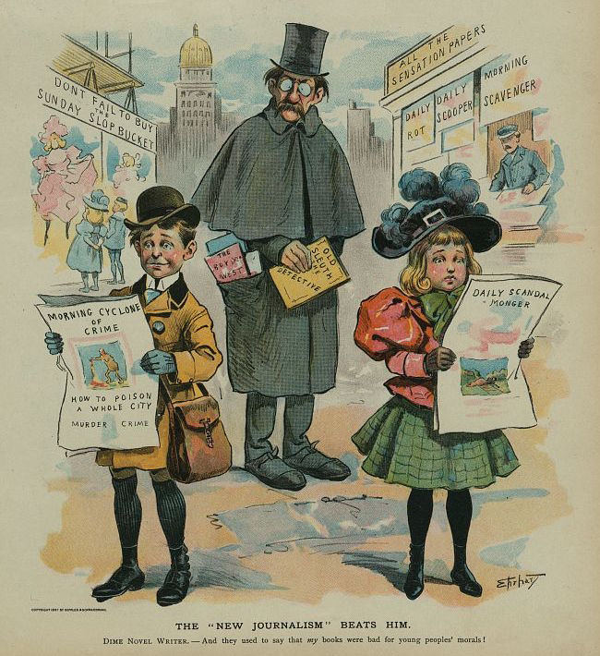
Media is biased
Everyone has biases they can’t help interjecting into anything they do or say.
Bias: A preference or inclination, especially one that inhibits impartial judgment
How the media reflects/presents that bias is known as “spin”
Notes:
Cartoon: The "new journalism" beats him / Ehrhart. - 1897 -https://www.loc.gov/item/2012647654/

Slide 5

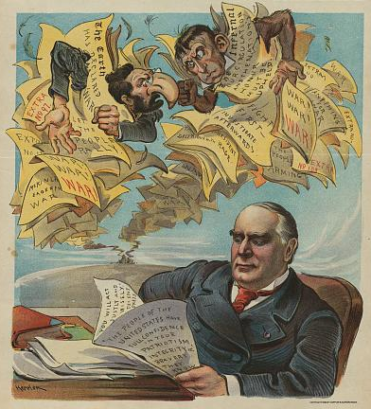
Balance: Are both sides represented equally?
Loaded Words: “finally”, “failure”, “savior”
Sensationalism: Build up the story for the sake of selling it
Images & Headlines: Do they match the story?
Context: Are facts, quotes, and other aspects of the story put into context?
Notes:
Another good example is “tax relief” referring to reducing taxes. The emotive word “relief” implies that tax is an unreasonable burden to begin with.
Photo: “Honor to McKinley!” 1898 - https://www.loc.gov/resource/ppmsca.28685/

Slide 6
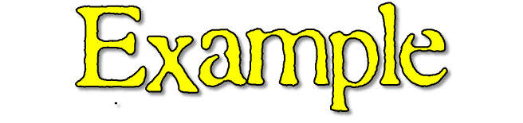
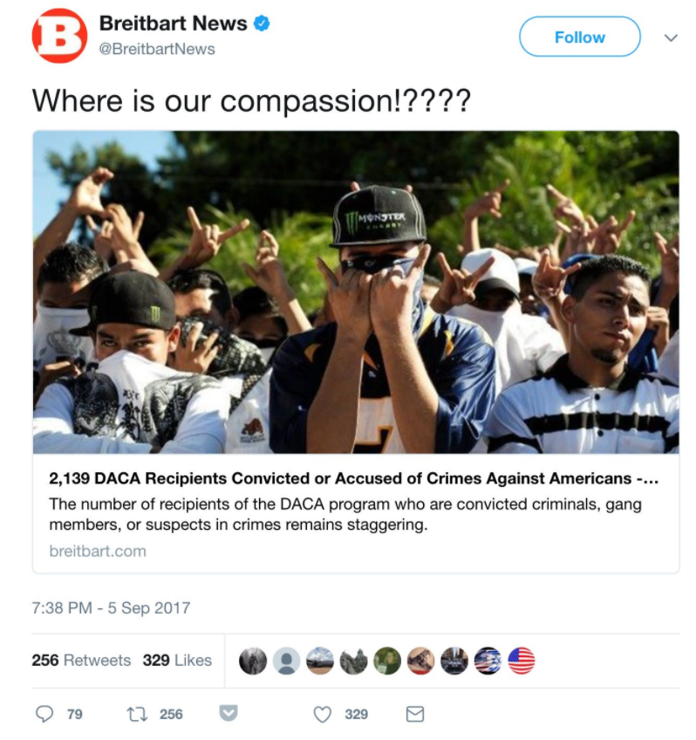
In September 2017, conservative news outlet Breitbart included this photo with an article on DACA “Dreamers” or undocumented people brought to America when they were young children.
What is your impression based on the Tweet, Image, & headline?
The photo is actually of gang members in San Salvador in 2013 – at a rally for peace and a gang truce and has nothing to do with DACA.
Notes:
Also to note – the article refers to 2,139 DACA recipients have had their protected status revoked because of alleged criminal activities over five years. There were about 800,000 people enrolled in DACA, so the percentage of DACA recipients involved in criminal behavior ends up being roughly 0.3 percent. In comparison, the national rate of people with felony convictions is over 8.5%.

Slide 7
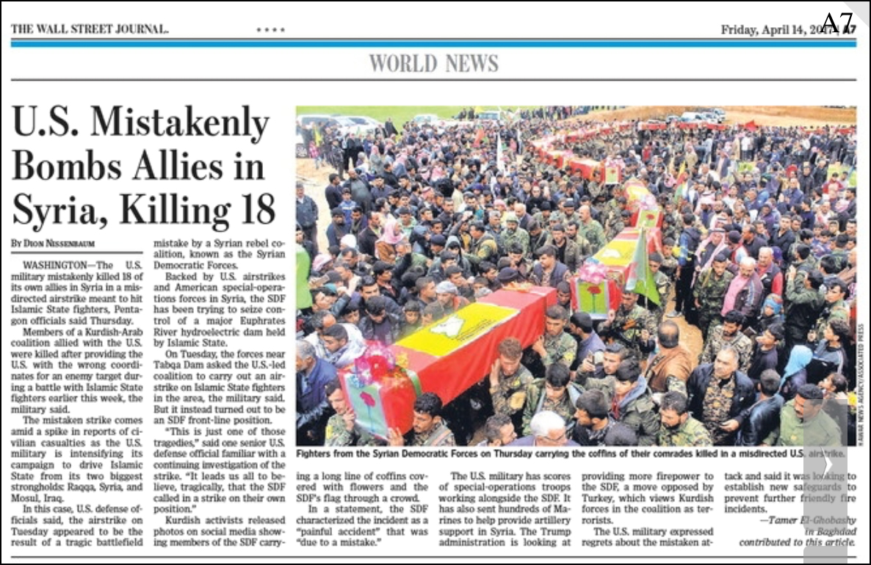
Members of a Kurdish-Arab coalition allied with the U.S. were killed after providing the U.S. with the wrong coordinates for an enemy target during a battle with Islamic State fighters earlier this week, the military said.
Notes:
First have students read the headline and get reactions. Then, have them read the 2nd paragraph where it says that the allies were killed because they gave the wrong coordinates to be hit. The SDF called for a US airstrike on their own position.

Slide 8

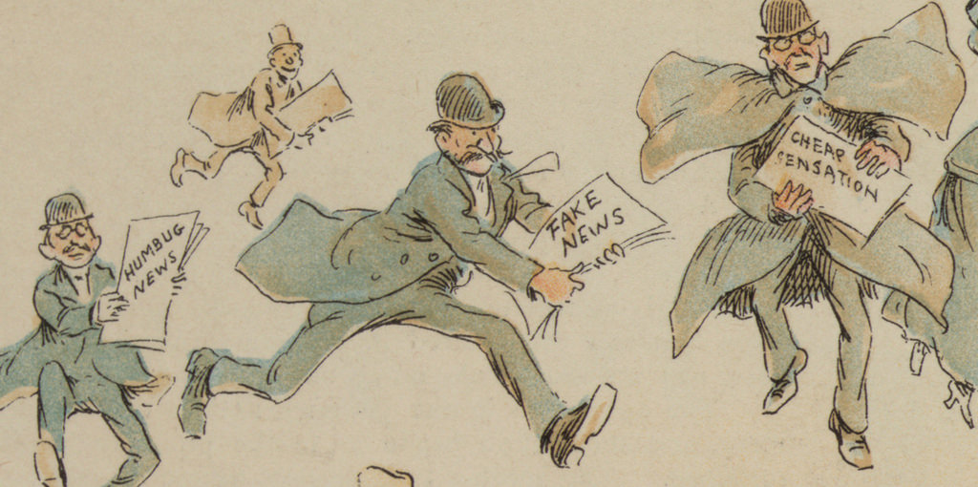
Now anyone can create a website that looks legitimate and post anything on it
In the 2016 election, millions were spent to boost fake news stories on Facebook
Many of these sites were created in other countries with foreign money to boost them
Notes:
Photo: The Fin de Siècle Newspaper Proprietor, 1894 - https://www.loc.gov/item/2012648704/

Slide 9
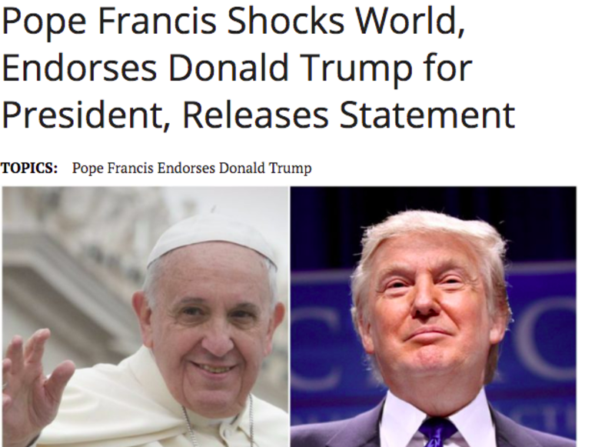
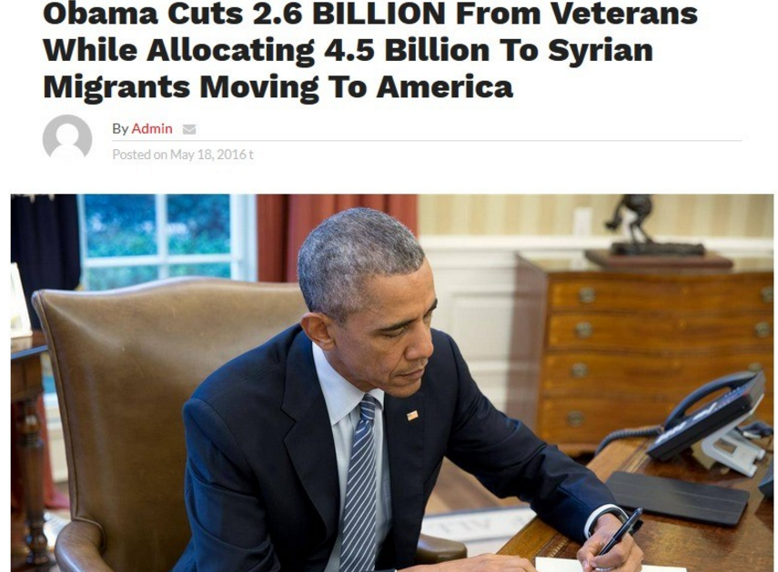
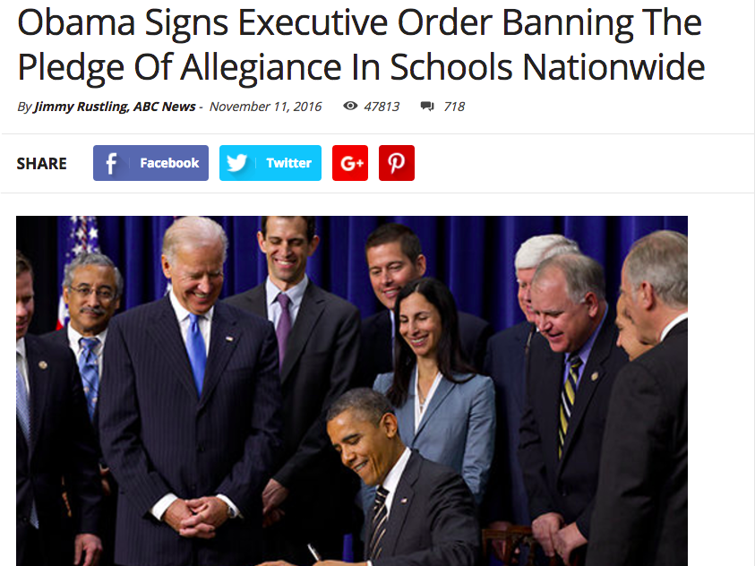
All of these stories are 100% false but had hundreds of thousands of online engagements.
Notes:
Source: http://www.businessinsider.com/fake-presidential-election-news-viral-facebook-trump-clinton-2016-11/#4-ireland-is-officially-accepting-trump-refugees-from-america-8

Slide 10
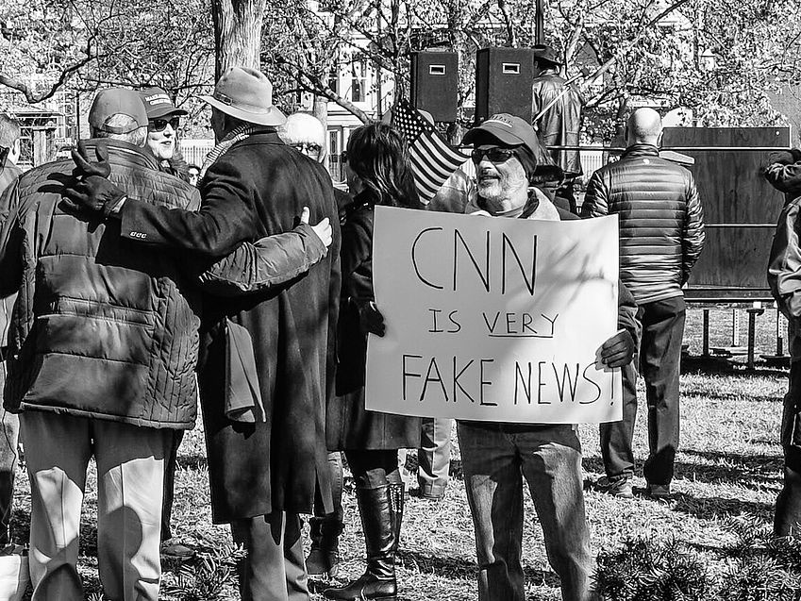
“Fake News” is NOT news you disagree with
It is outright false or misleading stories by minor sources
It is NOT the “mainstream” media (ABC, CBS, CNN, Fox, NBC)
These news agencies might have bias, but they are legitimate sources of news

Slide 11

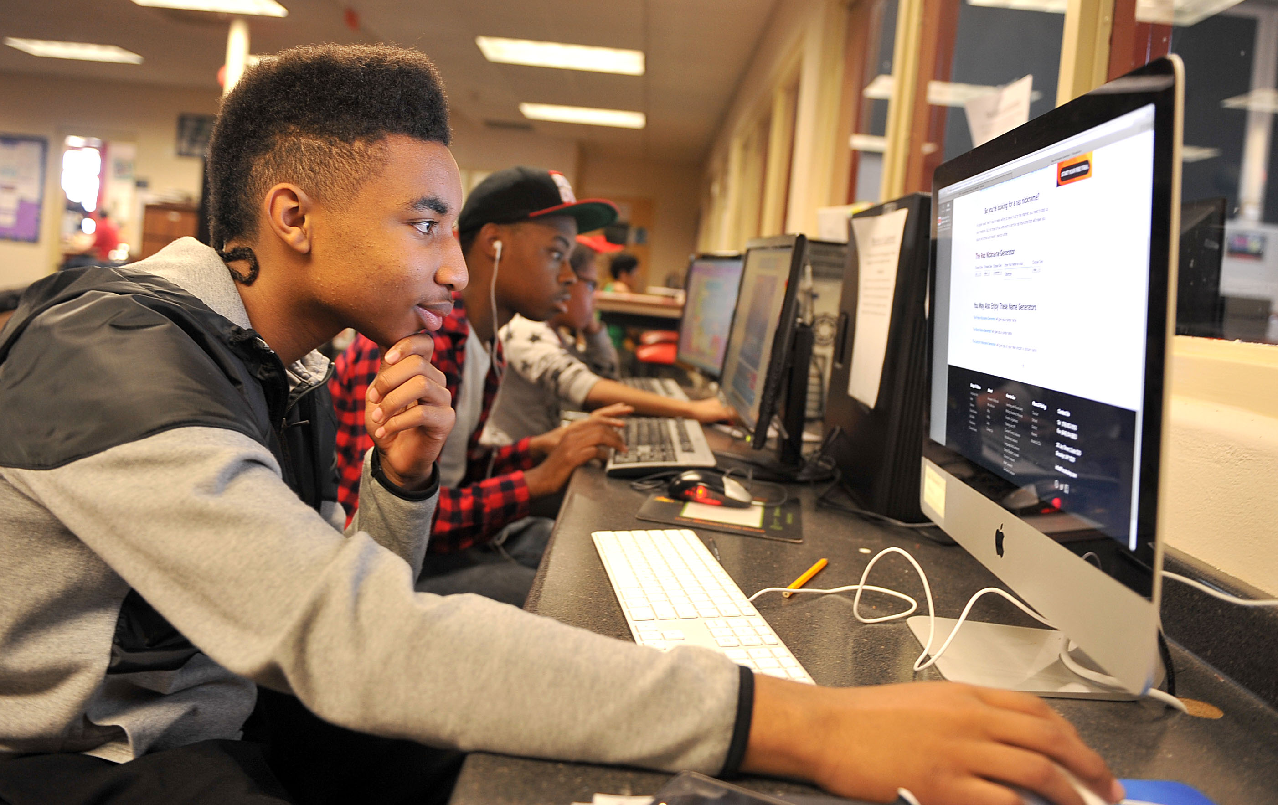
Lots of pop-ups and banner ads
What is the domain? Does it end in .biz, .ch, .ru, .de, etc
Look for an “about” page or Google the site name to learn
Look to see if any reputable news sites carry the same story
If it makes you angry – it’s probably designed to!

