Slide 1
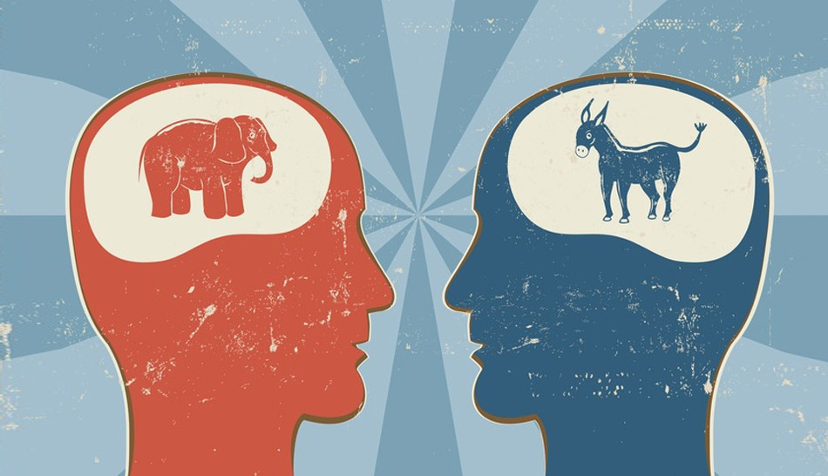



Can you tell the difference?

Slide 2

Do you consider yourself a conservative or a liberal and why?
One paragraph, five sentences

Slide 3

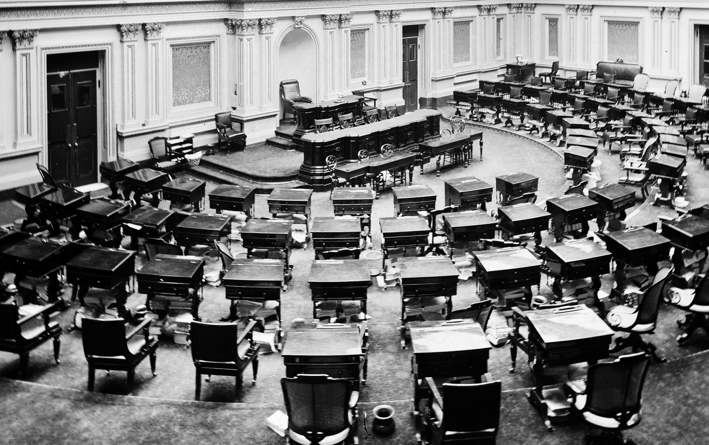
Liberal: One who believes government should be active in supporting political & social change; open to new behavior & ideas that are nontraditional; progressive
Conservative: One who favors traditional views & values in government & society & who is cautious regarding change; proponent of limited government and private property
  These definitions of the terms liberal and conservative apply primarily to the American political culture, and are not the only definitions

Slide 4

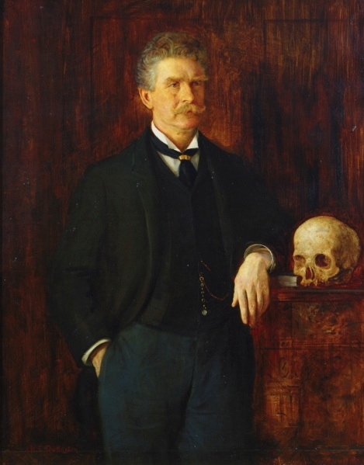
“Conservative, n: A statesman who is enamored of existing evils, as distinguished from the Liberal who wishes to replace them with others [new evils].”
- Ambrose Bierce

Slide 5


For each the following quotes, decide if this idea is a Liberal or a Conservative one and why!

Slide 6
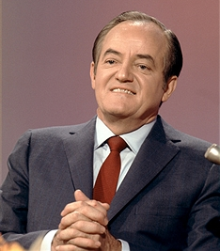

Quote #1
…the moral test of government is how that government treats those who are in the dawn of life, the children; those who are in the twilight of life, the elderly; and those who are in the shadows of life, the sick, the needy, and the handicapped.
LIBERAL

Slide 7
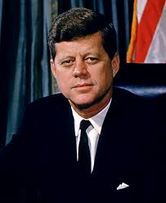
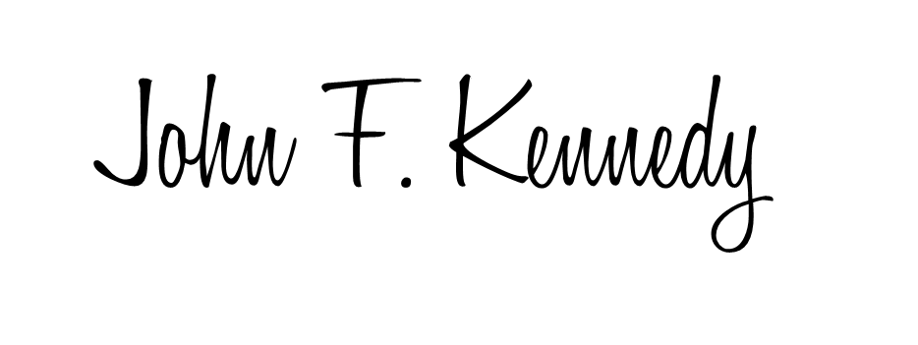
Quote #2
Change is the law of life. And those who look only to the past or present are certain to miss the future.
LIBERAL

Slide 8
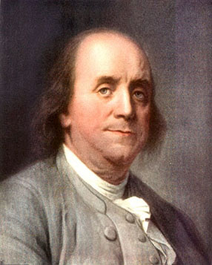

Quote #3
…the more public provisions [govt $] were made for [given to] the poor, the less they provided for themselves, and of course became poorer. And, on the contrary, the less was done for them, the more they did for themselves, and became richer.
CONSERVATIVE

Slide 9
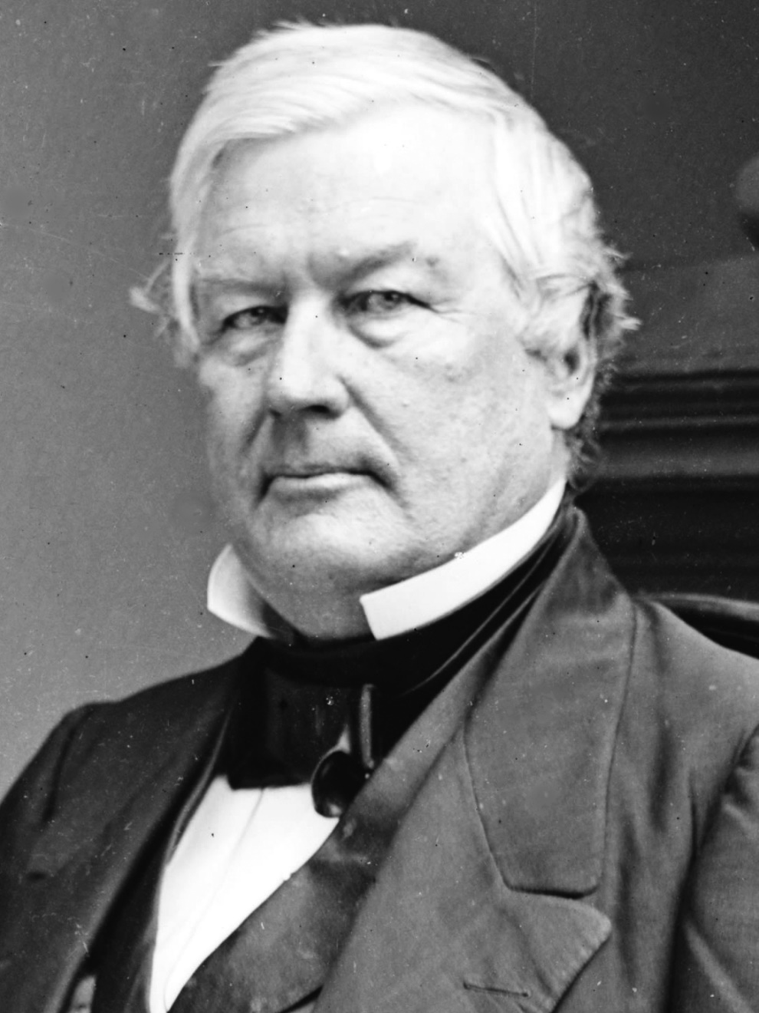

Quote #4
“It is not strange…to mistake change for progress.”
CONSERVATIVE

Slide 10
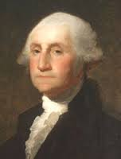

Quote #5
A free people ought not only to be armed, but disciplined.
CONSERVATIVE

Slide 11
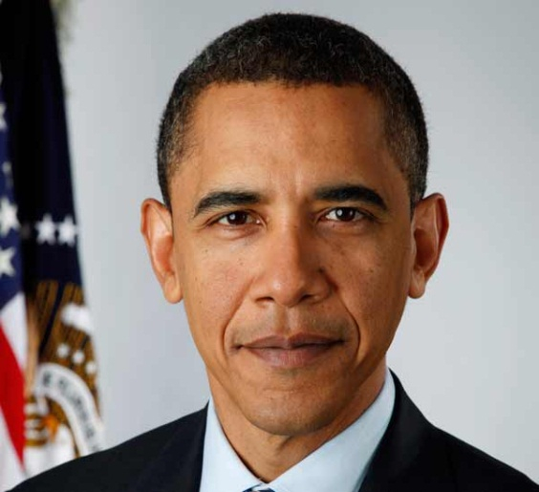
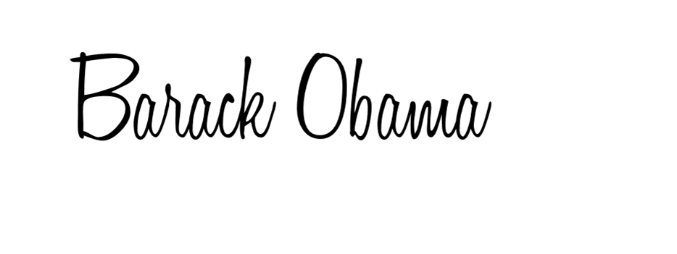
Quote #6
LIBERAL
If people cannot trust their government to the job for which it exists – to protect them and to promote their common welfare – all else is lost.

Slide 12
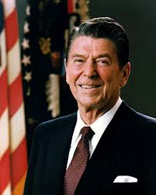

Quote #7
CONSERVATIVE
The nine most terrifying words in the English language are, I’m from the government and I’m here to help.

Slide 13
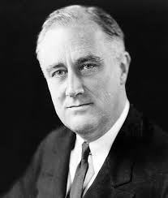

Quote #8
LIBERAL
Here is my principal: Taxes shall be levied according to the ability to pay. That is the only American principal.

Slide 14

Immigration reform is necessary
Affirmative action should be abolished
Pro-life (Anti-abortion)
Gay marriage should be legalized
Universal health care for all is a right
There is nothing wrong with prayer in schools
Capital punishment (death penalty) is wrong
Global warming isn’t a problem

Slide 15

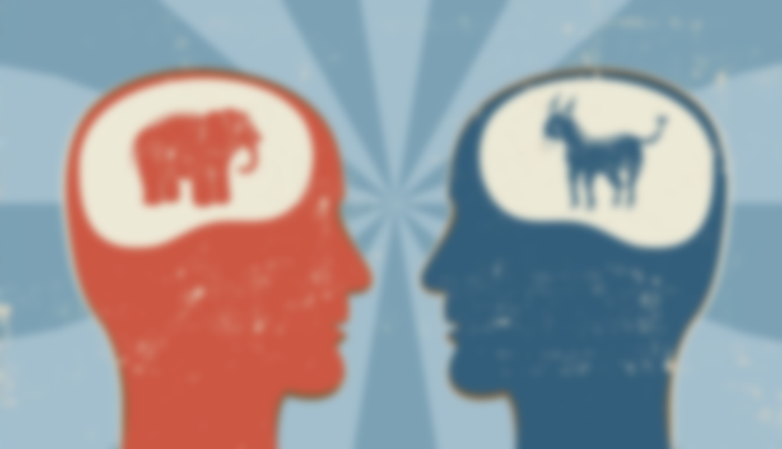
Reread your warm up…
Have you changed your mind?
If so, explain how/why
If not, add details to support your original choice

Slide 16
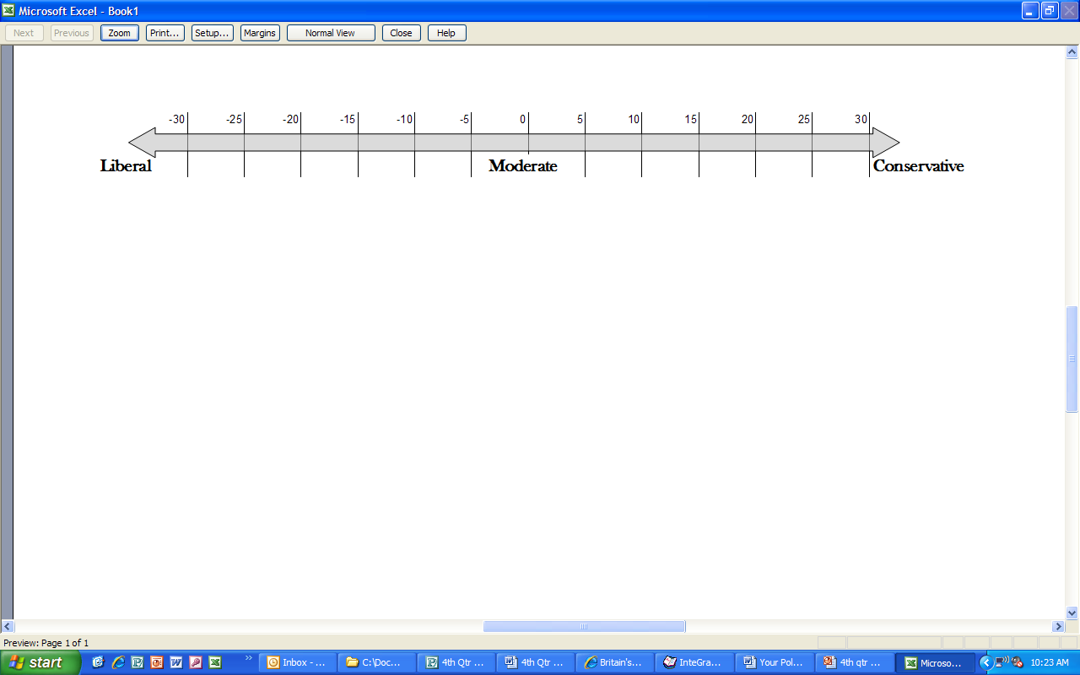
Political Spectrum
(left wing)
(right wing)

