Slide 1
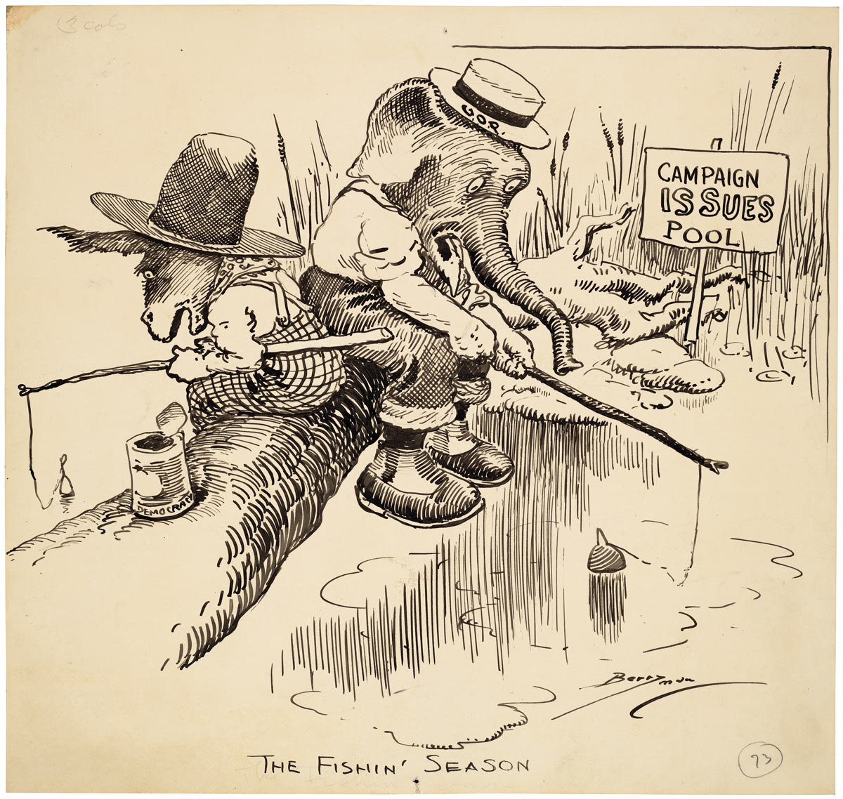
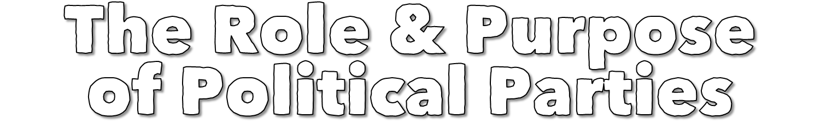

Slide 2
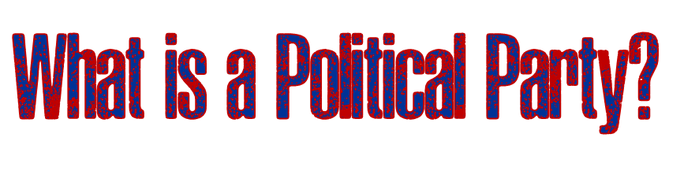
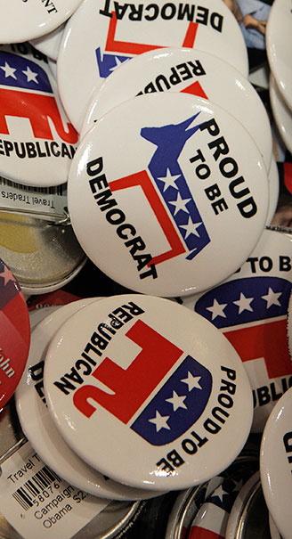
  A political party is a group of persons who seek to control government by winning elections and holding office.
  The two major parties in American politics are the Republican and Democratic parties.
  Parties can be principle-oriented, issue-oriented, or election-oriented. The American parties are election-oriented.

Slide 3
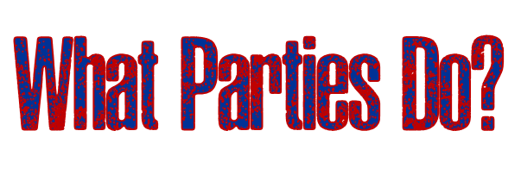
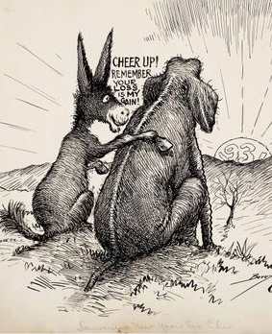
Nominate Candidate—Recruit, choose, and present candidates for public office.
Inform and Activate Supporters—Campaign, define issues, and criticize other candidates.
Act as a Bonding Agent—Guarantee that their candidate is worthy of the office.
Govern—Members of government act according to their partisanship, or firm allegiance to a party.
Act as a Watchdog—Parties that are out of power keep a close eye on the actions of the party in power for a blunder to use against them in the next election.

Slide 4
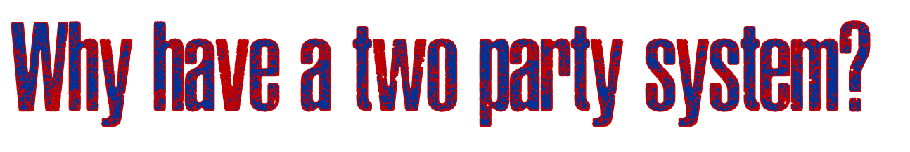
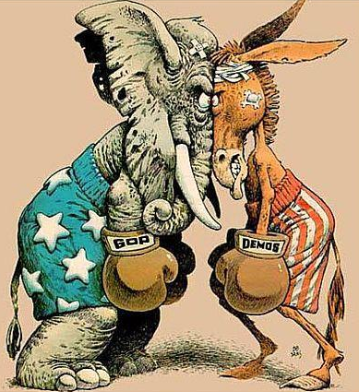
The Historical Basis. The nation started out with two-parties: the Federalists and the Anti-Federalists.
The Force of Tradition. America has a two-party system because it always has had one. Minor parties, lacking wide political support, have never made a successful showing, so people are reluctant to support them.
The Electoral System. Certain features of government, such as single-member districts, are designed to favor two major parties.
Ideological Consensus. Most Americans have a general agreement on fundamental matters. Conditions that would spark several strong rival parties do not exist in the United States.

Slide 5
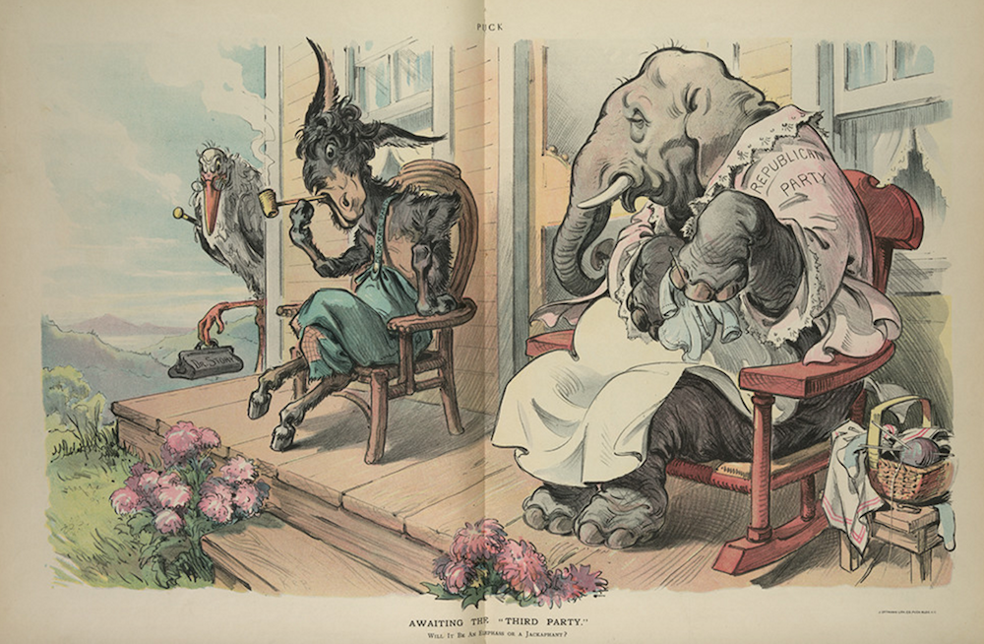

Slide 6
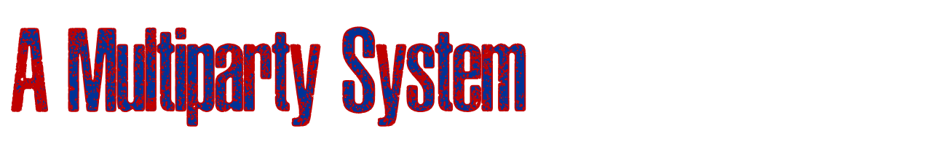
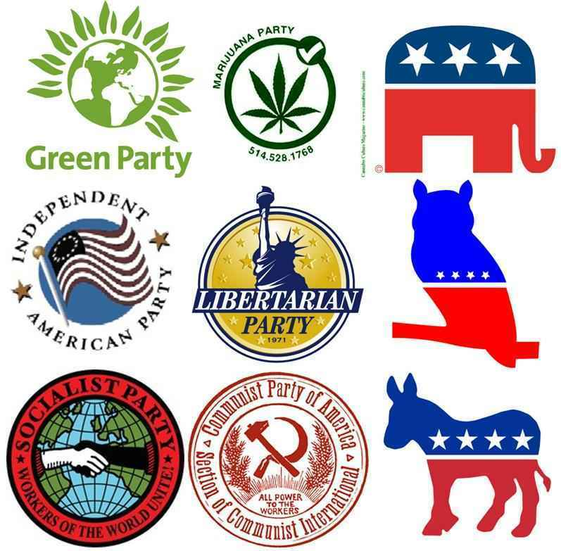
Disadvantages
Cause parties to form coalitions, which can dissolve easily.
Failure of coalitions can cause instability in government.
Advantages
Provides broader representation of the people.
More responsive to the will of the people.
Give voters more choices at the polls.

Slide 7
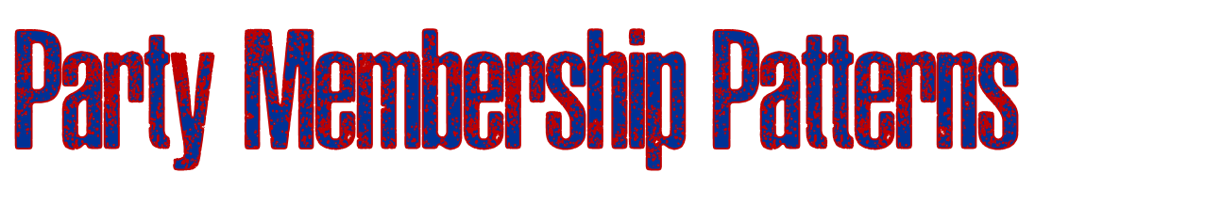
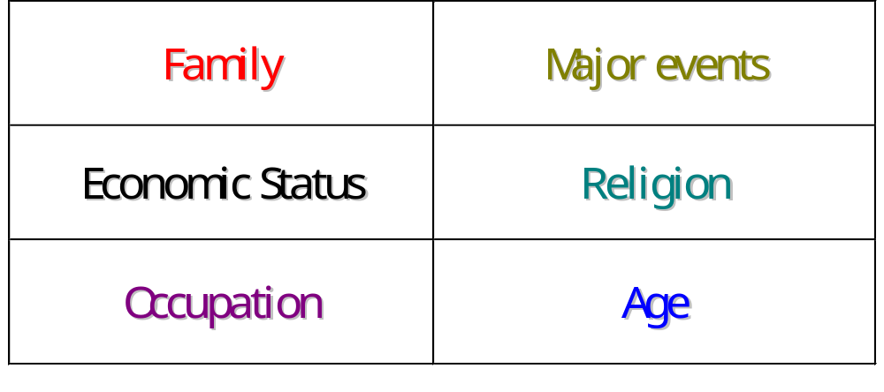
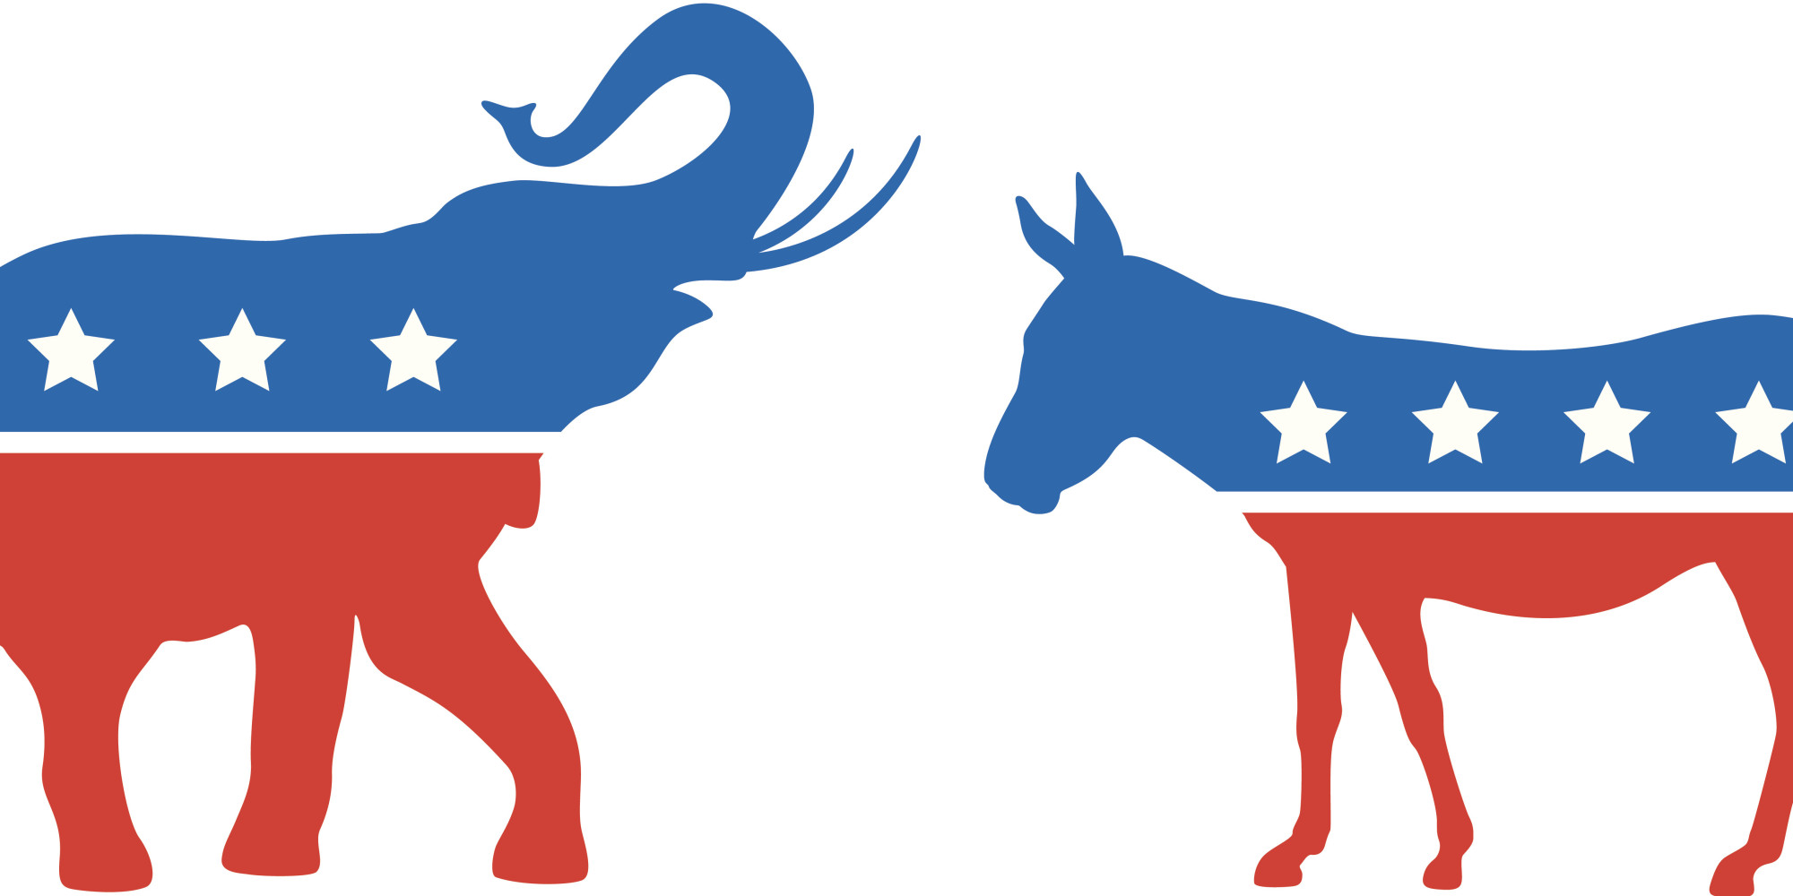
Factors that can influence party membership:

Slide 8
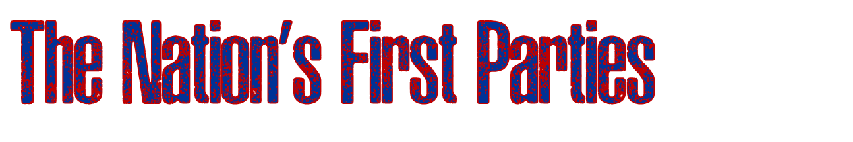
Federalists
Led by John Adams
Represented wealthy and upper-class interests
Favored strong executive leadership and liberal interpretation of the Constitution
Democratic-Republicans
Led by Thomas Jefferson
Represented the “common man”
Were the former Antifederalists

Slide 9
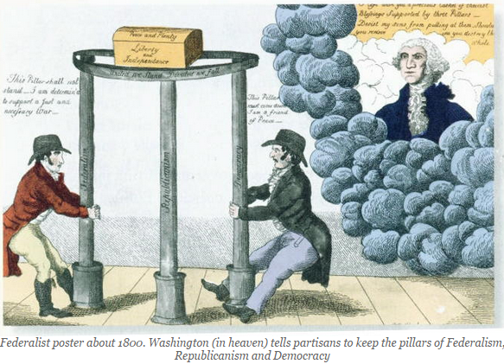

Slide 10
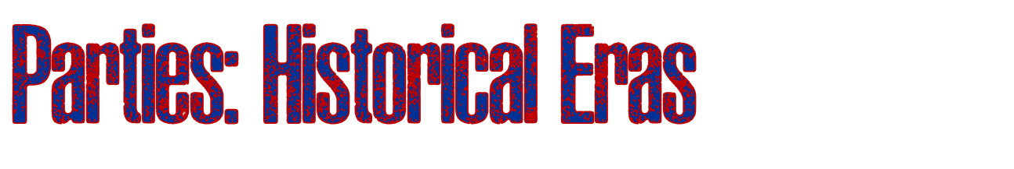
The Three Historical Eras
The Era of the Democrats, 1800—1860
  Democrats dominate all but two presidential elections.
  The Whig Party emerges in 1834, but declines by the 1850s, electing only two Presidents.
  The Republican Party is founded in 1854.
The Era of the Republicans, 1860—1932
  Republicans dominate all but four presidential elections.
  The Civil War disables the Democratic Party for the remainder of the 1800s.
The Return of the Democrats, 1932—1968
  Democrats dominate all but two presidential elections.
  Democrat Franklin D. Roosevelt is elected President four times.

Slide 11
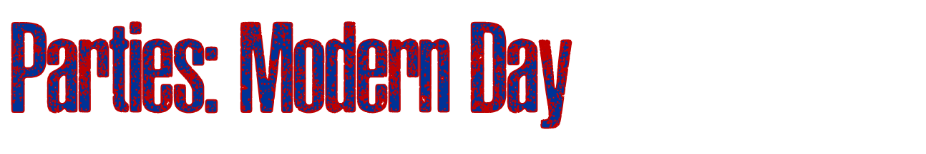
The Start of a New Era: The Era of Divided Government
Since 1968, neither Republicans nor Democrats have dominated the presidency and Congress has often been controlled by the opposing party.
1968–1976
Republicans hold the presidency
Congress is controlled by Democrats
1976–1980
Democrats hold the presidency
Congress is controlled by Democrats
1980–1992
Republicans hold the presidency
Senate controlled by Republicans 1980-1986, controlled by Democrats from 1986 to 1994
1992 – 2000
Democrats hold the presidency
Congress controlled by Republicans, 1994 to present
2008 – 2016
Democrats hold the presidency
Congress first controlled by Democrats but later Republicans
2016 -
Republicans hold the presidency
Congress is controlled by Republicans

Slide 12
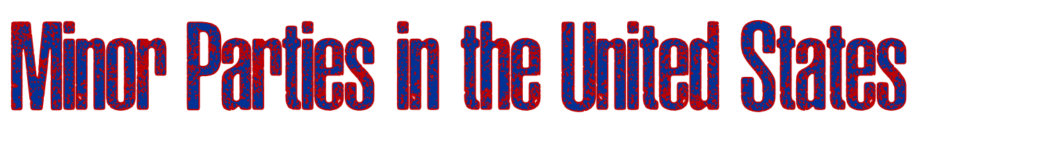
Types of Minor Parties
Ideological
Parties
Example:
Libtertarian
Party
Single-issue Parties
Example: Free Soil Party
Economic Protest Parties
Example: The Greenback Party
Splinter Party
Example: “Bull Moose” Progressive Party

Slide 13
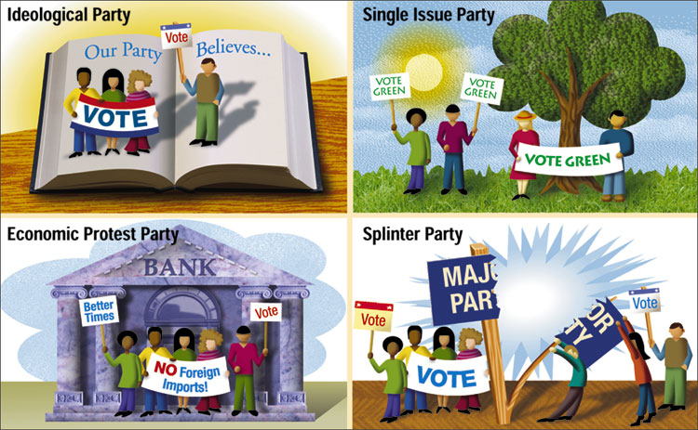

Slide 14
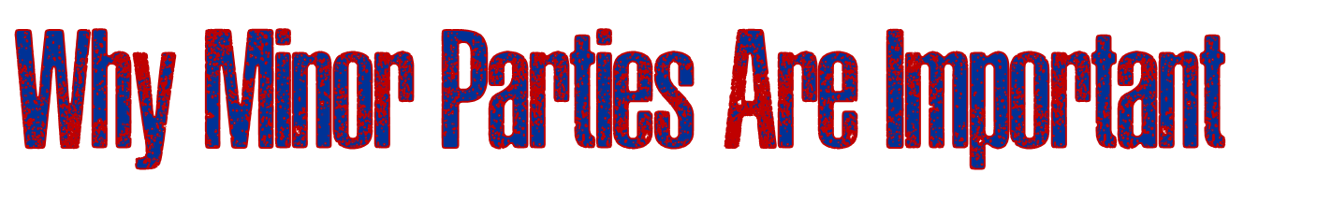
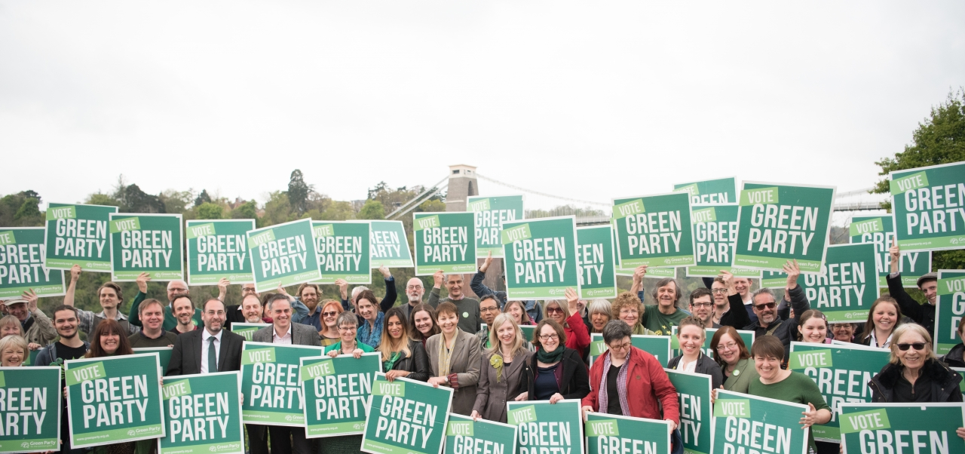
Minor parties play several important roles:
“Spoiler Role” - Can pull decisive votes away from one of the major parties’ candidates
Critic - Often take stands on and draw attention to controversial issues that the major parties would prefer to ignore
Innovator - Draw attention to important issues and propose innovative solutions to problems.

Slide 15

Both of the major parties are highly decentralized and fragmented.
Why?
The party out of power lacks a strong leader.
The federal system distributes powers widely, in turn causing the parties to be decentralized.
The nominating process pits party members against one another because only one person can chosen to be the party’s presidential candidate.

Slide 16
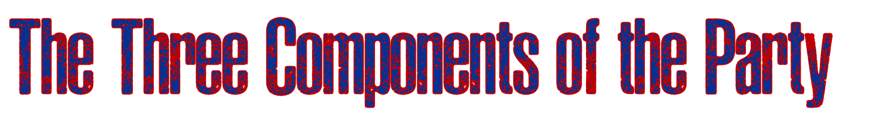
Party Components
The Party Organization:
Those who run and control the party machinery.
The Party in the Electorate
Those who always or almost always vote for party candidates.
The Party in Government
Those who hold office in the government.

Slide 17
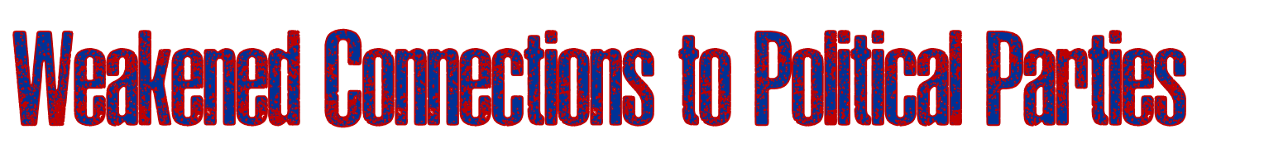
For voters :
More people are unwilling to label themselves as “Democrats” or “Republicans”
Split-ticket voting—voting for candidates of different parties for different offices at the same election
For candidates:
Structural changes have increased conflict and disorganization within parties
Changes in technology, especially the use the Internet, has made candidates more independent of the party organization

